Slide 1
Switching period with and without a gap provided by the NW
Single-TAG and dual-TAG
Ericsson
RAN4#110bis

Slide 2
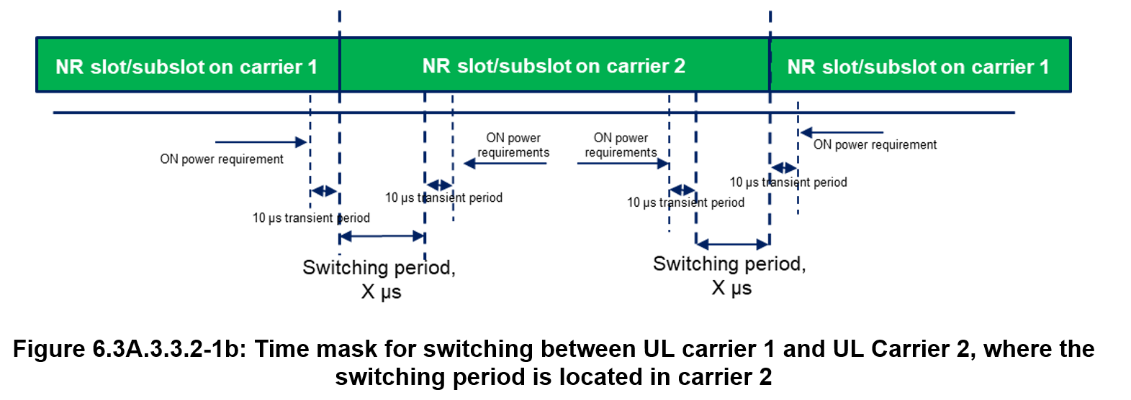
The switching period
The switching gap in 38.214
The UE may omit uplink transmission during the uplink switching gap $N_{\text{Tx}\text{1}\text{−}\text{Tx}\text{2}}$ if the conditions defined in this clause are met and the UE is configured with uplinkTxSwitching. The switching gap $N_{\text{Tx}\text{1}\text{−}\text{Tx}\text{2}}$ is indicated by UE capability uplinkTxSwitchingPeriod2T2T if uplinkTxSwitching-2T-Mode is configured, and uplinkTxSwitchingPeriod otherwise: […]
In 38.101-1
The switching periods described in Figure 6.3A.3.3.2-1a and Figure 6.3A.3.3.2-1b are located in either NR carrier 1 or carrier 2 as indicated in RRC signalling uplinkTxSwitchingPeriodLocation [7], and the length of uplink switching period X is less than the value indicated by UE capability uplinkTxSwitchingPeriod.
The supported switching gap contains the duration “X µs” of the TX switch, no matter the timing advance

Slide 3
The starting time T₀
Reply from RAN1 (R4-2311029)
Gap provided by NW (T₀ starting time from scheduling perspective and actual UL transmission)
When gNB provides sufficient time between the end of the UL transmission on the switch-from carrier and the start of the UL transmission on the switch-to carrier, in RAN4 understanding, the T₀ is the starting time for an uplink transmission on the switched-to carrier from network scheduling perspective and the starting time of actual uplink transmission from UE perspective.
Gap not provided by NW
When gNB does not provide sufficient time between the end of the UL transmission on the switch-from carrier and the start of the UL transmission on the switch-to carrier, and the switching period is located at the switch-to carrier according to the RRC signalling uplinkTxSwitchingPeriodLocation, UE may omit uplink transmission on certain symbol(s) on the switch-to carrier. From RAN1 perspective, T₀ is the starting time of uplink transmission from network scheduling perspective.

Slide 4
Gap not provided by the NW
Switching period configured on carrier 2, transmissions can start after T₀, from 38.101-1
The UE may omit uplink transmission on OFDM symbols that partially or fully overlap with the configured switching period for any timing advance difference.
T₀
2T→1T
carrier 2
Symbols omitted
1T→2T
T₀
X µs
carrier 1
carrier 1
Single TAG
T₀
carrier 2
1T→2T
X µs
X µs
Dual TAG
carrier 1
carrier 1
T₀

Slide 5
Gap provided by the NW
Sufficient time provided by NW before T₀ such that the following does not occur, from 38.101-1
-simultaneous transmission on two antenna ports on one uplink carrier on one band, and any transmission on another uplink carrier on another band
- transmission of any of the carriers for a duration of at least the uplink switching gap indicated by UE capability
T₀
2T→1T
carrier 2
1T→2T
T₀
Single TAG
X µs
carrier 1
X + RTD µs
(# symbols)
carrier 1
T₀
carrier 2
Gap length in practice: X + MRTD µs in # symbols
1T→2T
X µs
Dual TAG
carrier 1
X µs
carrier 1
T₀

