Slide 1
[AT125bis][101][V2X/SL] (OPPO)

Slide 2
ToDoOld RIL:s
W021/2/3, NEC (Boyuan)
Q635, QC (Umesh)

Slide 3
W021/2/3
Description: Solve the issue in multiple unicast links set up simultaneously
Proposed Change: Since UE may set up multiple unicast link simultaneously, it is not reasonable for UE to directly release one SL carrier for all unicast links after receiving the RRCReconfigurationSidelink message from one specific UE. Proposal: for the “1> for unicast”, change it to “1> for the destination identity of the corresponding unicast link”

Slide 4
W021: TP

Slide 5
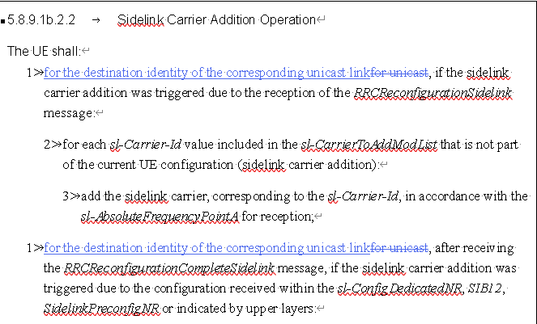
W022/3: TP

Slide 6
Comment

Slide 7
Conclusion
W021/2/3 = ?? PropAgree/PropReject

Slide 8
Q635
Description: Behavior in case of absence is unclear.
Proposed Change: Make it conditionally mandatory (or define default behavior as done in other P-max parameters in RRC).
sl-MaxTransPowerCA
The maximum total transmit power to be used by the UE across all sidelink carriers. <suggested text: “if absent, the UE applies the maximum power according to TS 38.101-1 [15] in case of an FR1 operation, TS 38.101-2 [39] in case of an FR2 operation.”>

Slide 9
Q635: History (R4-231775)
Issue 2. For SL CA P_{EMAX,CA}, it has been agreed below Pcmax equation while how to define P_{EMAX,CA} is not clear.
P_{CMAX_L} = MIN{10 log₁₀ ∑ p_{EMAX,C} - ΔT_{C}, P_{PowerClass, SL_CA} – MAX(MAX(MPR, A-MPR) + ΔT_{IB,c}+ΔT_{C}, P-MPR ), P_{Regulatory,} P_{EMAX,CA}}
P_{CMAX_H} = MIN {10 log₁₀ ∑ p_{EMAX,C} , P_{PowerClass, SL_CA}, P_{Regulatory}, P_{EMAX,CA} }
As background, for SL single carrier, P_{EMAX,c} is specified in TS 38.101-1 sub-clause 6.2E.4 as the value given by IE sl-maxTransPower, defined by TS 38.331. Also in case of NR CA, both P_{EMAX,CA} and 10 log₁₀ ∑ p_{EMAX,c} are separately considered in P_{CMAX}.
For SL CA P_{EMAX,CA}, the following alternatives are considered:
Alt.1 : Reuse the existing IE for SL CA, i.e.,
P_{EMAX,CA} = IE sl-maxTransPower (cc1) + IE sl-maxTransPower(cc2)
Alt.2 : Define new IE for SL CA, i.e.,
P_{EMAX,CA} = new IE, sl-maxTransPower-CA

Slide 10
Q635: History
p-Max
Value in dBm applicable for the intra-frequency neighbouring NR cells. If absent the UE applies the maximum power according to TS 38.101-1 [15] in case of an FR1 cell, TS 38.101-2 [39] in case of an FR2 cell or TS 38.101-5 [75] in case of an NTN cell. In this release of the specification, if p-Max is present on a carrier frequency in FR2, the UE shall ignore the field and applies the maximum power according to TS 38.101-2 [39]. This field is ignored by IAB-MT. The IAB-MT applies output power and emissions requirements, as specified in TS 38.174 [63].

Slide 11
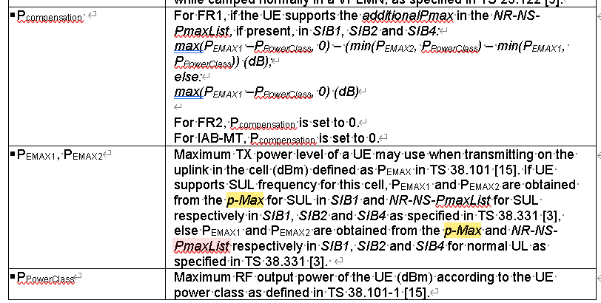
Q635: History
P-max was used for S-criterion

Slide 12
Q635: History
p-NR-FR1
The maximum total transmit power to be used by the UE in this NR cell group across all serving cells in frequency range 1 (FR1). The maximum transmit power that the UE may use may be additionally limited by p-Max (configured in FrequencyInfoUL) and by p-UE-FR1 (configured total for all serving cells operating on FR1).
p-NR-FR2
The maximum total transmit power to be used by the UE in this NR cell group across all serving cells in frequency range 2 (FR2). The maximum transmit power that the UE may use may be additionally limited by p-Max (configured in FrequencyInfoUL) and by p-UE-FR2 (configured total for all serving cells operating on FR2). This field is only used in NR-DC. A UE does not expect to be configured with this parameter in this release of the specification.

Slide 13
Q635: History
p-NR-FR1/2 was used for uplink power control

Slide 14
Q635: History
p-UE-FR1
The maximum total transmit power to be used by the UE across all serving cells in frequency range 1 (FR1) across all cell groups. The maximum transmit power that the UE may use may be additionally limited by p-Max (configured in FrequencyInfoUL) and by p-NR-FR1 (configured for the cell group).
p-UE-FR2
The maximum total transmit power to be used by the UE across all serving cells in frequency range 2 (FR2) across all cell groups. The maximum transmit power that the UE may use may be additionally limited by p-Max (configured in FrequencyInfoUL) and by p-NR-FR2 (configured for the cell group). A UE does not expect to be configured with this parameter in this release of the specification.

Slide 15
Comment
[OPPO] Our understanding of the yellow part in P-max is more for usage of the S-criterion. For uplink power control reason, there seems no big need, since UE would base on the formula (i.e., the remaining parts) to derive applicable Tx power.

Slide 16
Conclusion
Q635 = ?? PropAgree/PropReject

