Slide 1
3GPP and LTE-Advanced Status
Adrian Scrase
Head of 3GPP MCC,
ETSI CTO

Slide 2
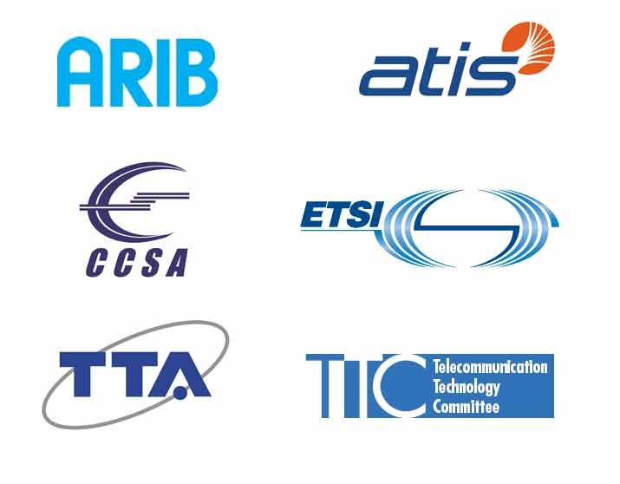

What is 3GPP?
Organizational Partners
6 Regional standards organizations (Asia, Europe & North America)
Market Representative Partners
13 Market partners representing the broader industry
Member Companies
(…)
Member Companies

Slide 3
3GPP Membership
39 Countries
390 Companies (via Regional Partners)
2005
2011
2004
2006
2009
2012
2007
2010
2008

Slide 4
Whole System Approach
Radio Interfaces
The Core network
Services
Higher data throughput
All-IP network
More IMS applications
Lower latency
Support of non-3GPP accesses
Greater session continuity
More spectrum flexibility
Improved security
Legacy
Improved CAPEX and OPEX
Greater device diversity
Interworking (Incl. GELTE)

Slide 5
3GPP Organization structure
Project Coordination Group
TSG GERAN
GSM/EDGE RAN
TSG CT
Core Network &Terminal
TSG SA
System Architecture
TSG RAN
Radio Access N/W
RAN5
Conformance Test
RAN1
Radio Layer 1
RAN2
Radio Layer2/3
RAN3
Access I/F
RAN4
Radio Performance
SA1
Services
SA5
O&M, Charging
SA2
Architecture/Stage2
CT3
Network I/F to out
CT4
Network I/F in 3GPP
CT6
UICC I/F
Smart Card Appl.
GERAN1
PHY
GERAN2
Layer2/3, Access I/F
GERAN3
Conformance Test
CT1
NAS (UE-MME I/f)
SA3
Security
SA4
Codec

Slide 6
Technical areas
GSM 1G
Analog technology.
Deployed in the 1980s.
GSM 2G
Digital Technology.
First digital systems.
Deployed in the 1990s.
New services such as SMS
and low-rate data.
Primary technologies
include IS-95 CDMA and
GSM.
3G ITU’s IMT-2000 required 144
kbps mobile, 384 kbps
pedestrian, 2 Mbps indoors
Primary technologies
include CDMA2000 1X/EVDO, WiMAX,
and UMTS-HSPA.
4G ITU’s IMT-Advanced
requirements include ability to
operate in up to 40 MHz radio
channels and with very high
spectral efficiency.
No technology meets
requirements today.
IEEE 802.16m and LTE
Advanced designed
to meet requirements.
Radio Technology
Spectrum availability, efficiency, flexibility
Higher Data Throughput, Lower Latency
Improved CAPEX and OPEX
IP Core Network
Support of non-3GPP Accesses (e.g. WiFi)
Optimized Packet Only Support
Enhanced QoS and Policy
Support for M2M
Greater Device Diversity
Service Layer
IMS and Applications
Session continuity

Slide 7
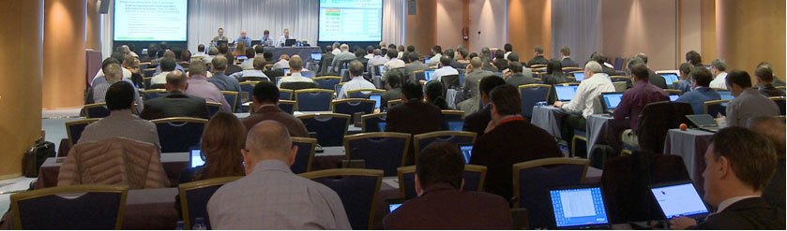
Ways of working
New work initiated by member companies via Work Items outlining scope and time plan.
Work Items prioritised if all estimated work cannot be done by the scheduled release deadline.
All 3GPP member companies contributes on equal terms on any work item
3GPP seeks consensus on all technical matters (but has mechanisms if consensus cannot be reached)
Release deadline respected, unfinished work deferred to a later release

Slide 8

Motivation for LTE-Advanced
1999
2011
Release 99
W-CDMA
3GPP aligned to ITU-R IMT process
Allows Coordinated approach to WRC
3GPP Releases evolve to meet:
Future Requirements for IMT
Future operator and end-user requirements
Release 4
1.28Mcps TDD
Release 5
HSDPA
Release 6
HSUPA, MBMS
ITU-R M.1457
IMT-2000 Recommendation
Release 7
HSPA+ (MIMO, HOM etc.)
Release 8
LTE
Release 9
LTE enhancements
3 Gbps
ITU-R M.[IMT.RSPEC]
IMT-Advanced Recommendation
Release 10
LTE-Advanced
64QAM
Release 11+
Further LTE enhancements
8x8 MIMO
100MHz BW

Slide 9

LTE-Advanced (Rel-10 onwards)
LTE-Advanced shall be deployed as an evolution of LTE and on new bands.
LTE-Advanced shall be backwards compatible with LTE. This is valid for the radio aspects as well as the upper-layer signaling and services.
➔ Smooth and flexible system migration from Rel-8 LTE to LTE-Advanced
LTE-Advanced contains all features of LTE Rel-8&9 and additional features for further evolution
LTE Rel-8 cell
LTE-Advanced cell
LTE Rel-8 terminal
LTE-Advanced terminal
LTE Rel-8 terminal
LTE-Advanced terminal
An LTE-Advanced terminal can work in an LTE Rel-8 cell
An LTE Rel-8 terminal can work in an LTE-Advanced cell

Slide 10
Release 12 RAN ‘Requirements’
Common and converged requirements identified:
Capacity increase to cope with traffic explosion
Energy saving
Cost efficiency
Support for diverse application and traffic types
Higher user experience/data rate
Backhaul enhancement

Slide 11
Release 12 RAN Priorities
Small Cell Enhancements:
TR 36.932 ‘Scenarios and Requirements’
LTE Multi-Antenna/site technologies such as:
3D MIMO/beamforming to allow beam control in both horizontal and vertical directions
Further CoMP/MIMO enhancements
New procedures and functionalities for LTE to support diverse traffic types
Control signaling reduction, etc.
Interworking with WiFi
Others:
Machine type communications(MTC)
Self-organizing network(SON)
Minimization of drive test(MDT)
Advanced receiver
Device to Device(D2D)
Further enhancements for HSPA including interworking with LTE

Slide 12
Release 12 SA Priorities
Rel-12
Non-3GPP: Offload & Convergence
> WLAN Network Selection for 3GPP Terminals (WLAN_NS)
> Study on Optimized Offloading to WLAN in 3GPP-RAT mobility (FS_WORM)
> Study on S2a Mobility based On GTP and WLAN access to EPC (FS_SaMOG)
>Policy and Charging Control for supporting fixed broadband access networks (P4C)
> IMS Business Trunking for IP-PBX in Static Mode of Operation (BusTI)
Operational Excellence
> Self-Organizing Networks (SON)
> OSS Interface Harmonization
> Codec for Enhanced Voice Services (EVS_codec)
> High Efficiency Video Coding (HEVC)
> Study on Security Assurance Methodology for 3GPP Network Elements (FS_SECAM)
New Opportunities
> Study on Proximity-based Services (FS_ProSe)
> Group Communication System Enablers for LTE (GCSE_LTE)
> Study on Improved Support for Dynamic Adaptive Streaming over HTTP in 3GPP (FS_IS_DASH)
> Integration of Single Sign-On (SSO) frameworks with 3GPP networks (SSO_Int)
> Machine-Type and other mobile data applications Communications enhancements (MTCe: MONTE, GROUP)
System Stability
> User Plane Congestion management (UPCON)
> Study on Core Network Overload (FS_CNO)
> Machine-Type and other mobile data applications Communications enhancements (MTCe: SDDTE, UEPCOP)

Slide 13
Core Network optimised for IP traffic and services
Multi-access, operators can influence the selection
Dual-stack IPv4/v6 connectivity
Network initiated QoS, PCC
Various ways to combine or split traffic off inside the network
Local IP Access (LIPA)
Selective IP Traffic Offloading (SIPTO)
WLAN offloading
IP Multimedia Subsystem
Single Radio Voice Call Continuity (SRVCC)
Network Sharing

Slide 14
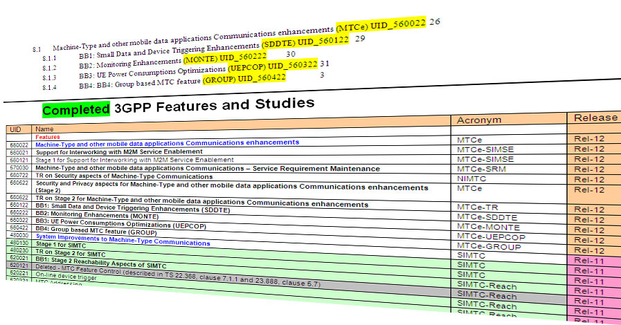
Machine-to-Machine (M2M)
M2M is recognized as a key segment in future packet networks
Initial 3GPP efforts have focused on the ability to differentiate machine-type devices
This allows the operator to selectively handle such devices in overload situations
Low priority indicator has been added to the relevant UE-network procedures
Overload and Congestion control is done on both core network and radio access network based on this indicator
Functions for device triggering and small data transmission added
Still a lot to do…Look at; http://www.3gpp.org/ftp/Information/WORK_PLAN/Description_Releases/ (See MTC (M2M) overview there)

Slide 15



Public Safety
3GPP has started work on public safety standards
3GPP is cooperating with the public safety community
Technical participation in Release 12 is on-going
LTE based public safety networks;
Use common off the shelf technology
Improve on existing capabilities with broadband and multimedia
Work Item | 3GPP Release | Work Item Document Reference
Proximity-based Services Specification (ProSe) | 12 | SP-120883
Group Communication System Enablers for LTE (GCSE_LTE) | 12 | SP-120876
Public Safety Broadband High Power User Equipment for Band 14 for Region 2 | 11 | RP-120362
http://www.3gpp.org/ftp/Information/WORK_PLAN/
Notes:
Standards that match market needs and deliver the right technical capabilities with true interoperability are a critical building block in creating successful national and international communication systems. Over the coming years 3GPP will be working with the commercial cellular and public safety community to develop enhancements to apply LTE to public safety and commercial critical communication scenarios. Companies and organizations with an interest in that process are encouraged to participate in 3GPP and to follow the development.
Starting from LTE Release 12, which is planned for freezing in mid-2014, the LTE standard will provide features including Proximity Services and Group Call Enablers that enable LTE to be used as part of a broadband public safety network. This will provide public safety users with economic benefits from increased use of common off-the-self technology (COTS) and technical benefits from improved data rates and multimedia communication. Commercial cellular operators will gain access to new capabilities that can enable new types of consumer and business services as well as being able to play a role in delivering public safety communications. Ultimately the most important benefits will be delivery of an enhanced public safety system which will provide better service to the whole community.

Slide 16
Key messages
3GPP is fully focused on:
Addressing the smartphone challenge with innovative features across radio and core
Optimizing the network for machine-to-machine support
Providing the industry with timely evolution
Securing backwards compatibility over the 3GPP accesses
More Information about 3GPP:
www.3gpp.org
contact@3gpp.org

