Slide 1
Discussion material for SA5#164.2 rapporteurs call
6G OAM Study rapporteurs:
Bahar Sadeghi (AT&T), Pengxiang Xie (ZTE)

Slide 2
Discussion items
6G OAM Study TR clause structure
Topic prioritization for June checkpoint

Slide 3
Discussion on 6G OAM TR structure
Proposed TR structure provided by rapporteurs
Includes input from SA5 leadership
Plan for this call:
Rapporteurs to provide background and overview of the clause structure
Collect input/feedback
Next steps:
Rapporteurs will share an updated TR structure based on the collected input
Rapporteurs submit the updated TR structure to SA5#165 for approval
Delegates are encouraged to prepare contributions according to the proposed TR structure
With the understanding that the structure is not yet approved and changes to the contributions may be needed during the meeting to match the finalized structure

Slide 4
Proposed 6G OAM TR structure
Based on the SA2 and SA1 6G TRs (TR 23.801-01 and TR 22.870, respectively)
As opposed to SA2, SA5 includes both stage 1 and stage 2
Harmonization for ease of consumption across groups
Architectural assumptions and requirements captured in a stand-alone clause
Management Scenarios:
6G OAM use cases to be captured at the SA1 TR 22.870 level to derive the business-level requirements; named: Management Scenarios
Management scenarios grouped according to SA1 TR 22.870 use case categories as starting point– may be updated by future contributions
WT 2.1 in 6G SID requires to investigate the UCs in SA1 TR 22.870 and identify the management requirements
Following SA1 categories is needed for consumption and traceability across groups
New categories may be added by future contributions

Slide 5
Proposed 6G OAM TR structure (cont.)
Key Issues:
Key Issues identify the technical topics/gaps for enabling management scenarios/business-level requirements and are used to derive the specification requirements
Key Issues are to be categorized into groups – The grouping/categories to be agreed
Solutions:
Potential solutions for all Key Issues captured in one clause
Each solution may address multiple specification requirements
Mapping tables in Annex A
Key Issues mapped to Management Scenarios
Solutions mapped to Key Issues

Slide 6
Proposed 6G OAM TR structure In a glance
Overview
6G Management System Architectural Assumptions and Requirements
6G Management Scenarios (& business-level requirements)
Key Issues (& specification requirements)
Solutions
Conclusions and Recommendations
Annex A

Slide 7
Discussion items
6G OAM Study TR clause structure
Topic prioritization for June checkpoint
Rel-20 SA5 checkpoints plan
Supporting material in Backup Slides:
Proposals endorsed in S5-255660 (SA5#164)
Rel-20 6G Timeline including SA5
SA2 6G study timeline/checkpoints

Slide 8
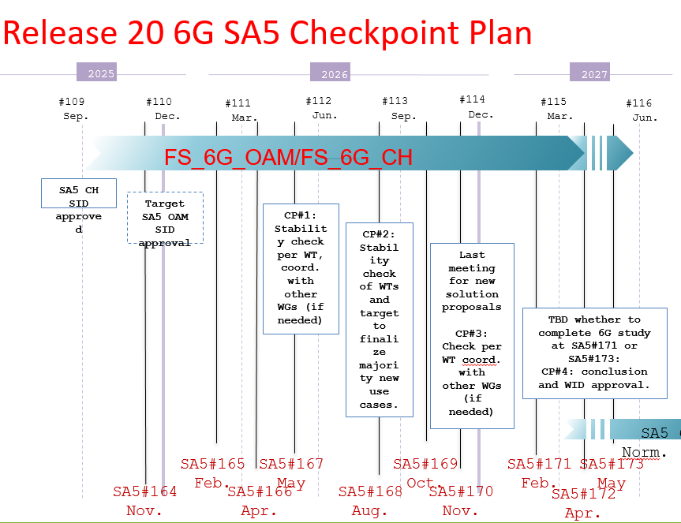
Release 20 6G timeline with SA5
CP1 Jun. 2026 (SA5#167):
Stability check per WTs & Dependency with SA2
SA5 shall have something on the table to analyze the dependency with other WGs before June 2026
CP2: Sep. 2026
Finalize major new management scenarios and key issues.

Slide 9
Topic prioritization for June checkpoint
Topics with cross-WG dependency:
Data Management -> SA checkpoint in June
Companies are welcome to suggest other topics for prioritization
To be agreed by SA5
Prioritized topics
Require sufficient information for coordination/discussion with other WGs by checkpoint
Companies are encouraged to submit contributions towards the prioritized topics
Contribution under such Topics are prioritized and allocated meeting time earlier in the week in support of achieving agreement during the week
Plan per meeting
Feb. meeting (SA5#165): management scenarios if any, key issues and requirements
April & May meetings (SA5#166 & #167): requirements and solutions

Slide 10
Backup Slides

Slide 11
S5-255660 Endorsed in SA5#164
Proposal 1:
To ensure that 6G OAM day one features have sufficient discussions on solutions and conclusions, it is necessary to set a finalized time for new use cases and requirements:
- Overview and Use cases should be fully discussed before September 2026.
- New requirements should finalised by December 2026.
- Potential solutions by March 2027, with the TR concluding no later than June 2027.
NOTE: The timing may be adjusted to sync with SA2 and overall 3GPP 6G time plan.
Proposal 2:
Introduce checkpoints to align with SA2 and RAN studies:
December 2026: discussion on how to split WIDs/SIDs based on SID conclusions and other WG requirements.
Additional checkpoints with SA1, SA2 and RAN2/RAN3, with timing depending on topics needing alignment.
NOTE: Rapporteurs should provide recommendations on which topic and timing for checkpoint on a case-by-case basis, the checkpoints timing may be adjusted according to the overall 6G work progress and could be coordinated by Rapporteurs with Chairs.

Slide 12
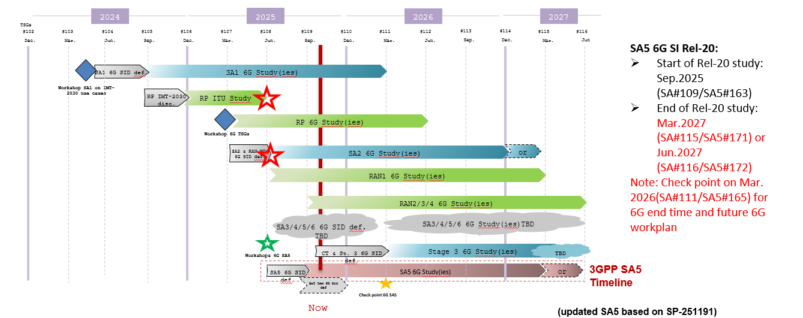
Release 20 6G timeline with SA5
At least 7 meetings for 6G OAM Study

Slide 13
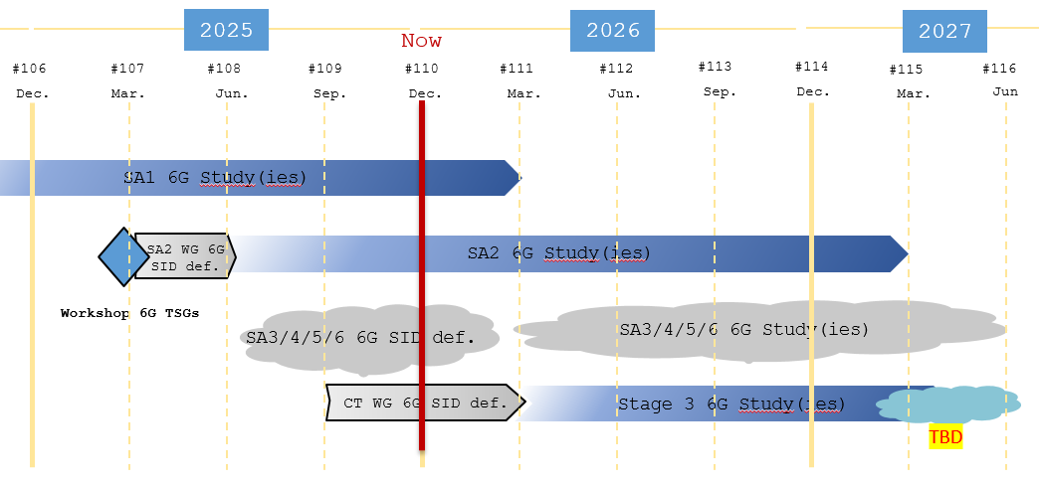
6G Study Planning in SA2
CP1: 2025.11 (3 meetings)
Make WTs stable, key issue discussion starts
CP2: 2026.2
key issue stable，solution discussion starts
CP3: 2026.5
Dependency among key issues and across TSG
CP4: 2026.11
Last meeting for new solution
CP5: 2027.3
Conclusion，WID approved

