Slide 1
To support async – analysis of CreateMOI and allocateNsi Rapporteur call, July 28th, 2022
Huawei
2022/07/28

Slide 2
HTTP Status Code 202 (Accepted)
HTTP the 2xx (Successful) class of status code indicates that the client's request was successfully received, understood, and accepted. For example, the 200 (OK) status code indicates that the request has succeeded.
HTTP Status Code 202 indicates that the request has been accepted for processing, but the processing has not been completed. This status code is useful when the actual operation is asynchronous in nature.
Its purpose is to allow a server to accept a request for some other process (perhaps a batch-oriented process that is only run once per day) without requiring that the user agent’s connection to the server persist until the process is completed.
Reference: IETF RFC 7231 HTTP Status 202 (Accepted)

Slide 3
28.532-h11 12.1.1.1.2 Operation createMOI

Slide 4
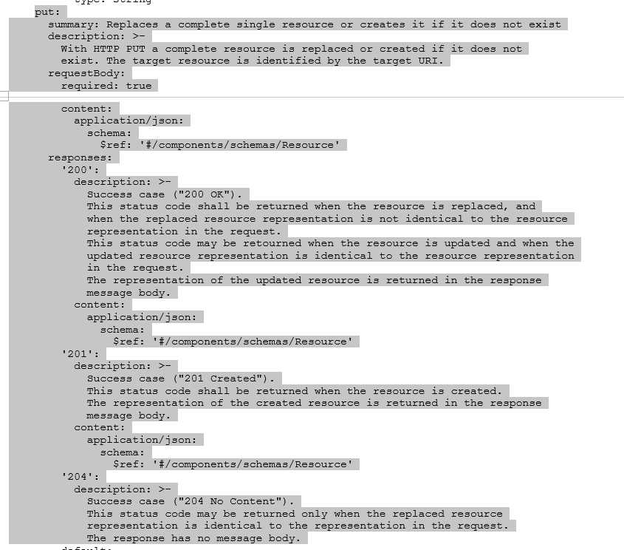
28.532-h11 A.1.1 OpenAPI document TS28532_ProvMnS.yaml"
Observation 1:
The server MUST create the resource before returning the 201 status code. If the action cannot be carried out immediately, the server SHOULD respond with 202 (Accepted) response instead.
HTTP Status 202 (Accepted) is missing in responses in 28.532
Proposal 1:
IF the group want to support async MOI creation for the cases of long time MOI creation (like slice), HTTP Status 202 (Accepted) needs to be added in 28.531.

Slide 5
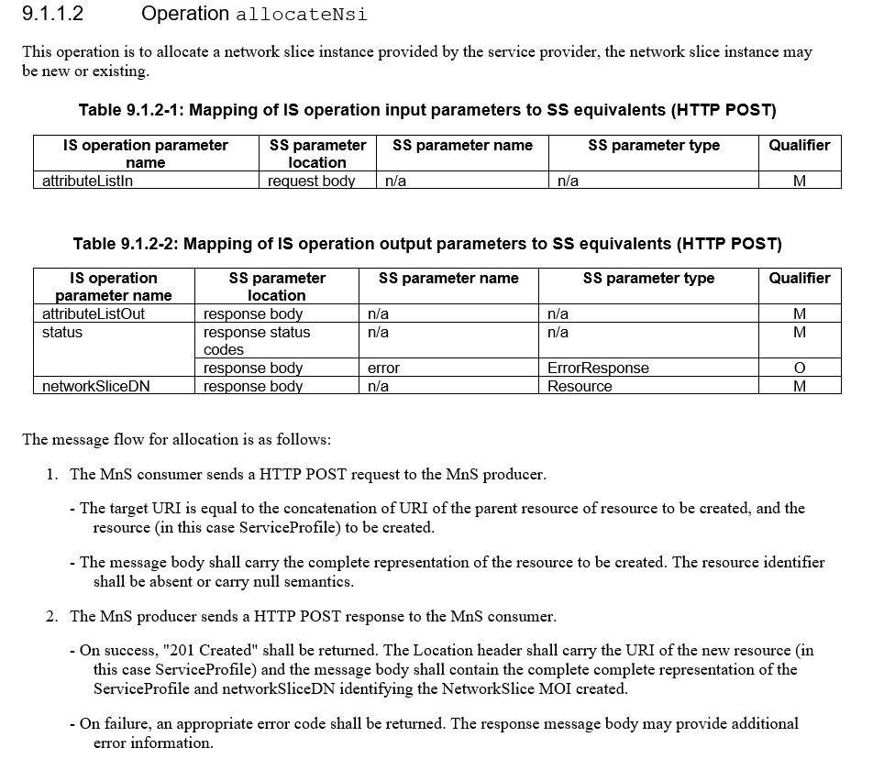
28.531-h40 9.1.1.2 Operation allocateNsi
Observation 2:
The server MUST create the resource before returning the 201 status code. If the action cannot be carried out immediately, the server SHOULD respond with 202 (Accepted) response instead.
HTTP Status 202 (Accepted) is missing in responses in 28.531
Proposal 2:
IF the group want to support async NSI allocation for the cases of long time NSI allocation
HTTP Status 202 (Accepted) needs to be added in 28.531 and
(see next page ->) attribute 'processMonitor' (tailored from 4.3.43 ProcessMonitor <<DataType>> of 28.622 ) needs to be added in 28.541

Slide 6
28.541-h70 6.3 Class definitions
processMonitor | An attribute describes the process monitoring information of the network slice. See corresponding processMonitor definition in TS 28.622[30]. | type: ProcessMonitor multiplicity: 1 isOrdered: N/A isUnique: N/A defaultValue: None isNullable: False
Attribute name | S | isReadable | isWritable | isInvariant | isNotifyable
id | M | T | F | F | T
status | M | T | F | F | T
progressPercentage | O | T | F | F | T
6.3.1 NetworkSlice
attribute 'processMonitor'
tailored from 4.3.43 ProcessMonitor <<DataType>> of 28.622
6.3.2 NetworkSliceSubnet

Slide 7
Thank you!

