Slide 1
NS Charging study – way forward (SA5#146)
Rapporteur: Gerald Görmer (MATRIXX Software)

Slide 2
FS_NETSLICE_CH_Ph2 - Next step (SA#146) - 1
TR 32.847: bring conclusions to Key Issue #1 & Key Issue #2 (Converged Charging for simultaneous number of UEs (respectively PDU sessions)/max. number of UEs (respectively PDU sessions) per network slice)
Proposal to cover the conclusion with a new WID on NSACF charging with a new specification for network slicing
Introduce new “Network Slice” charging TS umbrella for NS charging related TSs set
Question: take opportunity to consider a new stage 3 TS for new NS charging APIs with the new Nchf_NSConvergedCharging service ? (to avoid TS 32.291 to grow too much…)

Slide 3
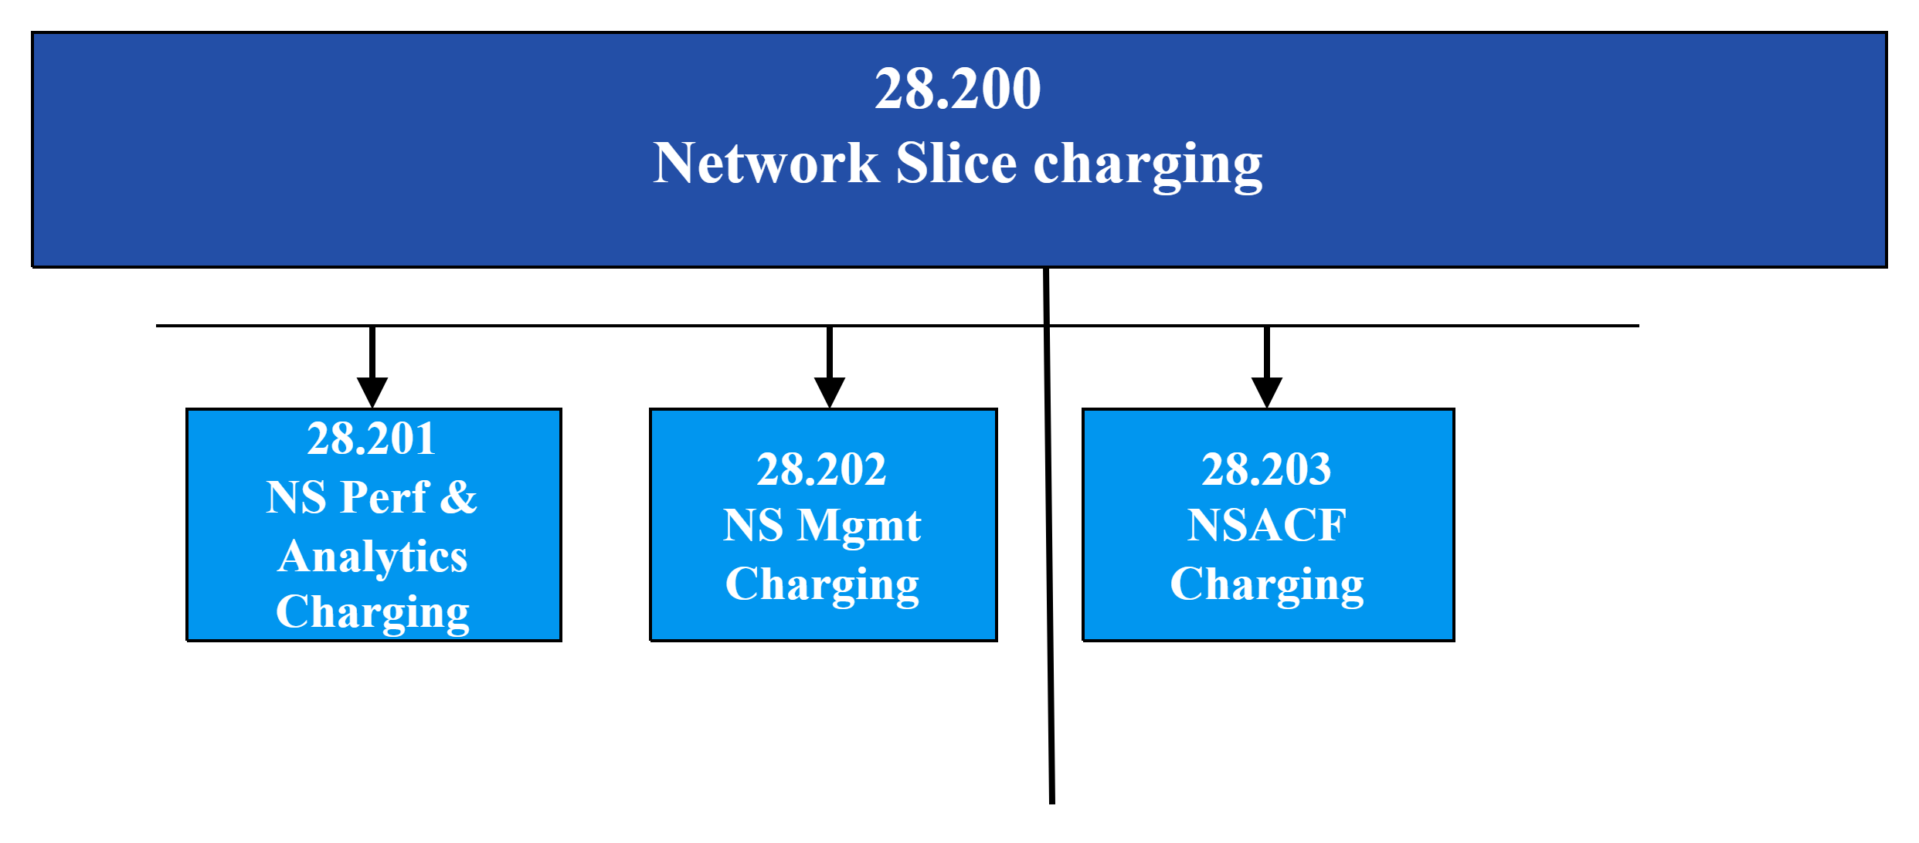
FS_NETSLICE_CH_Ph2 - Next step (SA#146) - 2

Slide 4
Thank you!

