Slide 1
Discussion paper to 3GPP Forge
Structure change
Sean Sun
(original 3GPP Forge Structure proposal is enclosed as Backup from chart 9)

Slide 2
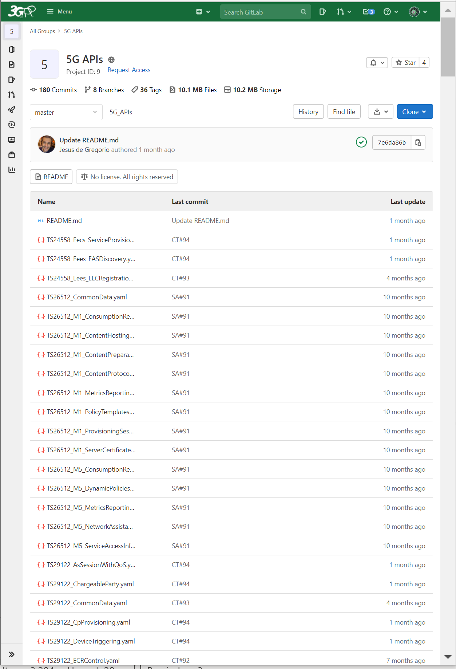
Implication of moving as proposed
Currently CT1/3/4 contains 158 Yaml files
After changes as proposed, SA5 yaml files (14 so far) will be moved to this folder (with 158 files). So
Each of your CR branch will include 172 yaml files
As CR author, you will be mostly working on 1 or 2 yaml files, but you must locate your yaml file among these 172 files
Each round of validation will take around 5m (if not merged as current standalone project, it takes around or less than 1m), hence much longer time for waiting
  Those CT 1/3/4 yaml will get validated (as waste)
  In the drop down list of branches, you will see the branches from other WG (like CT1/3/4)
  You will have permission to update files of other WG, and people from other WG could have change permission to SA5 files

Slide 3
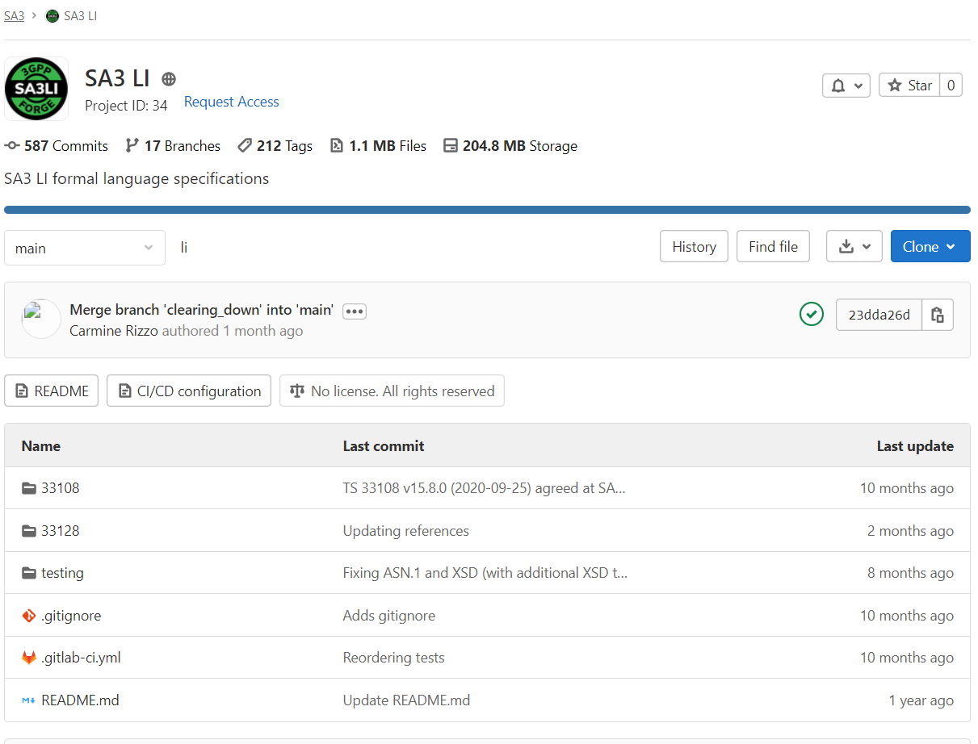
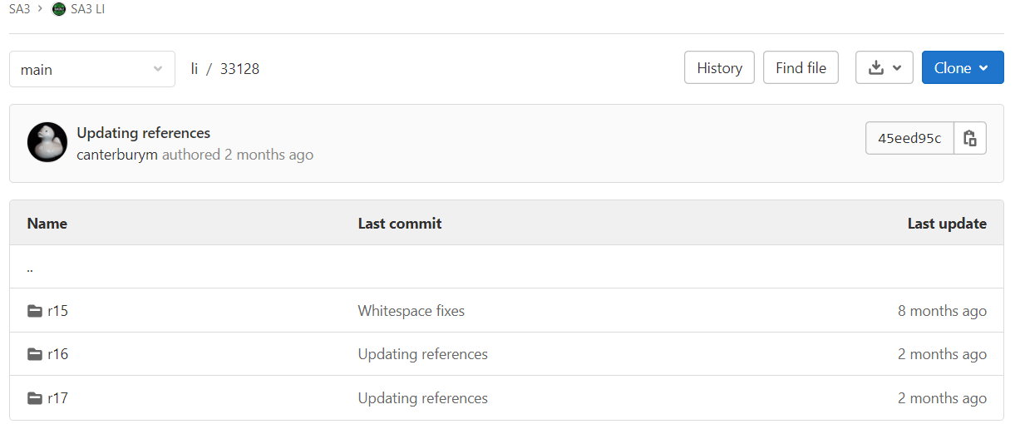
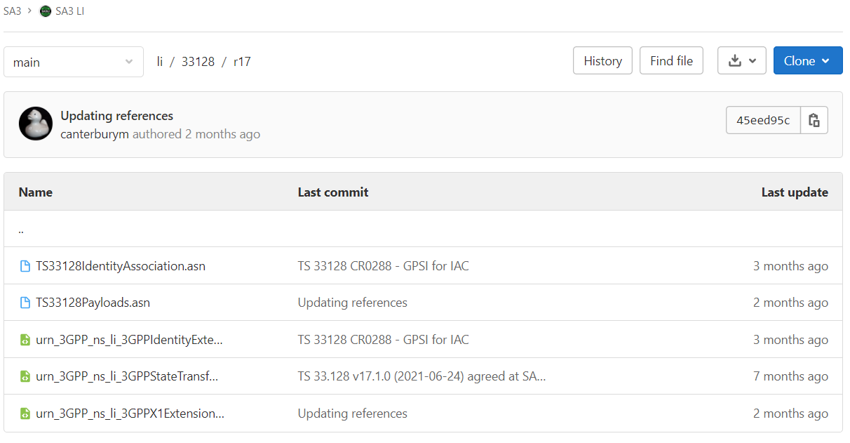
SA3 way of working and evaluation
Inside each branch, folder layout is based on spec
Each spec folder includes all supported all releases
Each release folder includes multiple types of code (ASN1, XSD, etc.)
Hence, each code commit could be applied to multiple releases
This is a good fit for SA3 with limited number of spec and code numbers

Slide 4
Proposal Objectives
Objectives:
Keep current SA5 repo as a standalone project (structure in the figure)
Improving SA5 working efficiency
Making full use of git for version control and releasing
forge.3gpp.org/rep/
all/5G_APIs
yaml
sa5/MnS/
OpenAPI
yaml
xsd
xsd
yang-models
yang
sa3/li/
33108
r6
asn.1
r16
33128
r15
r16
asn.1, xsd
r17
Current in Forge (as of Feb 2022)

Slide 5
Proposal details
The idea is to keep current Forge way of working as much as possible.
  keep SA5 project as standalone project (not to move and merge with other WG)
  Keep current layout of files (first level folder is per solution set)
  Keep current way of releasing (release per branch instead of separating folder)
  Change: yaml file name could be aligned with CT1/3/4
  If the external reference is not allowed, then we could take the following approach
    create a separate external_common_referenc.yaml file to implement the attribute definition in all external references [Similar way as it is now doing by YANG, but much simpler]
    replace the current 5gcNrm.yaml external reference to this new file
    Going forward, the CR author to ensure the update of the external refence content
    Pros: no any direct dependence with external yaml file, validation will be much faster
    Cons: the automatic sync with CT1/3/4 common data is broken, manual sync is needed (same as YANG)
  Alternatively,
    create a separate yaml file to include all external definition, 5gcNrm external reference could be refer to this file. (tested in branch: code_moderator_testing_branch_rel17_external_reference)
    Pros: automatic sync with CT1/3/4 common data is kept,
    Cons: external dependence still existed
In long term, we could consider moving this external_common_reference.yaml content to comDefs.yaml

Slide 6
Backup, comments to chart 6
No specific reason has been highlighted during the discussion
[Sean: some reasons, SA5 OpenAPI file number is small, but the project is quite active, i.e. 0.6 commit/day for Rel17 release branch with 20 authors
  SA5 team is focused on SA5 contents
  Easy maintenance of SA5 branches in Forge without impact to other WG, and vice versa
  Project level access control for finer permission control of SA5 contents
Current practice has shown that:
  No or few discrepencies between WG in the handling of OpenAPI
  The same rules can be followed by multiple WGs from CT and SA
Using a unique repository simplifies:
  The storage of OpenAPI files
  The life of MCC
  The validation process using common tools
  Cross-referencing with use of relative-path URIs [Sean : Agree to some extent]
Ease the path towards a normative use of Forge
[Sean: support to make the normative use of Forge, but not clear why current set is a blocking issue]

Slide 7
Comments to Proposal for all the file types
Files of the same types in the same repository [Sean: Not support. This is not good for development efficiency and keep focused, as SA5 support two Solution Set, for one contribution with two SS, it has to work on branches from two repositories]
Same common structure applied to all repos
For each repo, 1 stable branches per active release [Sean: support, this is current SA5 way]
  Rel-17 (current), Rel-16… Up to Rel-8 (other releases being closed)
Same use of the temporary branches per release as for OpenAPI [Sean: support, this is current SA5 way]
  Containing openAPi files implementing Rel-X agreed CR sent to the next TSG# as well as all the other (unchanged) files valid for the Rel-X
  Use to validate the draft version of OpenAPI and cross check
  Deleted after each plenary
Possibility for any required additional temporary branches (per WG meeting, per delegate, per CR, etc.) [Sean: support, this is close to current SA5 way]
  Deleted at the latest after each plenary
Specific validation tools per repo

Slide 8
Backup

Slide 9
3GPP Forge
Structure (KI#1)
Mr Lionel Morand
OpenAPI Task Force convenor
Notes:
Reminder:

Slide 10
Reminder
KI#1: Storage of 3GPP OpenAPI specification files in 3GPP Forge
  How to manage the OpenAPI specification files from CT and SA WGs using 3GPP Forge (repositories, branching, tagging, merging, permissions, etc.)?
  The main idea should be to have a consistent handling of the OpenAPI specification files across 3GPP WGs
  This can also be valid for the handling of file formats other than YAML files (json, asn.1, xsd, etc.)
Initial target: TSG#93
Final decision: TSG#95

Slide 11
Contributions shared on the mailing list
SA3LI approach (Mark, April 20)
  ASN.1 and XML
CT4 approach (Jesus, April 23)
  OpenAPI
SA5 approach (Zoulan, July 7)
  OpenAPI and Yang models
No further exchange

Slide 12
Existing 3GPP Forge Repositories
forge.3gpp.org/rep/
all/5G_APIs
yaml
sa5/MnS/
OpenAPI
yaml
xsd
xsd
yang-models
yang
sa3/li/
33108
r6
asn.1
r16
33128
r15
r16
asn.1, xsd
r17

Slide 13
Current OpenAPI Repositories
forge.3gpp.org/rep/
all/5G_APIs
174 OpenAPI files
CT1/3/4: 158, SA4: 14, SA5-Charging: 2
sa5/MnS/
OpenAPI
14 OpenAPI files
SA5-OAM: 14

Slide 14
Why different OpenAPI repositories?
No specific reason has been highlighted during the discussion
Current practice has shown that:
  No or few discrepencies between WG in the handling of OpenAPI
  The same rules can be followed by multiple WGs from CT and SA
Using a unique repository simplifies:
  The storage of OpenAPI files
  The life of MCC
  The validation process using common tools
  Cross-referencing with use of relative-path URIs
Ease the path towards a normative use of Forge

Slide 15
Cross-referencing and repositories
Common data types are data types that can be reused in multiple API
  E.g. the data type "Supi" (used in numerous APIs) is defined in the OpenAPI contained in TS 29.571
Common data are defined in an OpenAPI file and other APIs are just referencing to this OpenAPI file for the definition of these data types
If all the files are in the same repository, relative-path URI references can be used
  E.g. $ref: 'TS29571_CommonData.yaml#/components/schemas/Supi'
If the files reusing common data are in a different repository, Absolute URIs or Absolute-path URI have to be used
  E.g; $ref: 'https://forge.3gpp.org/rep/all/5G_APIs/raw/REL-16/TS29571_CommonData.yaml#/components/schemas/Supi'
Which implies that the APIs will not work if:
  the referenced files are moved to another repository
  All the files are moved to a particular development environment (e.g. after cloning a repository, or copying the files locally in a PC directory).

Slide 16
Proposal for OpenAPI files
Move SA5-OAM files from "SA5/MnS/OpenAPI" to "all/5G_APIs"
Impacts:
  Update of the file names in SA5 specs to adopt a common format (slide 10)
  LS OUT to external bodies to indicate the change of repository (if needed)
  Update 21.900 to remove the reference TS 29.501
  Publish a Common user guide (role, branching, tag, etc.)
  …

Slide 17
Proposal for all the file types
Files of the same types in the same repository
Same common structure applied to all repos
For each repo, 1 stable branches per active release
  Rel-17 (current), Rel-16… Up to Rel-8 (other releases being closed)
Same use of the temporary branches per release as for OpenAPI
  Containing openAPi files implementing Rel-X agreed CR sent to the next TSG# as well as all the other (unchanged) files valid for the Rel-X
  Use to validate the draft version of OpenAPI and cross check
  Deleted after each plenary
Possibility for any required additional temporary branches (per WG meeting, per delegate, per CR, etc.)
  Deleted at the latest after each plenary
Specific validation tools per repo

Slide 18
New proposed 3GPP Forge structure
forge.3gpp.org/rep/all/
xsd
xsd
5G_APIs
yaml
yang-models
yang
asn
asn.1

Slide 19
New proposed 3GPP Forge structure
forge.3gpp.org/rep/all/
/Rel-17
/TS29122_AsSessionWithQoS.yaml
xsd
/Rel-16
5G_APIs
/Rel-15
yang-models
/Rel-15-drafts-TSG#
/TS29.510_Nnrf_AccessToken.yaml
asn
/Rel-16-drafts-TSG#
/Rel-17-drafts-TSG#
/TS32291_Nchf_ConvergedCharging.yaml
* Possibility for any required additional temporary branches (per WG meeting, per delegate, per CR, etc.)

Slide 20
Proposed common File name format
Proposition: same format for all the files stored in 3GPP Forge:
  [TSnumber]_[filename].[ext]
    TSnumber: TS number
      Useful to link the file to the TS in which the content is specified.
      e.g. TS29501, TS24558
    filename: filename as defined in the specification
    ext: File extension (.yaml, .yang, .xsd, .asn, etc.)
  E.g.
    TS24558_Eees_EECRegistration.yaml
    TS28541_3gpp-5gc-nrm-FiveQiDscpMappingSet.yang
    TS33108_CONF-HI3-IMS.asn

