Slide 1
FS_BSP4SBA EN resolution and Way forward
Huawei – Imran Saleem

Slide 2
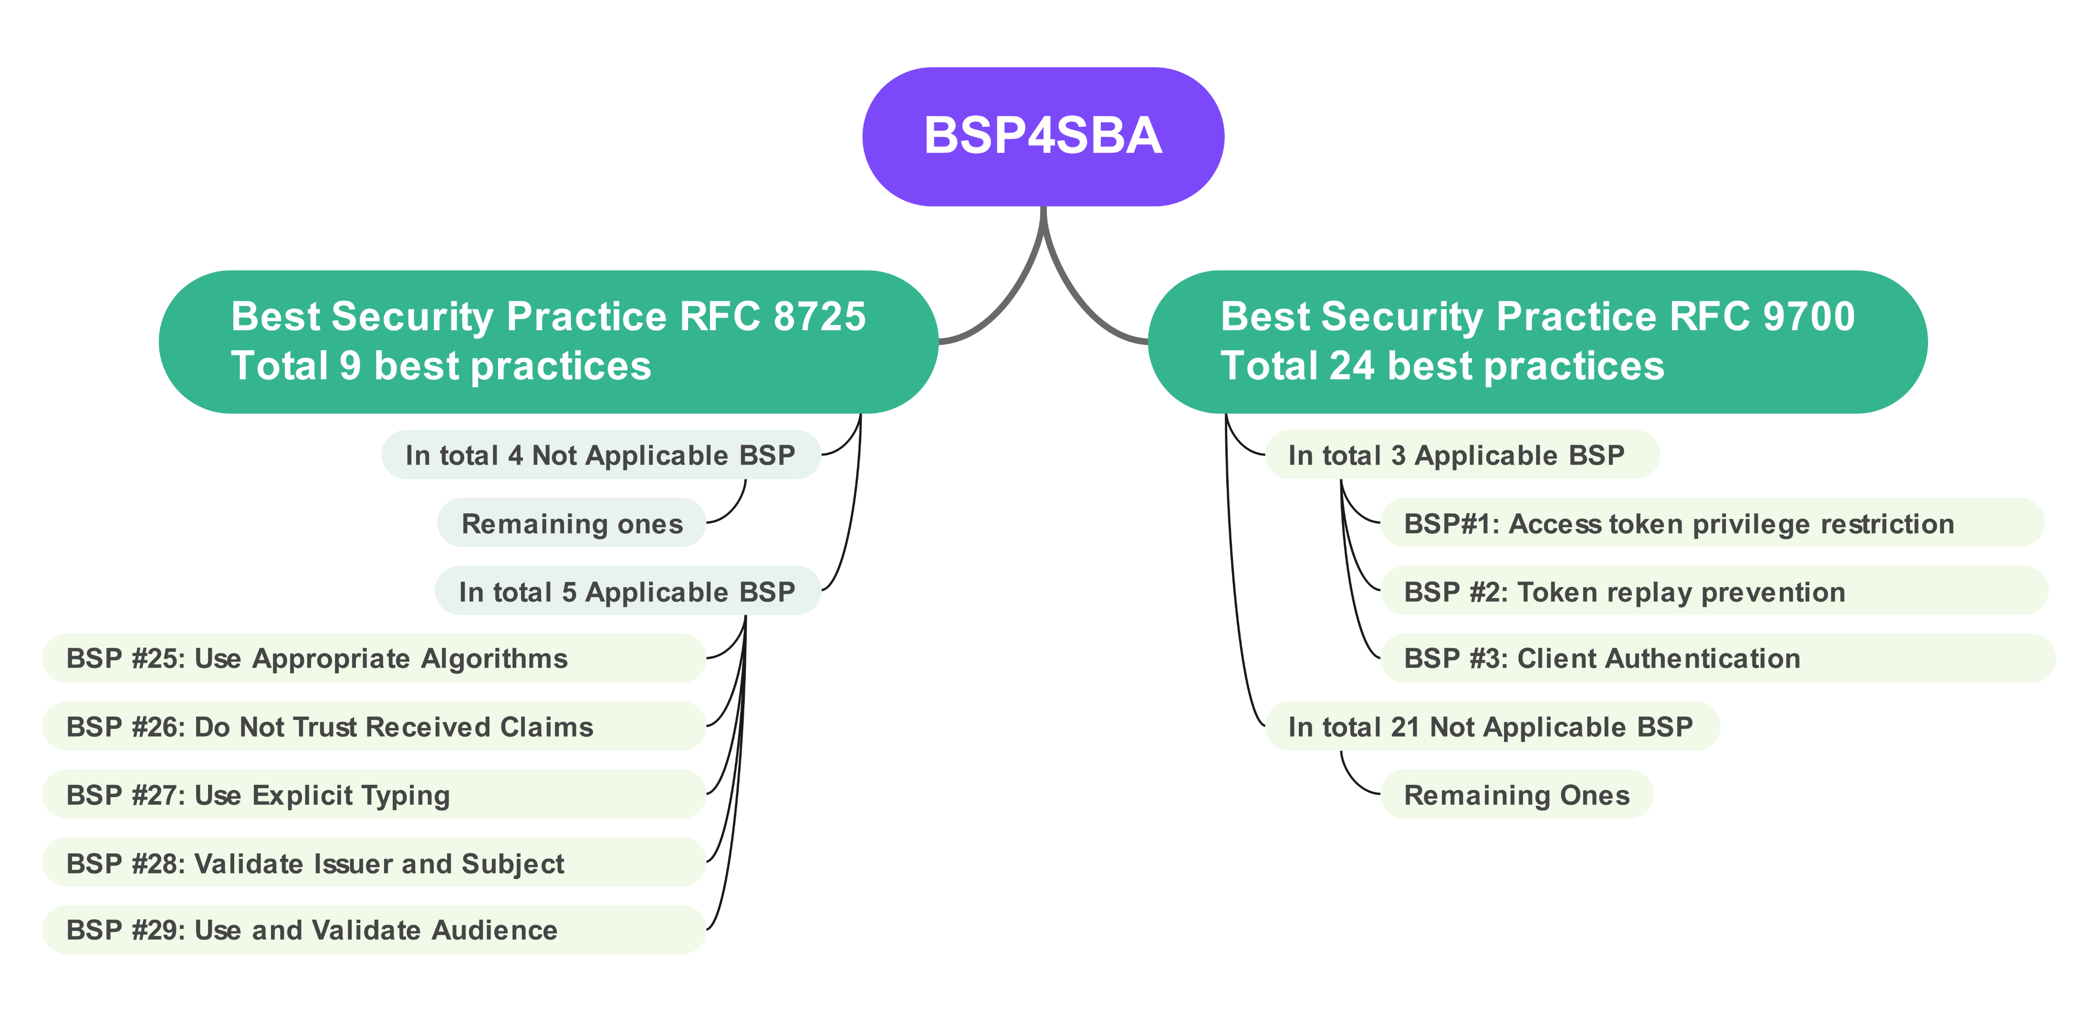
Highlights based on TR 33.755 V0.2.0

Slide 3
Applicable Open points RFC 9700
TR Ref. | Practice Name | Open areas | Resolution
BSP#1: | Access token privilege restriction | Assessment is FFS | Just remove the EN. Assessment contains already adequate details.
BSP#2: | Token replay prevention | Usage is FFS | Just remove the EN. Usage contains already adequate details.
 |  | Assessment is FFS | Resolve the EN : Token replay attacks more specifically in indirect communication, the risk appears to be limited with no immediate actions planned.
BSP#3: | Client Authentication | Usage is FFS | Just remove the EN. Usage contains already adequate details.
 |  | Assessment is FFS | Resolve the EN : Application of this particular best practice in indirect communication, the risk appears to be limited with no immediate actions planned.

Slide 4
Not Applicable Open points RFC 9700
TR Ref. | Practice Name | Open areas | Resolution
BSP#4: | Protecting Redirect-Based Flows | Assessment is FFS | Redirect-Based Flows are OAuth 2.0 authorization flows where the client is redirected through the browser to the authorization server to authenticate and grant access, and the authorization result is returned via a redirect back to the client. Redirect-Based Flows as a feature is not applied in 5G SBA security. Therefore, no further investigation is required.
BSP#5: | Resource Owner Password Credentials Grant | Assessment is FFS | The Resource Owner Password Credentials Grant is an OAuth 2.0 flow where the client directly uses the user’s username and password to obtain an access token, typically only used in highly trusted scenarios. Resource Owner Password Credentials Grant as a feature is not applied in 5G SBA security. Therefore, no further investigation is required.
BSP#6: | OAuth 2.0 Authorization Server Metadata | Description is FFS | OAuth 2.0 Authorization Server Metadata is a standard way for an authorization server to publish its configuration (such as endpoints, supported grant types, and token formats) so that clients can automatically discover how to interact with it.
 |  | Assessment is FFS | OAuth 2.0 Authorization Server Metadata as a feature is not applied in 5G SBA security. Therefore, no further investigation is required.
BSP#8: | Cross origin resource sharing (authorization endpoint) | Description is FFS | Cross origin resource sharing is layered on top of HTTP and allows responses to declare they can be shared with other origins.
 |  | Assessment is FFS | Cross origin resource sharing (authorization endpoint) as a feature is not applied in 5G SBA security. Therefore, no further investigation is required.
BSP#9: | Insufficient Redirection URI Validation | Description is FFS | The practice where authorization servers allow redirection URI patterns (e.g., wildcards or partial matches) to be registered instead of exact, fully specified redirection URIs. At runtime, the authorization server compares (“matches”) the redirection URI provided in the authorization request against the registered pattern and accepts it if it fits.
BSP#10: | Credential Leakage via Referer Headers | Description is FFS | Referer headers are HTTP headers sent to indicate where the current request came from?
 |  | Assessment is FFS | Referer headers are not applied to SBA security. Therefore, no further investigation is required.

Slide 5
Not Applicable Open points RFC 9700
TR Ref. | Practice Name | Open areas | Resolution
BSP#11: | Credential Leakage via Browser History | Description is FFS | Credential leakage via browser history refers to the unintended exposure of OAuth credentials (e.g., access tokens, authorization codes) when they are transmitted through front-channel mechanisms and become stored in a user-agent’s browser history.
BSP#12: | Mix-Up Attacks | Description is FFS | OAuth client is configured to interact with multiple authorization servers, and at least one of those authorization servers is controlled or influenced by an attacker in such a scenario client may be unable to reliably distinguish which authorization server issued a particular authorization credential. The objective of the attacker is to obtain valid credentials such as an authorization code or an access token that were originally issued by a non-compromised authorization server. Rather than attacking that server directly, the attacker exploits the client’s confusion.
 |  | Usage is FFS | There is no security related usage in 5G SBA security. (applicable to only implicit or authorization code grant types)
BSP#13: | Authorization Code Injection | Description is FFS | An authorization code is a short-lived credential issued to the client, which the client later exchanges directly with the authorization server to obtain access tokens securely. An attacker who has gained access to an authorization code contained in an authorization response can try to redeem the authorization code for an access token.
 |  | Assessment is FFS | Authorization code is not applied in 5G SBA security. Therefore, no further investigation is required.
BSP#14: | Access Token Injection | Description is FFS | An access token injection attack happens when an attacker takes a stolen access token and tricks a legitimate application (the client) into accepting and using that token as if it were issued for the current login session. (applicable to only implicit or authorization code grant types)
BSP#15: | Cross-Site Request Forgery | Description is FFS | A CSRF attack happens when an attacker tricks a user’s browser into sending a request to a legitimate application without the user realizing it.
BSP#16: | PKCE Downgrade Attack | Description is FFS | A PKCE downgrade attack happens when an attacker forces a login process to skip using PKCE, even though the authorization server supports it. This is possible when PKCE is optional instead of mandatory. PKCE (Proof Key for Code Exchange) is an OAuth 2.0 extension that prevents authorization code interception by having the client send a code challenge with the authorization request and later prove possession with a matching code verifier when exchanging the code.
 |  | Assessment is FFS | PKCE is not applied in 5G SBA security. Therefore, no further investigation is required.

Slide 6
Not Applicable Open points RFC 9700
TR Ref. | Practice Name | Open areas | Resolution
BSP#17: | Preventing Leakage via Metadata | Description is FFS | OAuth 2.0 Authorization Server Metadata is a standard way for an authorization server to publish its configuration (such as endpoints, supported grant types, and token formats) so that clients can automatically discover how to interact with it.
 |  | Assessment is FFS | OAuth 2.0 Authorization Server Metadata as a feature is not applied in 5G SBA security. Therefore, no further investigation is required.
BSP#18: | Open Redirection | Description is FFS | Open Redirection is a mechanism where the authorization server redirects client to a URI that is external or internal, this is normally done via open redirector end point at the authorization server.
 |  | Assessment is FFS | Open Redirection is not applied in 5G SBA security. Therefore, no further investigation is required.
BSP#19: | 307 Redirect | Description is FFS | A 307 Redirect is an HTTP status code indicating a temporary redirect where the client must repeat the original request method and body to the new location.
 |  | Assessment is FFS | Redirection end point is not applied in 5G SBA security. Therefore, no further investigation is required.
BSP#20: | TLS Terminating Reverse Proxies | Description is FFS | TLS terminating gateway acting as reverse proxies specifically on http layer where it normalize , sanitizes and enforce policies on http headers.
 |  | Usage is FFS | There is no security related usage in 5G SBA.
 |  | Assessment is FFS | http based header sanitization, normalization and enforcement as part of TLS terminating reverse proxies are not applied in 5G SBA security. Therefore, no further investigation is required.
BSP#21: | Refresh Token Protection | Description is FFS | The refresh token is used to request a new access token when needed, instead of keeping long-lasting access tokens active avoiding client proving its identity again when requesting a new token.
BSP#22: | Client Impersonating Resource Owner | Description is FFS | A resource server may mistake an Oauth client's identity for the identity of a resource owner and accidentally gives a Oauth client access to resource owner’s data.
 |  | Usage is FFS | Resource owner is involved in other type of grants such as authorization code grant hence there is no security related usage in 5G SBA.

Slide 7
Not Applicable Open points RFC 9700
TR Ref. | Practice Name | Open areas | Resolution
BSP#23: | Clickjacking | Description is FFS | Clickjacking is an attack where a user is tricked into clicking or typing on a hidden or disguised web page without realizing it.
 |  | Usage is FFS | Browser based user communication is not relevant to SBA and hence there is no security related usage in 5G SBA.
BSP#24: | Attacks on In-Browser Communication Flows | Description is FFS | In Browser Communication Flows are OAuth/OIDC interactions where the browser mediates communication between the authorization server and client so tokens or codes transit through browser side channels rather than only through direct server-to-server back channels
 |  | Assessment is FFS | In-Browser Communication Flows are not applied in 5G SBA security. Therefore, no further investigation is required.

Slide 8
Applicable Open points RFC 8725
TR Ref. | Practice Name | Open areas | Resolution
BSP#25: | Use Appropriate Algorithms | Usage is FFS | Just remove the EN. Usage contains already adequate details.
 |  | Assessment is FFS | The use of “none” algorithm is already barred in the specs. Therefore, no further investigation is required.
BSP#26: | Do Not Trust Received Claims | Usage is FFS | Just remove the EN. Usage contains already adequate details.
 |  | Assessment is FFS | No further improvements are required for the “kid” usage and validation. Validation of the x5u URL , the risk appears to be limited with no immediate actions planned.
BSP#27: | Use Explicit Typing | Description is FFS | Use Explicit Typing means clearly labeling the type of each token so that the system can verify it is being used only in its intended context and cannot be mistaken for another type.
 |  | Usage is FFS | As specified in TS 29.510 clause 6.3.5.2.3 in the access token response , the information element “token_type” is set to “bearer”.
 |  | Assessment is FFS | Explicit token type is already in use within the context of 5G SBA security. Therefore, no further investigation is required.
BSP#28: | Validate Issuer and Subject | Description is FFS | When a JWT contains an "iss" (issuer) claim, the application validates that the cryptographic keys used for the cryptographic operations in the JWT belong to the issuer. Similary, when the JWT contains a "sub" (subject) claim, the application validates that the subject value corresponds to a valid subject.
 |  | Usage is FFS | Reference: 13.4.1.1.2 of TS 33.501: The claims in the token issued by the NRF include the NF Instance Id of NRF (issuer), NF Instance Id of the NF Service Consumer (subject). The NF Service Producer checks that the integrity of the JWT using pubkey of the NRF (the issuer) which issued the token and subsequently validates the NF consumer Instance ID is part of the “subject” claim matches to the one used during the mTLS handshake.
 |  | Assessment is FFS | Validation of subject and issuer in the claims at the NF producer is applied in 5G SBA security. Therefore, no further investigation is required.
BSP#29: | Use and Validate Audience | Description is FFS | When a JWT contains an “aud" (Audience) claim, the application validates if the recipient node is the intended “audience” for that particular JWT.
 |  | Usage is FFS | Reference: 13.4.1.1.2 of TS 33.501: In 5G SBA, "aud" claim (e.g NF type of the NF Service Producer) validates if it is the intended audience for the particular JWT.
 |  | Assessment is FFS | Validation of “aud” at the NF producer is applied in 5G SBA security. Therefore, no further investigation is required.

Slide 9
Not Applicable Open points RFC 8725
TR Ref. | Practice Name | Open areas | Resolution
BSP#30: | Validate Cryptographic Inputs | Usage is FFS | While the use of (ECDH-ES) exist for the operations in SBA i.e JWT , the validation of the such Cryptographic Inputs is implementation specific.
 |  | Assessment is FFS | This set of best practice is considered implementation specific. Therefore, no further investigation is required.
BSP#31: | Ensure Cryptographic Keys Have Sufficient Entropy | Usage is FFS | While the use Cryptographic key exist for the operations in SBA i.e JWT, the validation of the such Cryptographic Entropy is implementation specific.
 |  | Assessment is FFS | This set of best practice is considered implementation specific. Therefore, no further investigation is required.
BSP#32: | Avoid Compression of Encryption Inputs | Usage is FFS | There is no related usage in 5G in the context of SBA security.
 |  | Assessment is FFS | This set of best practice is considered implementation specific. Therefore, no further investigation is required.
BSP#33: | Use Mutually Exclusive Validation Rules for Different Kinds of JWTs | Usage is FFS | Multiple “JWT type” are not applicable in SBA JWT Implementation. Only single type JWT is currently in use as specified in TS 29.510 clause 6.3.5.2.3 in the access token response , the information element “token_type” is set to “bearer”.
 |  | Assessment is FFS | Therefore, no further investigation is required.

Slide 10
Conclusion
Best practice as specified in RFC 9700 clauses 2.2, 2.5 for indirect communication , the risk appears to be limited with no immediate actions planned.
RFC 8725 clause 3.10 for indirect communication , the risk appears to be limited with no immediate actions planned.
Remaining set of applicable and non-applicable measure/controls outlined in the RFC 8725 clause 3.1, 3.2, 3.3, 3.4, 3.5, 3.6, 3.7 are implementation specific Therefore, no further action is required.

