Slide 1
R16: N3GPP and slicing
Laurent Thiébaut,
Jan 18th 2021 SA2 CC

Slide 2
N3GPP and slicing
All AMF supporting N3GPP access?
LG:
  You are assuming that all AMF(s) may not support N3GPP access but this is not correct.
  What happens if a UE first registered to 3GPP access with an AMF which does not support N3GPP access and then the UE tries to register N3GPP access?
  We didn't discussed such case and I believe that all AMF(s) in the network shall support N3GPP access if network deployed N3IWF.
Answer:
  if a UE first registered to 3GPP access with an AMF which does not support N3GPP access and then the UE tries to register N3GPP access? → the new registration (on N3GPP) fails, not dramatic. Network operators are free to deploy or NOT to deploy features like N3GPP access (there could be no N3IWF in a network)

Slide 3
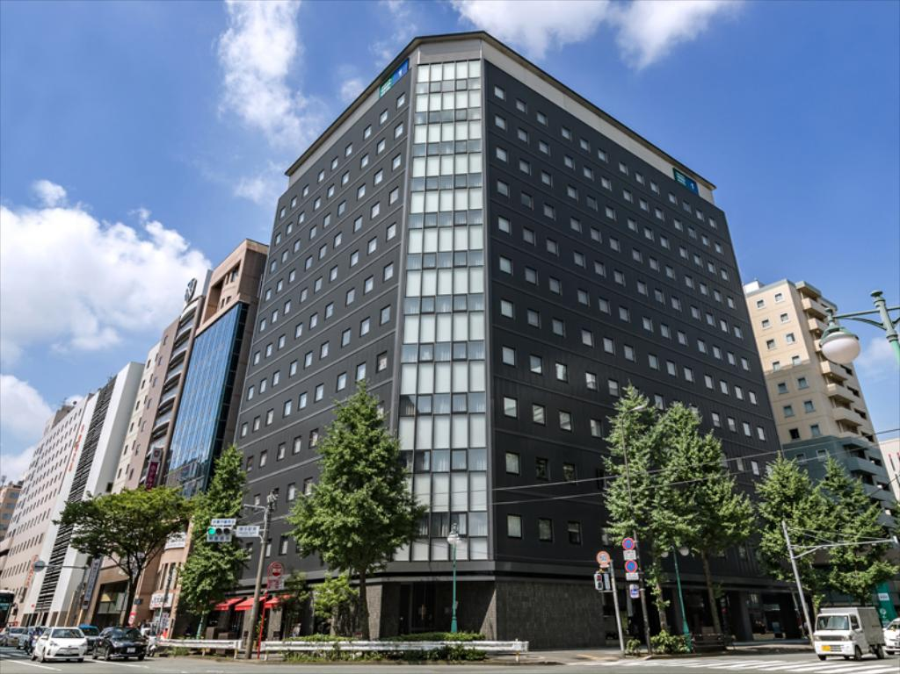

A
UE (no 3GPP coverage) registers via N3WIF that selects a non geographical AMF0
UE establishes a PDU Session and an emergency call
B)
User moves out of the building, gets 3GPP coverage, UE now served by 3GPP access? NG RAN picks another (geographical) new AMF
23.502 FIG 4.2.2.2.2 takes place
  Step 1 Registration request , …
  Step 4-5 UE context fetch, ….
  Step 18: If the AMF has changed and the old AMF has indicated that the UE is in CM-CONNECTED state via N3IWF, W-AGF or TNGF and if the new AMF and the old AMF are in the same PLMN, the new AMF creates an NGAP UE association towards the N3IWF/TNGF/W-AGF to which the UE is connected.
  What happens if new AMF does not support N3GPP and step18
N3GPP and slicing
A
REGISTER + PDU Session
REGISTER + PDU Session
N3IWF1
AMF0
Emergency Session
B3) NGAP UE association
B
B2) UE context fetch
NG RAN
New AMF
B1) REGISTER

Slide 4
N3GPP and slicing
23.502 FIG 4.2.2.2.2
23.502 (step4)“If the old AMF has PDU Sessions for another access type (different from the Access Type indicated in this step) and if the old AMF determines that there is no possibility for relocating the N2 interface to the new AMF, the old AMF returns UE's SUPI and indicates that the Registration Request has been validated for integrity protection, but does not include the rest of the UE context.”
Even old AMF it returns the context, what happens if step 18 is not done?
  “When served by the same PLMN for 3GPP and non-3GPP accesses, an UE is served by the same AMF except in the temporary situation described in clause 5.17 i.e. after a mobility from EPS while the UE has PDU Sessions associated with non-3GPP access.”
  If UE tries to move the PDU Session to 3GPP access (SM establishment with “existing PDU Session”

