Slide 1
Propose Work Plan for 5G-AIS in SA2#143e
Rapporteur/Tencent
2021.1.18

Slide 2
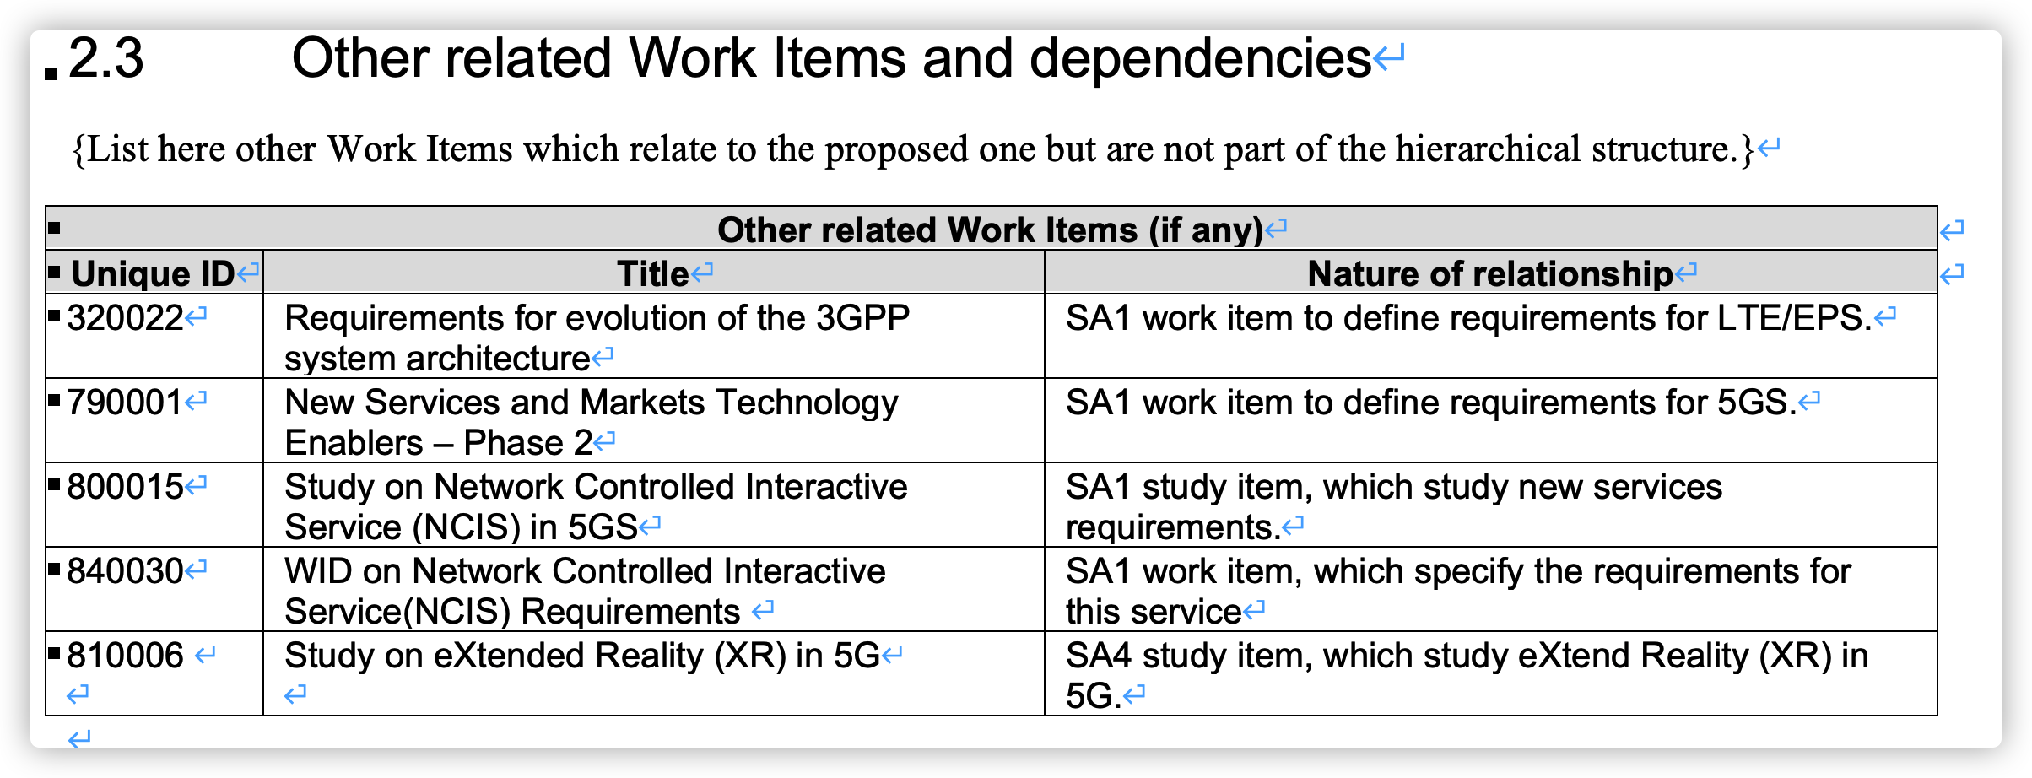
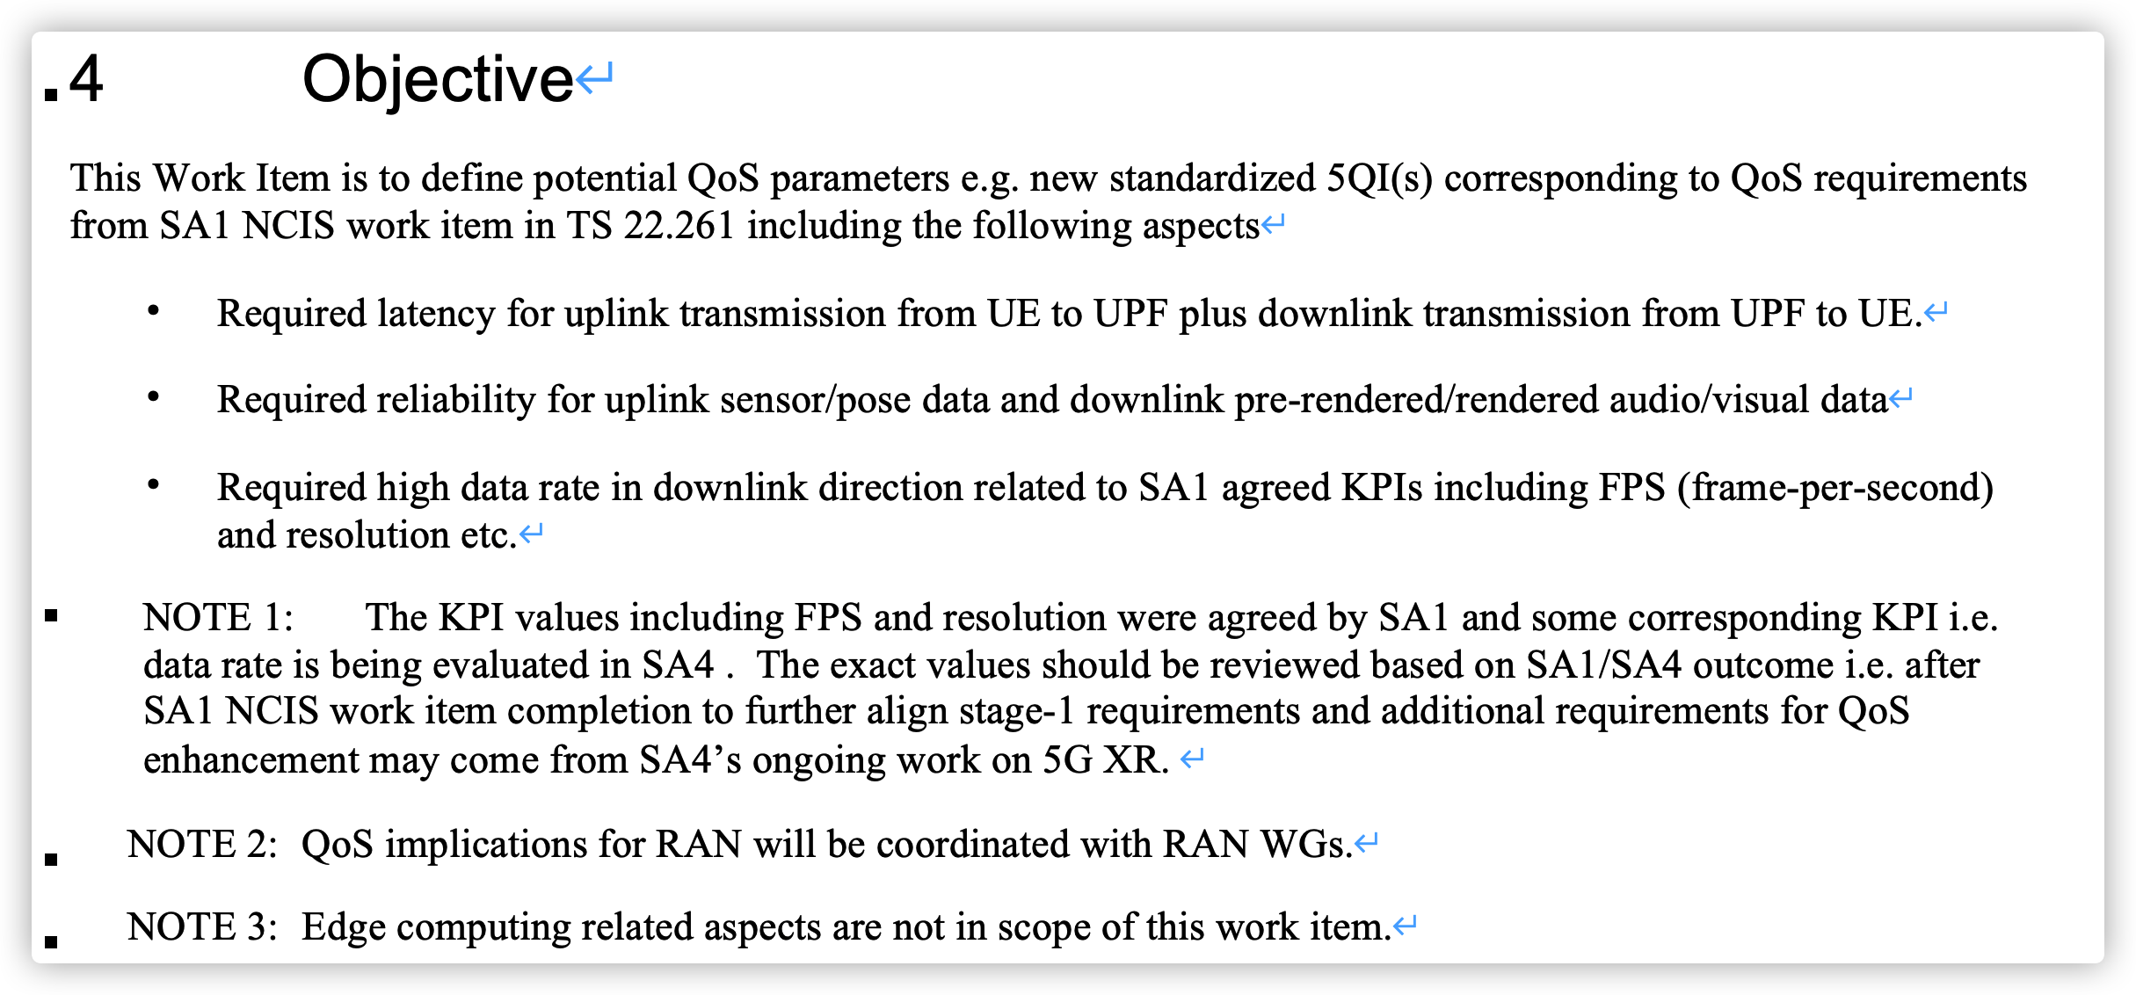
SA2 5G_AIS scope & objective
Other related work items & dependencies
Objectives

Slide 3
Progress in SA2#142e
SA2 LS on 5QI sent to RAN1/SA4 and wait for response
Very intensive discussion on periodicity and burst related parameters
S2-2008794 | [DRAFT] LS on New Standardized 5QIs for 5G-AIS | Tencent | LS out | Approval | revised
S2-2008795 | Discussion on New 5QI for 5G Advanced Interactive Services. | Tencent, OPPO, China Mobile, China Unicom, CATT | discussion | Decision | noted
S2-2008863 | Periodicity for Advanced Interactive Service. | Tencent, CATT, OPPO | draftCR | Approval | noted
S2-2008864 | QoS Enhancement for 3GPP Advanced Interactive Service | Tencent, Huawei, CATT, OPPO, Sony | draftCR | Approval | noted
S2-2008865 | QoS parameters for 3GPP Advanced Interactive Service | Tencent, Huawei, CATT, OPPO, Sony | draftCR | Approval | noted
S2-2008866 | PCC to support Advanced Interactive Service | Tencent, Huawei, CATT,OPPO, Sony | draftCR | Approval | noted
S2-2008891 | Proposed New 5QI for Interactive Services | Tencent, OPPO, China Mobile, China Unicom, Sony | draftCR | Approval | postponed
S2-2008969 | Discussion on new standardized 5QI for AIS. | Xiaomi | discussion | Approval | noted
S2-2008970 | Add new standardized 5QIs for Advanced Interactive Services | Xiaomi | CR | Approval | postponed
S2-2008972 | [DRAFT] LS on definition of new standardized 5QI for Advanced Interactive Services | Xiaomi | LS out | Approval | merged
S2-2008995 | Enhancements to support XR applications. | Qualcomm Incorporated | discussion | Agreement | noted
S2-2008996 | Extension of TSCAI to IP PDU Session type | Qualcomm Incorporated | draftCR | Approval | noted
S2-2008997 | Burst Arrival Time Offset indication in QoS Notification Control | Qualcomm Incorporated | draftCR | Approval | noted
S2-2008998 | [DRAFT] LS on additional QoS aspects for Advanced Interactive Services | Qualcomm Incorporated | LS out | Approval | postponed
S2-2008999 | [DRAFT] LS on slice based QoS handling | Qualcomm Incorporated | LS out | Approval | noted
S2-2009227 | LS on New Standardized 5QIs for 5G-AIS (Advanced Interactive Services) | SA WG2 | LS out | Approval | approved

Slide 4
Proposed work plan for SA2#143e
5QI
Rapporteur propose to wait for RAN1 response and if there is no RAN1 LS response, no discussion on this aspect
Service Assistance Information for AIS
Necessity of periodicity and burst parameters
Discuss the way to capture these parameters i.e. whether to reuse TSCAI or define a unified Service Assistance Information for both TSCAI and AIS?
Review updated contribution to 23.501/23.502/23.503

Slide 5
Thanks a lot!

