Slide 1
Discussion on Satellite Backhaul
CATT, ZTE

Slide 2
Outline
1) Satellite Backhauling Scenarios
2) Impacts brought by satellite backhaul
3) SA2 work on satellite backhauling
4) Observations and Proposals

Slide 3
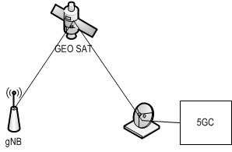
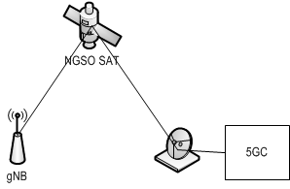
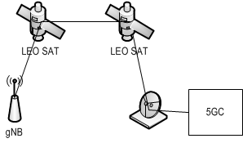
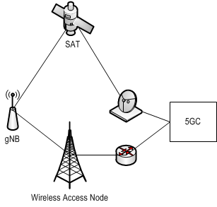
Satellite backhauling scenarios
s1. gNB connects to 5GC via a single GEO satellite
s2. gNB connects to 5GC via a single NGSO satellite
s3. gNB connects to 5GC via a single satellite with ISL
s4. gNB connects to 5GC with backhaul connections over different satellites
s5. gNB connects to 5GC with hybrid backhauls (e.g., satellite and terrestrial backhauls)
s6. gNB on-board connects to 5GC via satellites

Slide 4
Impacts brought by satellite backhaul
PCC and QoS aspect:
  Due to high latency of satellite backhaul, some services with 5QIs which have limited PDB (e.g., 100ms for IMS voice), may not be able to be satisfied, e.g., in scenarios s1, s3, s6.
  Backhaul latency may largely change in case of involving multi-hop ISL (e.g., s3) or backhaul switch(e.g., s4), CN PDB need to be changed accordingly.
  Due to bandwidth limitation , satellite backhaul may not be able to guarantee the GFBR indicated by the PCF, which causes service interruption if notification control is not applied.

Slide 5
Impacts brought by satellite backhaul
UPF selection aspect:
  Different backhaul connections have different latency, e.g., in s4 and s5, for some specific services, e.g. time sensitive services, the SMF need to take the backhaul latency on N3 interface into account to select a suitable UPF.
  Bandwidth limitation on satellite backhauls may also need to be considered for UPF selection, because selecting a UPF to use GEO satellite backhaul may not be a good choice in some cases, e.g. for HD video transmission.

Slide 6
Impacts brought by satellite backhaul
NAS timer aspect:
  The NAS message transmission delay between UE and the 5GC will be enlarged when satellite backhaul is in use. In some cases (e.g., s1, s3, s6), for successful NAS message transmission, some NAS layer timer values need to be extended.
  As the backhaul delays over different satellites are different, so when the backhaul connection for N2 connections changes, e.g. in s4, the NAS timer values may need to be changed accordingly.

Slide 7
Impacts brought by satellite backhaul
N2/N3 connection maintenance:
  Due to satellite movement, e.g. s2, or gNB movement, e.g. s6, the gNB will be subject to backhaul link break, which may lead to the interruption of signalling/data transmission.
  In s5, the gNB IP addresses for N2/N3 connections over terrestrial network and those over satellite network may be different. So when a gNB switches the backhaul connections from terrestrial network to satellite network or vice versa, the N2/N3 connections need to be re-established. Similar issue

Slide 8

SA2 work on satellite backhauling
In TR phase:
  PCC and QoS aspects:
    Solution 11 is proposed to allow the PCF to take Backhaul type indicated by RAN and/or QoS limitation reported by UPF into account to make/adjust policy decision.
    A NOTE indicates that the RAN feedback is required.
  UPF selection aspect:
    Solution 11 also proposes to allow the SMF to select a UPF based on the QoS limitation.
  NAS timer aspect:
    Not proceed in Rel 17.
  N2/N3 connection maintenance:
    Not touched.

Slide 9
SA2 work on satellite backhauling
In TS phase:
  PCC and QoS aspects:
    As RAN indicates no study in RAN, E/// (S2-2008453) proposes a solution based on CN configuration, which has no RAN impact, but it can only work in GEO case, i.e., s1.
  UPF selection aspect:
    Some enhancements are proposed, since some companies think it is not clear when and how to obtain QoS limitation, but there is no further progress due to dependency on RAN work.

Slide 10
Observations and Proposals
Observations:
  1. The scenarios and issues to support satellite backhaul need further study.
  2. Pure CN based solution can only address QoS related issues for GEO case, but can not solve other issues identified, so support of this solution doesn’t mean that GEO satellite backhaul is usable in Rel 17.
  3. Based on study in TR phase and current discussion in SA2, RAN based solution can better serve all satellite backhauling scenarios.
  4. Supporting satellite backhaul needs to involve RAN work due to the impacts to RAN.
  5. RAN will not study satellite backhaul in Rel 17, and it is not urgent to support satellite backhaul in Rel 17.

Slide 11
Observations and Proposals
Proposal:
  3GPP (RAN and SA WGs) needs to have a complete study on support of satellite backhaul and define general solutions.
  To avoid defining different solutions in different release, SA2 defers the support of satellite backhaul in 5GS until Rel 18.

Slide 12
Thank You!

