Slide 1
Status of SI progress – rapporteur’s view
Informal F2F meeting on Indoor industrial channel modeling
Berlin, July 1-2, 2019
Henrik Asplund
Ericsson
2019-07-01

Slide 2
Timeline
No online time
RAN1#94bis (Oct 2018)
  Start of SI
RAN1#95 (Nov 2018)
RAN1#AH (Jan 2019)
RAN1#96 (Feb 2019)
RAN1#96bis (Apr 2019)
  Online session, 0.25 TU
RAN1#97 (May 2019)
  Online session, 0.25 TU
Informal offline F2F meeting July 1-2
RAN1#98 (Aug 2019)
  Online session – finalizing CRs to TR 38.901, 0.5 TU
RAN#85 (Sep 2019)
  Close SI
9 email discussions completed: model framework agreed
Email agreements endorsed
6 email discussions completed
Email agreements endorsed
New email discussion to tentatively agree model details and perform calibration of model implementations (see next slide)

Slide 3
Timeline until completion of SI
New technical contributions (by mid-June)
Agree on model:
Scenario description
Path loss models
LOS probability
LSP table
Additional model components
Tentatively agree on model:
(Scenario description)
Path loss models
LOS probability
LSP table
(Additional model components)
Previous contribitions
Draft the CR
Agree on calibration assumptions
Perform calibration campaign
Summarize calibration campaign in a Tdoc
Approve CR
Informal F2F meeting July 1-2
[97-NR-10 ]Email discussion concluding July 12
RAN1 meeting in August

Slide 4
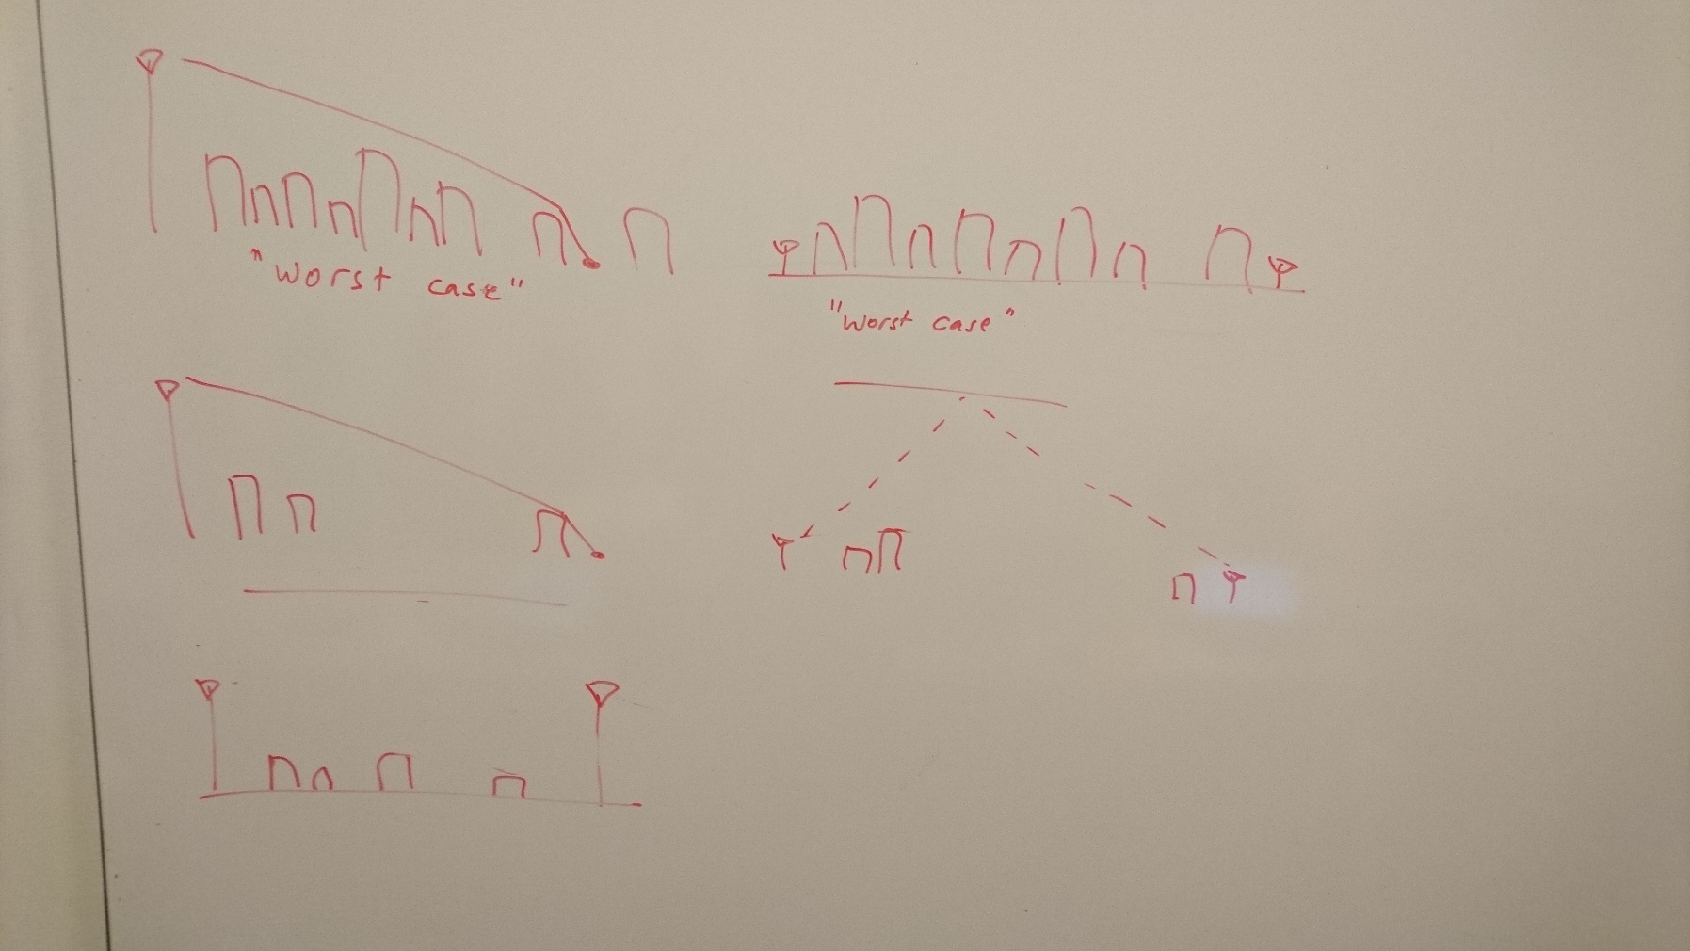
Industrial channel model
Technical progress
Agreed five sub-scenarios
  Low clutter density, embedded BS
  High clutter density, embedded BS
  Low clutter density, elevated BS
  High clutter density, elevated BS
  Elevated Tx to elevated Rx (BS-to-BS links)
Model details starting to fall in place
  Re-use stochastic model methodology from TR 38.901
  Parameterizations for new sub-scenarios still TBD
  New additions:
    Dual-mobility method adapted from V2x (TR 37.885)
    Absolute time of arrival (for positioning), exact model TBD

Slide 5
Remaining issues on different topics
Measurements
We have created an excel file listing all 80+ measurements contributions (tdocs, literature) including various attributes (frequency, distance range, ...).
Scenario description
Density definition: % of floor space occupied by clutter (machinery, shelves, conveyor belts, ...). What is ”low” and ”high” clutter density?
Range of factory hall sizes covered by the model: 20-160.000 m², 3-25 m ceiling height?
Simulation assumptions and metrics for channel model calibration
Path loss
Merging of path loss model parameters from different observations and sources
Specify additional loss for ”embedded devices”
LOS probability
Merging of empirical and analytical LOS probability functions, how to do this?
Decide on correlation distances and inter-link correlations
Fast fading modeling
Parameterization of fast fading for the different sub-scenarios, including merging of proposals from different companies
Dense multipath?
Additional modeling components
Spatial consistency: some correlation distances to be specified
Blocking models A and B to be adapted to industrial scenario
Dual mobility: Use Doppler model from V2x (TR 37.885). Doppler of scatterers is modeled stochastically, discussion on how
Absolute time of arrival: Proposals on lognormal, Gaussian, or exponential distribution for excess delay of first path in NLOS

Slide 6
Preferred outcome from F2F meeting
Merged proposals for path loss, LOS probability, and LSP parameters
Joint proposals on scenario description, additional modeling components, and calibration assumptions
The outcome of the F2F meeting will be submitted to [NR-97-10] for possible agreement
  Parameter values at least within square brackets so they can be used for channel model calibration

