Slide 1
Status of SI progress – rapporteur’s view
Informal F2F meeting on Indoor industrial channel modeling
Berlin, July 1-2, 2019
Henrik Asplund
Ericsson
2019-07-01

Slide 2
Timeline
No online time
RAN1#94bis (Oct 2018)
Start of SI
RAN1#95 (Nov 2018)
RAN1#AH (Jan 2019)
RAN1#96 (Feb 2019)
RAN1#96bis (Apr 2019)
Online session, 0.25 TU
RAN1#97 (May 2019)
Online session, 0.25 TU
Informal offline F2F meeting July 1-2
RAN1#98 (Aug 2019)
Online session – finalizing CRs to TR 38.901, 0.5 TU
RAN#85 (Sep 2019)
Close SI
9 email discussions completed: model framework agreed
Email agreements endorsed
6 email discussions completed
Email agreements endorsed
New email discussion to tentatively agree model details and perform calibration of model implementations (see next slide)

Slide 3
Timeline until completion of SI
New technical contributions (by mid-June)
Agree on model:
Scenario description
Path loss models
LOS probability
LSP table
Additional model components
Tentatively agree on model:
(Scenario description)
Path loss models
LOS probability
LSP table
(Additional model components)
Previous contribitions
Draft the CR
Agree on calibration assumptions
Perform calibration campaign
Summarize calibration campaign in a Tdoc
Approve CR
Informal F2F meeting July 1-2
[97-NR-10 ]Email discussion concluding July 12
RAN1 meeting in August

Slide 4
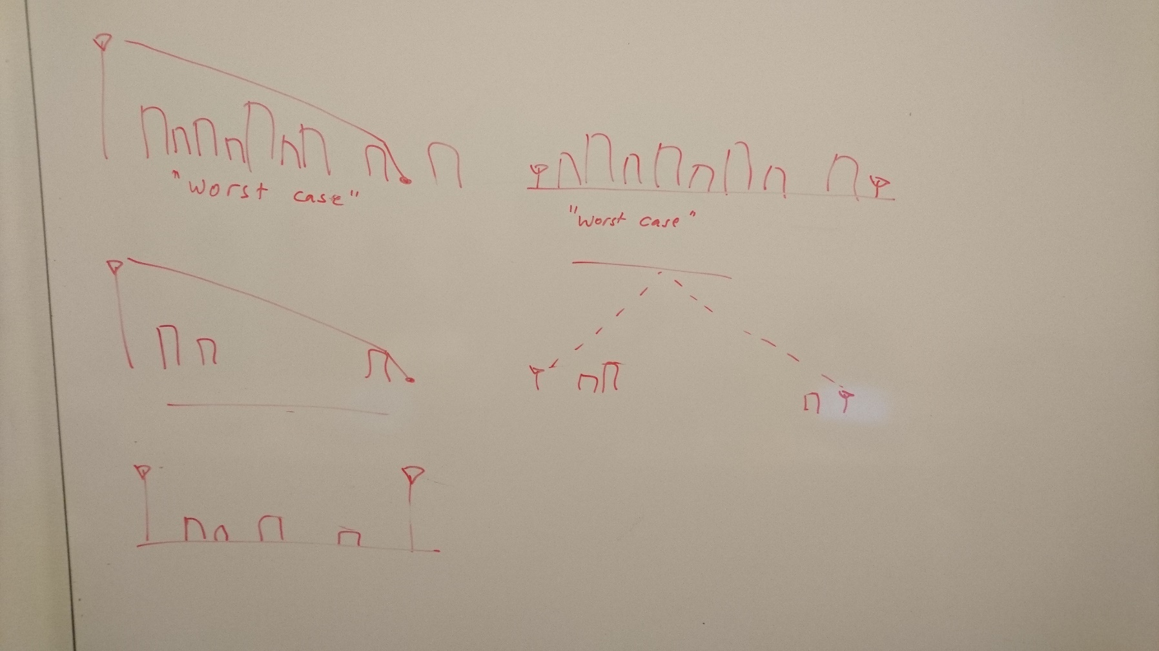
Industrial channel model Technical progress
Agreed five sub-scenarios
Low clutter density, embedded BS
High clutter density, embedded BS
Low clutter density, elevated BS
High clutter density, elevated BS
Elevated Tx to elevated Rx (BS-to-BS links)
Model details starting to fall in place
Re-use stochastic model methodology from TR 38.901
Parameterizations for new sub-scenarios still TBD
New additions:
Dual-mobility method adapted from V2x (TR 37.885)
Absolute time of arrival (for positioning), exact model TBD

Slide 5
F2F progress and remaining issues on different topics
Measurements
Additional measurements presented/contributed by Fraunhofer IIS/HHI, Huawei
Scenario description
Complete proposal for scenario description available
Simulation assumptions and metrics for channel model calibration available
Path loss
Merging of path loss model parameters from different observations and sources ongoing [Huawei has volunteered to complete this work and submit to the official email discussion]
Specify additional loss for ”embedded devices” – postponed until August awaiting further measurements and a complete proposal

Slide 6
F2F progress and remaining issues on different topics
LOS probability
Complete proposal for LOS probability available including autocorrelation distance
Inter-link correlations not treated
Fast fading modeling
Parameterization of fast fading for the different sub-scenarios, including merging of proposals from different companies ongoing [Fraunhofer has volunteered to complete this work and submit to the official email discussion]
No conclusions on dense multipath, encourage companies to analyze and provide input to Prague
Additional modeling components
Absolute time of arrival: Proposals on lognormal, Gaussian, or exponential distribution, or distance-dependence for excess delay of first path in NLOS
Companies encouraged to share raw data (f,d,Δτ) [Huawei has volunteered to collect and merge such data]
Recommended blocker sizes provided for blocking model B
Dual mobility: modeling of Doppler of scatterers specified

Slide 7
Next steps
Finalize meeting report [Ericsson]
By July 3
Submit merged proposals for path loss, fast fading, and LOS probability to [97-NR-10] [Huawei, Fraunhofer HHI, Ericsson]
By July 5 latest
Prepare proposals for agreement in [97-NR-10] based on the merged proposals and the meeting report [Ericsson]
By July 12 latest
Continue to maintain and update the respective merge summaries (path loss, fast fading, Δτ , etc) using the following email discussion thread:
[97-NR-11] Email discussion on other remaining aspects (potentially split into several sub-email-threads) till next meeting – Henrik (Ericsson)
Email discussion summaries to be submitted to RAN1#98

