Slide 1
Results on Relative Delay under NLOS
Huawei Technologies
Fraunhofer IIS

Slide 2
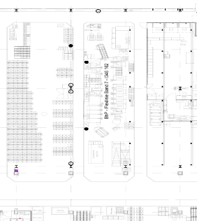
Measurement Setup #1
Corridor
NLOS Positions
 | x [m] | y [m] | z [m]
TX | 0 | 0 | 4.2
RX1a | 20 | 0 | 1.96
RX1b | 20 | -3.7 | 1.96
RX2a | 18.5 | 0 | 1.96
RX2b | 18.5 | -3.7 | 1.96
RX3a | 17 | 0 | 1.96
RX3b | 17 | -3.7 | 1.96
RX4a | 15.5 | 0 | 1.96
RX4b | 15.5 | -3.7 | 1.96
RX5a | 14 | 0 | 1.96
RX5b | 14 | -3.7 | 1.96
RX6a | 12.5 | 0 | 1.96
RX6b | 12.5 | -3.7 | 1.96
RX7a | 11 | 0 | 1.96
RX7b | 11 | -3.7 | 1.96
RX8a | 9.5 | 0 | 1.96
RX1c | 15.7 | -7.4 | 1.96
Production line
Elevation scanned at RX only from -30° to 30°
z
Production line
Industry 4.0 Plant for automotive related production, Germany
Multi-band measurements: 3-10 GHz, 28-38 GHz, and 56-66 GHz
30°HPBW at TX and RX
  Azimuth&Elevation scan
TX height: approx. 4.2m
RX height: approx. 1.96m
3D TX-RX2 distance ~18m
y
x
RX8a
RX7a
RX7b
RX6a
RX5a
RX4a
RX1c
RX3a
RX3b
RX2a
RX2b
RX1a
RX1b
Corridor
Corridor
TX
RX LOS
RX NLOS

Slide 3
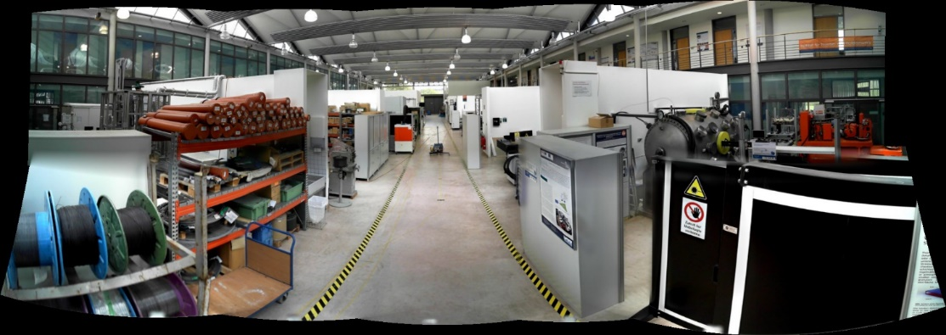
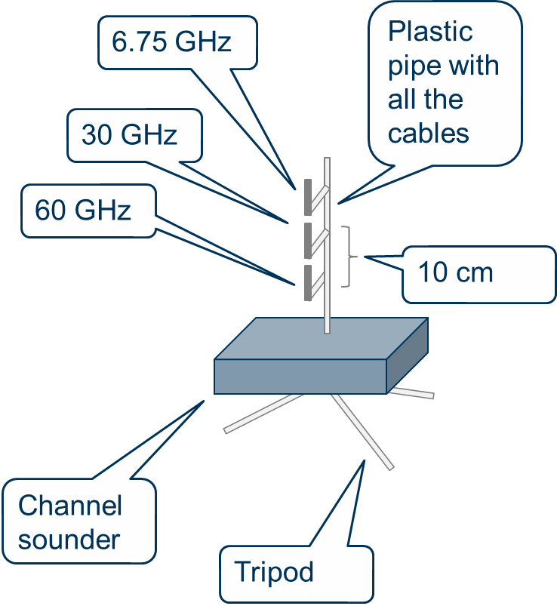
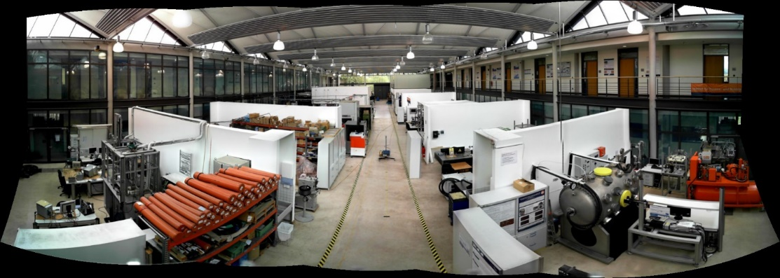
Measurement Setup #2
TX1
Machine Lab at TU Ilmenau, Germany
Multi-band measurements TX
  Directive antennas with 30° HPBW
  Scanning in azimuth: - 60° to 60° with 30° steps
  Scanning in elevation 0° to -30° with 30° steps
TX2
2x Tx positions
  TX1: clutter level (at approx. 2 m heigth) – subcenario 2
  TX2: above clutter level (at approx. 4 m heigth) – subscenario 4
23x Rx positions incl. LOS and NLOS
2x23x2 = 96 triple band measurement points
N9
N1
2m
N17
N23
N4
6.5m
2m
TX1/2
L23
N8
L1
N14
N5

Slide 4
Extraction of relative delay in NLOS
Position RX1b Measurement Setup #1
Use peak detection to identify multpath clusters/components
The delay of the „virtual LOS“ is calculated
The relative delay is the delay difference between the first detected peak and the „virtual LOS“ of the channel
Peak dection: MATLAB® peak detection algorithm is used, which intends to find local maximas in the PDPs. Only those peaks are considered as valid peaks which cross a threshold of maximum- 5dB value.

Slide 5
Model for relative delay in NLOS
(Combined 30 GHz data of meas. setup 1&2)
Clear dependence on Tx-Rx distance!

Slide 6
Standard error analysis –Normal Distribution
(Combined 30 GHz data of meas. setup 1&2)
Normal Distribution fit
Proposed Model 1
Relative Delay = max(alpha*d + C + n, 0)
where
alpha=3.67
C=-33.33
n~N(0,17.1)

Slide 7
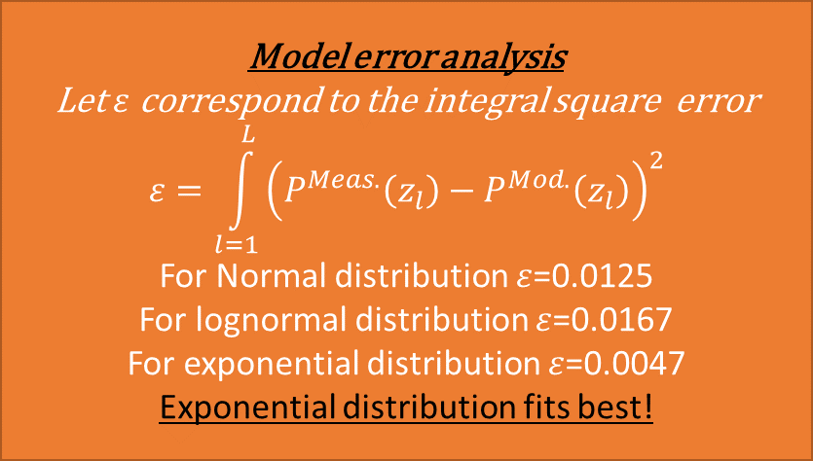
Standard error analysis
(Combined 30 GHz data of meas. setup 1&2)
Proposed Model 2
Relative Delay = max(alpha*d + C + n,0)
Where
alpha=3.67, C=-33.33
Sign of n is uniformly distributed (+ or -)
Abs(n) follows lognormal or exponential distribution
Lognormal- and Exponential Distribution fit
Model error analysis
Let $ε$ correspond to the integral square error
$$ε=\int_{l=1}^{L}{{\left(P^{Meas.}\left(z_{l}\right)−P^{Mod.}\left(z_{l}\right)\right)}^{2}}$$
For Normal distribution $ε$=0.0125
For lognormal distribution $ε$=0.0167
For exponential distribution $ε$=0.0047
Exponential distribution fits best!

Slide 8
Conclusion
Strong dependence of the relative delay on the Tx-Rx distance is observed
We have proposed two model the relative delay
  Exponential distribution seems the best fit for the variation around the linear function
  So the best model would be:
    Relative Delay = max(alpha*d + C + n,0)
      Where alpha=3.67, C=-33.33, sign of n is uniformly distributed (+ or -)
      Abs(n) follows exponential distribution

