Slide 1
Welcome to Fraunhofer HHI
Welcome to Berlin – Germany

Slide 2
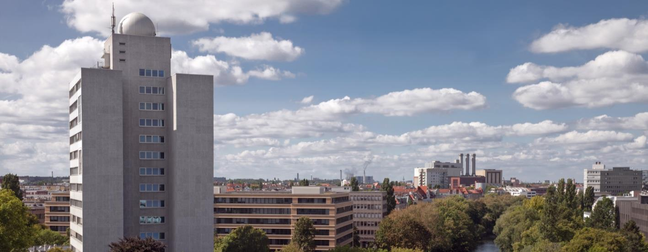
Fraunhofer Institute for Telecommunications, Heinrich Hertz Institute, HHI
1928 Founding of Heinrich Hertz Institute in Berlin
Since 1960s Research on fiber optical transmission
Since 1980s Research on digital video coding
Since 2003 Member of Fraunhofer-Gesellschaft
Since 2009 Branch site in Goslar, Germany

Slide 3
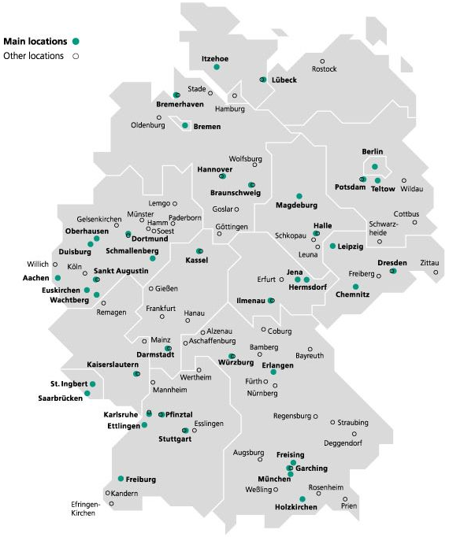
Fraunhofer-Gesellschaft
The Fraunhofer-Gesellschaft is the leading organization for applied research in Europe.
72 institutes and research units in Germany
Research cooperation around the world
More than 26,600 staff members
Budget: 2.6 billion €
Research highlights: MP3 audio codec, H.264, H.265 video codec, LTE mobile communications standard

Slide 4
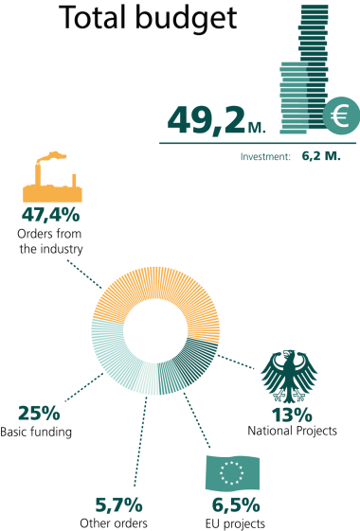
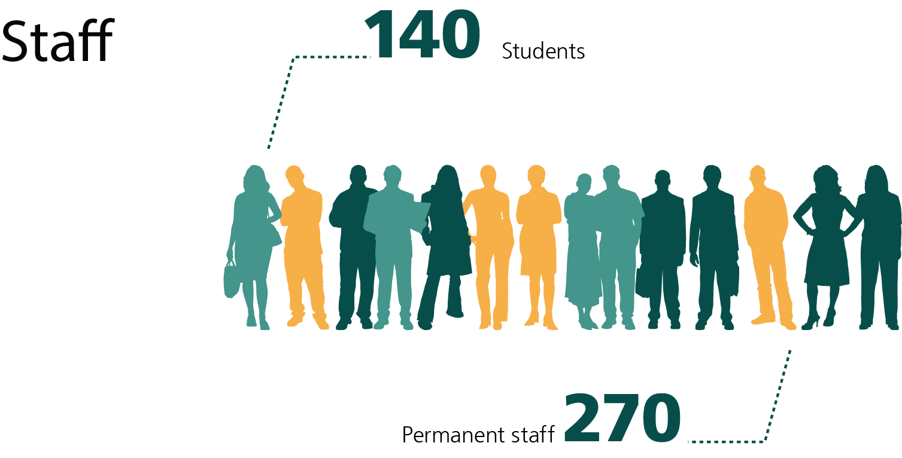
HHI Facts and Figures
Last updated: 2015

Slide 5
Departments
Photonic Networks and Systems
Photonic Components
Fiber Optical Sensor Systems
Wireless Communications and Networks
Vision and Imaging Technologies
Video Coding and Analytics
Photo: fotolia.com/SeanPavonePhoto | Edit: Fraunhofer HHI

Slide 6
Wireless Communications and Networks
Wireless solutions for future information networks
Extensive contributions to the theory, concept development and technical feasibility of radio systems
5G and beyond mobile radio networks
Radio propagation channel sounding and modelling
Link- and system-level simulations
Photo: fotolia.com/scandinaviastock

Slide 7
Channel Sounding and Modeling
Only two highlights
Instantaneous directional channel sounding using virtual circular array antennas up to 100 GHz
QuaDRiGa – free open-source reference channel model implementation, available at: https://quadriga-channel-model.de

Slide 8
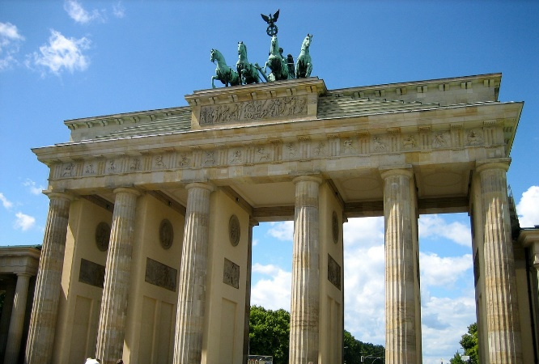
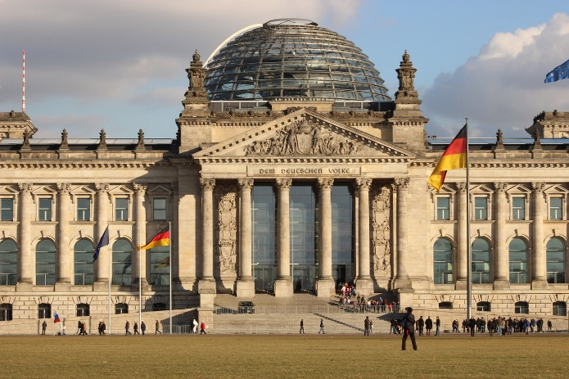
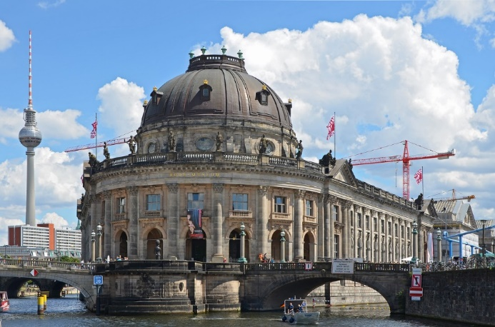
Berlin – Germany
Some places to see
Brandenburg Gate
Reichstag building
Museum Island

Slide 9
Berlin – Germany
Some history to remember
Founded 1237
The golden 1920s
The four sectors after 1945
The Berlin Wall from 1961
German reunification in 1990

Slide 10
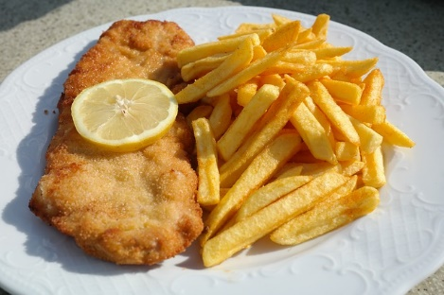
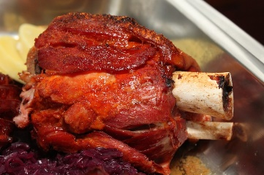
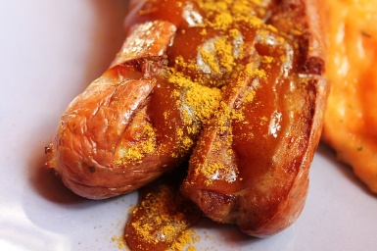
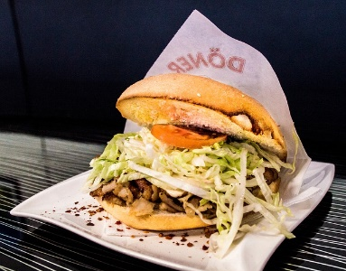
Berlin – Germany
Some foods to try
Berliner Eisbein
Schnitzel
Currywurst
Döner Kebab
Königsberger Klopse

Slide 11
Berlin – Germany
Some facts to forget
Nine times the size of Paris
More bridges than Venice
More museums than rainy days per year
Longest open-air gallery
Germany’s greenest city

Slide 12
Meeting information
Lunch break
Scheduled for 13:00 – 14:00 in the cafeteria on the ground floor

Slide 13
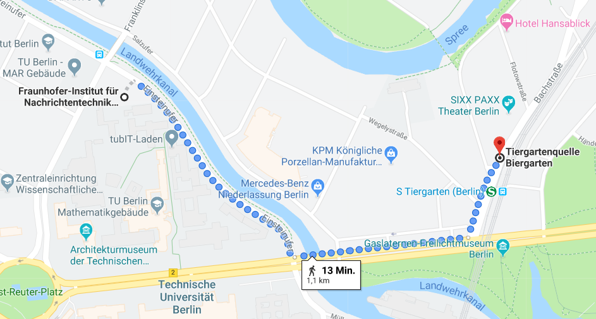
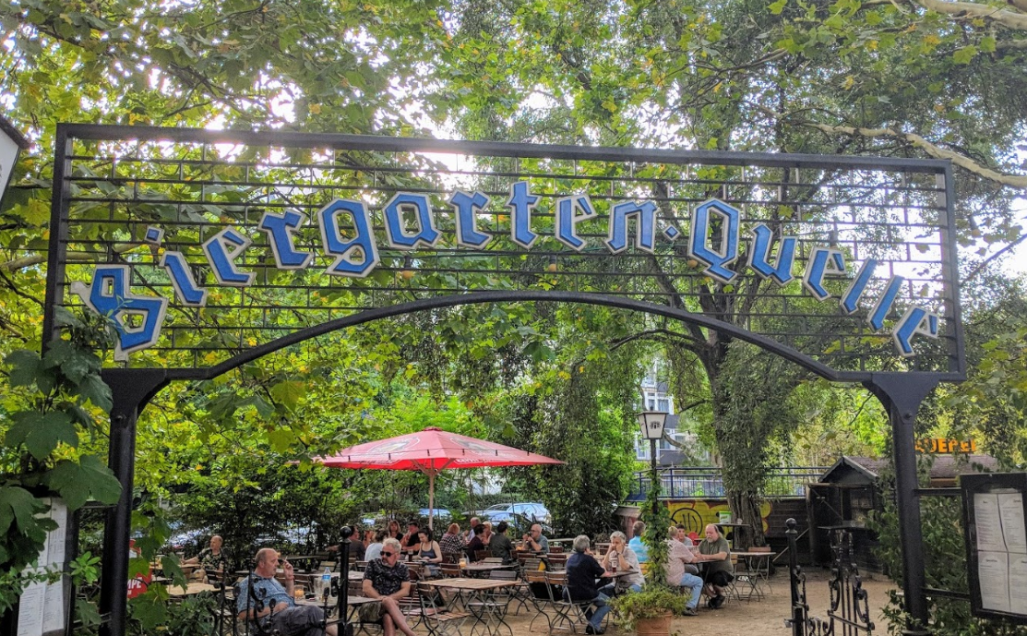
Meeting information
How about dinner?
Proposal: 19:00 at Tiergartenquelle (Biergarten)

Slide 14
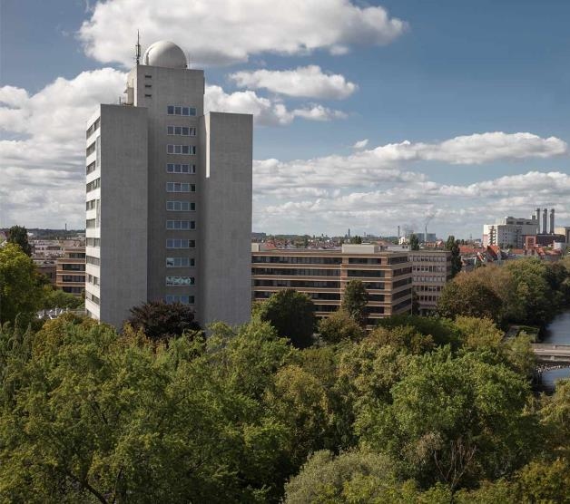
Fraunhofer-Institut für Nachrichtentechnik, Heinrich-Hertz-Institut, HHI
WE PUT SCIENCE INTO ACTION.
Contact:
Dipl.-Ing. Leszek Raschkowski
email leszek.raschkowski@hhi.fraunhofer.de phone + 49 30 31002 487
Einsteinufer 37 10587 Berlin

