Slide 1
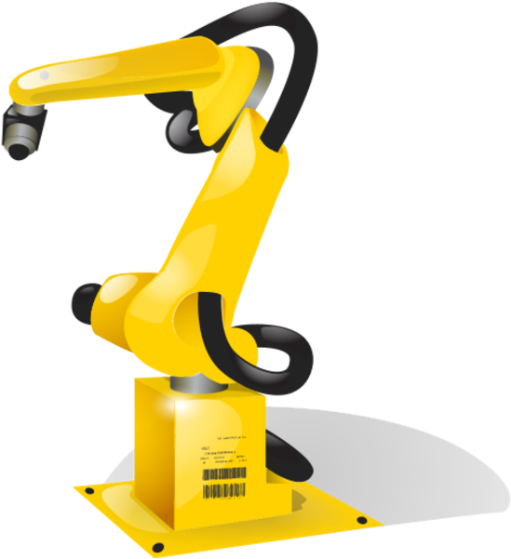



Industrial Indoor Measurements from 2-6 GHz for the 3GPP-NR and QuaDRiGa Channel Model DR. Stephan Jaeckel, Nick Turay, Leszek Raschkowski, Lars Thiele, Risto Vuohtoniemi, Marko Sonkki, Veikko Hovinen, Frank Burkhardt, Prasanth Karunakaran, Thomas Heyn
Notes:
Name, Topic
Fraunhofer
HHI, Berlin

Slide 2
Outline
Industrial Indoor Measurements
Motivation
Measurement Environment, Parameters and Equipment
Data Analysis
Results and Discussion
Conclusions

Slide 3
Motivation
Geometry-based stochastic channel models (GSCMs) are efficient for system-level-assessment (examples: 3GPP-NR, QuaDRiGa)
Models require parameterization to emulate the wireless propagation environment
Influence of an industrial production environment on the radio transmission, is not well understood, corresponding GSCM parameters are missing
Support for D2D and infrastructure-based systems is needed.
What we did:
Measurements in 5 factory halls at operational Siemens premises in Nuremberg
2.37 GHz and 5.4 GHz
5.9 km indoor measurement tracks

Slide 4
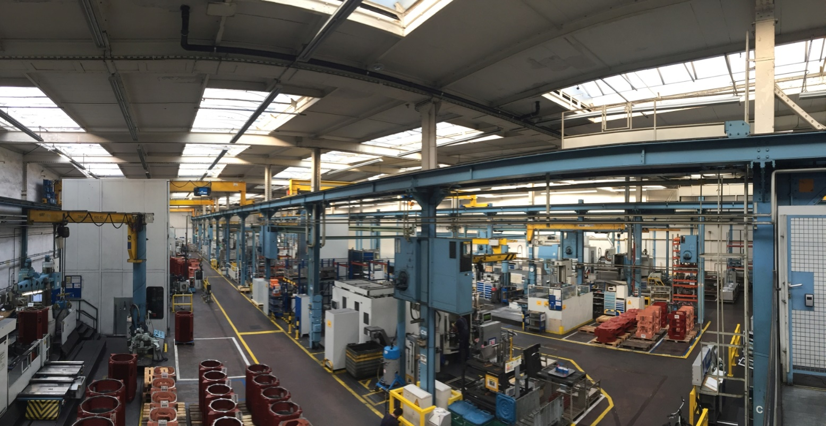
Measurement Environment
Example Production Hall at Siemens, Nuremberg, Germany

Slide 5
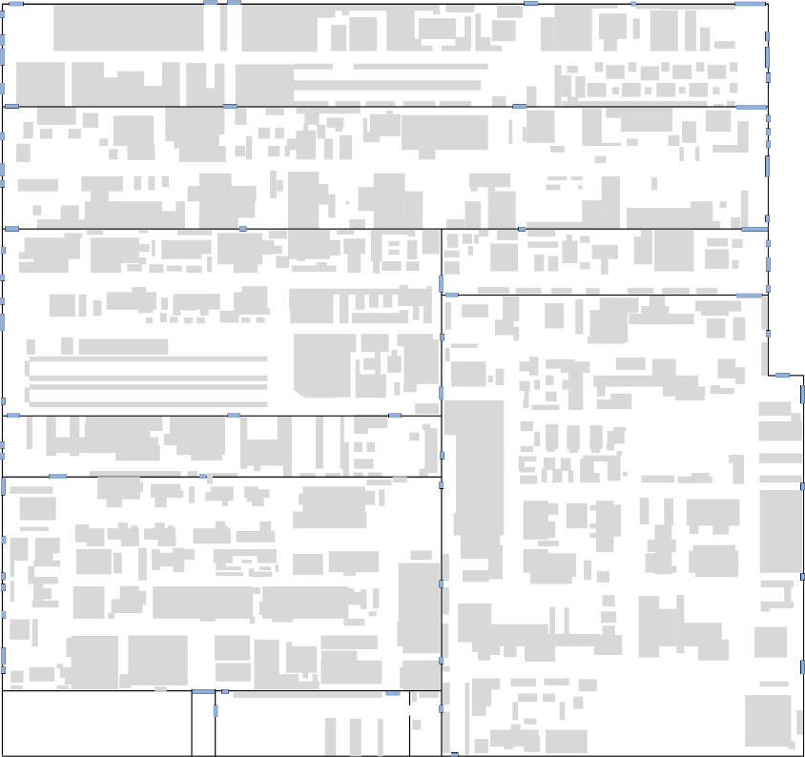
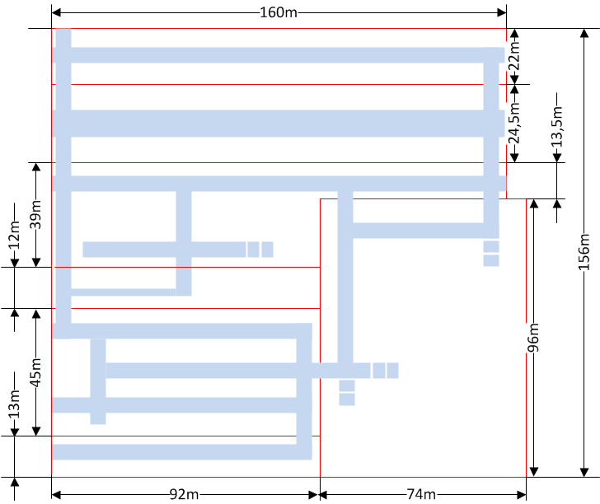
Measurement Environment
Factory Hall Floor Plan

Slide 6
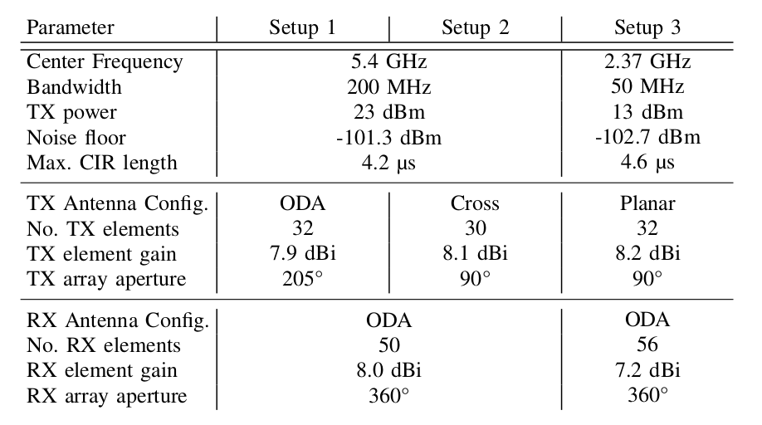
Overview
Measurement Parameters
Variable TX height: 2 m - 8 m
RX-TX distance: 10 m – 150 m
5.9 km indoor measurement track
5,500 sample points for LSP data analysis (after processing)
1/3 LOS, 2/3 NLOS

Slide 7
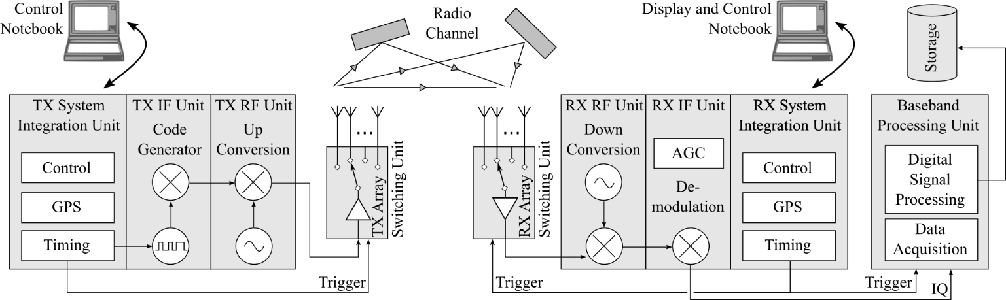
Equipment
Propsound Channel Sounder

Slide 8
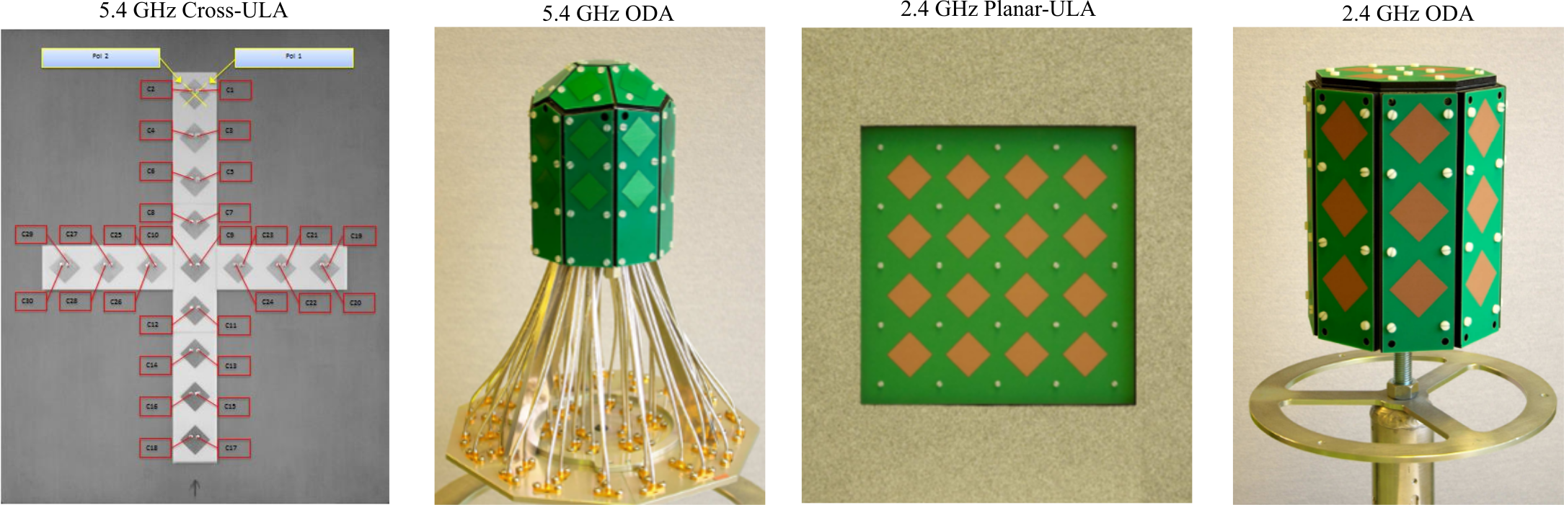
Equipment
Measurement Antennas for 5.4 GHz and 2.4 GHz

Slide 9
Data Analysis
List of Extracted Large-Scale Parameters
Path loss (PL) and shadow fading (SF),
Root mean square (RMS) delay spread (DS),
Ricean K-factor (KF),
RMS azimuth spread of arrival (ASA),
RMS azimuth spread of departure (ASD),
RMS elevation spread of arrival (ESA),
RMS elevation spread of departure (ESD), and
Cross polarization ratio (XPR).

Slide 10
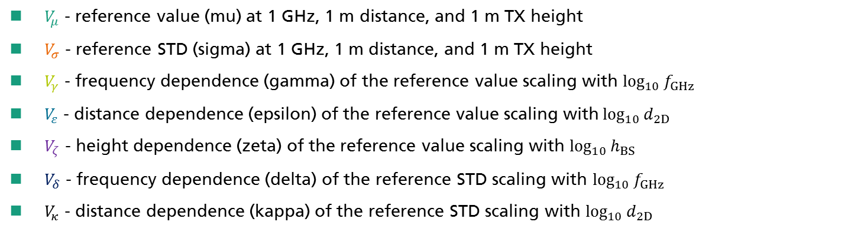

Data Analysis
Mapping of the Results
$$V=V_{μ}+V_{γ}∙\log_{10}{f_{GHz}}+V_{ε}∙\log_{10}{d_{2D}}+V_{ζ}∙\log_{10}{h_{BS}}+$$
$$X∙\left(V_{σ}+V_{δ}∙\log_{10}{f_{GHz}}+V_{κ}∙\log_{10}{d_{2D}}\right)$$
$V_{μ}$ - reference value (mu) at 1 GHz, 1 m distance, and 1 m TX height
$V_{σ}$ - reference STD (sigma) at 1 GHz, 1 m distance, and 1 m TX height
$V_{γ}$ - frequency dependence (gamma) of the reference value scaling with $\log_{10}{f_{GHz}}$
$V_{ε}$ - distance dependence (epsilon) of the reference value scaling with$\log_{10}{d_{2D}}$
$V_{ζ}$ - height dependence (zeta) of the reference value scaling with $\log_{10}{h_{BS}}$
$V_{δ}$ - frequency dependence (delta) of the reference STD scaling with $\log_{10}{f_{GHz}}$
$V_{κ}$ - distance dependence (kappa) of the reference STD scaling with $\log_{10}{d_{2D}}$

Slide 11
Results
Parameter |  | LOS | NLOS
Path Loss |  | 36.33 + 18.31 * log10( d_{2D} ) + 19.52 * log10( f ) | 29.12 + 24.07 * log10( d_{2D}) + 25.36 * log10( f )
Shadow fading (dB) | σ | 1.8 – 0.3 * log10( f ) | 1.15 + 3.15 * log10( f )
Decorr. [m] | λ | 15 | 30
Delay Spread | μ | -8.3 + 0.49 * log10( h_{BS} ) + 1.26 * log10( f ) | -8.19 + 0.3 * log10( h_{BS} ) + 1.37 * log10( f )
(log₁₀s) | σ | 0.09 + 0.07 * log10( f ) | 0.11
Decorr. dist (m) | λ | 50 | 52
Delay factor | r_{τ} | 2.7 | 3.0
K-Factor | μ | 7.8 - 7.7 * log10( h_{BS} ) - 7.3 * log10( f ) | 4.22 - 3.31 * log10( h_{BS} ) -11.7 * log10( f )
(db) | σ | 1.8 + 2.6 * log10( f ) | 1.1 + 2.23 * log10( f )
Decorr. dist (m) | λ | 32 | 14
ASA | μ | 1.69 | 1.62
(log₁₀°) | σ | 0.15 | 0.22
Decorr. dist (m) | λ | 10 | 13
ASD (3) | μ | 1.66 + 0.1 * log10( h_{BS} ) | 1.68 - 0.2 * log10( h_{BS} )
(log₁₀°) | σ | 0.12 | 0.1
Decorr. dist (m) | λ | 10 | 13
ESA / ZSA | μ | 1.64 – 0.5 * log10( d_{2D} ) | 1.64 - 0.5 * log10( d_{2D} )
(log₁₀°) | σ | 0.01 + 0.09 * log10( d_{2D} ) | 0.06 + 0.1 * log10( d_{2D} )
Decorr. dist (m) | λ | 10 | 20
ESD / ZSD | μ | 1.55 + 0.3 * log10( h_{BS} ) – 0.5 * log10(d_{2D} ) | 1.6 + 0.14 * log10( h_{BS} ) - 0.5 * log10( d_{2D} )
(log₁₀°) | σ | 0.01 + 0.09 * log10( d_{2D} ) | 0.17 + 0.1 * log10( d_{2D} )
Decorr. dist (m) | λ | 10 | 20
XPR | μ | 16.8 – 4.5 * log10( h_{BS} ) | 14.4 – 2.2 * log10( h_{BS} )
(dB) | σ | 3.1 | 2.4
Decorr. dist (m) | λ | 30 | 27

Slide 12
Results
Inter-Parameter Correlations
Cross-Correlations |  |  | LOS
 |  |  | DS | KF | SF | ASD | ASA | ESD | ESA | XPR
 | DS |  | 1 | -0.7 | -0.3 | 0.4 | 0 | 0.4 | 0.3 | -0.4
 | KF |  | -0.6 | 1 | 0.4 | -0.5 | 0 | -0.3 | -0.3 | 0.5
N | SF |  | 0.4 | 0 | 1 | 0 | 0 | 0 | 0 | 0
L | ASD |  | 0.2 | 0 | 0.2 | 1 | 0 | 0.4 | 0.2 | -0.5
O | ASA |  | 0 | 0 | 0.2 | 0 | 1 | 0.1 | 0.3 | 0
S | ESD |  | 0.3 | -0.3 | 0.3 | 0.4 | 0 | 1 | 0.3 | -0.2
 | ESA |  | 0.3 | 0 | 0.3 | 0 | 0.3 | 0.3 | 1 | -0.2
 | XPR |  | -0.4 | 0.3 | 0 | -0.2 | 0 | 0 | -0.3 | 1

Slide 13
Results
Valid frequency range: 2 to 6 GHz
Valid distance range: 5 to 150 m
Valid BS antenna height: 1 to 10 m
Valid MT antenna height: 1 to 3 m

Slide 14
Results
Key Findings (1)
Path Loss
6 dB higher PL (less power) in industrial LOS compared to 3GPP office LOS
12 dB lower PL (more power) in the measured industrial NLOS → strong reflections
Much smaller SF values compared to 3GPP office LOS: industrial 1.8 dB, office 3 dB ; NLOS: industrial 1.15 dB, office 8 dB
Delay spread
Measured DS increases with frequency (30 ns @ 2.4 GHz → 80 ns @ 5.4 GHz)
Similar results for LOS and NLOS
3GPP office scenario: 20 ns for LOS, 50 ns for NLOS

Slide 15
Results
Key Findings (2)
Ricean K-factor (KF):
LOS: Very small KF values (around 0 dB) for LOS
NLOS: LOS-like path (max. 5 ns from true LOS), approx. -3 dB KF
KF decreases with increasing TX height
Azimuth spread of arrival (ASA):
Measured values vary between 10 and 90 degree in LOS and NLOS
Median values around 45° (5.4 GHz) and 40° (2.37 GHz)
Signals arrive at the receiver from almost all directions

Slide 16
Results
Key Findings (3)
Azimuth spread of departure (ASD):
Antenna aperture too low for analysis in Setups 2 and 3
Similar results to ASA for Setup 1
Elevation spread of arrival (ESA):
Decrease with increasing distance between TX and RX (might be due to strong reflections at the ground and the roof of the hall)
Incident angle at the reflector (i.e., at ground and roof) decreases with larger distances and so does the angle spread at the receiver.
Effect is not considered by the 3GPP office.

Slide 17
Results
Key Findings (4)
Elevation spread of departure (ESD):
Antenna aperture too low for analysis in Setups 2 and 3
Similar results to ESA for Setup 1
Cross polarization ratio (XPR):
Between 13 dB and 16 dB for the 5.4 GHz measurements
Around 13 dB in case of 2.37 GHz
Consistent with the 3GPP office

Slide 18
Conclusions
Several measurements under different typical industrial scenarios and conditions
Measurement data was processed to calculate channel model parameters
Model supports application cases like automatic guided vehicles and D2D communication
Results are included in QuaDRiGa v2.2: http://quadriga-channel-model.de
Paper submitted to VTC Fall 2019 arXive version: http://arxiv.org/abs/1906.12145

Slide 19
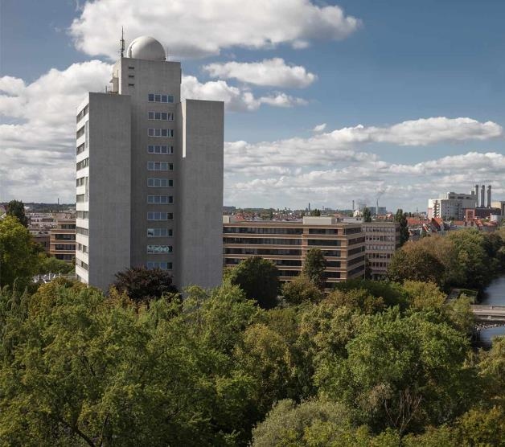
Fraunhofer-Institut für Nachrichtentechnik, Heinrich-Hertz-Institut, HHI
WE PUT SCIENCE INTO ACTION.
Contact:
Dr.-Ing. Stephan Jaeckel stephan.jaeckel@hhi.fraunhofer.de +49 30 31002 674
Einsteinufer 37 10587 Berlin

Slide 20
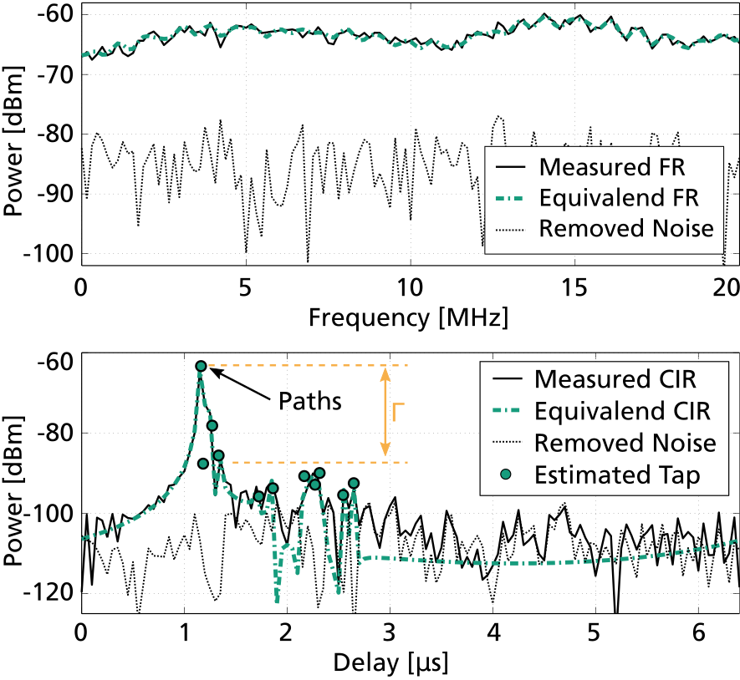
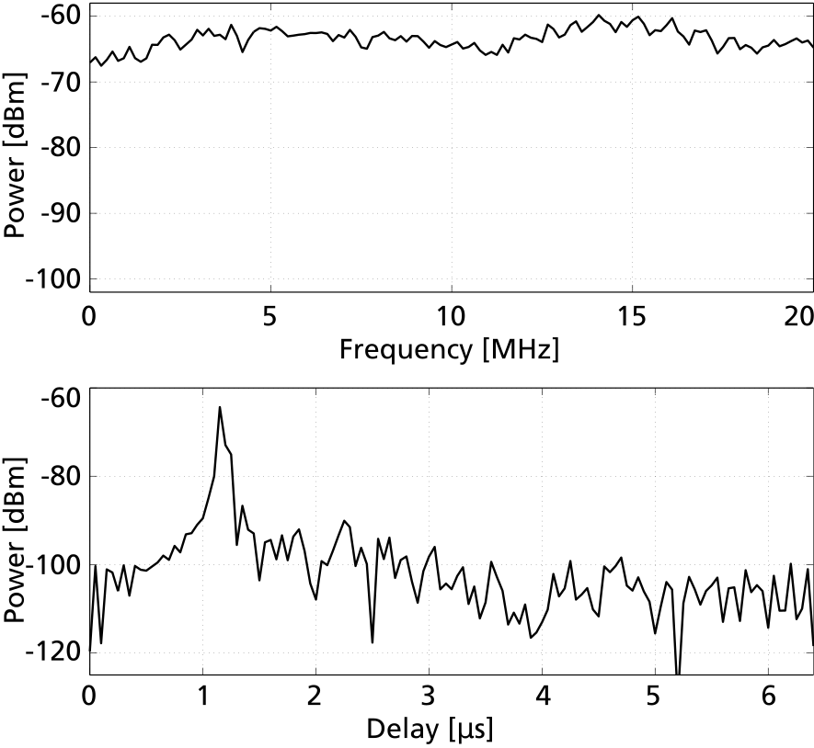
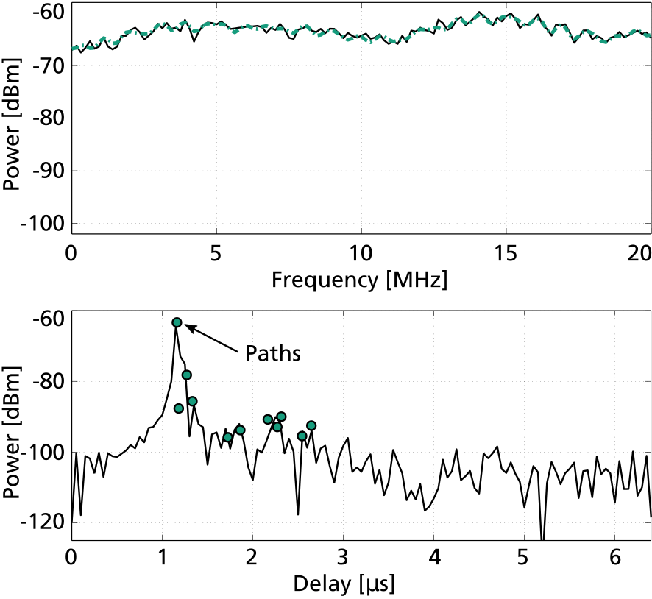
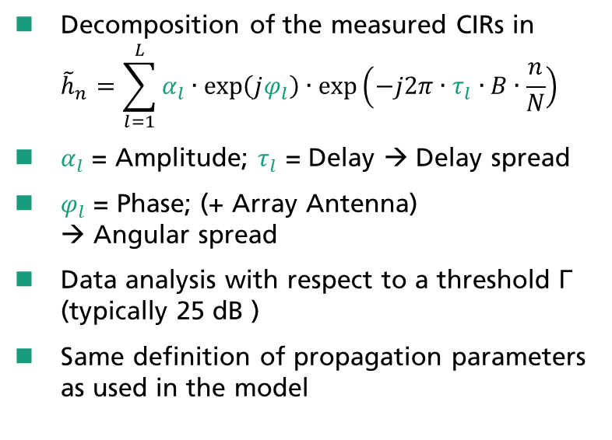
Data Processing
Extraction of multipath components
Decomposition of the measured CIRs in ${\tilde{h}}_{n}=\sum_{l=1}^{L}{α_{l}∙exp\left(jφ_{l}\right)∙exp\left(−j2π∙τ_{l}∙B∙\frac{n}{N}\right)}$
$α_{l}$ = Amplitude; $τ_{l}$ = Delay → Delay spread
$φ_{l}$ = Phase; (+ Array Antenna) → Angular spread
Data analysis with respect to a threshold Γ (typically 25 dB )
Same definition of propagation parameters as used in the model
Notes:
Basic processing, filtering and calibration → frequency response

