Slide 1
New 3GPP Meeting Application
Presentation of the new Graphical User Interface
ITC team

Slide 2
Introduction
The web application used to list and register to ETSI and 3GPP meetings (known as Meeting Calendar) will be updated in January 2019 (date to be communicated by helpdesk) .
It offers a more homogenous and user friendly interface. It has been developed using modern technologies.
  Visual aspects and navigation across pages have been made consistent
  New features have been implemented and existing features have either been preserved or adapted.
  Access rights have been checked: they are preserved when authorised.
  It is still accessible from home page of the 3GPP portal
  URLs sent in past notifications are preserved
  The same application is deployed on ETSI and 3GPP portals, with their own visual identity and specific features
The following slides show the main differences between the existing 3GPP application and the new one.

Slide 3
The new application in one slide
Login / logout
Meetings for which you are registered
Display options
List of all meetings
Link to register
Click on a meeting to display information
Registration form

Slide 4
Portal home page
Existing app
New app
Lighter look and feel for meetings list
More sorting options
Same login/password interface

Slide 5
Meetings list: display and filters
Existing app
New app
Direct access to filters
Quick view of meetings to which you can register
Display of new / cancelled meetings
TB selection driven by the “Working Group” filter field, and not by the 3GPP Portal Page “Select TSG/WG” menu

Slide 6
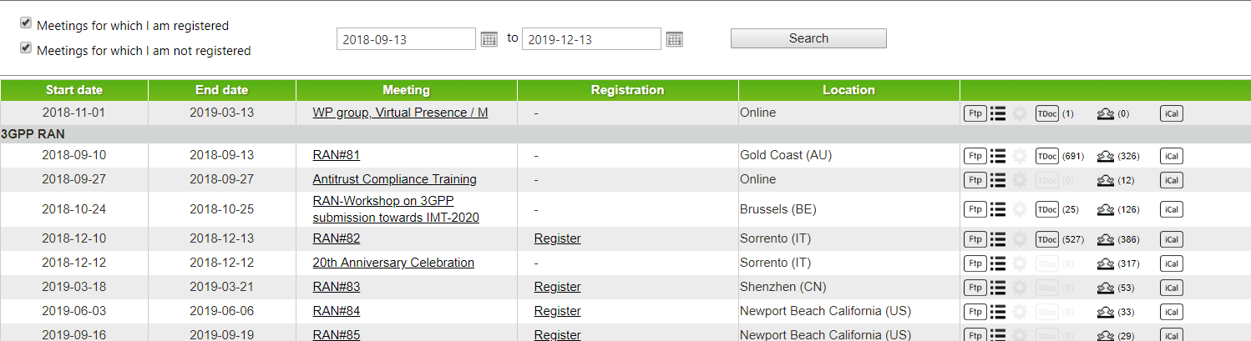
Meetings list: your meetings
Existing app
New app
All the meetings are in a scroll down list and you have to tick the boxes to see the meetings to which you are registered.
Screen divided into 2 parts :
  Top: list of meetings you are registered to
  Bottom: list of upcoming meetings

Slide 7
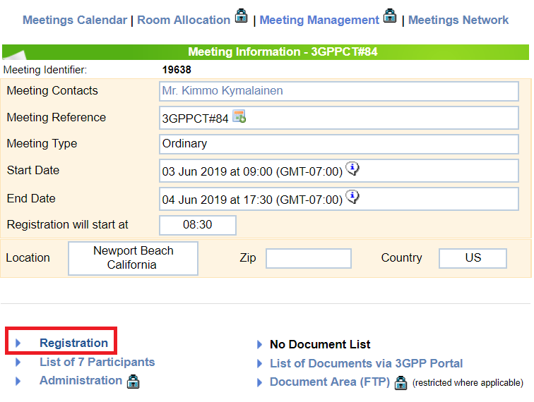
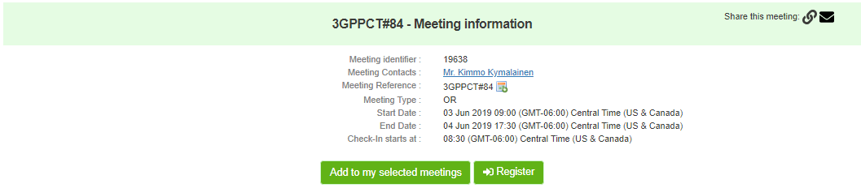
Register to a meeting: how to
Existing app
New app
From the list : Click on the meeting’s name and on “Registration” link
From the list : Click on the incoming arrow icon on the right
Or click on the meeting : click on Register button

Slide 8
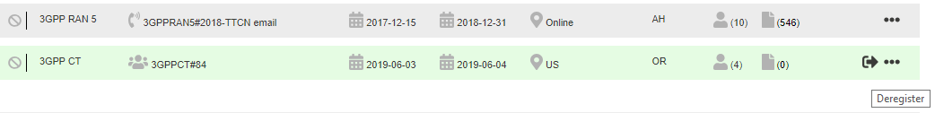
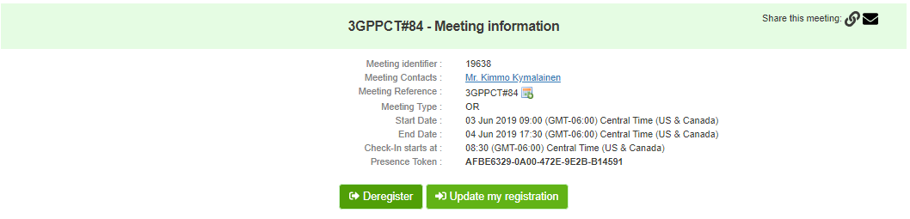
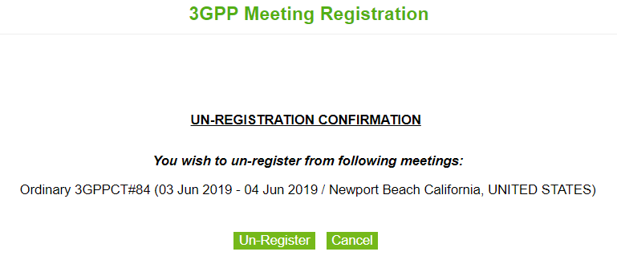
Deregister from a meeting: how to
Existing app
New app
1st step :
From the list : Click on the outgoing arrow icon on the right
Or click on the meeting : and then click on “Deregister” button
2nd step :

Slide 9
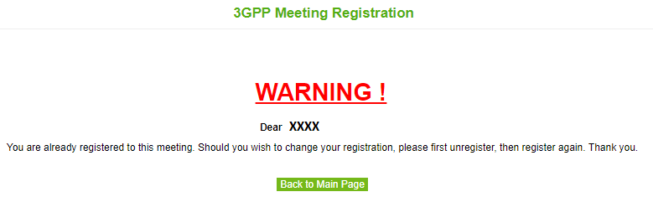
Modify a meeting registration: how to
Existing app
New app
From the list :
You must unregister then register again if you want to modify your registration.
Click “Update my registration” from the (…) icon on the meeting list or from the meeting details page
Then modify your registration options

Slide 10
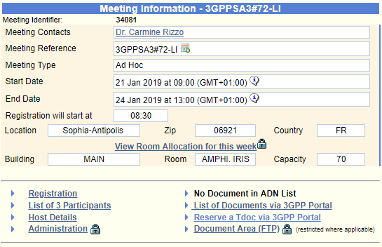
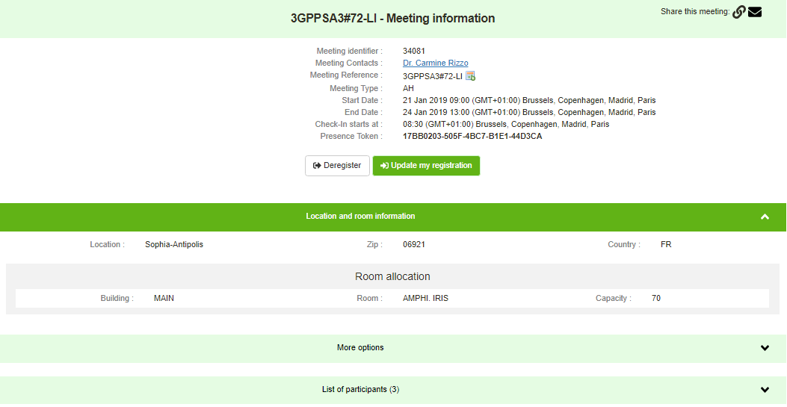
Meeting details
Existing app
New app
Meeting details are shown on the same page over the meeting list
There are 3 expandable sections
Meeting details are shown on a separate page

Slide 11
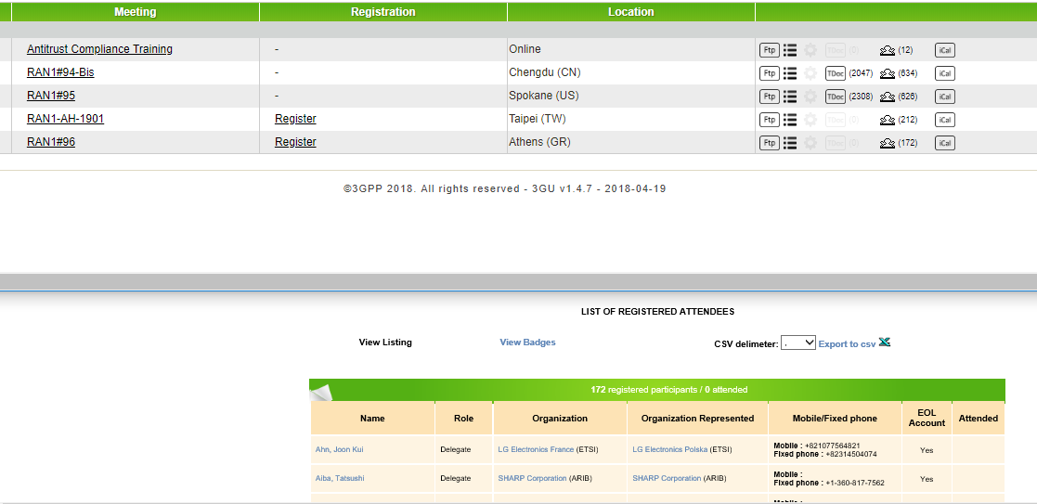
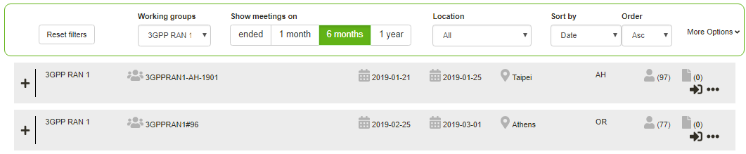
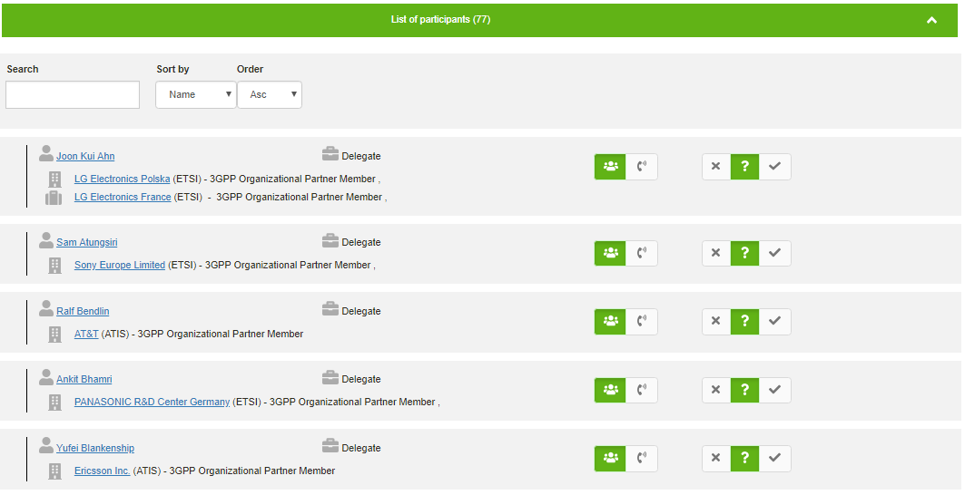
List of participants
Existing app
New app
Click on the “participants” icon of the concerned meeting
a new page opens with the list of participants
Click on the concerned meeting
Expand the “list of participants” from the meeting details page
GDPR compliant (no phone number publicly visible)

Slide 12
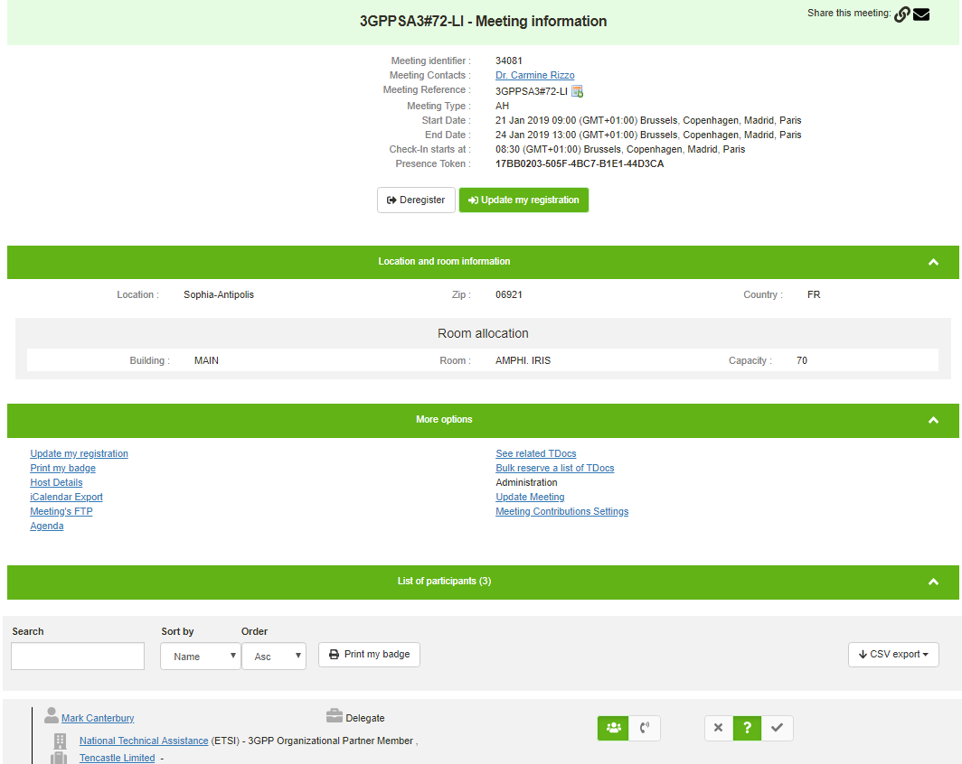
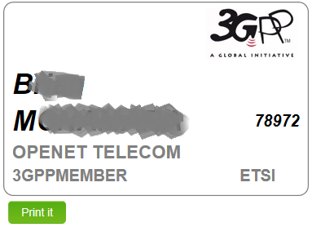
Print badges
Existing app
New app
Dear XXXXXX,
You have been successfully registered for the following meeting:
Meeting Reference: SA2#129-Bis
Meeting Location: West Palm Beach, Florida, UNITED STATES
Meeting Start Date: 26 Nov 2018 08:30
Meeting End Date: 30 Nov 2018 17:00
Representing: Openet Telecom (ETSI)
You will be able to confirm your participation to the meeting once you are in the meeting room by clicking on this link,
or by going to http://10.10.10.10/MtgPresence/registerPresence.aspx and entering token BE-685E-4B4C-A46A-CDD23CE39CBA in the text field.
To print your meeting badge, click here. IT IS IMPORTANT THAT YOU PRINT AND WEAR YOUR BADGE THROUGHOUT THE MEETING.
If you wish to cancel your registration to this meeting, click the following link:
Cancel Registration
Thank you for your registration
Accessible from a link sent in registration mail
A menu is available from the participant list
Still accessible from the email
Notes:
.

Slide 13
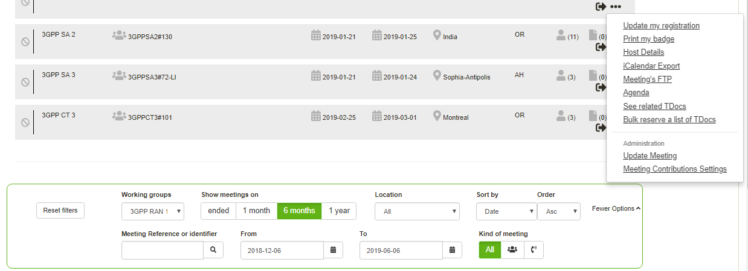
Access to user actions
Actionable icons replaced by a menu
The items list depends on the meeting configuration and your rights.
Filters directly reachable from the main page for a dynamic display of results.

Slide 14
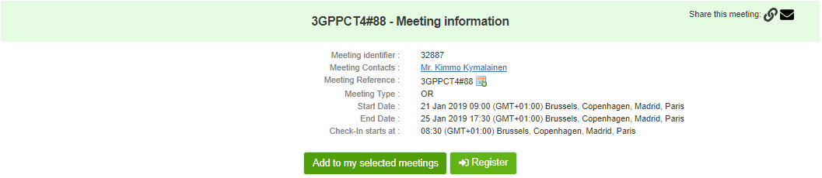
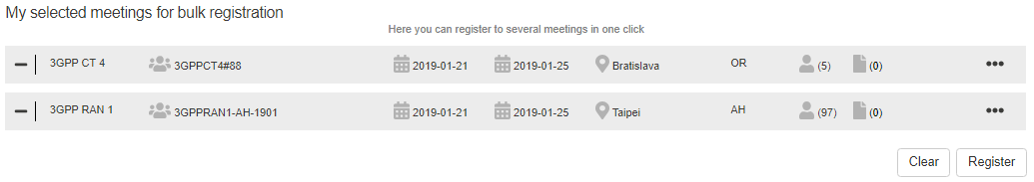
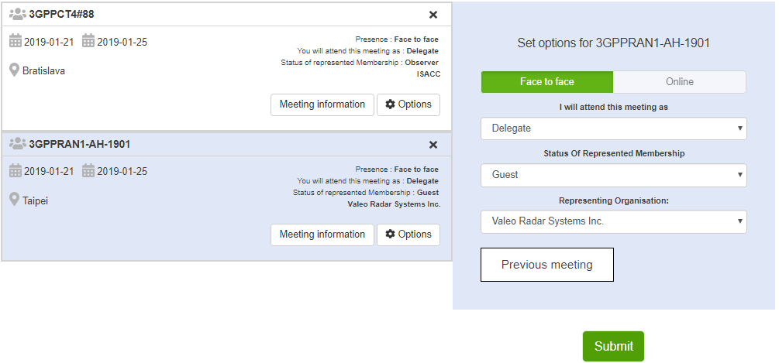
Bulk registration
1° Click on a meeting and “Add to my selected meetings” button, or click directly on the “+” icon.
2° Repeat the operation and check the list of selected meetings.
You can deselect them with the “-” icon.
3° Configure your options for each or for all meetings, status and represented organisation, then submit your registrations

