Slide 1
5GMARCH – Open Issues
Basavaraj (Basu)
Samsung

Slide 2
5GMARCH Open Issues
Issue-1: Non-MSGin5G UEs to initiate communication (p2p and group) towards MSGin5G service end points
Issue-2: Routing based on UE Service ID for message delivery to MSGin5G UEs and Non-MSGin5G UEs
Issue-3: Support for Constrained Device leveraging MSGin5G Gateway UE
Issue-4: Protocol adaptation when MSGin5G UEs support divergent protocols
Issue-5: Group information towards Non-MSGin5G UEs
Issue-6: Usage of SEAL Group Management
Issue-7: Delivery Report

Slide 3
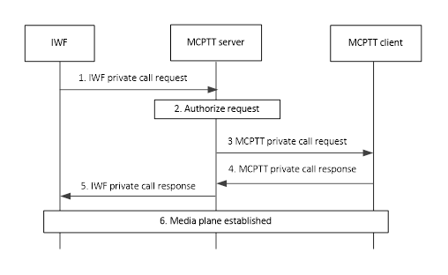
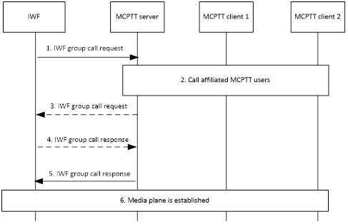

Issue-1: Non-MSGin5G UEs to initiate communication (p2p and group) towards MSGin5G service end points [1/2]
Examples from 3GPP TS 23.283
10.3.3.3 Group call setup initiated by LMR user on an interworking group defined in MCPTT system
10.4.2.2 LMR user initiating a private call with MCPTT user
Notes:
The interworking group has been defined in MCPTT system.
The mapping relationship of group and user identities between the MCPTT system and the LMR system has been configured at the IWF.
LMR user initiates a group call.
Notes:
The LMR user at the LMR system has initiated a private call towards an MCPTT user.

Slide 4
Issue-1: Non-MSGin5G UEs to initiate communication (p2p and group) towards MSGin5G service end points [2/2]
More examples from 3GPP TS 23.283
10.8.7 LMR user one-to-one SDS request to an MCData user
10.8.7.1 Signalling control plane
The procedure for an IWF requesting, on behalf of an LMR user, to send a signalling control plane SDS to a single MCData user is as specified in 3GPP TS 23.282 [6] subclause 7.4.2.2 for the one‑to‑one standalone short data service using the signalling control plane, with the exception that MCData client 1 is located behind the IWF. The source address of the SDS is the MCData ID that has been allocated to the LMR user. The IWF behaves as a peer MCData server.
10.8.9 LMR user group SDS request to an MCData group
10.8.9.1 Signalling control plane
The procedure for an IWF requesting, on behalf of an LMR user, to send a signalling control plane SDS to an MCData group is as specified in 3GPP TS 23.282 [6] subclause 7.4.2.5 for the group standalone short data service using the signalling control plane, with the exception that MCData client 1 is located behind an IWF and one or more of the MCData clients 2 to n can be behind IWFs that have affiliated to the MCData group (see subclause 10.1.2 of the present document). The SDS is addressed to the MCData group ID. The IWF behaves as a peer MCData server to other MCData servers.
Conclusion 1:
  Non-MSGin5G UE can initiate p2p communication towards MSGin5G service end point
  Non-MSGin5G UE can initiate group communication towards group owned by MSGin5G Server
  Non-MSGin5G UE can reply to a p2p communication received from MSGin5G service end point
  Non-MSGin5G UE can reply to a group communication received from the group owned by MSGin5G Server

Slide 5
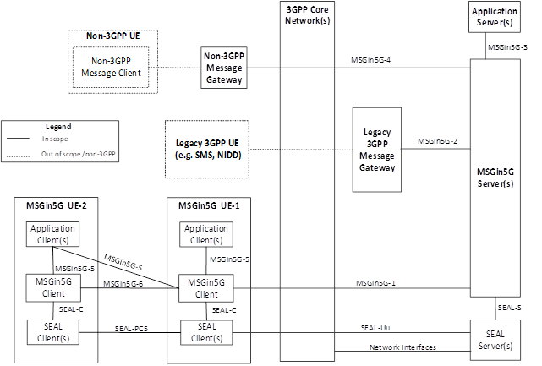
Issue-2: Routing based on UE Service ID [1/2]
Issue: To determine next hop for message delivery towards MSGin5G UEs
As per our architecture:
  MSGin5G Service supports UE Service ID which could of a MSGin5G UE or Non-MSGin5G UE (Legacy 3GPP UE or Non-3GPP UE)
  All UEs expected to consume MSGin5G Service are required to perform registration at MSGin5G Server
  MSGin5G Server communicates to MSGin5G UEs and Non-MSGin5G UEs on different interfaces
For Messages (p2p or Group) that needs to be delivered to a MSGin5G UE:
  Based on UE Service ID of MSGin5G UE, the MSGin5G Server sends the message over MSGin5G-1 interface
Conclusion 2:
  Based on UE Service ID, the MSGin5G Server determines for message delivery towards MSGin5G UEs is over MSGin5G-1 interface
  Based on UE Service ID, the MSGin5G Server determines for message delivery towards Non-MSGin5G UEs is either over MSGin5G-2 or MSGin5G-4 interfaces (it still needs to decide which interface… see next slide )

Slide 6
Issue-2: Routing based on UE Service ID [2/2]
As per our architecture:
  MSGin5G Service has multiple Message Gateways (Legacy 3GPP Message Gateway and Non-3GPP Message Gateway)
  Non-MSGin5G UEs register to the MSGin5G Server via Message Gateways
  MSGin5G Server communicates to Non-MSGin5G UEs on different interfaces (MSGin5G-2 or MSGin5G-4 )
For Messages (p2p or Group) that needs to be delivered to a Non-MSGin5G UE:
  The MSGin5G Server has to make a decision on whether to use MSGin5G-2 or MSGin5G-4 interface
  Hence, MSGin5G Server has to make a decision on selection of the appropriate Message Gateway (based on Non-MSGin5G UEs registration)
Conclusion 3:
  MSGin5G Server selects the appropriate Message Gateway for message delivery towards Non-MSGin5G UEs

Slide 7
Issue #3 – Support for Constrained Device leveraging MSGin5G Gateway UE
Current Status
  Align with the NOTE 5 of the architecture and also as per the suggestions received in previous meeting.
  “NOTE 5: When both UE-1 and UE-2 support MSGin5G Client, MSGin5G Client in UE-1 acts as a relay for the MSGin5G Client in UE-2 to receive MSGin5GService. When UE-2 does not support MSGin5G Client and only UE-1 supports MSGin5G Client, MSGin5G Client in UE-1 acts as a gateway for the Application Client in UE-2 to receive MSGin5G Service.”
  UE-2 needs to check with MSGin5G UE-1 whether it can act as gateway for UE-2 or not (In certain case – due to less power or connectivity issues) – MSGin5G UE-1 may not be able to act as Gateway UE although it can support such functionality.
    Application client within MSGin5G UE-1 do not need to check such capability
Changes are made – to use only UE-2, EN added to cover security aspects
Conclusion:
  Agree to current procedures which are aligned to NOTE 5
  Comments related to scenario where both UEs are MSGin5G UEs, could be discussed next meeting based on contributions

Slide 8
Issue-4: Protocol adaptation when MSGin5G UEs support divergent protocols
MSGin5G Service is application layer service
MSGin5G Message defined in TS 23.554 – It needs to send leveraging some application level protocols
  E.g. #1: MSGin5G Message can be sent over HTTP
    As per RFC 7231: “The Hypertext Transfer Protocol (HTTP) is a stateless application-level protocol for distributed, collaborative, hypertext information systems.”
  E.g. #2: MSGin5G Message can be sent over CoAP
    As per RFC 7252: “The Constrained Application Protocol (CoAP) is a specialized web transfer protocol for use with constrained nodes … ”
  E.g. #3: any other protocol
  Actual selection of protocol using which the MSGin5G will be sent is CT1 responsibility
However, MSGin5G service needs to support both constrained device and unconstrained devices
If MSGin5G message is sent over HTTP by unconstrained MSGin5G UE towards constrained MSGin5G UE (which understands MSGin5G Message received over CoAP only)
  In this case, we need an entity who adapts from one application protocol to another.
Proposed paragraph for MSGin5G Server: As per the application architecture defined in clause 5.2, the MSGin5G UE-1 can be constrained device or unconstrained device. It is possible that both originator and recipient devices supports MSGin5G client (i.e. they are MSGin5G UEs). To send MSGin5G Message from originator (which is MSGin5G UE) to the recipient (which is also MSGin5G UE) – no Message Gateway functions are involved. MSGin5G Server needs to adapt the MSGin5G Message to enable message exchange between heterogeneous MSGin5G UEs.
Conclusion:
  Agree that MSGin5G performs protocol adaptation as and when necessary

Slide 9
Issue-5: Group information towards Non-MSGin5G UEs
Approach 1: GMS sends Group creation notification to Message Gateway
Requires to introduce new interface between GMS and Message Gateway, i.e. architectural impacts
Approach 2: MSGin5G Server takes responsibility to send the Group creation notification to non-MSGin5G members
No new interface
Approach 3: MSGin5G Server takes responsibility to send the Group creation notification to all group members
Conclusion: To go with Approach 3.

Slide 10
Issue-6: Usage of SEAL Group Management
Issue 1a: List of group management operations to be supported for MSGin5G Service
Based on requirements analysis and available SEAL procedures, following procedures need to be referred from SEAL specification:
  Group creation
  Group membership notification – any changes to group info
  Group information query
  Group configuration management
    Store group configurations at the group management server
    Retrieve group configurations
    Subscription and notification for group configuration data
  Location-based group creation
  Group announcement and join
    Group member leave
Conclusion:
Support procedures marked in bold at this meeting
Support for other procedures to be discussed in the next Meeting

Slide 11
Issue-7: Delivery report
Can p2p message be used for carrying Delivery Report as a payload?
How to distinguish between actual p2p message between end points v/s p2p message carrying Delivery Report?
How to map the received Delivery Report to the actual message when using p2p message?

Slide 12
Summary
It is requested to agree way forward as per the conclusions made on the slides

