Slide 1
DP on FBC and QBC in Roaming Architecture
(SA5 #148)
Chen Shan Huawei

Slide 2
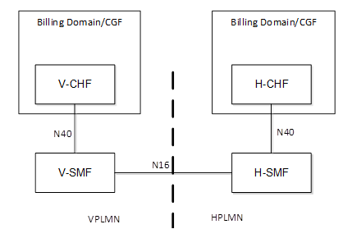


Roaming Charging Architecture
Roaming Architecture and QBC/FBC
  FBC: Used for the Retails. In the roaming architecture, the H-PLMN is responsible for the retails.
  QBC: Used for the Interconnection. In the roaming architecture, the H-PLMN/V-PLMN is responsible for the interconnection.
  QBC used for Interconnection
  QBC used for Interconnection
Figure 1: Home Routed Roaming
Figure 2:Local breakout Roaming
V-SMF & V-CHF | H-SMF & H-CHF
QBC | QBC FBC QBC and FBC
QBC and FBC | QBC FBC QBC and FBC
V-SMF & V-CHF | V-SMF & H-CHF
QBC | QBC FBC QBC and FBC
QBC and FBC | QBC FBC QBC and FBC
Source: TS 32.290 V18.0.0

Slide 3
Thank you!

