Slide 1
SA5 OAM&P Exec Report
SA5#146bis-e, 16 – 19 January, 2023
E-meeting
Zou Lan, SA5 Vice-Chair, HUAWEI
Thomas Tovinger, SA5 Chair, ERICSSON
Mirko Cano Soveri, MCC

Slide 2
Documents endorsed by OA&M
TDoc | Title | Source | Potential related topics and related groups
S5-231010 | Proposed way forward for the Rel-18 work on EE | Huawei
S5-231011 | Revised WID Rel-18 Work Item on 5G energy efficiency phase 2 | Huawei
S5-231032 | Rel-18&Rel-19 time plan proposal for OAM | SA5 Vice Chair (Huawei)
S5-231082 | Discussion paper on Using Forge-Git as the primary storage for Code | Ericsson | CT
S5-231148 | Discussion paper on KPI, KQI, QoE | Nokia
S5-231149 | 3GPP Rel-18 work on EE | Huawei | All 3GPP TSGs and WGs
S5-231150 | Clarifying multilevel attribute properties | Ericsson
S5-231195 | DP WF for normative specifications development of AI/ML management | NEC, Intel
S5-231196 | DP AIML collaboration with other 3GPP groups | Huawei | RAN1/RAN3/SA2/SA1
Agreement for wayforward for Rel-18 WID preparation:
1. Normative work related to a new agreed WID will not be started before the corresponding study is concluded.
2. Anyone could propose to add new objectives to the agreed WID with the progress of study from SA5 #147 or later.
3. In SA5#146bis-e, the agreed WID will only contain the objectives which could be agreed by the group with the current agreement of study progress.
Way forward for using forge as primary storage for code:
Try to agree on this proposal with the OpenAPI Task Force group, to have a joint proposal to the SA#99 plenary.

Slide 3
Revised / New Rel-18 Study / Work Items agreed
Tdoc | Type | Release | Title | Source | Potential related groups
S5-231198 | SID revised | Rel-18 | Updated Study on alignment with ETSI MEC for Edge computing management | Samsung | SA6, ETSI MEC
S5-231199 | WID new | Rel-18 | New Rel-18 WID AI/ML management | Intel, NEC | RAN3, SA2, ETSI ZSM
S5-231200 | WID new | Rel-18 | Rel-18 WID on Intent driven Management Service for mobile network phase 2 | Huawei, Ericsson | SA2, RAN3, ETSI ZSM, TM Forum

Slide 4

Leaders’ recommendation for SA5 OAM time planning (S5-231032)
SA5 OAM Release 18 planning：
Mar 2022 (TSG#95): SA5 SIDs/WIDs specified
Mar 2023 (SA#99) and Jun 2023(SA#100): SA5 SID concluded and Rel-18 WID started if needed
Sep 2023 (TSG#101): Stage 1 work freeze
Dec 2023 (TSG#102): Stage 2 Functional work Freeze and stage 3(OAM/CN related), provide inputs to CT
Mar 2024 (TSG#103): Stage 2 Functional work Freeze and stage 3 (RAN related)
SA5 OAM Release 19 planning：
June 2023 SA Rel-19 workshop: Provide SA5 relevant Rel-19 inputs/planning to Jun SA workshop
Sep 2023 (TSG#101): Submit Rel-19 1st package following 3GPP timelines
Dec 2023 (TSG#102): Submit Rel-19 final package following 3GPP timelines
Note:
We should strictly follow the 3GPP release timelines (especially to align the stage 3 freeze date).
For the CT related features, we need to provide inputs to CT as early as possible.
Management aspects which have no CN/RAN dependency or which needs to influence CN/RAN should be addressed as early as possible.
Avoid exception requests as much as possible, in case the work could not be completed according to the time plan, either narrow down the scope of the work, or postpone the work to next release.

Slide 5

Release 18 timeline– figure with SA5 OAM (S5-231032)
2022
2023
2024
TSG#93-e
TSG#94-e
TSG#95-e
TSG#96
TSG#97-e
TSG#98
TSG#99
TSG#100
TSG#101
TSG#102
TSG#103
TSG#104
TSG#105
Sep.
Dec.
Mar.
Jun.
Sep.
Dec.
Mar.
Jun.
Sep.
Dec.
Mar.
Jun.
Sep.
Release 18
SA1 Stage 1 100%
RAN Content def.
RAN4
content def.
Stage 2 (SA2, SA6,…) Normative
Studies (SA5 OAM)
Stage 1 (SA5 OAM)
SA5 OAM Rel-18 Timeline
Stage 2 Functional and stage 3 work (OAM/CN related),
provide inputs to CT
Stage 2 Functional and stage 3 work (RAN related)
RAN1
Maint.
RAN Completion (RAN2/3/4core)
Maint.
RAN4_Perf
Stage 3 (CT & SA)
Note: All starting dates are indicative
ASN.1 & Open APIs
ASN.1
1st review
Now

Slide 6
Release 19 timeline– figure with SA5 OAM (S5-231032)
2022
2023
2024
TSG#93-e
TSG#94-e
TSG#95-e
TSG#96
TSG#97-e
TSG#98
TSG#99
TSG#100
TSG#101
TSG#102
TSG#103
TSG#104
TSG#105
Sep.
Dec.
Mar.
Jun.
Sep.
Dec.
Mar.
Jun.
Sep.
Dec.
Mar.
Jun.
Sep.
SA1 Stage 1 80%
100%
RAN Rel-19 workshop
RAN Content def.
RAN4
content def.
Note: All starting dates are indicative
SA Rel-19
Workshop (TBC)
SA St.2 Content approval
Note: Other Rel-19 milestones/timelines to be specified (latest June 2023 for SA/CT)
SA5 OAM Rel-19 Timeline
Rel-19 planning
SA Rel-19 workshop
1st package
Now
final package

Slide 7
List of submitted Cross WI/SI topics
The following topics are addressed in the meeting:
[SA5#146bis-e], 6.1.1-DP, Group#1 (S5-231048/S5-231013) DP on async LCM operations and async network slice provisioning
[SA5#146bis-e], 6.1.1-DP, Group#2 (S5-231014/S5-231102/S5-231103/S5-231104/S5-231031) DP on intent driven management for network slicing
[SA5#146bis-e], 6.1.1-DP, Group#3 (S5-231015/S5-231027/S5-231028) DP on Restructuring of TS 28.622
[SA5#146bis-e], 6.1.1-DP, Group#4 (S5-231019/S5-231043/S5-231081) DP Service Management and KPI, KQI, QoE
[SA5#146bis-e], 6.1.1-DP, Group#5 (S5-231040/S5-231026) DP on way forward for mulitple data collection mechanisms
[SA5#146bis-e], 6.1.1-DP, Group#6 (S5-231025/S5-231030/S5-231085/S5-231106) DP on Consolidation of alarm related definitions way forward of FS_FSEV and predicted alarms and Stateless Alert
[SA5#146bis-e], 6.1.1-DP, S5-231012 3GPP Rel-18 work on EE
[SA5#146bis-e], 6.1.1-DP, S5-231039 DP on naming convention of MnS using CRUD operation with certain NRM
[SA5#146bis-e], 6.1.1-DP, S5-231044 DP on interoperability support using SBMA
[SA5#146bis-e], 6.1.1-DP, S5-231046 Rel-18 WISI analysis proposal
[SA5#146bis-e], 6.1.1-DP, S5-231053 Discussion paper on relation between FS_NSCE, MSAC, NPN and NSOEU
[SA5#146bis-e], 6.1.1-DP, S5-231086 DP on way forward of FS_DCSA
[SA5#146bis-e], 6.1.1-DP, S5-231087 DP on wayforward of autononous network levels
[SA5#146bis-e], 6.1.1-DP, S5-231088 DP on ANL relation with other autonomy features
[SA5#146bis-e], 6.1.1-DP, S5-231105 Clarifying multilevel attribute properties
[SA5#146bis-e], 6.1.1-DP, S5-231141 DP on Enhancement of Subscriber and Equipment Trace

Slide 8
List of submitted Rel-18 WIs
The following new Wis/SIs are addressed in the meeting:
Intelligence and Automation email thread TITLE list:
[SA5#146bis-e], 6.2.1-IA, GROUP#1 (S5-231016/S5-231022) New WID on intent-driven management
[SA5#146bis-e], 6.2.1-IA, GROUP#2 (S5-231023/S5-231140/S5-231142) New WID AI/ML management
[SA5#146bis-e], 6.2.1-IA, S5-231029 New WID on measurement data collection to support RAN intelligence
[SA5#146bis-e], 6.2.1-IA, S5-231089 New WID on autonomous network levels phase 2
[SA5#146bis-e], 6.2.1-IA, S5-231090 New Rel-18 WID on Enhancement of the Management Aspects related to NWDAF
Management Architecture and Mechanisms email thread TITLE list:
[SA5#146bis-e], 6.2.2-MAM, GROUP#1 (S5-231021/S5-231047) New WID on enhance SBMA
[SA5#146bis-e], 6.2.2-MAM, GROUP#2 (S5-231049/S5-231050) Updated WID on enhanced edge computing management
[SA5#146bis-e], 6.2.2-MAM, GROUP#3 (S5-231080/S5-231079) New WID on Management Aspects of NTN Enhancement
[SA5#146bis-e], 6.2.2-MAM, S5-231024 New WID on SBMA enabler enhancements
[SA5#146bis-e], 6.2.2-MAM, S5-231083 New WID on Management Aspect of 5GLAN
[SA5#146bis-e], 6.2.2-MAM, S5-231107 New Rel-18 WID on Management Aspects of URLLC
[SA5#146bis-e], 6.2.2-MAM, S5-231108 New Rel-18 WID on Management Aspects of 5G Network Sharing Phase2
[SA5#146bis-e], 6.2.2-MAM, S5-231110 New WID on Management of cloud-native Virtualized Network Functions
[SA5#146bis-e], 6.2.2-MAM, S5-231137 Updated Rel-18 WID Enhancement of Management of Trace/MDT phase 2
Support of New Services email thread TITLE list:
[SA5#146bis-e], 6.2.3-SNS, GROUP#1 (S5-231010/S5-231011) Revised WID Rel-18 Work Item on 5G energy efficiency phase 2
[SA5#146bis-e], 6.2.3-SNS, GROUP#2 (S5-231051/S5-231052) New WID on enhanced management of non-public networks
[SA5#146bis-e], 6.2.3-SNS, S5-231041 New SID on management aspects of Digital Twin Network
[SA5#146bis-e], 6.2.3-SNS, S5-231045 New WID on network slice management capability exposure
[SA5#146bis-e], 6.2.3-SNS, S5-231091 New Work Item on Network and Service Operations for Energy Utilities

Slide 9
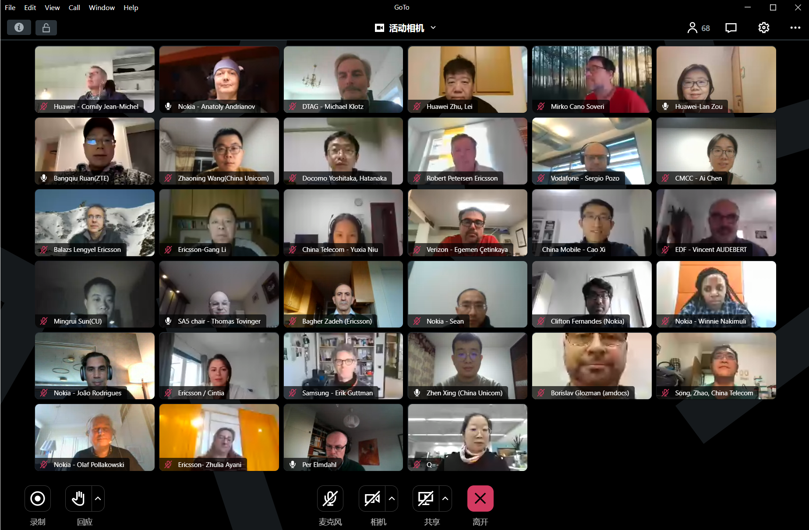
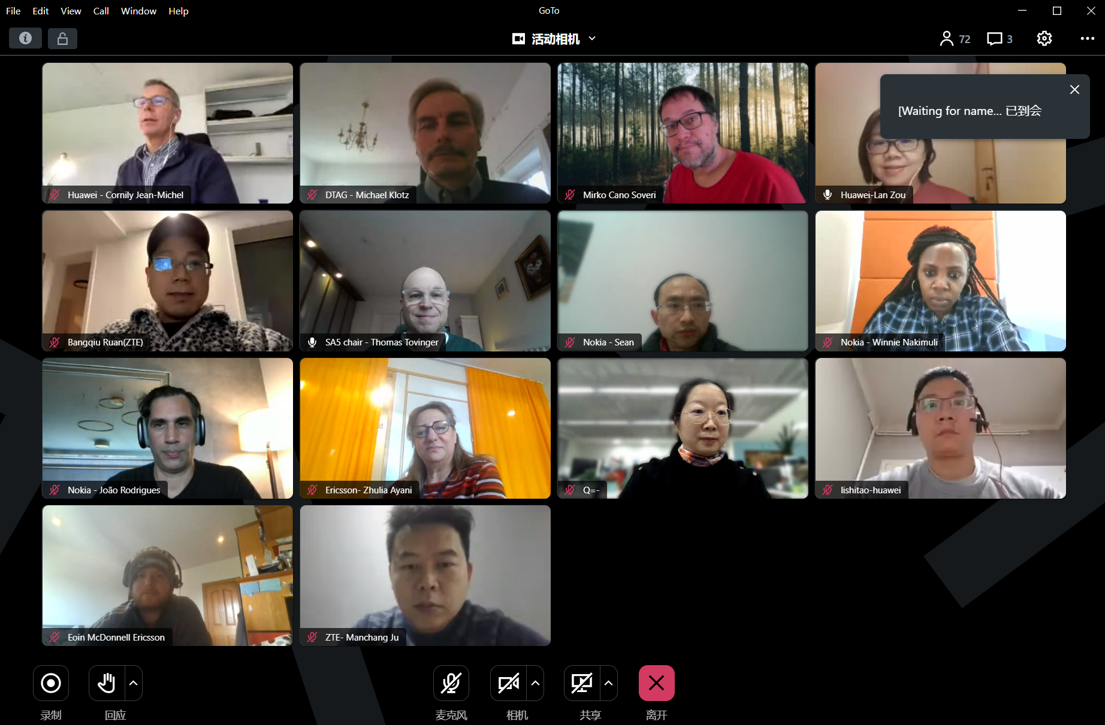
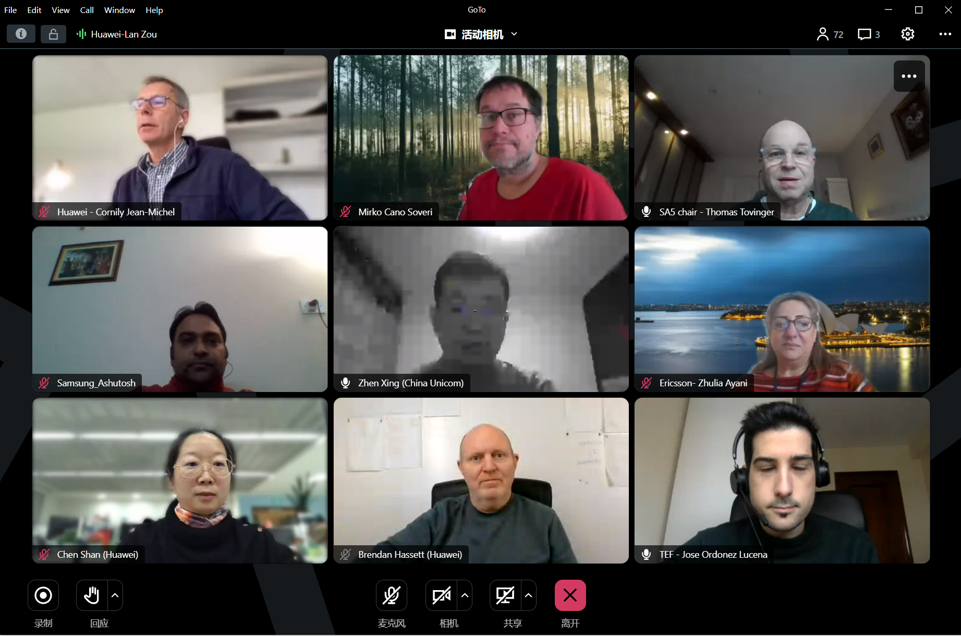
Thank you!

