Slide 1
DP on Charging ID Uniqueness
(SA5 #145e)
Chen Shan Huawei

Slide 2
Charging Architecture---Non Roaming
PCF
SMF Charging id (Unit 32)
ASN.1 @32298 Generic ASN.1 definitions charging id （INTEGER ）
Based on the LS (S5-225016)
  The Npcf_SMPolicyControl (TS 29.512) and the Npcf_PolicyAuthorization service (TS 29.514) use the ChargingId data type, Uint32, defined in TS 29.571, to forward the access network charging identifier in the “accNetChaIdValue” attribute. And consequently, both services have been updated to support from Rel-17 on a new attribute (“accNetChargIdString” data type string), controlled by feature support (AccNetChargId_String), that allows the encoding in long character strings of the SMF generated charging identifier.
Charging ID: Unit32 @29512 refer to TS 29571
SMF
CHF
Charging ID: Unit32 @32291 refers to TS 29571
PCF
Charging ID: Unit32 @29512 refers to TS 29571
I-SMF
SMF
CHF
Charging ID: String@29502
Charging ID: Unit32 @32291 refers to 29571

Slide 3
Charging Architecture---Roaming
V-CHF
H-CHF
H-PCF
V-CHF
H-CHF
Ch ID, H-CHid : U32 @29571
Ch ID: U32 @29571
Ch ID: U32 @29512/29571
Ch ID, U32 @29571
Ch ID: U32 @29571
V-SMF
H-SMF
I-SMF
V-SMF
Chid, H-CHid: String@29502
Charging ID: String@29502
Home Routed Charging architecture
Home Routed Charging architecture with I-SMF
H-CHF
V-CHF
V-CHF
H-CHF
Ch ID: U32 @29571
Ch ID: U32 @29571
HPCh ID: U32 @ 29502
Ch ID, U32 @29571
Ch ID: U32 @29571
H-SMF+PGW
V-SMF
Charging ID: String@29502
HPCh ID: String @ 29502
V-SMF
Ch ID: OctetString @29274
V-SGW
Local-breakout Charging architecture
Interworking HR Roaming

Slide 4
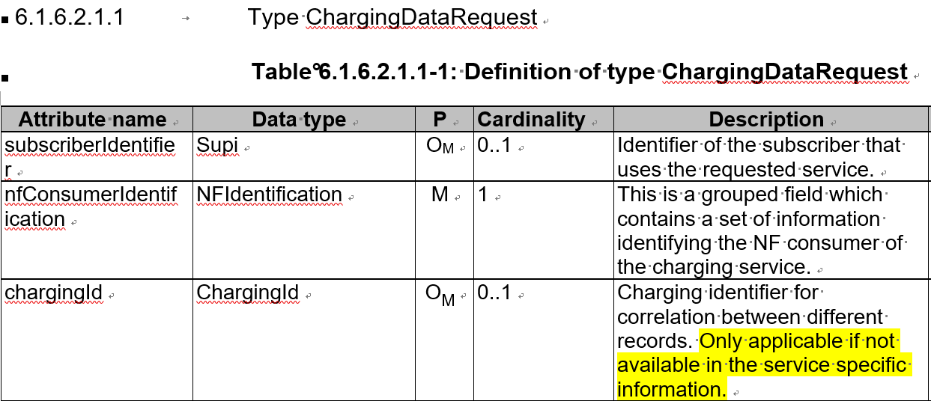
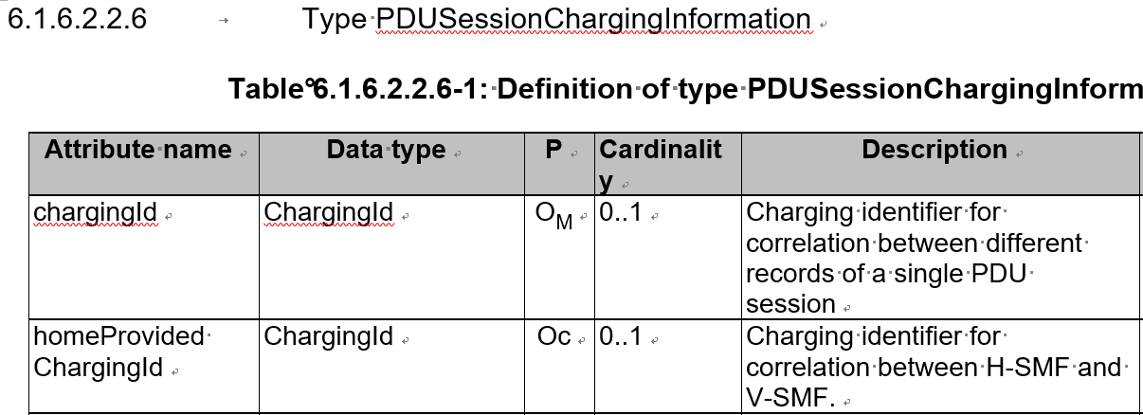

Charging ID definition
Charging ID description in Charging Specifications
  TS 32.255
  5.1.4 Charging Identifier
  Charging identifier is created to allow correlation of charging information.
  For the SMF the charging identifier is assigned per PDU session including the case of I-SMF insertion. At each PDU session establishment, i.e. assignment of a new PDU session id, a new PDU session specific SMF Charging Identifier is….
  TS 32.290
  5.4.7 Charging identifier
  The charging identifier is assigned by the NF consumer, making it possible to correlate the charging information from different events or sessions. The assignment is NF consumer dependent. The charging identifier may also be used for duplicate detection see clause 5.5.2.
  Charging ID definition

Slide 5
Suggestion
TS | Content | Current | Proposal | NF
TS 32.291 | Charging ID in PDU Session | Refer to TS 29571 Unit 32 | Supported feature: String | SMF
 | Home provided charging id | Refer to TS 29571 Unit 32 | Supported feature: String ? | SMF
 | Charging ID in Message level | Refer to TS 29571 Unit 32 | Supported feature: String ? | Othe NF, except SMF ?
TS 32.298 | Charging ID in PDU Session | INTEGER | Supported feature: OCTET STRING?
 | Home provided charging id | INTEGER | Supported feature: OCTET STRING ?
 | Charging ID in Message level | INTEGER | Supported feature: OCTET STRING ?

Slide 6
Thank you!

