Slide 1
SA5 OAM&P Exec Report
SA5#142e, 4 – 12 April, 2022 e-meeting
Zou Lan, SA5 Vice-Chair, HUAWEI
Thomas Tovinger, SA5 Chair, ERICSSON
Mirko Cano Soveri, MCC

Slide 2
Incoming LSs(1/2)
Tdoc | Title | Source | Decision | Reply In
S5-222136 | LS on the specification of AT commands for NR QoE | C1-222058 | noted
S5-222137 | Reply LS ccSA5 On User Consent Updating | C4-221413 | noted
S5-222138 | LS ccSA5 on Traffic usage reporting on 5MBS service | C4-221443 | replied to | S5-222812
S5-222139 | Reply LS on Enhancement on Charging Identifier Uniqueness Mechanism | C4-221440 | noted
S5-222140 | LS reply from ENSWI to 3GPP SA5 on overall architecture for network slice ordering, provisioning and assurance | GSMA | replied to | S5-222814
S5-222141 | Resubmitted LS on the first deliverable on use cases for autonomous networks from ITU FG-AN | ITU FG-AN | replied to | S5-222560
S5-222142 | TM Forum E2E team Response to liaison S5-215530 | TM Forum | replied to | S5-222815
S5-222143 | Minutes Formal Liaison Meeting #15 Minutes 21st February 2022 Liaison AN-SDO2022-02 | TM Forum | noted
S5-222144 | Publication of NFV SOL001 V4.2.1 | ETSI ISG NFV | noted
S5-222145 | Further Operator Platform Group questions following SDO Workshop | GSMA | noted
S5-222146 | Further reply LS ccSA5 on QoE report handling at QoE pause | R2-2201862 | noted
S5-222147 | LS ccSA5 on the specification of AT commands for NR QoE | R2-2202017 | noted
S5-222148 | Reply LS ccSA5 on maximum container size for QoE configuration and report | R2-2202018 | noted
S5-222149 | LS ccSA5 on logged MDT configuration at SN in DC scenario | R2-2204063 | noted
S5-222150 | LS on RAN2 agreements on NR QoE | R2-2204202 | noted
S5-222151 | Resubmitted Response to LS Reply LS on Enhancement of RAN Slicing | R3-216238 | replied to | S5-222645
S5-222152 | LS ccSA5 on User consent Updating | R3-221210 | noted
S5-222153 | LS ccSA5 on QoE Measurement Session Start and Measurement Session End Indication from the UE | R3-221243 | noted
S5-222154 | Reply LS to SA5 on beam measurement reports | R3-221383 | postponed
S5-222155 | LS on QMC related RAN3 progress | R3-221437 | noted

Slide 3
Incoming LSs(2/2)
Tdoc | Title | Source | Decision | Reply In
S5-222156 | LS on configuration updates of MDT M1, M8 and M9 in RAN3 specifications | R3-221445 | postponed
S5-222157 | Reply LS on MDT M6 calculation for split bearers in MR-DC | R3-222868 | noted
S5-222158 | LS on RAN3 agreements for NR QoE | R3-222890 | postponed
S5-222159 | Reply LS ccSA5 on MINT functionality for Disaster Roaming | S2-2201514 | replied to | S5-222575
S5-222160 | Reply LS ccSA5 on MBS Service Area Identity and start procedure for broadcast service | S2-2201517 | noted
S5-222161 | Reply LS ccSA5 on Further GSMA OPAG questions following SDO Workshop | S2-2201721 | noted
S5-222162 | Reply LS ccSA5 on User Consent Updating | S3-220474 | noted
S5-222163 | Reply LS ccSA5 on Reply LS on MINT functionality for Disaster Roaming | S3-220518 | noted
S5-222164 | Reply LS ccSA5 on Further Operator Platform Group questions following SDO Workshop | S3-220571 | noted
S5-222165 | LS Reply ccSA5 on maximum container size for QoE configuration and report | S4-220237 | noted
S5-222166 | LS Reply on QoE configuration and reporting related issues | S4-220309 | postponed
S5-222167 | Resubmitted LS on TS 28.404/TS 28.405 Clarification | S4-211234 | postponed
S5-222168 | Reply LS ccSA5 on Prioritized Vehicle to Cloud Technical Solutions (Automotive Edge Computing Consortium (AECC)) | S6-220265 | noted
S5-222169 | Reply LS ccSA5 on further Operator Platform Group questions following SDO Workshop | S6-220432 | noted
S5-222170 | Resubmitted LS/r on methodology harmonization update (reply to 3GPP TSG SA5-S5-215481) | ITU-T SG2 | replied to | S5-222570
S5-222351 | LS ccSA5 on MEC Federation and interest to collaborate | ETSI ISG MEC | noted
S5-222553 | Reply LS ccSA5 to GSMA Operator Platform Group on edge computing definition and integration | SP-220003 | noted
S5-222554 | Reply LS ccSA5 to GSMA OPG on Further Operator Platform Group questions following SDO Workshop | SP-220346 | noted
S5-222555 | LS ccSA5 on Request to clarify whether there are IPR issues with using 3GPP terminology and information objects and names in code contributed to ONAP | ONAP | noted
S5-222556 | LS on enforcement of maximum number of UEs and maximum number of PDU sessions in a network slice. | GSMA | noted

Slide 4
Outgoing LSs
Tdoc | Title | To | Cc | ReplyTo
S5-222560 | Reply LS on the first deliverable on use cases for autonomous networks from ITU FG-AN (ITU FG-AN) | ITU-T SG2, SG3, SG5, SG9, SG11, SG12, SG15, SG16, SG17, SG20, CITS, FG-AI4EE, FG-AI4NDM, FG-AI4AD, GSMA, IEEE, ETSI ISG ZSM, ETSI ISG NFV, ETSI TC INT, TM Forum, IETF, IRTF, Linux Foundation Networking, Open Networking Foundation, LF AI & Data Foundation, O-RAN Alliance, NGMN | SA | S5-222141
S5-222568 | LS on the clarification of Dynamic EAS instantiation triggering | SA6 | -
S5-222570 | Reply LS on methodology harmonization update | ITU-T SG2 | - | S5-222170
S5-222575 | Reply to LS on MINT functionality for Disaster Roaming | SA2 | SA,CT, RAN,SA3, CT1, CT4, CT6, RAN2 | S5-222159
S5-222645 | LS on Response to LS on Enhancement of RAN Slicing from RAN3 | RAN3 | - | S5-222151
S5-222812 | Reply to LS on Traffic usage reporting on 5MBS service | CT4 | SA2 | S5-222138
S5-222814 | Reply LS to GSMA NG ENSWI on overall architecture for network slice ordering, provisioning and assurance | GSMA NG ENSWI | SA | S5-222140
S5-222815 | Reply LS to TM Forum on overall architecture for network slice ordering, provisioning and assurance | TM Forum | SA | S5-222142
S5-222816 | LS on changes over E1AP due to RACH NSA Measurements | RAN3 | - | -

Slide 5
Revised Rel-17 Work Items / Study Items
Tdoc | Type | Release | Title | Source
S5-222269 | Revised WID | Rel-18 | Update SID on enhancement of management of NPN | Huawei

Slide 6
Agreed new Rel-18 Work Items / Study Items
Tdoc | Type | Release | Title | Source | Potential related groups
S5-222631 | New SID | Rel-18 | Study on measurement data collection to support RAN intelligence | Intel Korea, Ltd. Verizon, AT&T, CMCC | RAN2, RAN3
S5-222578 | New WID | Rel-18 | Enhancements of 5G performance measurements and KPIs phase 2 | China Telecommunication Corp., Intel | SA2, RAN3 and RAN2
S5-222579 | New SID | Rel-18 | Study on Management Aspects of IoT NTN Enhancements | China Unicom | SA WG2, RAN WG3

Slide 7
Documents endorsed by OA&M
TDoc | Title | Source | Potential related topics and related groups
S5-222627 | Discussion on enhanced QoS model | Ericsson LM
S5-222723 | Discussion Paper on 5G exposure | AT&T, Deutsche Telekom, Ericsson, Huawei, Intel, Orange, Samsung, Telefonica, Verizon | SA1,5G-ACIA, 5G Slicing Association,SA2, SA6
S5-222679 | DP on external API for Capability Exposure | Alibaba Group, AsiaInfo
S5-222573 | Discussion paper on Forge change in SA5 OAM proposed in SP-220341 | Nokia, Nokia Shanghai Bell | CT
S5-222574 | DP on the relationship of CAMARA and SA work on capability exposure | TELEFONICA S.A. | CAMARA
S5-222489 | DP Deprecating attributes, data types and IOCs | Ericsson
S5-222551 | Collection of Rel-18 3GPP SA5 OAM WoPs | SA5 Vice Chair

Slide 8

OAM General Topics (Rel-18 prioritization and Work Package)
Info about WoP:
  We need to start the Rel-18 work at SA5#142e – all SA-approved Rel-18 WI/SIs should be on the agenda.
  Definition of the complete set of WoPs for each Rel-18 WID/SID should be proposed by the work item rapporteurs as input contributions to SA5#142e and agreed there, which means that the WoPs can and should then be used as basis for selection of subsets of the WoPs on the agenda for SA5#143e.
  Therefore we need some other less formal way of reducing the agenda for SA5#142e, if we want that – like a leaders recommendation of what to focus on, e.g. initial skeleton proposals and/or DPs. Maybe this will come natural anyway for a first Rel-18 meeting, so we did not decide on any such leaders recommendation yet (but I still ask everyone to consider that, to avoid a huge overload of Rel-18 contributions at the same time as we need to finish the Rel-17 work items with approved exceptions as well as the earlier Rel-17 studies that continue into Rel-18).
  The WoPs shall in no way modify the content or meaning of the objectives in the approved WID/SIDs – they are only allowed to identify clearly defined subsets of the objectives, typically one WoP per “main bullet” in the WID/SID Objectives, or in some cases subsets of a bullet if it’s clearly separable.
  The SA5#142e-agreed complete set of WoPs for each Rel-18 WID/SID should be documented as an “SA5-local WID/SID update with WoPs” (no need to send them to SA for approval).
  Then we ask the rapporteurs to propose a subset of all agreed WoPs to be recommended to the leaders to be put on the agenda for next meeting, which means that contributions to the next meeting (143e) are only allowed to address the selected WoPs. We don’t spend time on this selection during the meeting, as the agreed WoPs are not known until the end of the meeting but also to save time for the tdoc discussions and conclusions in the meeting.
  We will add the selection of subsets of WoPs to the real meeting agenda as “level 4 (or 5)” agenda item (e.g. 6.3.4.1 for WoP no. 1 in agenda 6.4.3) so that this has to be used for tdoc agenda allocation in 3GU. This is possible in 3GU according to Mirko. The next meeting’s draft agenda shall be sent out for email review asap after the meeting, and then it will be decided by the leaders after any comments have been considered. Thus the WoP selection for SA5#143e should be known soon after SA5#142e finished, for everyone to be able to plan and prepare contributions for SA5#143e as early as possible.
  This also means that the leaders have “full control” to decide about the WoP selection in the agenda for next meeting (like we always have for the agenda), and it is not possible to contribute to any other WoPs than the selected ones.
  This also has the big advantage that we can follow the “statistics of number of tdocs for every WoP” at every meeting to see an indication of the progress for each WoP and at the end of the release check if all objectives (WoPs) have been addressed with some contributions (and how many were agreed).
S5-222551 Collection of Rel-18 3GPP SA5 OAM WoPs
  We ask every rapporteur to make the following calculation, based on this “formula”:
  X = Total number of WoPs for the WI/SI
  Y = Number of SA5 meetings from start to the target date (not counting the potential ad-hoc in Oct.)
  Z = Divide X by Y, round up to next integer number (if not already integer) and add +1
  Z = allowed number of WoPs at every meeting.

Slide 9
OAM General Topics (Forge collaboration with CT)
Forge collaboration background information:
SA approved forge structure: SP-220341 Proposed recommendations on Storage of 3GPP OpenAPI specification files in 3GPP Forge
Request from CT Chair and CT expect:
A. Update the file names to start with TS number, Correct internal references to common defs (and other SA5 spec) to take into account the file name update
B. Use relative URIs to refer to external specifications (e.g. TS29571)
C: “comDefs.yaml" and “"coslaNrm.yaml"
Progress in SA5#142e:
1. List of SA5#142 agreed tdocs:
Collaboration with CT on Forge (TS 32.312&28.532&28.536&28.538&28.541&28.550&28.622&28.623):
[SA5#142e], 6.3-MAINT, S5-222384 Rel-17 CR TS 28.312 OpenAPI file name and dependence change-intentNrm
[SA5#142e], 6.3-MAINT, GROUP#1 (S5-222580/S5-222502) Draft CR 28.532 OpenAPI file name and dependence change
[SA5#142e], 6.3-MAINT, S5-222382 Rel-16 CR TS 28.536 OpenAPI file name and dependence change-coslaNrm
[SA5#142e], 6.3-MAINT, S5-222385 Rel-17 CR TS 28.538 OpenAPI file name and dependence change-edgeNrm
[SA5#142e], 6.3-MAINT, GROUP#2 (S5-222581/S5-222582/S5-222583) TS 28.541 OpenAPI file name and dependence change-5gcNrm-nrNRM-SliceNrm.yaml
[SA5#142e], 6.3-MAINT, S5-222518 CT OpenAPI file relative-path URI references and dependence change for 5gcNrm.yaml
[SA5#142e], 6.3-MAINT,S5-222503 Rel-16 Draft CR 28.550 OpenAPI file name and dependence change
[SA5#142e], 6.3-MAINT, GROUP#3 (S5-222584/S5-222585) TS 28.623 OpenAPI file name and dependence change-comDefs-genericNRM.yaml
2. Issues have been addressed in SA5#142e (corresponding to the requests A-B-C above from CT Chair and CT expect):
A. Filename alignment:
a) Add TS number: Rel-16 related draftCRs have been updated and agreed.
B. Absolute/relative URI: Rel-16 related draftCRs have been updated and agreed.
3. Issues to be addressed in SA5#143e (corresponding to the requests A-B-C above from CT Chair and CT expect):
A. Filename alignment:
a) Add TS number: Block approve of Rel-16 CRs and Rel-17 mirror CRs based on agreed draftCRs.
b) Lowercase/Uppercase: Need new contributions to address this issue.
B. Absolute/relative URI: Block approve of Rel-16 CRs and Rel-17 CRs agreed draftCRs.
C. Two issues from Jesus related to “comDefs.yaml" and “"coslaNrm.yaml"
4 . Collaboration plan with CT after SA5#143e:
After 3GPPSA5#143-e, we will have to copy the SA5 OpenAPI files into the draft release branches right before TSG#96.
As the draft versions of the specifications sent to TSG#96 for approval should be available at the end of the week 21, I would propose to use May 27 as the targeted date for copying the SA5 files in the draft branches of 5G-APIs.
Of course, they can also be made available in week 22 but the sooner will be the better for having all the files available, to have more time to generate CRs if needed after error detection during the final sanity check.

Slide 10
Overview of Rel-17 SA5 OAM WIs/SIs
8 ongoing WIs/SIs, 16 finished WIs, 8 finished SIs
8 ongoing WIs with exception, 16 finished WIs
0 ongoing SIs, 8 finished SIs
 | Rel-17 Operations, Administration, Maintenance and Provisioning (OAM&P)
1 | (finished) Additional NRM features | adNRM | 870026
2 | (finished) Enhancements of 5G performance measurements and KPIs | ePM_KPI_5G | 880025
3 | (finished) Management of MDT enhancement in 5G | e_5GMDT | 870025
4 | (Exception) Enhancement of QoE Measurement Collection | eQoE | 870027
5 | (finished) Management Aspects of 5G Network Sharing | MANS | 900021
6 | (finished) File Management | FIMA | 910030
7 | (Exception) Access control on management service | MSAC | 930010
8 | (finished) Enhancement of service-based management architecture | NSA_SBMA | 930009
9 | (finished) Autonomous network levels | ANL | 880027
10 | (Exception) Intent driven management service for mobile networks | IDMS_MN | 810027
11 | (Exception) Enhanced Closed loop SLS Assurance | eCOSLA | 870030
12 | (finished) Network policy management for 5G mobile networks | NPM | 860024
13 | (Exception) Enhancements of Management Data Analytics Service | eMDAS | 850028
14 | (finished) Enhancements of Self-Organizing Networks (SON) for 5G networks | eSON_5G | 870028
15 | (finished) Generic Plug and connect | PACMAN | 910029
16 | (finished) Enhancement of Handover Optimization | E_HOO | 880029
17 | (finished) Enhancements on EE for 5G networks | EE5GPLUS | 870022
18 | (finished) Discovery of management services in 5G | 5GDMS | 820035
19 | (Exception) Management data collection control and discovery | MADCOL | 880028
20 | (finished) Management of non-public networks | OAM_NPN | 870023
21 | (finished) Enhancement on Management Aspects of 5G Service-Level Agreement | EMA5SLA | 870024
22 | (finished) Management of the enhanced tenant concept | eMEMTANE | 880026
23 | (Exception) Edge Computing Management | ECM | 920019
24 | (Exception) Network slice provisioning enhancement | eNETSLICE_PRO | 940033
 | Rel-17 OAM&P Studies
1 | (finished) Study on autonomous network levels | FS_ANL | 850032
2 | (finished) Study on management and orchestration aspects with integrated satellite components in a 5G network | FS_5GSAT_MO | 830025
3 | (finished) Study on enhancement of Management Data Analytics Service (finished) | FS_eMDAS | 850028
4 | (finished) Study on enhancements of edge computing management | FS_eEDGE_Mgt | 870029
5 | (finished) Study on access control for management service | FS_MNSAC | 890016
6 | (finished) Study on new aspects of EE for 5G networks | FS_EE5G | 870021
7 | (finished) Study on Management Aspects of 5G Network Sharing | FS_MANS | 920018
8 | (finished) Study on network slice management enhancements | FS_NSMEN | 860022

Slide 11
Overview of Rel-18 SA5 OAM ongoing WIs/SIs
Altogether 31 WIs/Sis, including 23 ongoing Sis and 5 ongoing Wis, 2SIs and 1 WI are waiting for SA approval.
Rel-18 OAM&P Studies
Intelligence and Automation
1 | Study on enhancement of autonomous network levels | China Mobile, Huawei | FS_eANL | SP-211446
2 | Study on evaluation of autonomous network levels | China Mobile, Huawei | FS_ANLEVA | SP-211445
3 | Study on enhanced intent driven management services for mobile networks | Huawei, Ericsson | FS_eIDMS_MN | SP-211450
4 | Study on intent-driven management for network slicing | Ericsson, Huawei | FS_NETSLICE_IDMS | SP-220278
5 | Study on AI/ ML management | Intel, NEC | FS_AIML_MGMT | SP-211443
6 | Study on Enhancement of the management aspects related to NWDAF | China Telecom | FS_MANWDAF | SP-211435
7 | Study on Fault Supervision Evolution | China Mobile, Huawei | FS_FSEV | SP-220153
8 | Study on measurement data collection to support RAN intelligence (wait for SA approval) | Intel | FS_MEDACO_RAN | S5-222631
Management Architecture and Mechanisms
9 | Study on Enhancement of service based management architecture | Huawei, Ericsson | FS_eSBMA | SP-211451
10 | Study on Basic SBMA enabler enhancements | Nokia | FS_eSBMAe | S5-221506
11 | Study on Management Aspects of URLLC | China Unicom | FS_URLLC_Mgt | SP-220146
12 | Study on Management Aspects of 5GLAN | China Mobile | FS_5GLAN_Mgt | SP-220324
13 | Study on Management of Cloud Native Virtualized Network Function | China Mobile | FS_MCVNF | SP-220150
14 | Study on Management Aspects of 5G MOCN Network Sharing Phase2 | China Unicom | FS_MANS_ph2 | SP-220151
15 | Study on continuous integration continuous delivery support for 3GPP NFs | Lenovo | FS_CICDNS | SP-211427
16 | Study on Management of Trace/MDT phase 2 | Nokia | FS_5GMDT_Ph2 | SP-220152
17 | Study on YANG PUSH | Ericsson | FS_YANG | SP-200765
18 | Study on Management Aspects of IoT NTN Enhancements (wait for SA approval) | FS_IOT_NTN | China Unicom | S5-222579
Rel-18 OAM&P Studies
Support of New Services
19 | Study on enhancement of management of non-public networks | Huawei | FS_OAM_eNPN | SP-211436
20 | Study on new aspects of EE for 5G networks Phase 2 | Orange | FS_EE5G_Ph2 | SP-211440
21 | Study on Network and Service Operations for Energy Utilities | Samsung | FS_NSOEU | SP-211622
22 | Study on Key Quality Indicators(KQIs)for 5G service experience | Huawei | FS_KQI_5G | SP-211433
23 | Study on Deterministic Communication Service Assurance | Huawei | FS_DCSA | SP-211442
24 | Study on management aspects of network slice management capability exposure | Alibaba | FS_NSCE | SP-220142
25 | Study on alignment with ETSI MEC for Edge computing management | Huawei | FS_MEC_ECM | SP-220147
Rel-18 Operations, Administration, Maintenance and Provisioning (OAM&P)
Intelligence and Automation
26 | Self-Configuration of RAN NEs | China Mobile, Huawei | RANSC | SP-211431
Management Architecture and Mechanisms
27 | Network slicing provisioning rules | Ericsson | NSRULE | SP-211449
28 | Additional NRM features Phase 2 | Nokia | AdNRM_ph2 | SP-220351
29 | enhanced Edge Computing Management | Samsung, Intel | eECM | SP-220154
30 | Enhancements of 5G performance measurements and KPIs phase 2 (wait for SA approval) | ePM_KPI_5G_Ph2 | China Telecom, Intel | S5-222578
Support of New Services
31 | Enhancements of EE for 5G Phase 2 | Orange | EE5GPLUS_Ph2 | SP-211441

Slide 12
Rel-16/Rel-17 CRs (1/2)
Working Progress
The following topics are discussed in the meeting.
Collaboration with CT on Forge (TS 32.312&28.532&28.536&28.538&28.541&28.550&28.622&28.623):
[SA5#142e], 6.3-MAINT, S5-222384 Rel-17 CR TS 28.312 OpenAPI file name and dependence change-intentNrm
[SA5#142e], 6.3-MAINT, GROUP#1 (S5-222501/S5-222502) Draft CR 28.532 OpenAPI file name and dependence change
[SA5#142e], 6.3-MAINT, S5-222382 Rel-16 CR TS 28.536 OpenAPI file name and dependence change-coslaNrm
[SA5#142e], 6.3-MAINT, S5-222385 Rel-17 CR TS 28.538 OpenAPI file name and dependence change-edgeNrm
[SA5#142e], 6.3-MAINT, GROUP#2 (S5-222221/S5-222222/S5-222223) TS 28.541 OpenAPI file name and dependence change-5gcNrm-nrNRM-SliceNrm.yaml
[SA5#142e], 6.3-MAINT, S5-222518 CT OpenAPI file relative-path URI references and dependence change for 5gcNrm.yaml
[SA5#142e], 6.3-MAINT,S5-222503 Rel-16 Draft CR 28.550 OpenAPI file name and dependence change
[SA5#142e], 6.3-MAINT, GROUP#3 (S5-222293/S5-222294) TS 28.623 OpenAPI file name and dependence change-comDefs-genericNRM.yaml
Long term plan for improvement:
Reimplement (mainly copy the actual definition from CT files) the depended common data type in a separate yaml files (e.g., externalDefs.yaml) (One option is to add an informative Annex to 28.623 to add this yaml file)
replace the current 5gcNrm.yaml external reference from CT files to externalDefs.yaml
Going forward, the CR author to ensure the update of the external refence content into externalDefs.yaml
TS 28.541:
[SA5#142e], 6.3-MAINT, GROUP#10 (S5-222058/S5-222134) TS 28.541 attribute related to nextHopInfoList in EP_transport
[SA5#142e], 6.3-MAINT, S5-222081 Rel-16 CR TS 28.541 Fix attribute properties for configurable5QISetRef and dynamic5QISetRef
[SA5#142e], 6.3-MAINT, S5-222119 Rel-16 CR 28.541 Diagram fix for NRM fragment for RRM policies
[SA5#142e], 6.3-MAINT, S5-222215 Rel-16 TS 28.541 Fixing OpenAPI Discoverability issue in Stage3-5gcNrm.yaml
[SA5#142e], 6.3-MAINT, S5-222216 Rel-16 TS 28.541 Fixing OpenAPI Discoverability issue in Stage3-nrNrm.yaml
[SA5#142e], 6.3-MAINT, S5-222217 Rel-16 TS 28.541 Fixing OpenAPI Discoverability issue in Stage3-sliceNrm.yaml
[SA5#142e], 6.3-MAINT, S5-222248 Rel-16 Draft CR 28.541 Correction on minor errrors in nrNRM yaml
[SA5#142e], 6.3-MAINT, S5-222250 Rel-16 Draft CR 28.541 Correcton on the attribute definition in the wrong yaml file
[SA5#142e], 6.3-MAINT, S5-222264 Rel-17 Draft CR 28.541 Correction on two SLA attributes
[SA5#142e], 6.3-MAINT, S5-222386 Rel-16 CR TS 28.541 Correction to RRMPolicy_ IOC reference in RRMPolicyRatio IOC
[SA5#142e], 6.3-MAINT, S5-222388 Rel-16 CR TS 28.541 Add attribute properties for NetworkSliceSubnet attribute priorityLabel
[SA5#142e], 6.3-MAINT, S5-222390 Rel-17 CR TS 28.541 Fix to change Support Qualifier to S
[SA5#142e], 6.3-MAINT, S5-222391 Rel-17 CR TS 28.541 Define LogicInterfaceInfo datatype and fix attribute properties for logicInterfaceInfo
[SA5#142e], 6.3-MAINT, S5-222495 DraftCR 28.541 Correct NR NRM defaultValue Null
[SA5#142e], 6.3-MAINT, S5-222527 Rel-17 Draft CR 28.541 Correct maximumDeviationHoTrigger for D-LBO
[SA5#142e], 6.3-MAINT, S5-222528 Fix BWP association to NRCellDU
[SA5#142e], 6.3-MAINT, GROUP#4 (S5-222532/S5-222535) Update 5QI set description

Slide 13
Rel-16/Rel-17 CRs (2/2)
Working Progress
The following topics are discussed in the meeting.
TS 28.552:
[SA5#142e], 6.3-MAINT, S5-222209 Rel-17 draftCR 28.552 Correct handover execution failure per beam pair measurement
[SA5#142e], 6.3-MAINT, S5-222210 Rel-17 draftCR 28.552 Clean up of PM related to MRO
[SA5#142e], 6.3-MAINT, S5-222342 Rel-17 draftCR for TS28.552 Correct the QoS flow setup related counters
[SA5#142e], 6.3-MAINT, GROUP#5 (S5-222363/S5-222380) Rel-17 draftCR for TS28.552 the measurement object class to support MOCN network sharing with multiple Cell Identity broadcast scenarios
[SA5#142e], 6.3-MAINT, S5-222470 Rel-16 draftCR 28.552 Clean up of PM related to MRO
[SA5#142e], 6.3-MAINT, S5-222487 Rel-17 Draft CR 28.552 Correct implementation mistakes
TS 28.554:
[SA5#142e], 6.3-MAINT, GROUP#6 (S5-222320/S5-222321) draftCR 28.554 update formula of of PDU session establishment success rate
TS 28.622&TS 28.623:
[SA5#142e], 6.3-MAINT, S5-222102 Re-16 CR 28.622 Add missing definitions of common data types
[SA5#142e], 6.3-MAINT, S5-222111 Rel-16 CR 28.623 Stage 3 Yang fix for 3GPP Common Trace
[SA5#142e], 6.3-MAINT, GROUP#7 (S5-222202/S5-222203) draftCR Alignment of parameter names to 32.422
[SA5#142e], 6.3-MAINT, GROUP#8 (S5-222204/S5-222205) draftCR Structuring of TraceJob IOC and Clean Up
[SA5#142e], 6.3-MAINT, GROUP#9 S5-222206 Rel-16 draftCR 28.622 Clean up of attribute properties
[SA5#142e], 6.3-MAINT,S5-222537 Rel-16 Input to DraftCR Alarm Handling Clarifications
[SA5#142e], 6.3-MAINT,S5-222539 Rel-16 Input to DraftCR YANG corrections
TS 28.622&TS 28.541:
[SA5#142e], 6.3-MAINT, GROUP#11 (S5-222548/S5-222549) Rel-17 Input to DraftCR Correct isOrdered-NA and isUnique-NA for multivalue attributes
TS 28.532:
[SA5#142e], 6.3-MAINT, S5-222096 Rel-16 CR 28.532 Correct definition of Resource
[SA5#142e], 6.3-MAINT, S5-222099 Rel-16 CR 28.532 Correct REST SS of deleteMOI
[SA5#142e], 6.3-MAINT, S5-222530 Fix FileDataType definition (OpenAPI)
[SA5#142e], 6.3-MAINT, S5-222546 Rel-17 Input to DraftCR Data change notifications YANG-in-Rest format
TS 28.536:
[SA5#142e], 6.3-MAINT, S5-222132 Fixing OpenAPI Discoverability issue in CoslaNrm.yaml stage 3
[SA5#142e], 6.3-MAINT, S5-222552 draftCR R17 Add support for disabling CL for certain MOI
TS 28.538:
[SA5#142e], 6.3-MAINT, S5-222131 Fixing OpenAPI Discoverability issue in EdgeNrm.yaml stage 3
TS 32.156:
[SA5#142e], 6.3-MAINT, S5-222526 Rel-17 Input to DraftCR Dont use isNullable true
TS 32.158:
[SA5#142e], 6.3-MAINT, S5-222075 Rel-16 CR 32.158 Add definition of secondary resource
[SA5#142e], 6.3-MAINT, S5-222076 Rel-16 CR 32.158 Add definition of resource "/{MnSName}/{MnSVersion}"
[SA5#142e], 6.3-MAINT, GROUP#12 (S5-222078/S5-222079) Rel-16 CR 32.158 Clarify clause Creating a resource with identifier creation by the MnS Producer/Consumer
[SA5#142e], 6.3-MAINT, GROUP#13 (S5-222080/S5-222082/S5-222083/S5-222084/S5-222085/S5-222086/S5-222087/S5-222092) Rel-16 CR 32.158 Clarify clause Design pattern
[SA5#142e], 6.3-MAINT, S5-222094 Rel-16 CR 32.158 Add missing clause Large queries
[SA5#142e], 6.3-MAINT, S5-222095 Rel-16 CR 32.158 Correct examples in Annex A
TS 32.160:
[SA5#142e], 6.3-MAINT, S5-222547 Rel-17 Input to DraftCR YANG Mapping Corrections

Slide 14
Rel-17 WI eQOE/MSAC/ECM/eNETSLICE_PRO
WI code | WI Title | Completion rate | TS/TR | Tdoc reference | Target date | Rapporteur | Related groups | Related topic
eQoE | Enhancement of QoE Measurement Collection | 15%->20%->40%->60% ->90%->92% | TS28.307/28.308/28.309/28.404/28.405/28.406/28.622/28.623/28.533 | SP-200193 | SA#96 (Jun. 2022) | Ericsson | RAN2/RAN3/SA4
MSAC | Access control for management service | 0%->10%->50%->60%->65% | TS28.533/28.622/28.623/28.532 | SP-210859 | SA#96 (Jun. 2022) | Nokia | SA3
ECM | Edge Computing Management | 0%->10%->25%->50%-90%->100% | TS 28.538 | SP-210388 | SA#95 (Mar 2022) | Samsung | SA2/SA6/NFV
eNETSLICE_PRO | Network slice provisioning enhancement | 0%->0%->50%->70% | TS 28.531/28.541 | S5-215497 | SA#96 (Jun. 2022) | Samsung |  | Slicing
Working Progress
eQoE: The following topics were discussed and need further discussion.
QoE Measurement Collection for Signalling Based Activation case in NR, and Handling QoE Measurement Collection at handover in NR to TS 28.405 and adding QoE attributes to 28.622/623.
MSAC:
Authentication/Authorization Work flow discussed and clarified; as for enhancement to NRM for both stage 2 and stage 3, a few problems are addressed in this meeting.
ECM: :
All the comment raised by MCC in #142e were addressed.
eNETSLICE_PRO:
The WG agreed on feasibility check related contributions after a long discussion. The objective related with capabilities and asynchronous mode is still pending as the related contributions did not get agreed. If those contribution will not be agreed in next meeting we either have to down scope and WID or ask for one more exception.

Slide 15
Rel-17 WI MADCOL/eMDAS/eCOSLA/IDMS_MN
WI code | WI Title | Completion rate | TS/TR | Tdoc reference | Target date | Rapporteur | Related groups | Related topic
MADCOL | Management data collection control and discovery | 40%->40%->45%->55% | TS28.533/28.532/28.622/ 28.623 | SP-200465 | SA#96 (Jun. 2022) | Nokia | SA2/RAN2/RAN3
eMDAS | Enhancements of Management Data Analytics Service | 0%->10%->25%->45%->65%->85% | TS 28.104/ and another new TS (being requested by the revised WID) | SP-210132 -> Revised WID in S5 216348 | SA#96 (Jun. 2022) | Intel,NEC | SA2/RAN3 | Data analytics
eCOSLA | Enhanced Closed loop SLS Assurance | 60%->70%->80%->90%->95% | TS28.535/28.536/28.533/28.541/28.546/28.552/28.553 | SP-200196 | SA#96 (Jun. 2022) | Ericsson | ZSM/SA2/RAN3 | Closed loop interaction
IDMS_MN | Intent driven management service for mobile networks | 70%->75%->80%->95%->99% | TR28.812/TS 28.312 | SP-180899 | SA#96 (Jun. 2022) | Huawei | SA2/RAN3/ZSM | Intent
Working Progress
MADCOL:
Substantial progress was made at this meeting. The contributions on how to select the data and related network nodes for data production was agreed (based on a Working Agreement). IN addition, the contribution proposing to use the concept of a geo area for specifying the area of interest for data production was agreed (based on a Working Agreement). Data identifiers for Trace and MDT were approved as well.
eCOSLA: :
The group has been working to resolve last outstanding questions captured in the Editor’s Notes and also conditionally agreed additional stage 2 definitions.
IDMS_MN:
The remaining Editor’s Notes mentioned in the exception request are addressed and the concrete content for the TS 28.312 is finished. Next meeting will focus on the clean up for the TS 28.312 to be ready for SA approval.
The following aspects are discussed and agreed:
1. Address the Editor's Notes issues
2. Update clause 7 stage3 to align with clause 2 stage2
3. Update intent information model
4.pCR TS 28.312 Add verbalization of expectation to intent Model
5.pCR TS 28.312 Update intent fulfillment tracking in information model
6.pCR 28.312 Update procedures for intent management
7.pCR TS 28.312 Move clause 6.4 scenario specific IntentExpectationto 6.2
eMDAS:
The pCRs on the multiple subjects were agreed at SA5#142e.
Add requirements for AI/ML selection
Add requirements for control of AI/ML Training
Add NRM fragments for AI/ML Training
Support for Training of ML-based functions
Add AI-ML background
Extend requirements for coverage analytics
Critical Maintenance Management
Network Slice Traffic Prediction
Correct the referred clauses
Add common information elements of MDA outputs
Update NRM for MDA request
Enhancing MDA request IOC
Clarify MDA interactions
Prediction of service failures
Add stage 2 description of failure predication analytics
Add stage 2 description of failure predication analytics
Clarifications on MDA Context
Add an enumeration value in output for “Network slice throughput analysis”
eMDAS:
Add an enumeration value in output for “Network slice throughput analysis”
Multiplicity change for “Affected Objects” IE in “NW slice load analysis”
Multiplicity change for “Affected Objects” IE in “Service experience analysis”
Modify the paging requirements based on geographical area
Update the analytics output of coverage analysis use case
Add MDA capability for MDA assisted energy saving analysis
Update use case description for MDA assisted energy saving analysis
Define the data type of statistics of cells energy saving state
Add MDA related service components
Add mobility performance analysis solution
Rapporteur clean-up
Editorial, enhancements and modifications on MDA overview
Editorial modifications on MDA functionality and service framework
Add historical data handling for MDA
Clarifications on MDA Types
Adding domain observation data as input in cross-domain MDA
The plan is to complete this work item in SA5#143e, and no more exception is to be requested.

Slide 16
Rel-18 SI Intelligence and Automation
WI code | WI/SI information | Rapportuer | Target date | Completion rate | Related groups | Related topic
FS_eANL | Study on enhancement of autonomous network levels (FS_eANL) (SP-211446) | China Mobile, Huawei | SA5#145/SA#97(Sep 2022) | 0->10% | SA2, RAN3 and ETSI ZSM
FS_ANLEVA | Study on evaluation of autonomous network levels(FS_ANLEVA) (SP-211445) | China Mobile, Huawei | SA5#147/SA#99(Mar 2023) | 0->10% | SA2, RAN3 and ETSI ZSM
FS_eIDMS_MN | Study on enhanced intent driven management services for mobile networks (FS_eIDMS_MN) (SP-211450) | Huawei, Ericsson | SA5#145/SA#97(Sep 2022) | 0->15% | SA2, RAN3, ETSI ZSM, TM Forum
FS_NETSLICE_IDMS | Study on intent-driven management for network slicing (FS_NETSLICE_IDMS) (SP-220278) | Huawei, Ericsson | SA5#145/SA#97(Sep 2022) | 0->10%
FS_AIML_MGMT | Study on AI/ ML management (FS_AIML_MGMT) (SP-211443) | Intel, NEC | SA5#145/SA#97(Sep 2022) | 0->5% | SA1, SA2, RAN3 and RAN2
FS_MANWDAF | Study on Enhancement of the management aspects related to NWDAF (FS_MANWDAF) (SP-211435) | China Telecom | SA5#146/SA#98(Dec 2022) | 0->15% | SA2
FS_FSEV | Study on Fault Supervision Evolution (FS_FSEV) (SP-220153) | China Mobile, Huawei | SA5#147/SA#99(Mar 2023) | 0->10%
Working Progress
FS_eANL: The following aspects are discussed and agreed:
Initial skeleton and structure
Scope
Instruction of Key Issue# 6-1: autonomous network level for RAN energy saving
FS_ANLEVA: The following aspects are discussed and agreed:
Initial skeleton and structure
Scope, Concept description for autonomous network level evaluation
FS_eIDMS_MN: The following aspects are discussed and agreed:
Initial skeleton and structure, Scope
Instructions of Key Issue# 4.1 intent driven approach for RAN energy
Instructions of Key Issue# 4.2 Intent conflicts and intents containing contradictions
FS_NETSLICE_IDMS
This was the first meeting for this study and the group has been discussing and agreed the table of content, introduction and scope. Initial input for background information was also discussed.
FS_AIML_MGMT
The scope and overview for TR 28.908 were agreed.
FS_MANWDAF: Several contributions regarding the problems that will be studied and solved in this TR are discussed and approved:
S5-222052: Initial Skeleton
S5-222621: clause titles for TR28864
S5-222622: new KI on NRM enhancement to support Multiple NWDAF Deployment
S5-222623: Add new key issue for the NRM enhancement of NWDAF
S5-222624: Add new key issue for the performance management
FS_FSEV: The following aspects are discussed and agreed:
Initial skeleton
structure
Scope

Slide 17
Rel-18 SI Management Architecture and Mechanisms
WI code | WI/SI information | Rapporteur | Target date | Completion rate | Related groups | Related topic
FS_eSBMA | Study on Enhancement of service based management architecture ( FS_eSBMA ) (SP-211451) | Huawei, Ericsson | SA5#147/SA#99(Mar 2023) | 45%->50%
FS_eSBMAe | Study on Basic SBMA enabler enhancements (FS_eSBMAe) (SP-220145) | Nokia | SA5#146/SA#98(Dec 2022) | 0%->5%
FS_URLLC_Mgt | Study on Management Aspects of URLLC (FS_URLLC_Mgt) (SP-220146) | ChinaUnicom | SA5#145/SA#97(Sep 2022) | 0%->10%
FS_5GLAN_Mgt | Study on Management Aspects of 5GLAN (FS_5GLAN_Mgt) (SP-220324) | China Mobile | SA5#146/SA#98(Dec 2022) | 0%->10% | SA2
FS_MCVNF | Study on Management of Cloud Native Virtualized Network Functions (FS_MCVNF) (SP-220150) | China Mobile | SA5#147/SA#99(Mar 2023) | 0%->0%
FS_MANS_ph2 | Study on Management Aspects of 5G MOCN Network Sharing Phase2 (FS_MANS_ph2) SP-220151) | China Unicom | SA5#145/SA#97(Sep 2022) | 0%->10%
FS_CICDNS | Study on continuous integration continuous delivery support for 3GPP NFs (FS_CICDNS) (SP-211427) | Lenovo | SA5#143e/SA#96(Jun 2022) | 80%->85%
FS_5GMDT_Ph2 | Study on Management of Trace/MDT phase 2 (FS_5GMDT_Ph2) (SP-220152) | Nokia | SA5#146/SA#98(Dec 2022) | 0%->10%
FS_YANG | Study on YANG PUSH(FS_YANG) ( SP-200765) | Ericsson | SA5#146/SA#98(Dec 2022) | 10%->10%
Working Progress
FS_eSBMA
Analysis on the applicable content from TS 32.101 section 7 to SBMA, and update 32.401 and 32.404 for SBMA are approved to be added into the study.
FS_eSBMAe
The schema used for “notifyMOIChanges” was agreed as one key issue.
For targeted notification subscriptions some contributions related to describing the current situation were agreed.
FS_URLLC_Mgt
The cover page and the skeleton have been initialized. The first issue has been added.
FS_5GLAN_Mgt: The following items have been approved:
Add TR structure
Add scope of management aspect of 5GLAN
Add concepts and background of FS_5GLAN_Mgt
FS_MCVNF：No contributions submitted to this meeting.
FS_MANS_ph2
The cover page and the skeleton have been initialized. Two issues have been added.
FS_CICDNS
Some text improvements were accepted. A final solution was approved and now all scenarios have high level solutions to be developed further during the WID phase. A key issue on proposing the overall process is contested and couldn’t reach agreement
FS_5GMDT_Ph2: The following aspects are discussed and approved
Skeleton
Scope
Description of Key Issue ‘Reporting of Collected Management Data’
FS_YANG: No contributions submitted to this meeting. No progress in the study has been made.
Work on topic was explored in the contribution S5-222546rev1 Data change notifications YANG-in-Rest format, however this still received objection as a delegate claimed the topic needs further work.

Slide 18
Rel-18 SI Support of New Services
WI code | WI/SI information | Rapporteur | Target date | Completion rate | Related groups | Related topic
FS_OAM_eNPN | Study on enhancement of management of non-public networks (FS_OAM_eNPN) (SP-211436) | Huawei | SA5#146/SA#98(Dec 2022) | 0->10%
FS_EE5G_Ph2 | Study on new aspects of EE for 5G networks Phase 2 (FS_EE5G_Ph2) (SP-211440) | Orange | SA5#149/ SA#100(June 2023) | 0->10% | RAN WGs
FS_NSOEU | Study on Network and Service Operations for Energy Utilities ( FS_NSOEU) (SP-211622) | Samsung | SA5#146/SA#98(Dec 2022) | 0->10%
FS_KQI_5G | New Study on Key Quality Indicators (KQIs) for 5G service experience (FS_KQI_5G) ( SP-211433) | Huawei | SA5#146/SA#98(Dec 2022) | 0->5% | SA4,RAN2,RAN3
FS_DCSA | Study on Deterministic Communication Service Assurance (FS_DCSA) (SP-211442) | Huawei | SA5#146/SA#98(Dec 2022) | 0->5% | SA2, SA6, RAN2, SA4
FS_NSCE | Study on Network Slice Management Capability Exposure (FS_NSCE ) (SP-220142) | Alibaba | SA5#147/SA#99(Mar 2023) | 70%->75% | SA3, SA, RAN
FS_MEC_ECM | Study on alignment with ETSI MEC for Edge computing management (FS_MEC_ECM) (SP-220147) | Huawei | SA5#145/SA#97(Sep 2022) | 0->5% | SA6, ETSI MEC
Working Progress
FS_OAM_eNPN: Agreed the following KIs
Key Issue on Resource isolation demand for Smart Grid Utilities
Key Issue on E2E fault management
Key Issue on Management of NPN service customer
FS_EE5G_Ph2
TR 28.913 skeleton was approved.
Three key issues have been introduced in TR 28.913.
FS_NSOEU
the skeleton, structure, scope, overview and an informative annex was agreed. No outstanding or controversial issues arose at the meeting. The skeleton now contains ‘key issues’ which may not be needed in practice as the work progresses, unless multiple solutions will be submitted. At subsequent meetings, the objectives will be addressed.
FS_KQI_5G: The following aspects were approved
Initial skeleton, TR structure, Scope and 5G KQI scenarios.
FS_DCSA: The following aspects were approved
Initial skeleton
TR structure
Scope
Overview
FS_NSCE:
Several contributions have been approved:
S5-222756 Describe possible solution for EGMF
S5-222680 Update use case 5.2
S5-222725 Solution on exposure architecture and related API
Several discussion papers have been endorsed:
S5-222723 Discussion paper on 5G exposure
S5-222679 DP on external API for Capability Exposure
FS_MEC_ECM
Additional procedure for query and update got agreed.
Changes to EESFunction IOC was conditionally approved.

Slide 19
Rel-18 WI Intelligence and Automation
WI code | WI/SI information | Rapporteur | Target date | Completion rate | Related groups | Related topic
RANSC | Self-Configuration of RAN NEs (RANSC) (SP-211431) | China Mobile,Huawei | SA5#149/ SA#100 (June 2023) | 0->5%
Working Progress
RANSC
The following aspects are discussed and approved:
Initial skeleton
Structure
Scope
Concept and background is noted due to Nokia's objection.

Slide 20
Rel-18 WI Management Architecture and Mechanisms
WI code | WI/SI information | Rapporteur | Target date | Completion rate | Related groups | Related topic
NSRULE | Network slicing provisioning rules (NSRULE) (SP-211449) | Ericsson | SA5#145/SA#97(Sep 2022) | 0%->15%
AdNRM_ph2 | Additional NRM features Phase 2 (AdNRM_ph2) (SP-220351) | Nokia, Nokia Shanghai Bell | SA5#147/SA#99(Mar 2023) | 0%->5%
eECM | Enhanced Edge Computing Management (eECM) (SP-220154) | Samsung, Intel | SA5#147/SA#99(Mar 2023) | 0%->5%
Working Progress
NSRULE
This was the first meeting for this work item and the group discussed new requirements to support provisioning rules and impacts on network slicing operations and NRM.
AdNRM_ph2
A CR on Access specific slice configuration agreed; discussion on enhanced QoS model endorsed
NRM enhancements for Adding Scheduler IOC and Enhance PerfMetricJob by scheduling condition, and Enhancement of SupportedPerfMetricGroup are discussed, but further discussion needed, hence noted.
eECM
Additional procedure for query and update got agreed.
Changes to EESFunction IOC was conditionally approved.

Slide 21
Rel-18 SI Support of New Services
WI code | WI/SI information | Rapporteur | Target date | Completion rate | Related groups | Related topic
EE5GPLUS_Ph2 | Enhancements of EE for 5G Phase 2 ( EE5GPLUS_Ph2) (SP-211441) | Orange | SA5#149/June 2023(SA#100) | 0%
Working Progress
EE5GPLUS_Ph2
No contribution to this first meeting.

Slide 22
List of latest DraftCRs
Tdoc# | Title | Source Company | Rapporteur | Agenda
S5-213674-> S5-215622 -> S5-222751 | DraftCR for eCOSLA - TS 28.535 | Ericsson | Jan Groenendijk | 6.6.4
S5-215550->S5-216596->S5-222522-> S5-222752 | DraftCR for eCOSLA - TS 28.536 | Ericsson | Jan Groenendijk | 6.6.4
S5-214759 | DraftCR for eQoE - TS 28.405 | Ericsson | Robert Petersen | 6.6.1
S5-215364->S5-222643 | DraftCR for MADCOL TS 28.622 | Nokia | Olaf Pollakowski | 6.6.2
S5-222644 | DraftCR for MADCOL TS 28.623 | Samsung | Deepanshu
S5-215492+S5-221559 -> S5-222753 | DraftCR for MADCOL TS 28.537 | Nokia | Olaf Pollakowski | 6.6.2
S5-222642 | DraftCR for eECM – TS 28.538 | Samsung | Deepanshu | 6.6.6

Slide 23
Rapporteur calls (draft plan after SA5#142e)
Latest update on the rapporteur call agenda in : https://www.3gpp.org/ftp/Email_Discussions/SA5/OAM%20rapporteur%20calls/Rapporteur%20call%20%23142e

Slide 24
TRs / TSs to be sent to SA#96-e
Tdoc | Title | Source | Sent for
S5-222263 | Presentation sheet of TS 28.312 for SA Information and Approval | Huawei | Approval

Slide 25
Exception to be sent to SA#96-e
Tdoc | Title | Source

Slide 26
TRs / TSs to be sent to Edithelp
Tdoc | Title | Source

Slide 27
New action items from this meeting
Item | Description | Rel. | Owner | Status | Target
142e.1 | Propose check the LS from RAN3 and see whether there is any impact to SA5 specifications. (S5-222157 Reply LS on MDT M6 calculation for split bearers in MR-DC (R3-222868)) RAN3 kindly asks SA5 to update the specifications in accordance with above agreements. Note: No reply to RAN3 is required but “RAN3 kindly asks SA5 to update the specifications in accordance with above agreements”. | Rel-18 | All | Open | SA5#142e
142e.2 | Propose check the LS from GSMA and see whether there is any impact to SA5 specifications. (S5-222556 LS on enforcement of maximum number of UEs and maximum number of PDU sessions in a network slice (GSMA)) the NG.116 has been updated to add an attribute "maximum number of UEs with at least one PDU session/PDN connection". GSMA NG ENSWI kindly requests 3GPP SA2 and SA5 to take the above into account. | Rel-18 | All | Open | SA5#142e

Slide 28
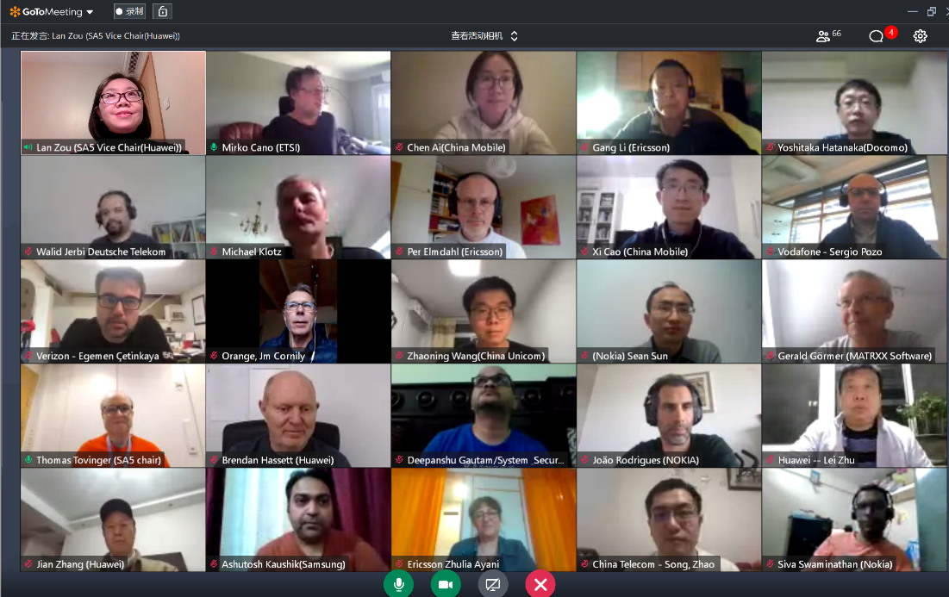
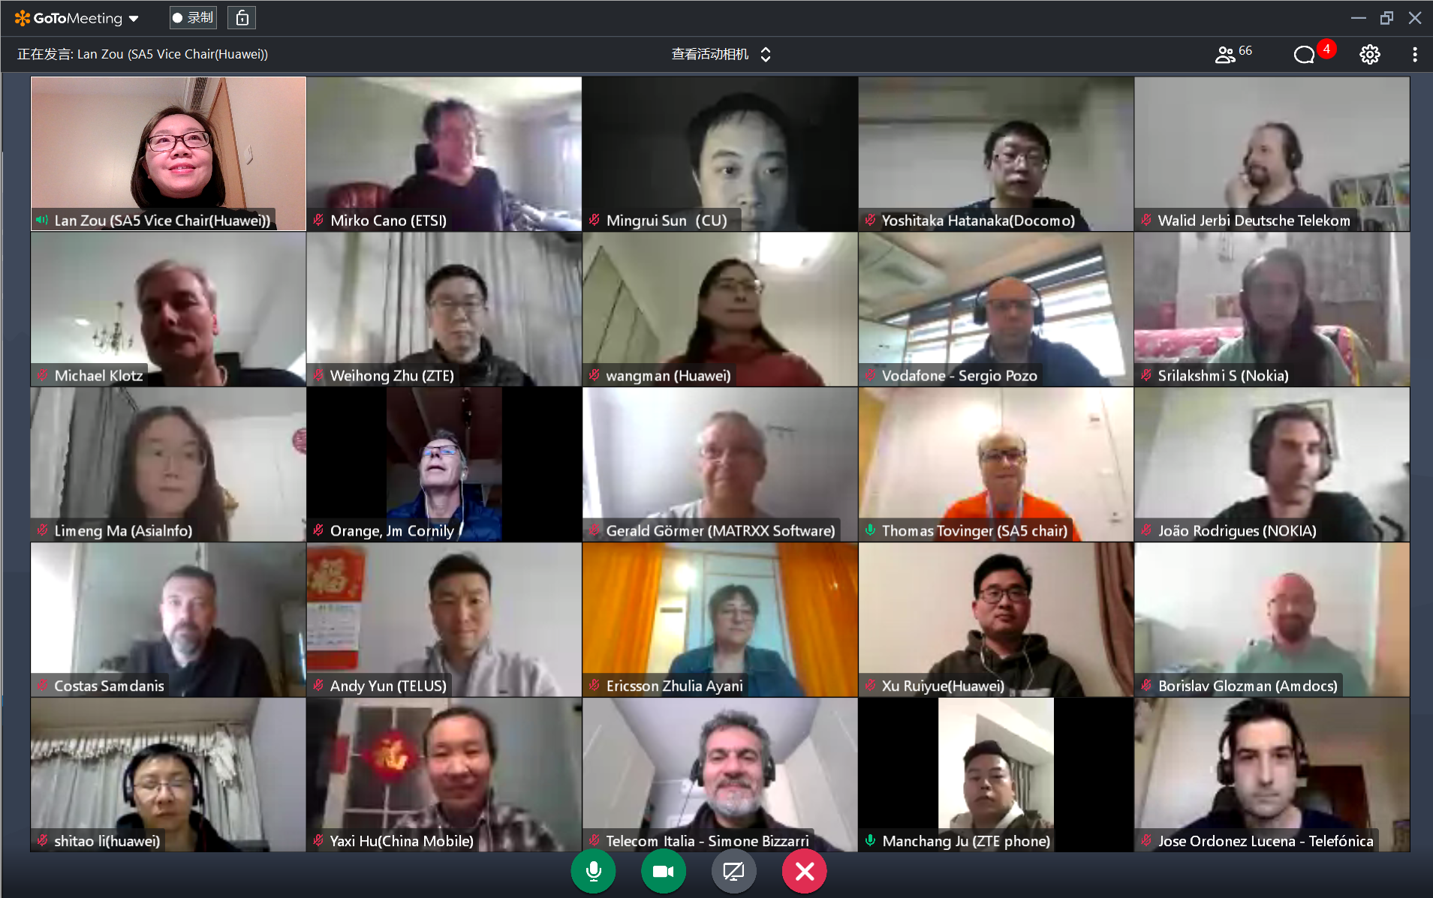
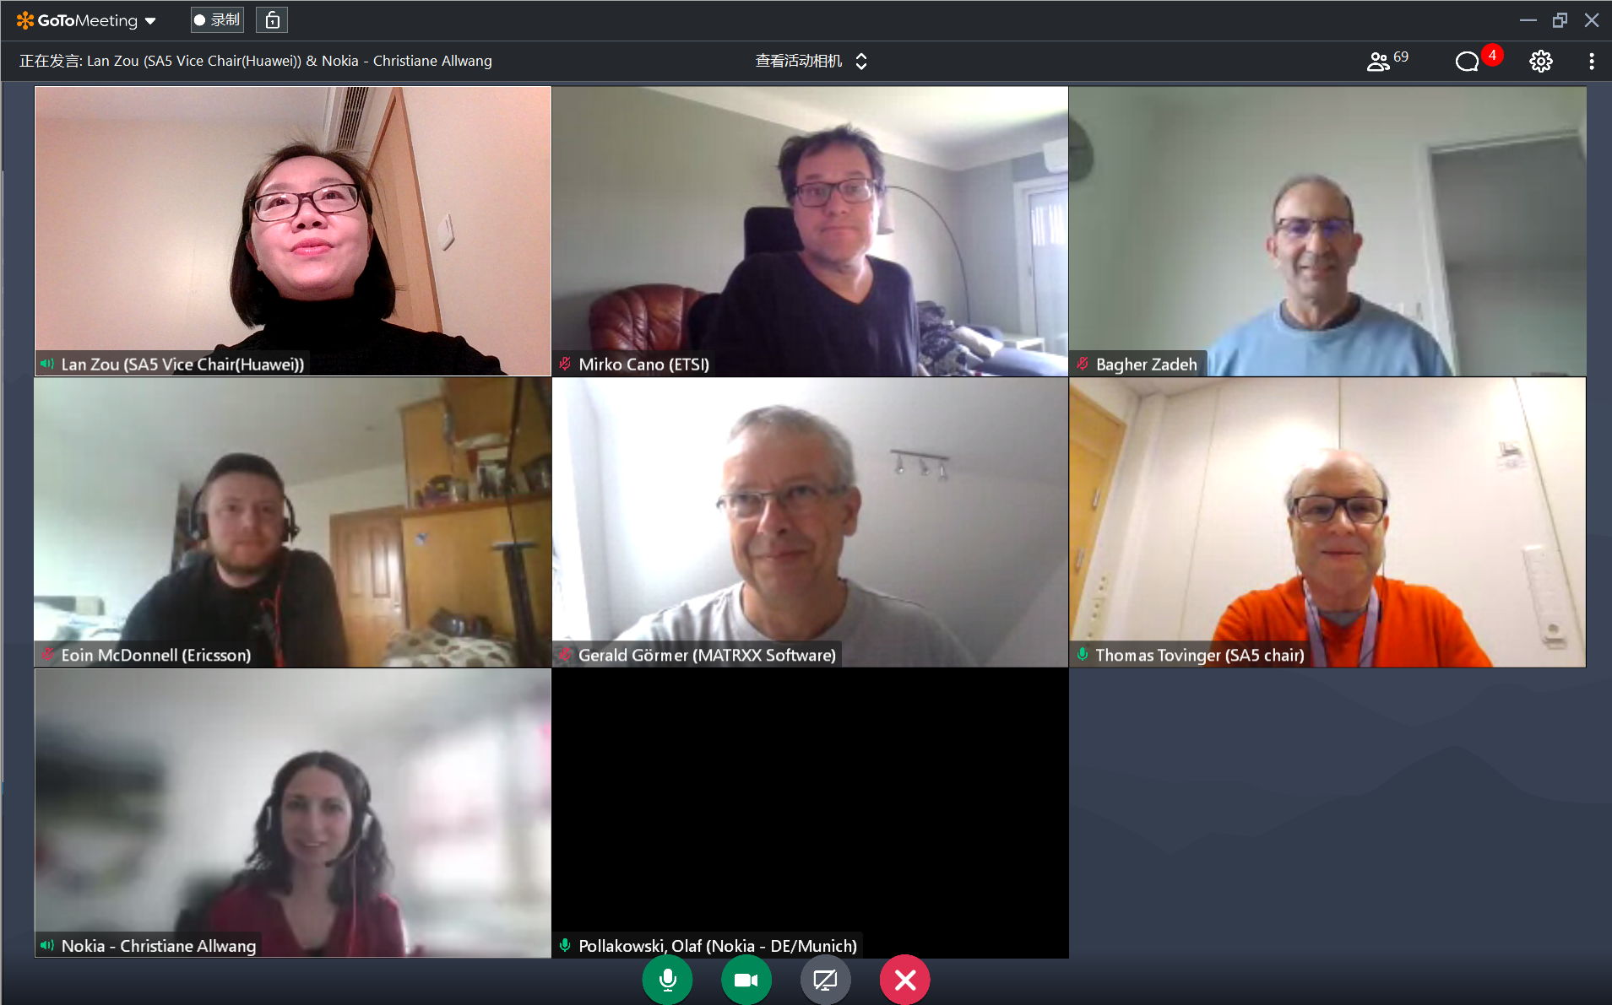
Thank you!

Slide 29
3GPP SA5 Time plan
SA5 time plan:
S5-221173 Rel-18 time plan proposal for OAM (Endorsed)
  SA5 OAM Release 18 planning：
  Mar 2022 (TSG#95): SA5 SIDs/WIDs specified
  Sept 2022 (#97) and Dec 2022 (#98): SA5 SID concluded and Rel-18 WID started if needed
  Mar 2023 (TSG#99): Stage 1 work freeze
  Sep 2023 (TSG#101): Stage 2 Functional work Freeze and stage 3(OAM/CN related), provide inputs to CT
  Dec 2023 (TSG#102): Stage 2 Functional work Freeze and stage 3 (RAN related)
  SA5 OAM Release 19 planning：
  After Jun 2023 (TSG#100): start of Rel-19 planning
  Sep 2023 (TSG#101): Start of Rel-19

Slide 30
Release 18 timeline – figure with SA5 OAM
2021
Now
2022
2023
2024
TSG#
91
92
93
94
95
96
97
98
99
100
101
102
103
104
Stage 1 (SA1)
Rel-18 Content def.
Content def. RAN4
Prio
Stage 2 (SA2, SA6,…)
RAN1
RAN Completion (RAN2, RAN3, RAN4 core)
Stage 3 (CT & SA)
ASN.1 & Open APIs
RAN4 performance
Studies (SA5 OAM)
Stage 1 (SA5 OAM)
Stage 2 Functional and stage 3 work (OAM/CN related),
provide inputs to CT
SA5 OAM Rel-18 Timeline
Stage 2 Functional and stage 3 work (RAN related)
SA5 OAM Rel-19 Timeline
Rel-19 planning
Start of Rel-19
Note: starting dates are indicative

