Slide 1
3GPP SA5 Forge repository structure proposal
SA5#132e, 17 Aug – 28 Aug,2020 e-meeting
Zou Lan, SA5 Vice Chair

Slide 2
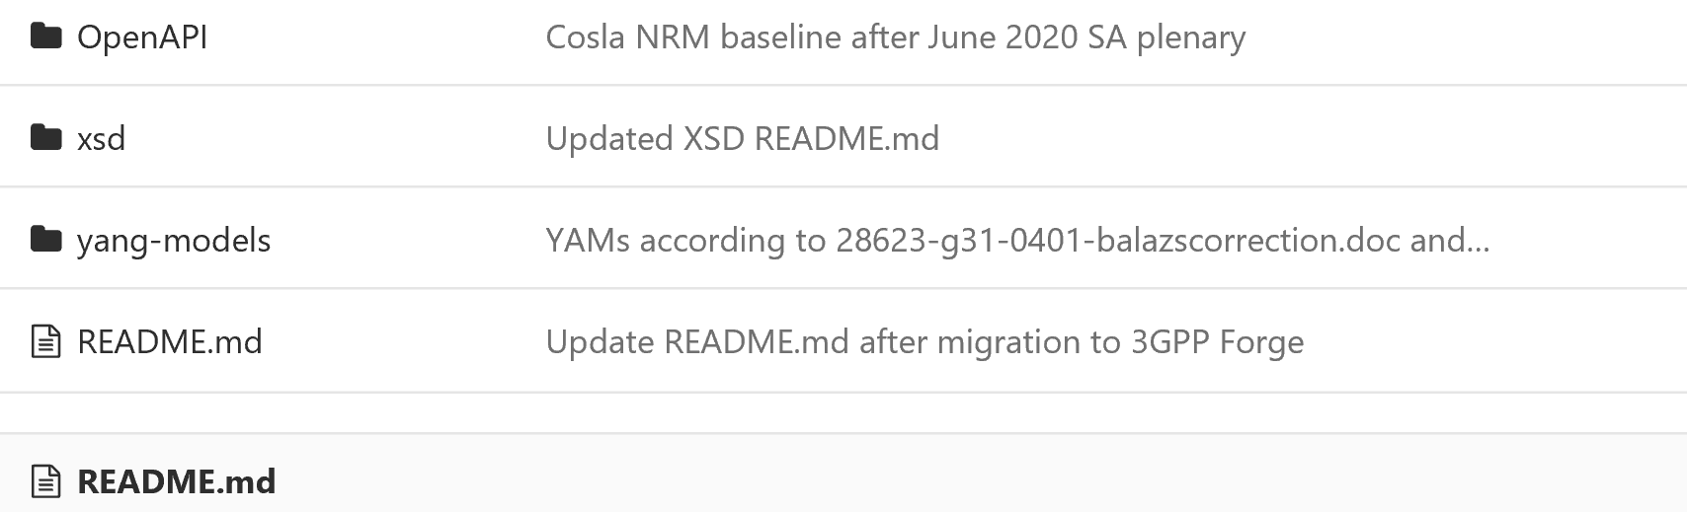
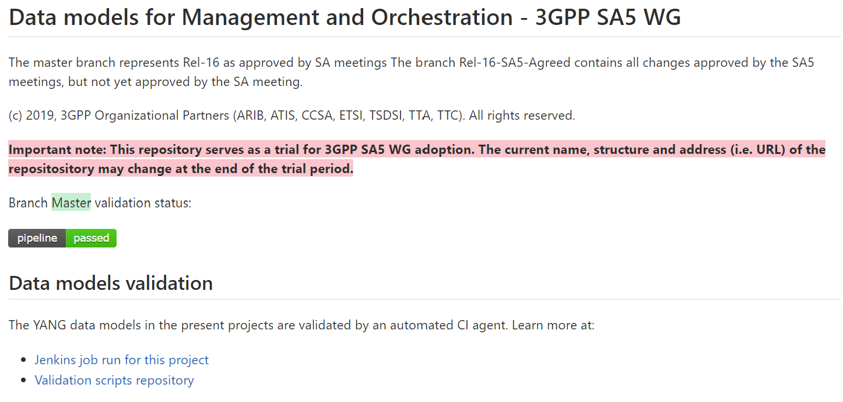
Current layout of 3GPP Forge for SA5
SA5 - Management and Orchestration
https://forge.3gpp.org/rep/sa5
Trial – SA5 Data models
https://forge.3gpp.org/rep/sa5/data-models
Issues:
“Trial-SA5 data model” needs to be renamed.
Website link “data-models” also needs to be updated.
There is no differentiation of Rel-16 and Rel-17

Slide 3
Proposal layout of 3GPP Forge for SA5
SA5 - Management and Orchestration
https://forge.3gpp.org/rep/sa5
Management and Orchestration APIs
https://forge.3gpp.org/rep/sa5/MnS
https://forge.3gpp.org/rep/sa5/MnS/tree/Rel-16
Rel-16
Rel-17
https://forge.3gpp.org/rep/sa5/MnS/tree/Rel-17

Slide 4
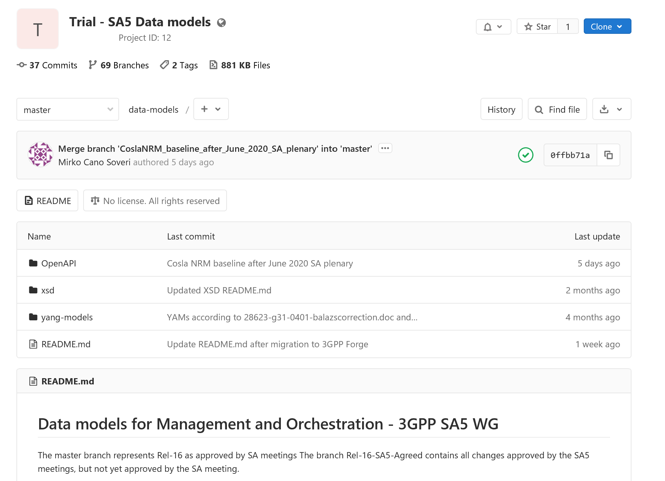
Modification proposal of 3GPP Forge for SA5
3. Rename to “management and Orchestration APIs”
1. Rename to “Management and Orchestration APIs”
2. create Rel-16 branch now (spawn off master) and
spawn Rel-17 once we publish something with v.17.x.x.
4. Revise the text to “The Rel-16 branch represents the latest Rel-16 content approved and published after each TSG SA plenary.”

Slide 5
Summary of use 3GPP forge for SA5
“master” branch
  dynamic and represents the current “work in progress” release (whatever SA5 works on today)
“Rel-16” branch
  is semi-dynamic and represents the latest (updated after each SA plenary) status of the release 16 published code (e.g. content extracted from 16.x.x MS Word documents)
“Rel-17” branch
  is semi-dynamic and represents the latest (updated after each SA plenary) status of the release 17 published code (e.g. content extracted from 17.x.x MS Word documents)
“tag” branch:
  “SA88-Rel16” (Anatoly created this one) is a “tag” branch – it’s static (does not change) and represents read-only snapshot of the Rel-16 content approved/published after SA88 plenary
  We will need “SA88-Rel16”, “SA89-Rel16”, “SA89-Rel17”, “SA90-Rel16”, “SA90-Rel17” later… to be created/published after each SA plenary
Rel-15 or other branch:
  Whether we need to touch/create any Rel-15 or SAxx-Rel15 branches depends on SA5 decision to publish (or not) Rel-15 content…

Slide 6
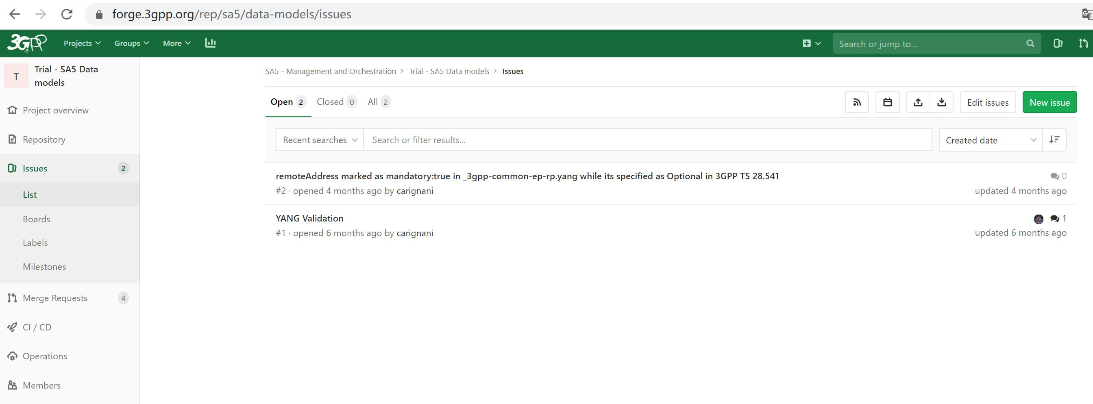
Proposal handling of Non-3GPP member request to 3GPP Forge
How non-3GPP member report 3GPP Forge issue？
https://forge.3gpp.org/rep/sa5/data-models/issues
Proposal:
Non-3GPP members could provide issue in 3GPP forge. (Whether reporting issue in 3GPP forge is allowed by non-3GPP members?)
Need a 3GPP SA5 contact regularly check the new issues and coordinate in 3GPP SA5 for feedback solutions/recommendations.
3GPP members are volunteered to provide related contributions for the update of 3GPP specifications.

Slide 7
For discussion and endorsement
Page 3: Proposal layout of 3GPP Forge for SA5
Page 6: Proposal handling of Non-3GPP member request to 3GPP Forge

