Slide 1
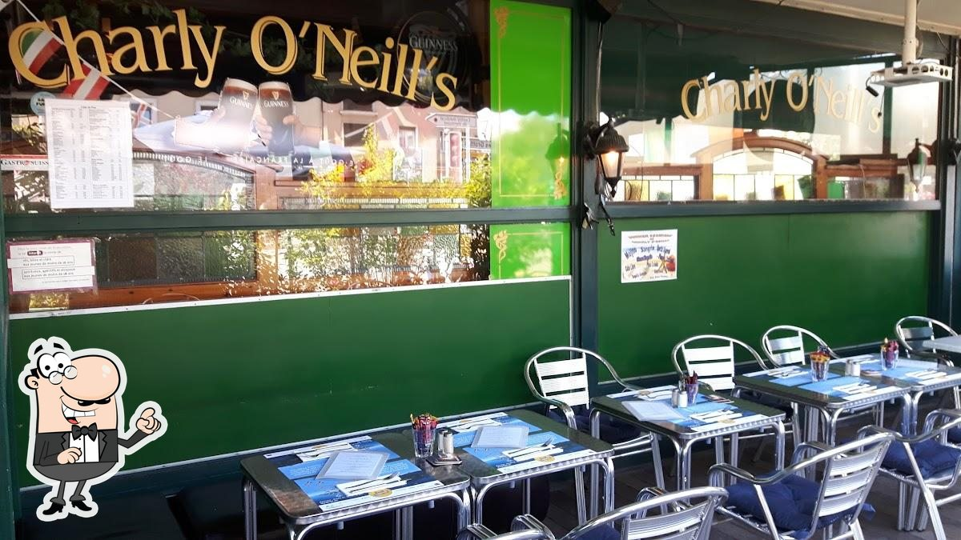
Social Gathering during SA4#131
Thursday, February 20 2025 at 1930

Slide 2

Details
SA4 Colleagues,
to continue the good spirit of social gatherings, here is a proposal for another self-funded social event at SA4#131. Everyone is invited, and I have a pre-reservation for 40-50 people. The event is flexible, but I would like to get a good estimate of the number of people showing up to speak with the location owner.
We got great support from locals (many of them are out this week as there is school vacation). We have a highly recommended Irish pub Charly O'Neills Irish Pub. And as a nice side effect, this pub will host band on tour stopping in Geneva this week, known as "The Ambisonics".
The place will be walk-in, drink and eat for yourself. However, in order to pre-reserve properly, please let us know if you will join.
Please send your reservation here.
Date and Schedule:
February 20, 2025
Meet there from 19:30 onwards, concert will start at around 20:45.
Directions from EBU (20min on bus 8)
Costs:
No costs, payment at site
Feel free to invite other locals and friends.
The SA4 social event team (Thomas and Chairs)

Slide 3
