Slide 1
Brief report from SA#106 on SA4 topics
Frédéric Gabin, SA4 Chair, Dolby France SAS (ETSI)
SA4#131, Geneva, Switzerland, 17-21 February 2025
Tdoc: S4-25xxxx

Slide 2
Outline
General information
Outcome of SA4 submissions
Guidance to SA4
Planning

Slide 3
General information
General:
  3GPP TSG SA#106 took place 10-13 December 2024 and was hosted by ETSI in Madrid, Spain.
Inputs
  The SA#106 documents: https://www.3gpp.org/ftp/tsg_sa/TSG_SA/TSGS_106_Madrid_2024-12/Docs
Reports
  SA#106 report: https://www.3gpp.org/ftp/tsg_sa/TSG_SA/TSGS_106_Madrid_2024-12/Report
  SA4 report to SA: SP-241671
  RAN report to SA: SP-241911
  CT report to SA: SP-241892
  Workplan: SP-241881

Slide 4
Outcome of SA4 submissions (reports)
SP-241459 (REPORT) SA WG4 report to SA#106 (Source: SA WG4 Chair)
Document for: Presentation
Abstract:
SA WG4 report to SA#106. https://www.3gpp.org/ftp/tsg_sa/TSG_SA/TSGS_106_Madrid_2024-12/Docs/SP-241459.zip
Questions and comments:
Slide 36: Approval is requested for the IVAS fixed-point Decoder and Renderer 90% delivery (SP-241766).
The SA WG4 Chair was thanked for this report, which was noted.
Status: Noted.
SP-241671 (REPORT) SA WG4 SWG Reports (Source: SA WG4 Secretary)
Document for: Information
Abstract:
SA WG4 SWG Reports.
Plenary Discussion:
This was provided for information and was noted.
Status: Noted.

Slide 5
Outcome of SA4 submissions (reports)
SP-241766 (REPORT) IVAS Codec testing report (Source: SA WG4)
Document for: Approval
Abstract:
IVAS Codec testing report.
Plenary Discussion:
This report was approved.
Status: Approved.
SP-241886 (TOR) Proposed Updated Terms of Reference for SA WG4 and Sub Working Groups (Source: SA WG4)
Document for: Approval
Abstract:
SA WG4 SWG Reports.
Plenary Discussion:
This updated ToR was approved.
Status: Approved.

Slide 6
Outcome of SA4 submissions – (New WIDs) - 1
SP-241672 (WID NEW) New WID on 5G Real-time Transport Protocol Configurations, Phase 2 (Source: SA WG4)
Document for: Approval
Abstract:
New WID on 5G Real-time Transport Protocol Configurations, Phase 2.
Plenary Discussion:
MediaTek commented that objective 5 mentions coordination between SA WG2 and RAN WG2 but as the results of this is uncertain, the note should reflect that it is subject to normative work done in SA WG2 and RAN WG2. This was revised to SP-241961.
This new WID was approved.
Status: Approved.

Slide 7
Outcome of SA4 submissions – (New WIDs) - 2
SP-241673 (WID NEW) New WID on Diverse audio CApturing system for Smartphone devices (Source: SA WG4)
Document for: Approval
Abstract:
New WID on Diverse audio CApturing system for Smartphone devices.
Plenary Discussion:
This was revised to add the TS number in SP-241962.
This new WID was approved.
Status: Approved.

Slide 8
Outcome of SA4 submissions – (New WIDs) - 3
SP-241674 (WID NEW) New Work Item on Architectural Updates for Advanced Media Delivery (Source: SA WG4)
Document for: Approval
Abstract:
New Work Item on Architectural Updates for Advanced Media Delivery.
Plenary Discussion:
The completion dates should be corrected and more supporting companies requested to be added. The TD title should be corrected. This was revised to SP-241963.
This new WID was approved.
Status: Approved.

Slide 9
Outcome of SA4 submissions – CRs, TS/TRs -
Except for the CR below, all SA4 CRs, TS and TRs submitted for approval were approved/noted as is.
SP-241587 (CR) 26.512 CR0084R2 (Rel-18, 'F'): [5GMS_Pro_Ph2] Canonical 5GMS AS host name for universal Media Entry Point URL embedded in portable Service URL (Source: BBC, Qualcomm Incorporated)
Document for: Approval
Abstract:
Company contribution that additionally updates 3GPP Forge version tags in annex C to 'TSG106-Rel18'.
Comment: Revision of S4-242103.
Plenary Discussion:
This CR was approved.
Status: Approved.
SP-241742 (CR PACK) CR Pack on 5GMS_Pro_Ph2 (Source: SA WG4)
Document for: Approval
Abstract:
26.512 CR0081R3; 26.510 CR0010R1; 26.512 CR0083R3; 26.512 CR0084R1; 26.510 CR0012R1.
Plenary Discussion:
26.512 CR0084R1 was considered as revised. The remaining CRs in this CR Pack were approved. (This CR Pack was partially approved).
Status: Partially approved.

Slide 10
Guidance and actions to SA4
March 2025 3GPP 6G Workshop: Agenda and Details: SP-241737
SA WG Rel-20 5G-A capacity consolidated information: SP-241907
5GA Guidance to SA2: SP-241989
Acronyms MCC (see next slide): SP-241990
IETF dependencies (see next slides): SP-241893
CT tracking of OpenAPI changes from other WG (see next slides): SP-241892
SA4 should provide the workload split between Rel-20 5GA/FS_6G at TSG SA#107 (March 2025)

Slide 11

Endorsed by SA#106
For all normative WIDs, use the following suffixes and names :
Group/topic | Acronym’s Suffix¹ | WI Name’s prefix⁴
SA1 | -REQ | Stage 1 for
SA2 | -ARC | Stage 2 for
SA3 | -SEC | Security for
SA3 Lawful Intercept | -LI | Lawful Intercept for
SA4 | -MED | Media aspects for
SA5 for Management | -OAM | OAM for
SA5 for Charging | -CH | Charging for
SA6 for Mission Critical | -MC | Stage 2 for
SA6 for Application Enablement and Framework | -APP | Stage 2 for
CT WGs² | -CT | CT Aspects for
RAN’s Core Part | -Core | Core Part:
RAN’s Perf Part | -Perf | Perf. Part:
RAN’s UE Conformance Testing | -UEConTest | UE Conformance -
¹Mandatory. The suffix comes completely at the end,, even after the “_PhN”, e.g. “5GSat_Ph3-S2”
²can also be WG-specific if necessary, e.g. ‘-CT1’ and “CT1 aspects for”, etc.
⁴ Recommendation. Can differ as needed
For normative WIDs, the sign “-” shall be used ONLY for the suffixes above & forbidden at other places.
For study WIDs, “-” is forbidden. The suffixes can still be used (optional). If so, use “_” (e.g. _REQ)

Slide 12

Reminder on IETF dependencies (SP-241893)
Reminder
  To allow tracing of all IETF drafts referenced in 3GPP specifications
  IETF dependencies newly introduced in a 3GPP specification should be reported to the workplan manager by the 3GPP WG chairs.
  IETF Coordinator will trace the progress of the IETF draft
  The workplan manager will add a line to the workplan for each IETF draft.
  The workplan manager will mark the task as completed once the IETF draft becomes an RFC and the RFC is referenced in the 3GPP TS

Slide 13
Referenced Expired drafts (2/3)
draft-bhutton-json-schema-01
  Title: JSON Schema: A Media Type for Describing JSON Documents
  Status: Last version published in 06/2022
  Expired internet draft, SA4 and SA5 referenced older versions in TS 26.346, TS 26.348, TS 32.158 and TS 32.160
Note: The JSON Schema TSC ( https://json-schema.org/slack ),it is open if a new draft will be provided to IETF.
The latest versions of JSON Schema can be found here: https://json-schema.org/specification
Copyrights do not allow 3GPP to reference. 3GPP need to reference the expired draft version on IETF server.

Slide 14
Referenced Expired drafts (3/3)
draft-bhutton-json-schema-validation
  Title: JSON Schema Validation: A Vocabulary for Structural Validation of JSON
  Status: Last version published 06/2022
  Expired internet draft, SA4 referenced in TS 26.510 and TS 26.512 , SA5 referenced older versions in TS 32.158 and TS 32.160
draft-handrews-json-schema-hyperschema
  Title: JSON Hyper-Schema: A Vocabulary for Hypermedia Annotation of JSON
  Status: Last version published in 09/2019
  Expired internet draft, SA5 referenced older versions in TS 32.158 and TS 32.160

Slide 15
CT Information to TSG SA (1/2)
For 5G APIs, if there are URI query parameters defined as array or JSON object, the format of the query parameters shall be documented in the corresponding yaml file (see clause 5.3.13 of TS 29.501). However there are some specifications fail to follow this rule, which may lead to interoperability issues.
In TS 29.501 it is clarified that if the formatting definition is missing from the yaml file, the default format defined in TS29.501 shall apply. In addition, CT requests rapporteurs shall bring CRs (from Rel-19 onwards) to add the formatting definition (if missing).

Slide 16
Information to TSG SA (2/2)
In CT we are using standardized format for Software versioning (format: Major. Minor.Patch). CT noted that the check to identify OpenAPIs which are changed due to a change of a definition which is imported from a different TS/OpenAPI. CT agreed to run a trial on a tool developed by MCC to identify them. MCC will run the tools and provide an excel list containing effected OpenAPIs. Rapporteurs are asked to check this file and provide the related version update CRs. The tool expects that a CR list on the cover page the OpenAPIs impacted by a datatype change. The tool provided at forge.3gpp.org/swagger/tools/types.html provide the list to be added on the CR cover page.
CT WG chairs are asked to provide feedback on the tool to next plenary.

Slide 17
Releases 19 to 21 timelines
Note: All starting dates are indicative
2024
2025
2026
2027
2028
2029
TSGs
#103
#104
#105
#106
#107
#108
#109
#110
#111
#112
#113
#114
#115
#116
#117
#118
#119
#120
#121
#122
#123
#124
#125
#126
Mar.
Jun.
Sep.
Dec.
Mar.
Jun.
Sep.
Dec.
Mar.
Jun.
Sep.
Dec.
Mar.
Jun.
Sep.
Dec.
Mar.
Jun.
Sep.
Dec.
Mar.
Jun.
Sep.
Dec.
Stage 2
SA1 St.1, Content Definition (RAN & SA St.2): completed Dec. 2023
RAN Completion**
ASN.1
&
Open
APIs
*: +3 months for RAN4
**: - 3 months for RAN1 &
+ 3 months for RAN4 perf
Release 19
Stage 3 (CT & SA)
5GA Stage 1
Release 20 5GA
5GA Stage 2
5GA RAN Completion**
Chart showing Normative dates
(timeline for 5GA studies not shown)
5GA Stage 3
FS_6G Stage 1
Release 20 FS_6G
FS_6G RAN P
FS_6G Stage 2
or
Chart showing Studies dates
(no 6G normative work in Rel-20)
FS_6G RAN WG**
FS_6G Stage 3
TBD
Rel-21 timeline to be decided no later than June 2026
ITU deadlines for 6G: March 2029 for technology proposal, mid-2030 for specifications
Release 21 6G
Now

Slide 18
Release 19 timeline
2023
2024
2025
2026
TSGs
#99
#100
#101
#102
#103
#104
#105
#106
#107
#108
#109
#110
#111
#112
Mar.
Jun.
Sep.
Dec.
Mar.
Jun.
Sep.
Dec.
Mar.
Jun.
Sep.
Dec.
Mar.
Jun.
SA1 Stage 1 80%
100%
RAN Rel-19 workshop
RAN Content def.
RAN4
content def.
SA Rel-19
Workshop
St.2 Content approval
Stage 2 (SA2, SA6,…) Normative
RAN1
RAN Completion (RAN2/3/4core)
RAN4_Perf
Stage 3 (CT & SA)
ASN.1 & Open APIs
Note: All starting dates are indicative
Now

Slide 19
Release 20 5GA timeline
Note: All starting dates are indicative
2024
2025
2026
2027
TSGs
#113
#114
#102
#103
#104
#105
#106
#107
#108
#109
#110
#111
#112
#115
#116
Dec.
Mar.
Jun.
Sep.
Dec.
Mar.
Jun.
Sep.
Dec.
Mar.
Jun.
Sep.
Dec.
Mar.
Jun
SA1 5GA SID definition
SA1 5GA Studies + Norm 80%
100%
St.2 SID def.
St. 2 (SA2, SA6, …) 5GA St.+Norm 80%
100%
Workshop 5GA SA
RAN WG SID def.
RP Content def.
RAN4 C.def.
Workshop 5GA RAN
RAN1
RAN Completion (RAN2/3/4core)
RAN4 Perf
St.3 SID def. TBD
Stage 3 5GA St + Norm
5GA ASN.1 & Open APIs
Now

Slide 20
Release 20 (FS) 6G timeline
Note: All starting dates are indicative
2024
2025
2026
2027
TSGs
#113
#114
#102
#103
#104
#105
#106
#107
#108
#109
#110
#111
#112
#115
#116
Dec.
Mar.
Jun.
Sep.
Dec.
Mar.
Jun.
Sep.
Dec.
Mar.
Jun.
Sep.
Dec.
Mar.
Jun
SA1 6G SID def.
SA1 6G Study(ies)
Workshop IMT-2030 use cases
RP IMT-2030 disc.
RP ITU Study
RP 6G Study(ies)
Workshop 6G TSGs
SA2 & RAN WGs 6G SID def.
SA2 6G Study(ies)
or
RAN1 6G Study(ies)
RAN2/3/4 6G Study(ies)
SA3/4/5/6 6G SID def. TBD
SA3/4/5/6 6G Study(ies)TBD
CT & St. 3 6G SID def.
Stage 3 6G Study(ies)
TBD
Now

Slide 21
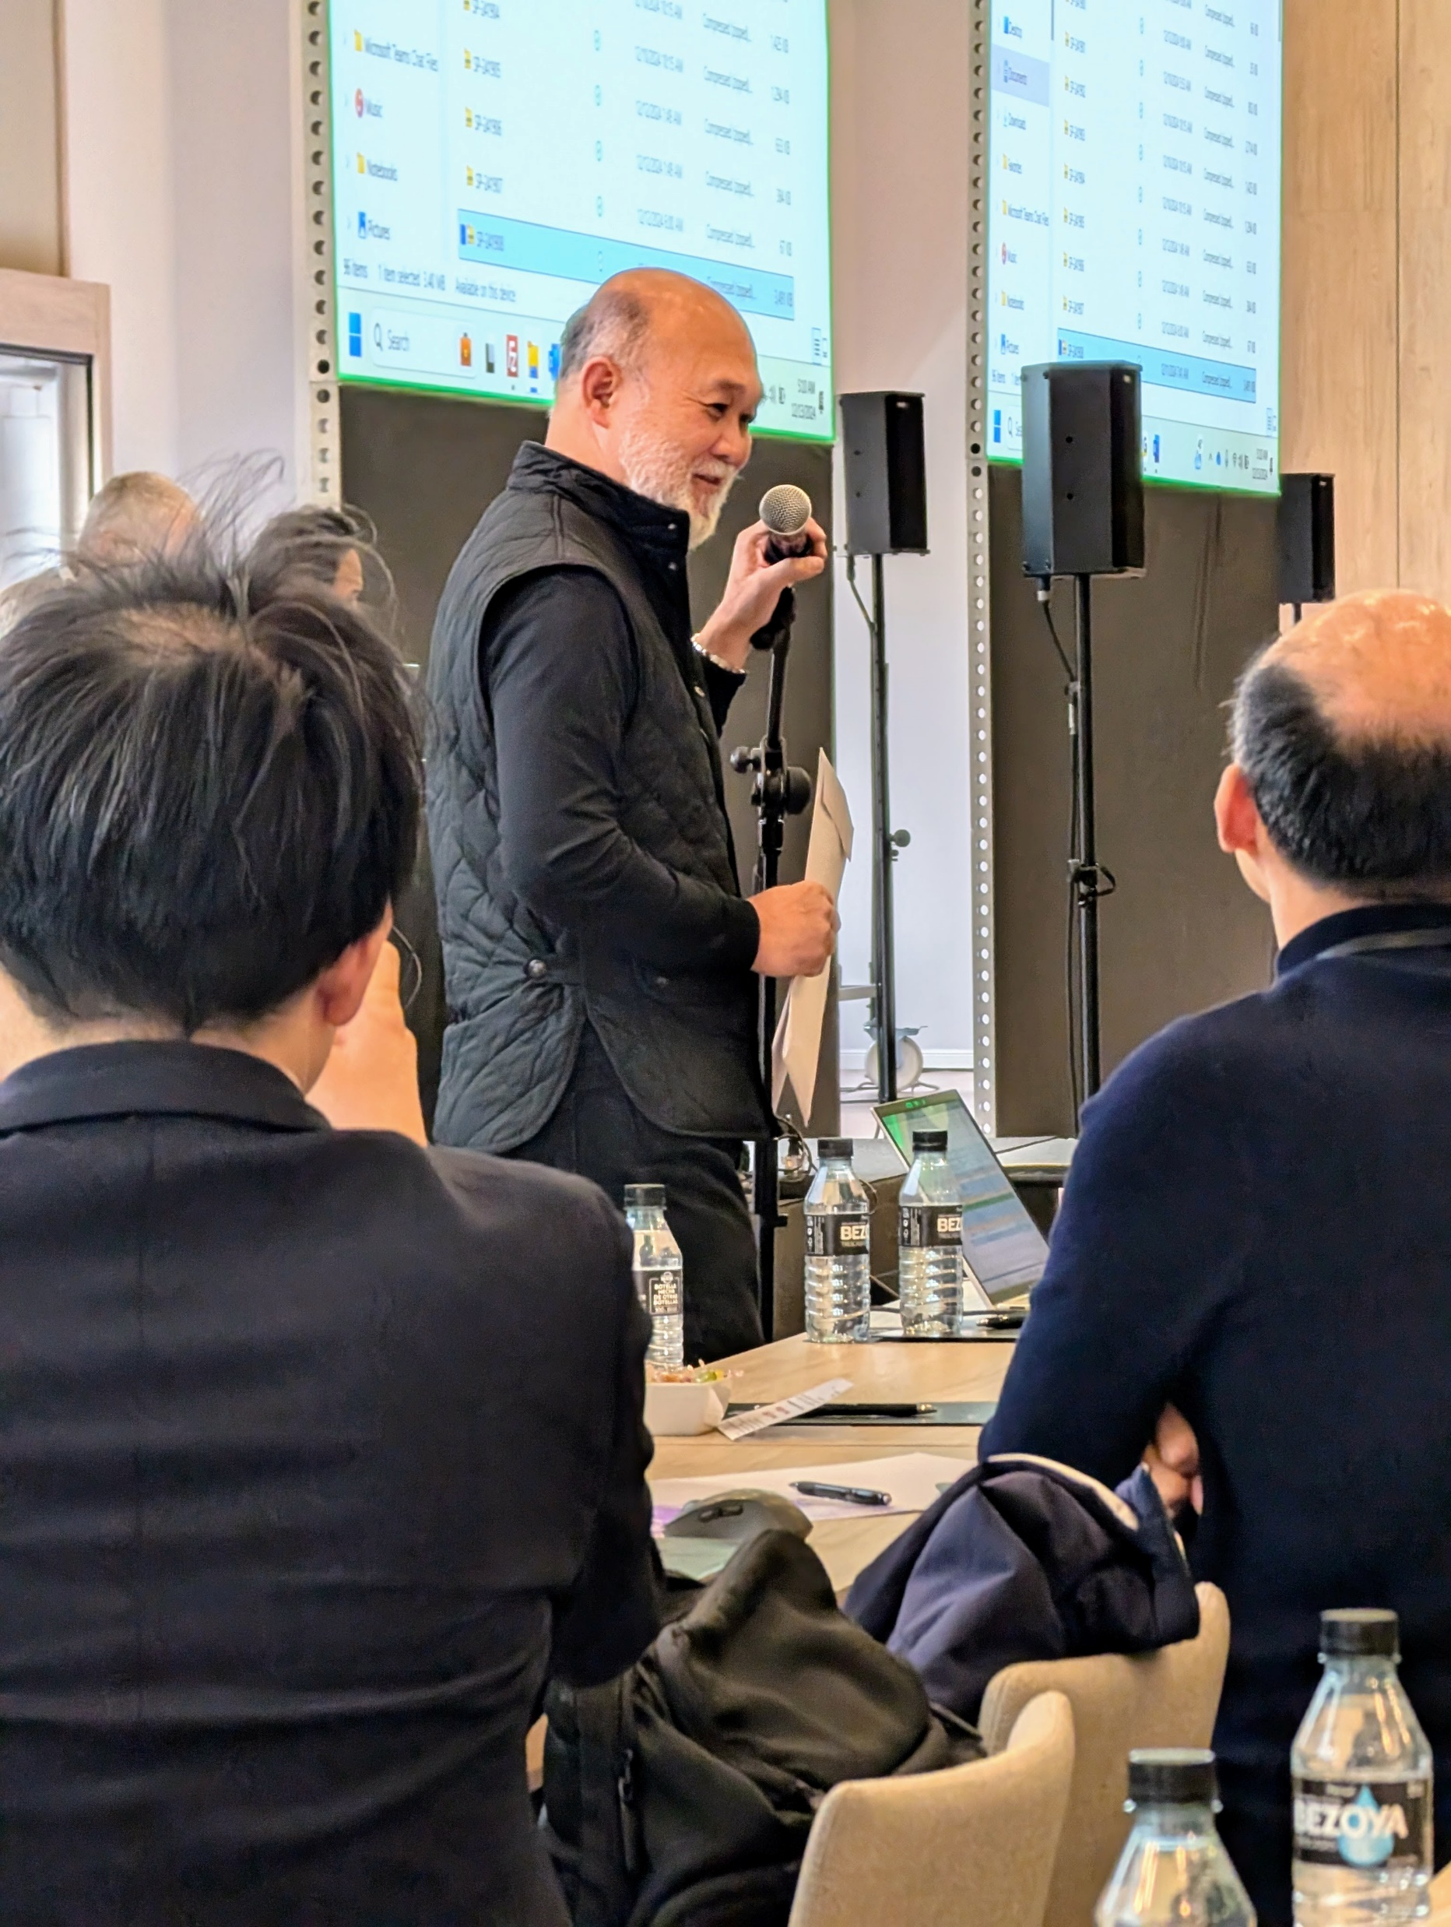
Thank You!
And all the best to Gerry Libunao !
Frédéric Gabin
3GPP SA4 Chair
mail: frederic.gabin@dolby.com
phone: +33 678448575

