Slide 1
Early Thoughts on Rel-20 5GA and 6G
3GPP TSG-SA4 Meeting #131 S4-250143
Geneva, Switzerland, 17th Feb 2025 - 21st Feb 2025
Source: Qualcomm Incorporated
Agenda Item: 6.1
Document for: Discussion and Agreement
tsto@qti.qualcomm.com

Slide 2
Vision
3GPP SA4 should be well-recognized for important media-related specifications:
Developer-friendly: APIs, code, examples, git-environments, exchange with developers
Implementability of the specifications (test, evaluation, code, reference software)
addressing market needs, deployment feasibility, sustainability, innovation platform, monetization opportunities, cost-conscious
Timeliness: allow things to do quicker, do things at the right time, leave time to address essential work
Develop specifications against meaningful KPIs for media services
Collaboration with the industry and market representation partners
Generally, build on the principles established in the 5G era and evolve (or adapt) based on experiences and learning

Slide 3
(Un)-Successful Projects in 3GPP SA4 – the media WG for 6G
Success defined by commercial adaption
Courtesy of Frederic Gabin

Slide 4
Reference Implementations and Software
Do we need reference/evaluation implementation of 3GPP defined technologies?
Validation and Verification of the Standard/specification
Allows early demos and proof-of-concepts
Minimizes the barriers to introduction of new technologies
Can be used as reference for more optimized implementation in SW or HW
Shares the efforts across multiple companies contributing to the standards
Can be used in production and commercial services
transparency and trust as literally you can open the code and inspect it

Slide 5
Planning of new work
Start of new work could benefit from good preparation – Rel-19 planning in SA4 was a good step forward, re-use and improve
5GA and FS_6G planning should have dedicated time slots in the near future
We propose to have either a f2f meeting or an online meeting prior to SA4#133-e (July 2025)
Could be a series of online workshops to collect ideas from members about potential 5GA and FS_6G topics
Submission of new work is beneficially based on common template/check box
A template was proposed and partially used during the Rel-19 planning (see for example S4-250016)
A new study item submission is encouraged to include
Expectation of type of study: New exploration, continuation of existing specification, others
Realistic Time and Work Plan
Vision for normative work: What is expected to happen after study is complete (stage-2, stage-3, OpenAPIs, code, etc.)
Supporters, preferably with individuals that can be contacted for more information
Plans for usage of software and evaluation tools
Some sort of indication for market needs, commercial relevance, if possible.
Such an approach allows for consistency in submission and reduces online discussion times
We recommend to to discuss use of software, data sets, tool-based specifications for stage-3 (OpenAPI, etc.), etc. based on existing experiences in Rel-19.
This may include to rely on external organizations such as 5G-MAG

Slide 6
Selected Topics
5G Advanced and 6G Vision

Slide 7
Concrete ideas for Rel-20 5GA
Planning not yet complete, but at least an indication
Avoid starting substantial new topics in Rel-20 5GA unless required by SA1/SA2
Continue normative work on studies not yet completed in Rel-19, e.g. for
Advanced Media Delivery (see remaining Key Issues and possibly new ones)
Avatar Representation phase 2
VOPS and Beyond2D (extensions to VOPS)
For AI4media, if we focus on commercially relevant use cases
Acoustics-related topics (ATIAS and DACAS), if not completed in Rel-19
To 5GA, only studies should be added for which the core work can be completed in a normative work phase in Rel-20

Slide 8
Rel-19 planning
What’s happening?
Study? Normative Work? Done? Candidates.
Assumptions:
Initially no normative work in Rel-20, all studies
Rel-19 work with normative follow is considered Rel-20 study
Start of independent normative work is highly discouraged.

Slide 9


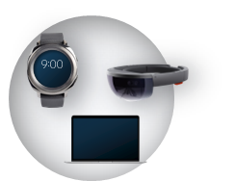
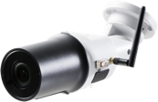
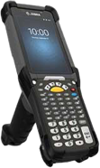
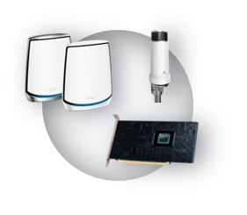

Fundamental 6G motivation
Operators networks
Increasing revenue with new use cases/services
Reducing network TCO (total cost of ownership)

Slide 10


Enhanced and New Experiences
Sustainability
More details in Backup
Advancements in underlying technology, new services enabled by them & a holistic look at sustainability will drive the 6G design

Slide 11
A vision for 6G
Preliminary thoughts: priorities – value add for Operators and Service Providers
Full-body Avatar communication ➔ Avatar Communication Service (Quality, Devices, etc.)
Video Codecs
How to deal with external next-generation video codecs?
Do we have specific scenarios and use cases from mobile/3GPP for new codecs?
Audio Codecs (very-low bitrate supporting satellite) and NTN media
AI-based media compression and work flows ➔ how can collaboration be done
Advanced Media Delivery ➔ Media Distribution architecture (with other orgs)
Trusted and private communication and media in GenAI era
6G Media Messaging – Media formats and interoperability
Gaussian Splats – use cases, work flows, user generated content
User-experience based services and traffic analysis
More details in Backup for Pink Topics
Notes:
from “C-sim” to “C-sim+ training framework+training data+quantization+environment”
an ML-based codec Csim is similar to an executable: you can run it, but you cannot modify it, and you are limited in optimizing it. To have the same functionality as a C codec implementation used to give you in the pre-ML days, you will need:
The ML-based codec weights and Csim
The training framework
The data used for training
The quantization framework
An environment, e.g. using Docker, so that everybody has the same package versions etc.

Slide 12
Considerations for promotion and success tracking
Maintain a table of features in SA4 and track their commercial success based on table in slide
Improved joint promotion of 3GPP SA4 work in 3GPP, in our companies and in public
Create a common slide deck for 3GPP SA4 promotion and maintain the slide deck to be accessible
ask rapporteurs to create ONE to TWO slides to be added to the common deck during or after completion of a study or work.
In the long term, ask leadership and/or have designated responsible people/teams for
General improved 3GPP SA4 promotion and messaging
working with 3GPP Marcom, MRPs (5G-MAG), partners (GSMA, etc.) and identify what can be done within 3GPP and what should be done outside (LinkedIn, Blogs, Publications, opportunities, presentations, shows, demonstrations, surveys)
Consider organizing regular industry workshops (one per Release) to promote 3GPP SA4 and to collect input from external (attached to some event) such as previous Ecosystem & Standards workshops (including other 3GPP WGs)

Slide 13
Proposals for 5GA and FS_6G planning
5GA and FS_6G planning should have dedicated time slots prior to SA4#133-e (07/2025)
A first batch (at most 50%) of 5GA and FS_6G studies may be agreed for SA#109 (09/2025) and a second batch may be agreed for SA4#110 (12/2025)
Note: exact workload will depend on requested exceptions and overspills from Rel-19 – less is probably more.
FS_6G planning requires to take into account
planning on the transition of 5G media services (RTC, MBS, 5GMS) to 6G.
Potential new media related service requirements (communication with SA1 may be needed)
Input from external sources – is there any way to collect new context from MRPs, partners, industry
Improved working procedures: We recommend to establish a team/task force to discuss use of software, data sets, tool-based specifications for schema/OpenAPI and so on based on existing experiences in Rel-19.
Proposal on split between 5GA and FS_6G:
5GA studies (or normative work under exceptions) should have at most 50% of the workload in SA4
To 5GA, only studies/work should be added for which the core work can be completed in a normative Rel-20 work phase
Submission of new work is beneficially based on common template/check box (details see earlier)

Slide 14
Based on our initial input we look forward to collaborate on shaping an input of 5G-MAG into 3GPP for 6G

Slide 16
Use Cases and Fundamental Technologies

Slide 17


Next Generation Broadband
Description: Use cases requiring significantly higher peak data rates and user experience than those that are supported in 5G
Backhaul for Wireless Data Centers
Wireless Fiber to Home

Slide 18


Immersive Platforms and Services
Description: Use cases involving high data rate and very low latency for supporting multimedia, highly immersive and multi sensory interactions
Other Examples:
Metaverse Gaming/Entertainment and Collaboration
Mixed Reality Co-Design, Mixed Reality Telepresence,
Holographic Video Conferencing
Holographic Telepresence
Metaverse Collaboration

Slide 19

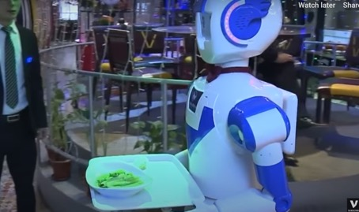
Real Time Control
Description: This class of services will push the technology boundary to deliver even lower latency and higher reliability/availability beyond 5G
Other Examples:
Vehicle Platooning/Cooperative Maneuvering
Autonomous Service Robots,
Rescue robots
Collaborative Industrial Robots
Autonomous and Interactive Service Robots

Slide 20

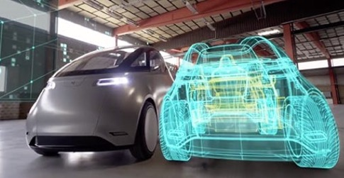
Spatial Perception
Description: Use cases exploiting new/improved capabilities of wireless sensing (and positioning) to offer services
Other Examples:
Smart Agriculture
Environmental Monitoring
Brain Communications and human implants
Sensing Networks
Digital Twins*
*A digital twin is the real-time digital replica of a real-world object, which connects physical systems and digital spaces. Digital twin can monitor, design, simulate, analyze, optimize and predict the behavior of physical systems.

Slide 21
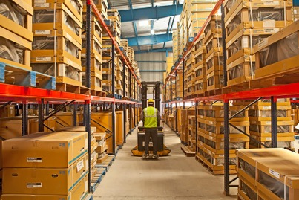
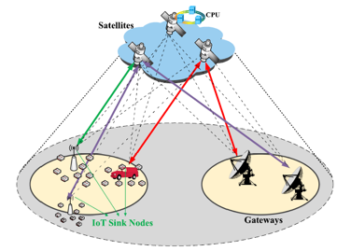
Pervasive Access
Description: Use cases supporting very high density of devices, specially, devices with low complexity
Other Examples:
Public Safety applications
Next Generation Smart Grid
Asset Management using Zero powered tags
Wide Area IoT Network with NTN

Slide 22

Sustainability
Description: Use cases that address social, environmental and economic sustainability challenges
Other Examples:
Seamless and ubiquitous coverage and connectivity e.g., for bridging the divide
Multi-connectivity using UAVs, GEOs, LEOs and HAPs
Devices with scalable affordability
Global/3D Coverage and Connectivity

Slide 23
Why? Cost Reductions

Slide 24
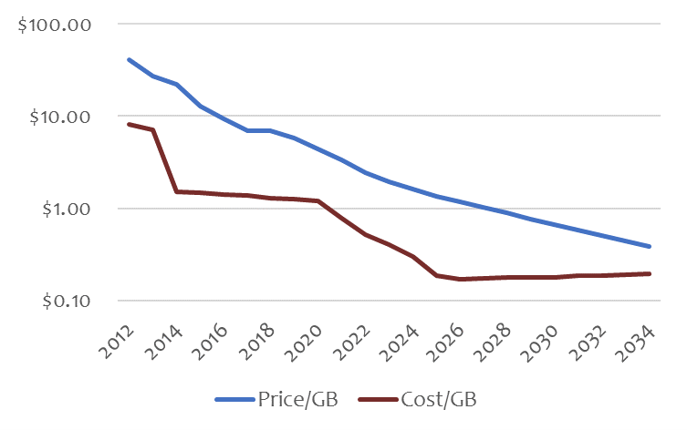
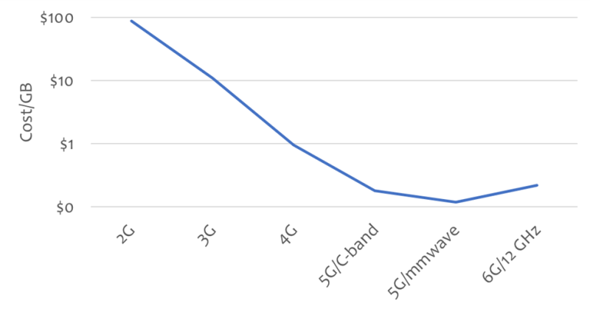
Trouble ahead: 6G cost per GB may pose problems
https://www.fiercewireless.com/tech/trouble-ahead-6g-cost-gb-may-pose-problems-madden
In 2014, after the introduction of LTE, the American telcos spent about $0.96 per GB to deliver data, but charged more than $10 per GB....a 10:1 ratio ➔ allowed the operators to offer ‘unlimited’ plans because the cost of delivery was so much smaller than the revenue created
Today, the cost has dropped to $0.30 but the retail price per GB is down to $2. By 2028, the retail price will drop below $1/GB, but the operators will have very few ways to reduce cost, and their costs are likely to remain in the range of $0.30 ➔ 3:1 ratio

Slide 25
Cost Reductions - General
Deployment cost reduction
New spectrum deployment, existing network upgrade, cost effective coverage, leverage device density, ..
Operating cost reduction
Network energy saving, automation, cooperative communications, …

Slide 26
Cost Reduction Example 1: 6G RAN sharing
More advanced forms of RAN sharing can play a major role for TCO reduction and should be studied in the 6G era
Shared RAN deployment ➔ CapEx and OpEx reduction
Sharing could be the full RAN, as illustrated, or some components of RAN, e.g., RU-only
Separate Core networks ➔ Differentiating services
Differentiating services for competition
RAN resource sharing alternatives
Alt 1: Cost reduction only, equipment sharing without spectrum sharing
E.g., 200+100+200 for three operators based on their spectrum holdings
Alt 2: Spectrum sharing within a wide carrier 500 MHz
Single carrier/scheduler, QoS enforced based on operator agreements
Benefits include higher trunking efficiency; better coexistence with non-IMT services on sub-bands; enabling new wideband services (e.g., high-resolution sensing)
Core
A
Core
B
Core
C
Core
A
Core
B
Core
C
RAN
A
RAN
B
RAN
C
Radio Area Network
CU
CU
CU
CU
DU
DU
DU
DU
RU
RU
RU
RU
f1
f2
f3
f1+f2+f3

Slide 27
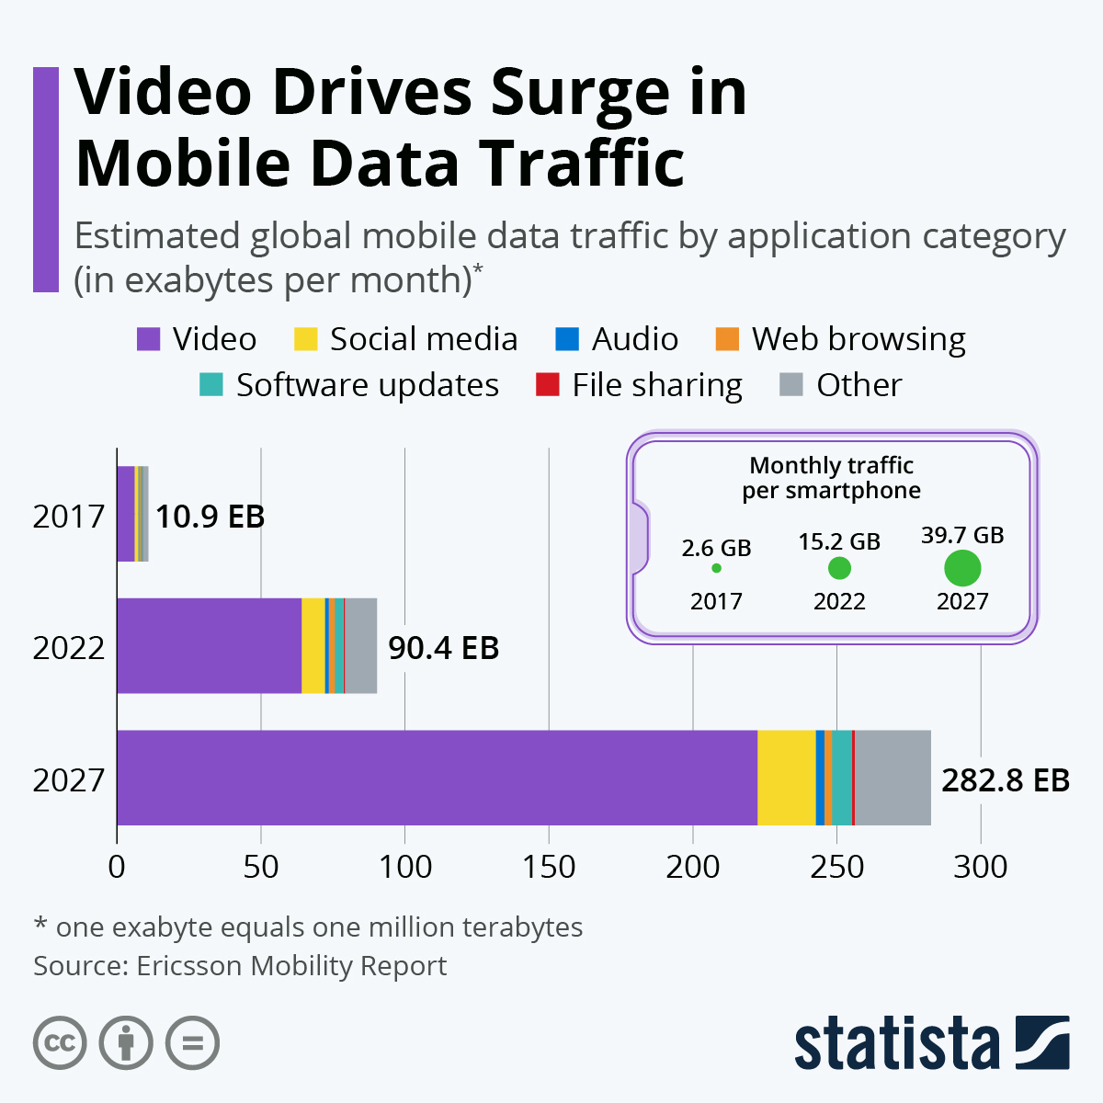
Cost Reduction Example 2: Video Delivery
Provide technologies for operators and service provider to invest in cost saving technologies
Data points
At the end of 2023, video traffic is estimated to account for 73 percent of all mobile data traffic (Ericsson Report)
With 97 percent, video traffic has significantly more downlink than uplink traffic (Ericsson Traffic Analysis)
Video content to account for almost 80 percent of mobile traffic, which is projected to triple in the next five years.
The cost of video delivery needs to be reduced
Potential objective for 6G
Potential Technologies:
New codecs, AI, Smart delivery, Monetization, New KPIs, Energy Saving
Collaboration between Media Service provider and MNO
Amortization of the MNO loss on Gbyte 10:1 ➔ 3:1 needs to be addressed for video delivery (80% of all traffic)

Slide 28






Cost Reduction Example 3: Global universal Media Delivery Platform
Continue and accelerate the integration of Media Verticals to 3GPP global delivery platform – economy of scale
Unified technology – many emitters can access many devices
Media Service providers focus on services rather than delivery
6G Platform (including previous G technologies)
FWA

Slide 29
Lessons learned from 5G: verticals
Important to avoid duplication of work vs what already exists
(1) Focus on requirements first
Identify very specific requirements for the 6G version of a new vertical
(2) Once requirements are identified, perform a gap analysis vs the 5G/5G-Advanced version
What is missing?
Are there commercially available products for the 5G/5G-A version?
Does the extent of what is missing / gain in performance justify a redesign from scratch?
Could one just evolve the “5G version” of that vertical (thus preserving compatibility) and rebrand it “6G”?
(3) Consider stickiness & replacement rate of the vertical
Verticals work under different timelines compared to smartphone industry (vs. 3GPP Releases cycle)
Concrete examples based on 4G-5G transition to learn from
5G Massive IOT and 5G Broadcast were “based” on solutions developed during the 4G era following a gap analysis => duplication was avoided
NR V2X was developed very rapidly, before LTE V2X could gain adoption => Some perception of fragmentation was created

Slide 30
Some more thoughts wrt to Media & 5G-MAG
To be refined and improved
Verticals & RAN
Early RAN design consideration for verticals such as Broadcast, NTN, Production – even if not addressed in first release, ensure extensibility, not an afterthought
Examples: Time Frequency Interleaver, Multiplexing with legacy broadcast, UHF band support, channel bandwidth
3GPP should be well-recognized for important media-related specifications, including
Developer-friendly: APIs, code, examples, git-environments, exchange with developers
Implementability of the specifications (test, evaluation, code, reference software)
addressing market needs, deployment feasibility, sustainability, innovation platform, monetization opportunities, cost-conscious
Timeliness: allow things to do quicker, do things at the right time, leave time to address essential work
Develop specifications against meaningful KPIs for media services
Collaboration with the industry and market representation partners
Generally, build on the principles established in the 5G era and evolve and adapt based on experiences and learning
Media Delivery Architecture and Services
build on existing architectures: 5G Media Delivery Architecture and IMS
No revolution, but evolution and adaptation to 6G core, radio and design principles
Support foundational technologies such as cloud, AI, virtualization, orchestration, split processing ➔ develop more use cases
Create enablers for richer media experiences (Media Service Enablers), but not full services

Slide 31
Codec Specifications
What can SA4 do?
Speech/Audio – typically developed in 3GPP SA4
Video – typically relying on external technologies
For NGVC, different levels may be considered: 1) Characterization framework (i) 2) Interoperable Operation Points (n) 3) permitted/recommended for a 3GPP service (n) 4) mandatory for a 3GPP Service (n)
New use cases and requirements may be defined to create input to standardization work in external organizations
Full specification done in 3GPP ➔ good
Better integration of technologies in apps and web
Usability of core codec components in different app environments – more MSE like

Slide 32
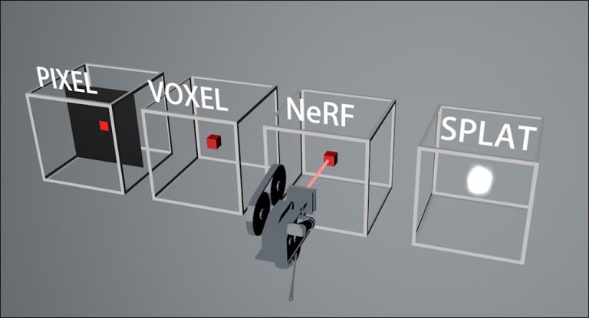

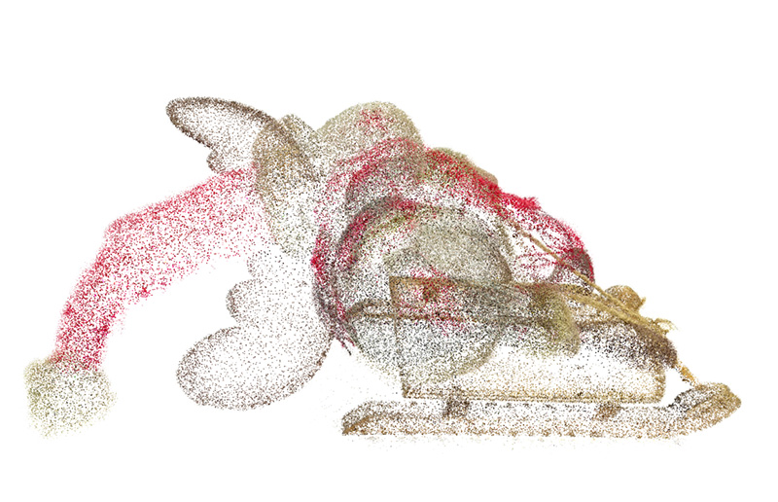

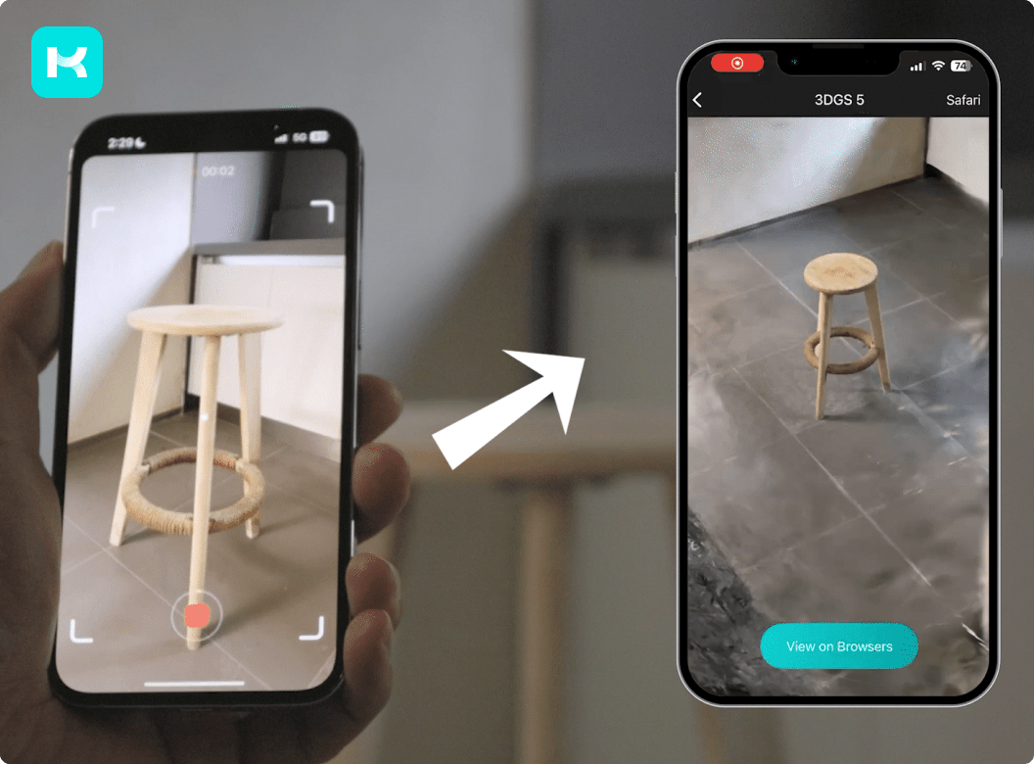
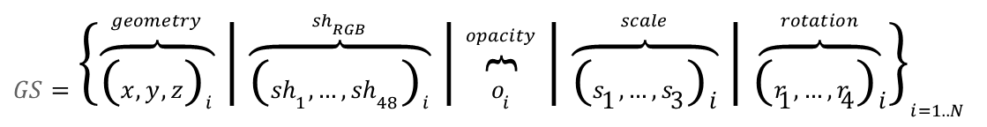
Gaussian splats
The representation format the 6G era?
${GS=\left\{\overset{geometry}{\overbrace{{\left(x,y,z\right)}_{i}}} | \overset{{sh}_{RGB}}{\overbrace{{\left({sh}_{1},…,{sh}_{48}\right)}_{i}}} | \overset{opacity}{\overbrace{o_{i}}} | \overset{scale}{\overbrace{{\left(s_{1},…,s_{3}\right)}_{i}}} | \overset{rotation}{\overbrace{{\left(r_{1},…,r_{4}\right)}_{i}}}\right\}}_{i=1..N}$
2D Pixels are state of the art – do we need “Voxels” at all ➔ commercially no
However, Gaussian Splats have the potential to surpass other volumetric representations
Why are "a bunch of blobs in space” so interesting:
3D Representations can be generated from a set of simple images (typically 50-100 images) ➔ UGC
Rendering of Gaussian splats is relatively trivial on GPUs using native functionalities (DirectX, WebGPU, Vulkan)
Gaussian splats can be edited locally, are not a whole-scene model (in contrast to NeRFs)
Gaussian Splats may be the representation formats in the 6G era ➔ hands-on study needed
Representation and work-flow centric, compression-agnostic, user-generated content
Simple is important – focus on manageable real use cases, static images, device-based processing, etc.
Capture
Training
Rendering
Compute, Compression, Container and Communication (4C)

Slide 33
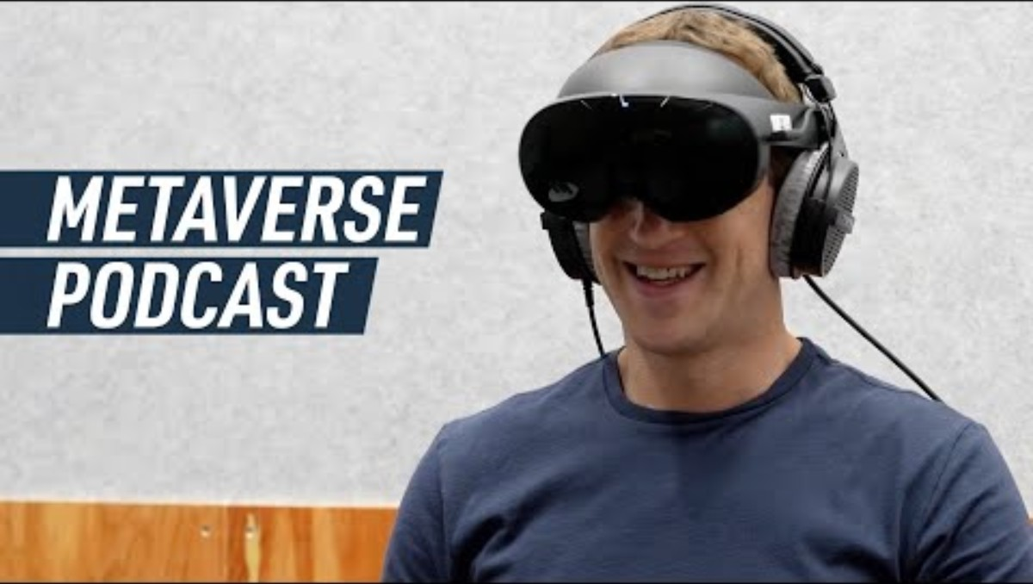
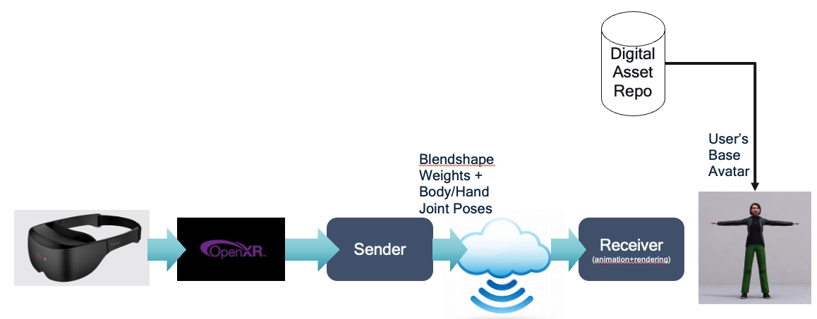
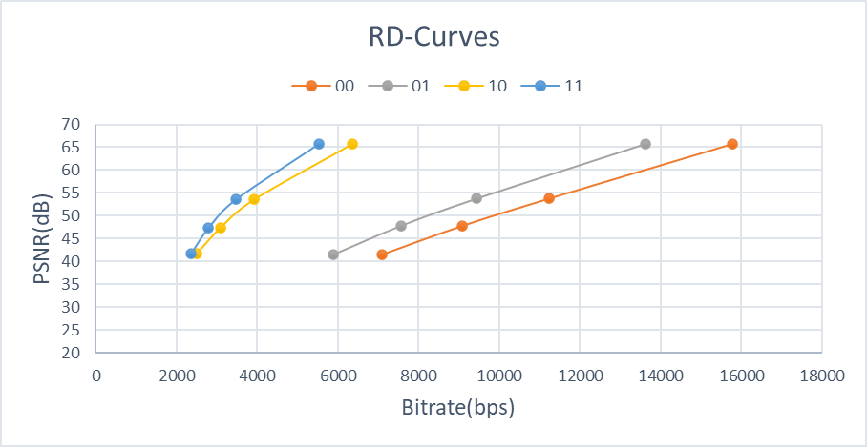




Avatar Communication
Making the Lex Fridman – Mark Zuckerberg interview a reality
A combination of technologies provides realistic Avatar-based calling
Many steps towards making this a broadly available service, with many question marks on technology, privacy, user experiences, social impacts, authenticity, security, and and and.
Animation Bitstreams – not a bitrate challenge
MPEG’s ARF a first step

Slide 34
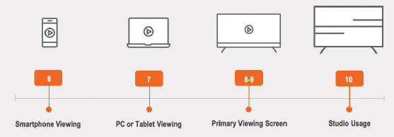
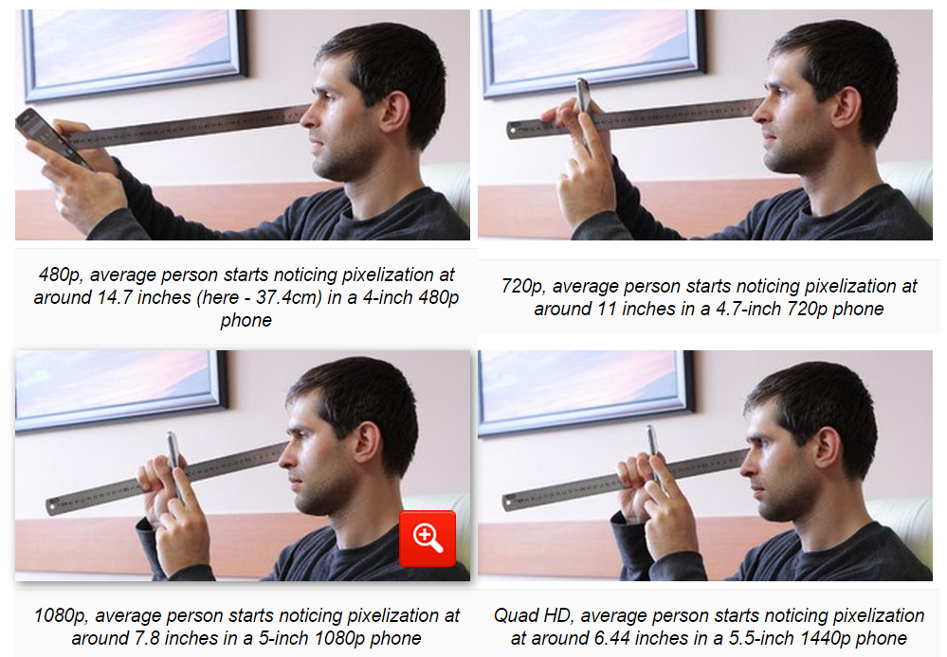
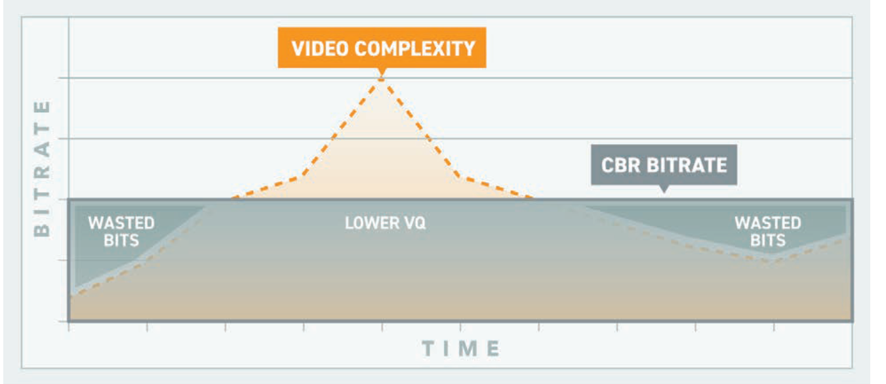
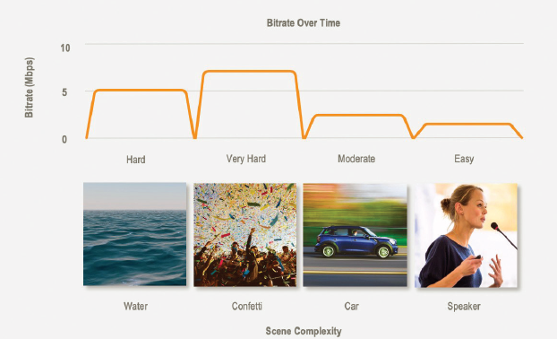
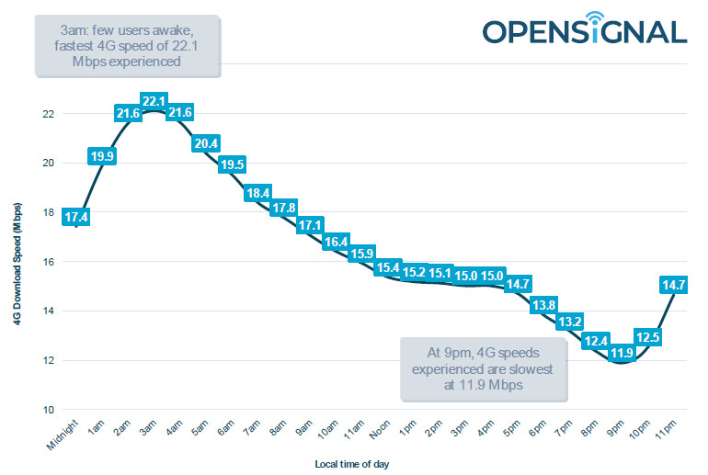
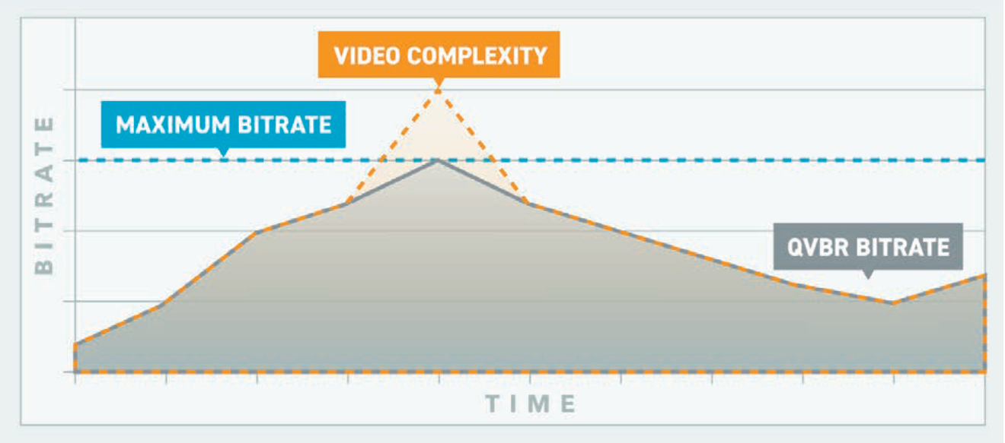
User Experience – Content & Device Aware Streaming and Delivery
Take into account devices, users, content, resources, subscription models, latency, etc. for overall quality improvement
Controlled fairness of players
A couple of good pointers and resources:
TR 26.949
Content-Aware Encoding (Yuriy Reznik, Brightcove)
Achieving Great Video Quality Without Breaking the Bank (AWS)
Netflix: Optimized shot-based encodes: Now Streaming!
Device Consumption
GBR QoS?
AI and Big data may help
Content Complexity
Radio Resources
CBR
CVBR
CAE

Slide 35
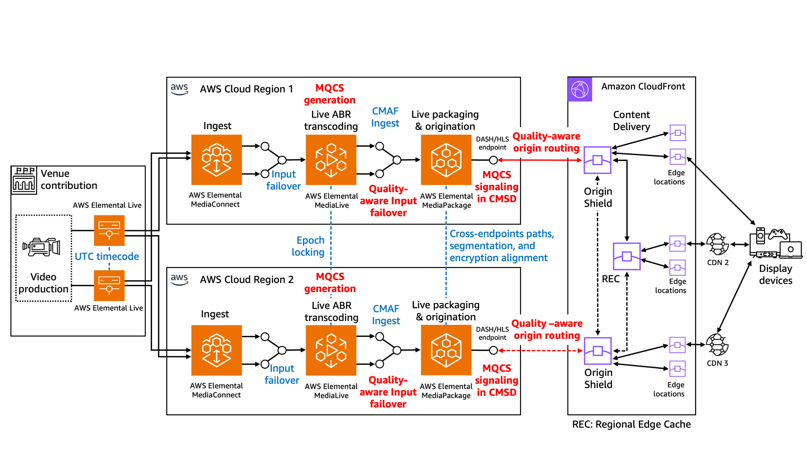
Advanced Media Delivery ➔ Media Delivery Architecture
How can 5G/6G networks be integrated and combined with modern media delivery systems
3GPP Advanced Media Delivery
Common Client Metadata.
Common Server-and Network-Assisted Streaming.
Multi-Access Media Delivery.
Media Delivery from multiple service endpoints/location.
Modem Usage Optimized Media Streaming.
DASH/HLS Interoperability.
Further harmonization of RTC and Streaming for Advanced Media Delivery.
Improved QoS support for Media Streaming services.
QUIC-based segmented media delivery.
In-band signalling of QoS for 5G Media Streaming.
Dynamic content generation from multiple sources.
In-session Unicast Repair for MBS Object Distribution.
MBS User Service and Delivery Protocols for eMBMS.
Selected MBMS Functionalities not supported in MBS.
Example: Amazon Delivery System architecture
https://aws.amazon.com/blogs/media/improve-your-viewers-live-streaming-experience-with-media-quality-aware-resiliency/
3GPP, 5G and 6G should be compatible with modern media delivery
Collaboration with media organizations (SVTA, DVB?)
5G-MAG should be a facilitator to connect the media industry

