Slide 1

SA4#124 Social
May 25, 2023

Slide 2

House of Tales – Immersive Stories
For the social event, we have three rooms.
Date and Time: May 25, 2023 - 19:15 – 21:00 CEST
Location: House of Tales, Zimmerstraße 90, 10117 Berlin-Mitte
https://www.houseoftales.de/en/home#1
Costs: 30 Euros per person - nothing else included
Instructions are in English
Rooms
19:30 – 20:30 Checkpoint Charlie (6 Persons) – be there at 19:15
20:00 – 21:00 One Night in Hong Kong (6 persons) – be there at 19:45
20:00 – 21:00 The curse of the Pharao (10 persons) – be there at 19:45

Slide 3
Assignment
Name | Assignment
Frédéric Gabin | Pharao
gaelle martin-cocher | Hong Kong
Jan Holub | Charlie
Andrei Stoica | Hong Kong
Andre Schevciw | Pharao
Gilles | Pharao
Alexis Tourapis | Pharao
Julien Lemotheux | Charlie
Igor Curcio | Charlie
Serhan Gül | Hong Kong
Gerhard Tech | Pharao
Emmanuel | Pharao
Mary-Luc | Pharao
Nien Wu | Pharao
Wang Bin | Hong Kong
Saba Ahsan | Pharao
stephane onno | Hong Kong
Ahmed Hamza | Charlie
Gazi Karam Illahi | Charlie
Tomas Toftgård | Charlie
Thorsten Lohmar | Pharao
IMED BOUAZIZI | Hong Kong

Slide 4
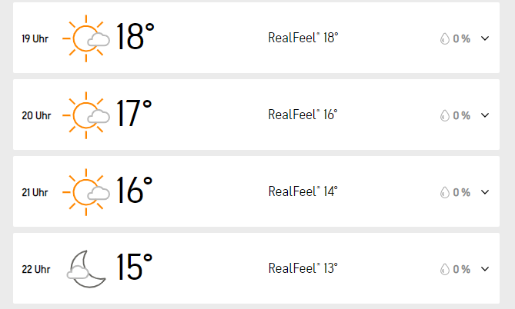
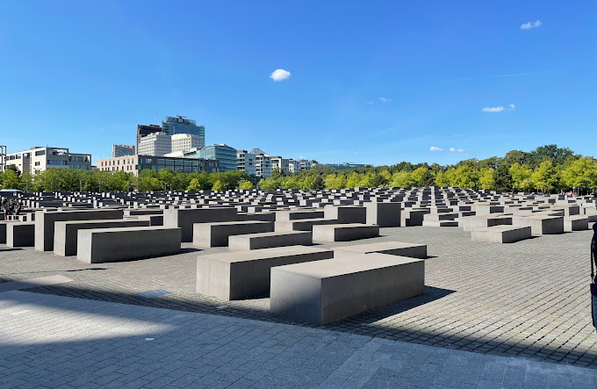
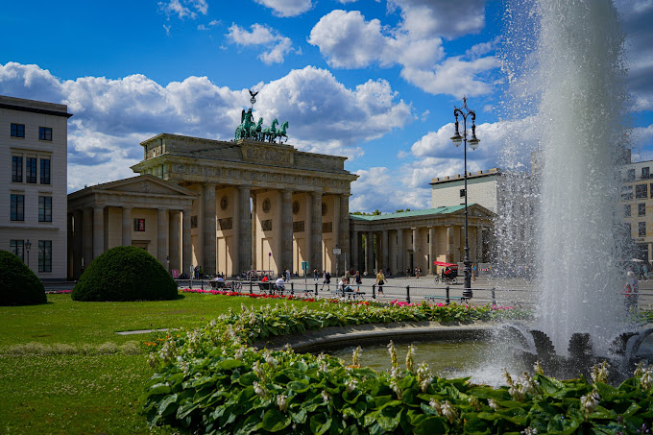
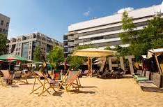
Food, afterwards and others
Closeby there is Charlie's Beach
  From April to October we offer a place in the middle of the hustle and bustle of Friedrichstrasse and invite you to take a short break in the urban jungle
  Schützenstraße 2, 10117 Berlin
You can have drinks and food in food area
Proposal: we meet there from 20:30 onwards and anyone can join us once done with walking and if you make it out of Escape room
People not participating can still come and explore nearby area and then we meet for food area
  Brandenburger Tor
  Holocaust Memorial

Slide 5
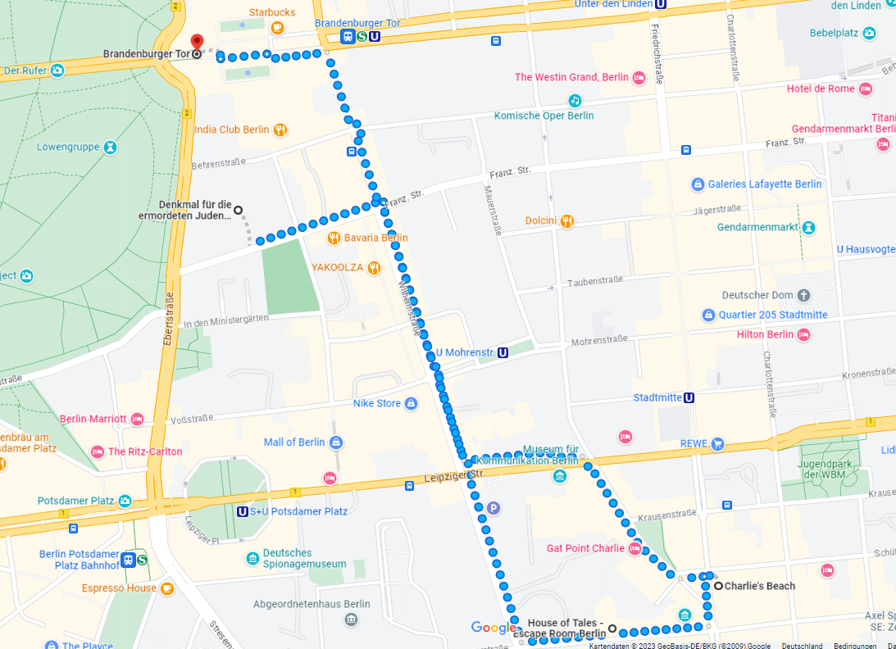
1 km

Slide 6
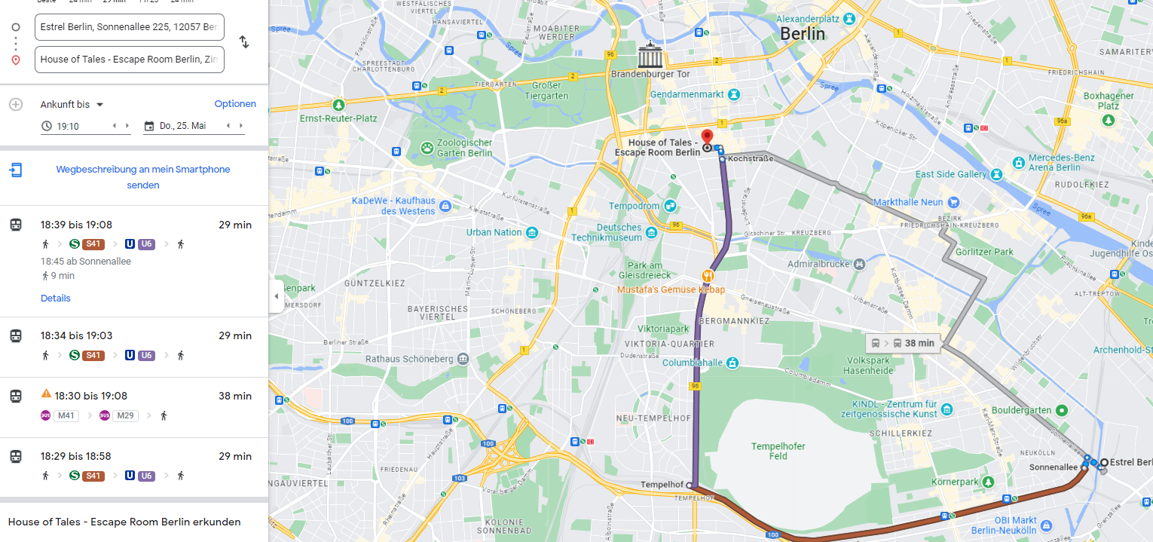
How to get there – public transport

Slide 7
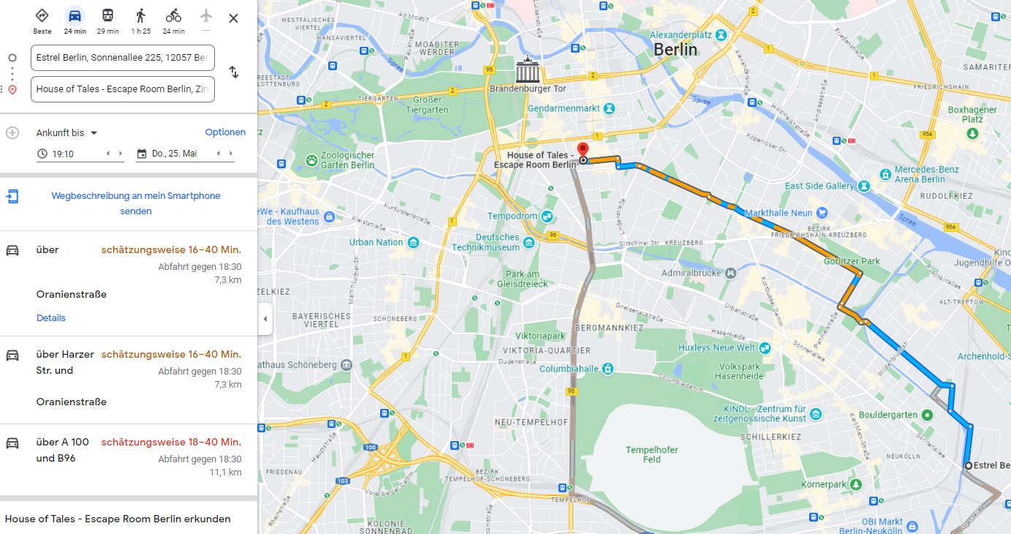
How to get there – Taxi

Slide 8
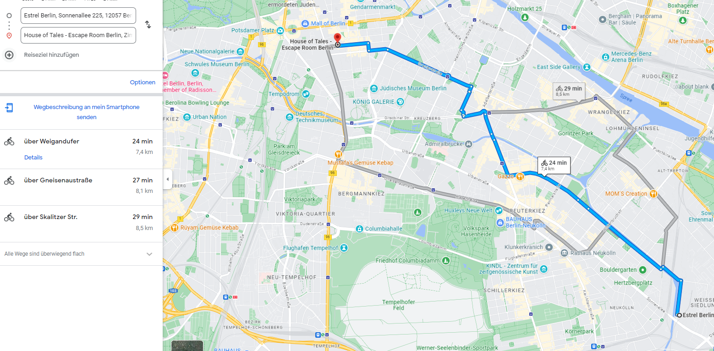
How to get there – Bike

Slide 9
Questions
Assignment ok?
How many would join for food at 20:30? I can reserve a corner
If you wanna join for Taxis/Uber, get together with room mates
Others?

