Slide 1
X0 Interface & ATTESTATION
s3i210850r1
Update on TC-LI work
October 2021
ABSTRACT: Summary of the on-going work in TC-LI on the development of the X0 interface and the attestation required of the platform before X1 is sufficiently trusted to pass targets.

Slide 2
LI
Architecture
ELI = Element of LI (POI, TF, MDF)
LICM = LI Certificate Manager
LINC = LI Network Controller
LI-NO = LI Network Output
LISE = LI Security Engine
X0 is used to build trust between the ADMF and ELIs
X1 is used to provision targets

Slide 3
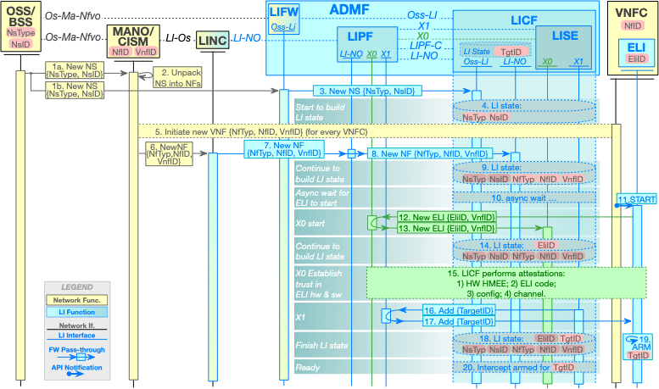
LI provisioning flow

Slide 4
Attestation actors
X0 … for the network is "dark and full of terrors."
-- George R. R. Martin

Slide 5
Attestation provisioning
--”Ground Truth”
The truth is rarely pure and never simple.
-- Oscar Wilde

Slide 6
Attestation Evidence Building
--aka “Attester turtles”
"But what does this second turtle stand on?" persisted James patiently.
To this, the little old lady crowed triumphantly,
"It's no use, Mr. James—it's turtles all the way down.”
-- J. R. Ross, Constraints on Variables in Syntax, 1967

Slide 7
Attestation full picture

Slide 8
Attestation Layers

Slide 9
Discrete vs.
System on Chip
--
Roots of Trust

Slide 10
Certificate provisioning

Slide 11
Block flow

Slide 12
Remote attestation

Slide 13
Attack actors/vectors

