Slide 1
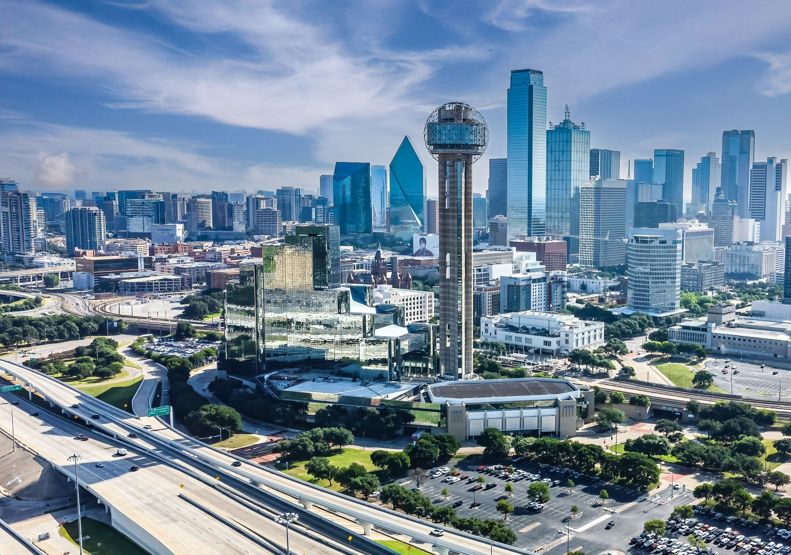


Working Group Meetings Dallas
November 17-21, 2025 | Dallas, Texas

Slide 2

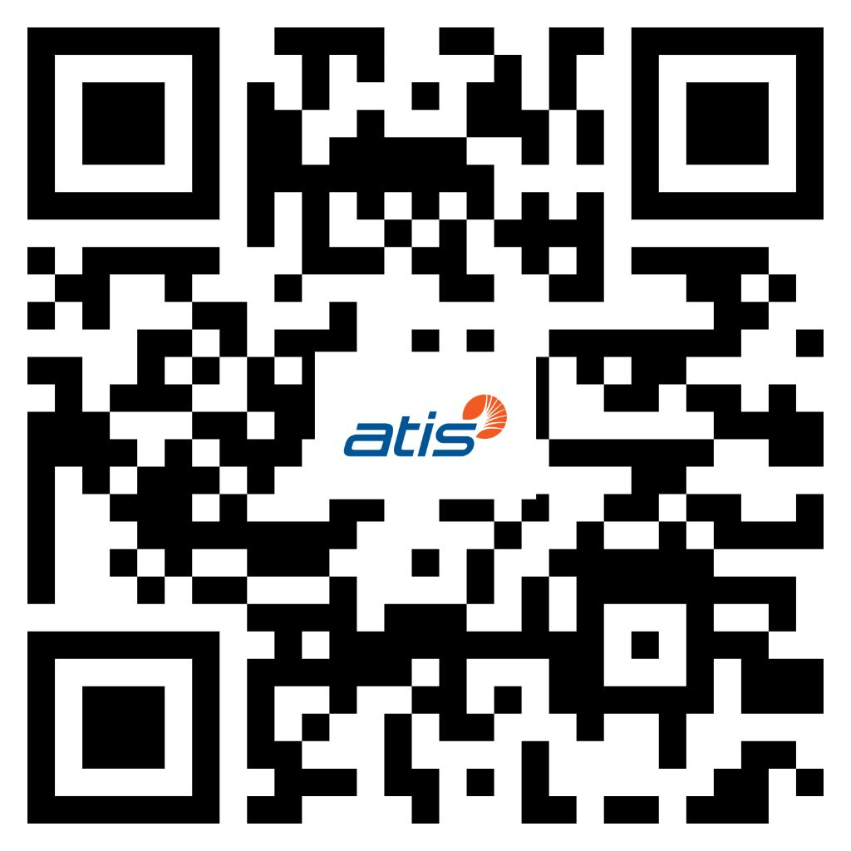
Visit the 3GPP Dallas website for updated meeting information:
https://3gppmeetings.atis.org/Dallas2025/
For inquiries during the meeting contact:
Dallas2025@atis.org

Slide 3
Registration Desk
Location: Lone Star Preconvene – Convention Center 2nd Floor
Badge Pickup Begins: Sunday, Nov 16 @ 2:00 PM
ATIS will provide badges and lanyards. Register via the 3GPP Portal and pick up your badge at the Registration Desk.
Visit Calgary will have a booth near the ATIS Registration table to answer questions about visiting Calgary (Nov 2026 WGs).

Slide 4
Security/Registration
Delegates must pick up their badges at the Registration Desk in Lone Star Preconvene (Convention Center 2nd Floor)
For security, only delegates wearing Dallas meeting lanyards with badges will be permitted to enter the meeting rooms and coffee breaks.
Security is not provided in the meeting rooms; you are responsible for your own equipment.
There is no QR code or scanning to enter the meeting rooms.
In case of emergencies, the U.S. emergency number is 9-1-1.

Slide 5
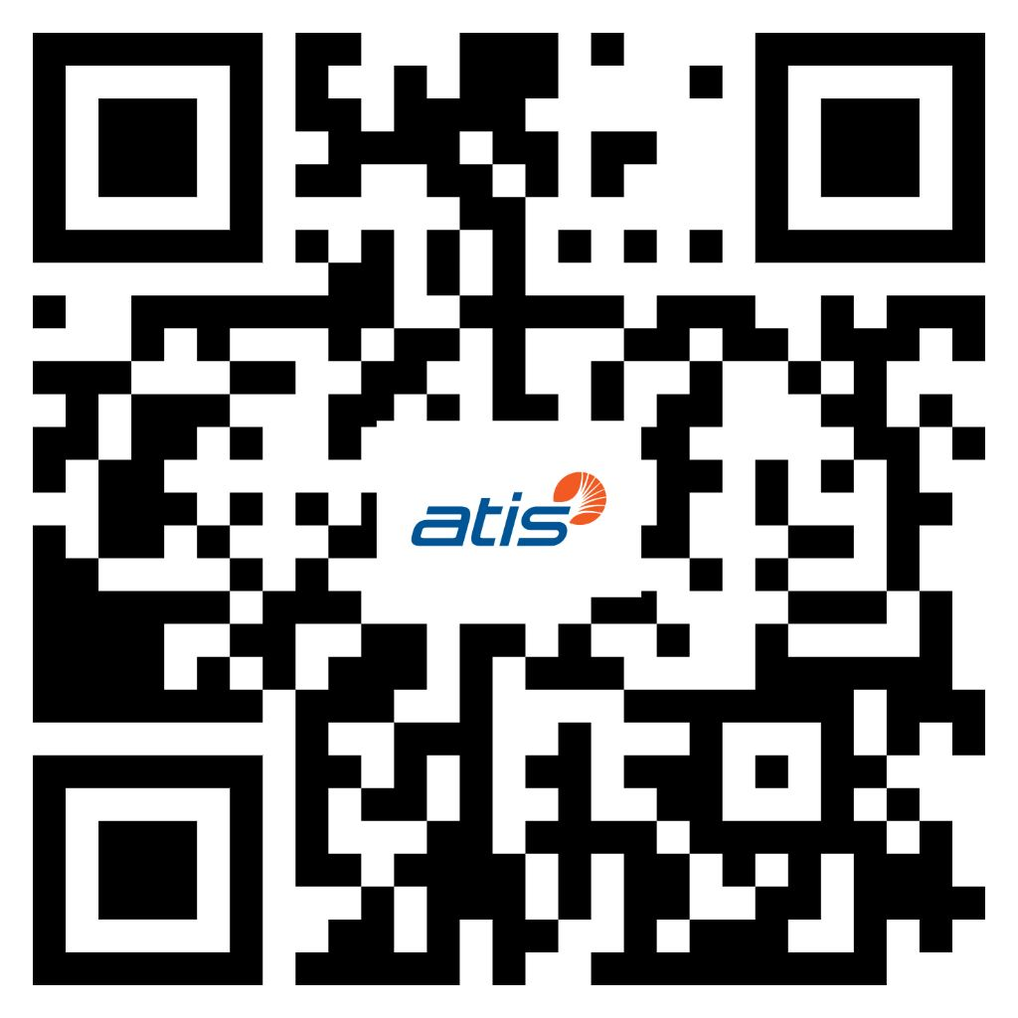
Visa Letters
Visa Letter Pickup for Baltimore (TSG 2025), Calgary
(WG 2026), and Boston (TSG 2026)
Location: Lone Star Preconvene, Registration Desk
Visa Letter Pickup Hours:
Tuesday-Thursday*: 9:00 AM – 7:00 PM
Friday: 9:00 AM – 12:00 PM
*Visa letter requests for in-person pickup must be submitted by 3 PM on Thursday, November 20. Scan the QR code above to request a hard copy for pickup.
Direct visa letter inquiries to Jo Seibel at jseibel@atis.org (cc: visas@atis.org).

Slide 6
Meeting Hours
There are limits on meeting times:
Monday: 9:00 AM – 7:30 PM
Tuesday/Wednesday/Thursday: 8:00 AM – 7:30 PM
Friday: 8:00 AM – 4:00 PM
*Please note, meeting times will be strictly observed to avoid incurring union overtime. Outside of the stipulated meeting hours, the venues’ AV, screens, projectors or microphones may not be used. Personal projectors may not be used at any time.
Please consult agenda documents for individual working groups for specific meeting times for each working group.

Slide 7

Coffee Breaks
Monday
RAN/SA/CT Morning Coffee Break: 10:30 AM – 11:00 AM
  Lone Star Preconvene (Convention Center 2nd Floor)
  SA/CT Afternoon Coffee Break: 3:30 PM – 4:00 PM
  Grand Ballroom Preconvene (Convention Center 1st Floor)
  RAN Afternoon Coffee Break: 4:30 PM – 5:00 PM
  Lone Star Preconvene (Convention Center 2nd Floor)
Tuesday – Thursday
  SA/CT Coffee Breaks: 10:30 AM – 11:00 AM, 3:30 PM – 4:00 PM
  Grand Ballroom Preconvene (Convention Center 1st Floor)
  RAN Coffee Breaks: 10:30 AM – 11:00 AM, 4:30 PM – 5:00 PM
  Lone Star Preconvene (Convention Center 2nd Floor)
Friday
RAN/SA/CT Morning Coffee Break: 10:30 AM – 11:00 AM
Lone Star Preconvene (Convention Center 2nd Floor)

Slide 8

WiFi Info
Wireless LAN:
SSID: 3GPPWIFI
Password: 3GPP3GPPM (CAPITAL LETTERS!)
Server IP Address: 10.10.10.10
--> USUAL SETTING
Notes:
Same for both hotels

Slide 9
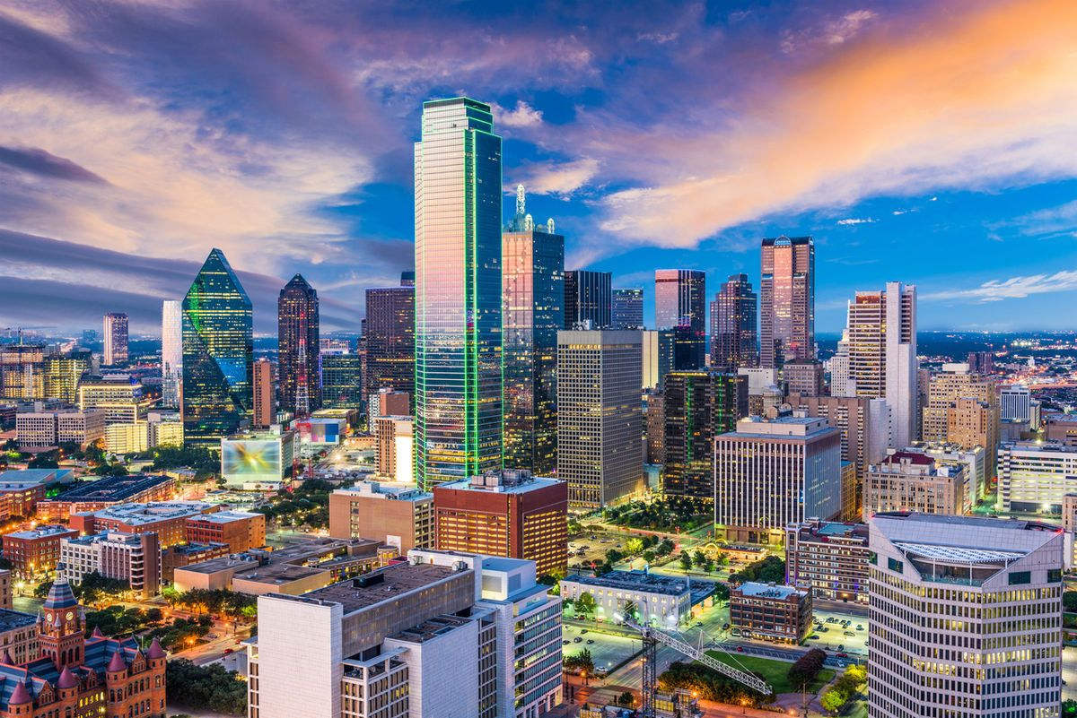
Welcome to Dallas!
Explore Dallas by visiting these top attractions
Reunion Tower & GeO-Deck
Dallas Arboretum and Botanical Gardens
Dallas World Aquarium
Dallas Zoo
Dallas Museum of Art
Perot Museum of Nature and Science
The Sixth Floor Museum at Dealey Plaza
George W. Bush Presidential Center
Six Flags Over Texas
Dallas Cowboys Stadium Tour - NFL Football
Dallas Mavericks – NBA Basketball
Dallas Stars vs Seattle Kraken – NHL Hockey
Take a look at Devaki Chandramouli’s list of nearby Dallas Restaurants and Attractions.
Explore Visit Dallas' website for guides, discounts, and special events.

Slide 10
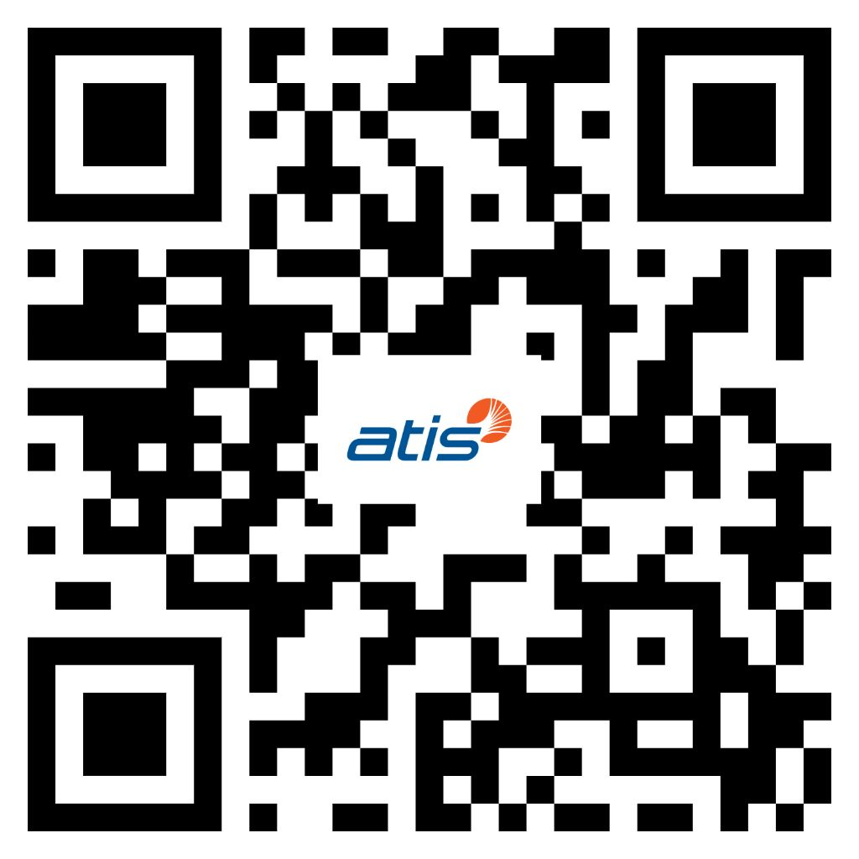
Dining Options
For more dining options visit our Guide to Dallas.
In-House
Draft Sports Bar & Lounge
  Hours: 5pm-12am
Open Palette
  Hours: 7am-10pm
Open Market Grab n Go
  Hours: 6am-10pm
The Parlor – Speakeasy
  Hours: 7pm-12am
Nearby
Sapa House
Kitchen + Kocktails
La Stella Cucina Verace
Sloane's Corner
Elm Street Cask & Kitchen
Corrientes 348 Argentinian Steakhouse

Slide 11
RAN Meeting Rooms
RAN1 Main - Lone Star Ballroom B
(Convention Center, 2nd Floor)
RAN1 Breakout 1 - Lone Star Ballroom A4 (Convention Center, 2nd Floor)
RAN1 Breakout 2 - Dallas Ballroom B
(Convention Center, 1st Floor)
RAN1 Breakout 3 - City View 8 (Hotel, 4th Floor)
RAN1 Breakout 4 - Seminar Theater (Hotel, 2nd Floor)
RAN2 Main - Lone Star Ballroom A1-3
(Convention Center, 2nd Floor)
RAN2 Breakout 1 - Austin Ballroom 1
(Hotel, 2nd Floor)
RAN2 Breakout 2 - Dallas Ballroom C (Convention Center, 1st Floor)
RAN2 Breakout 3 - City View 7 (Hotel, 4th Floor)
RAN3 Main - Lone Star Ballroom C4
(Convention Center, 2nd Floor)
RAN3 Breakout 1 - City View 2 (Hotel, 4th Floor)
RAN3 Breakout 2 - City View 1 (Hotel, 4th Floor)
RAN4 Main - Lone Star Ballroom C1-2
(Convention Center, 2nd Floor)
RAN4 Breakout 1 - San Antonio Ballroom A
(Convention Center, 3rd Floor)
RAN4 Breakout 2 - City View 6 (Hotel, 4th Floor)
RAN4 Breakout 3 - State Room 4
(Convention Center, 3rd Floor)
RAN5 Main - Lone Star Ballroom C3
(Convention Center, 2nd Floor)
RAN5 Breakout 1 - San Antonio Ballroom B
(Convention Center, 3rd Floor)
Sheraton Dallas Hotel & Convention Center – Meeting Rooms
Notes:
Same for both hotels

Slide 12
SA Meeting Rooms
SA1 Main - Dallas Ballroom A1-2 (Convention Center, 1st Floor)
SA1 Breakout 1 - State Room 2 (Convention Center, 3rd Floor)
SA2 Main - Dallas Ballroom D1-3 (Convention Center, 1st Floor)
SA2 Breakout 1 - Austin Ballroom 3 (Hotel, 2nd Floor)
SA2 Breakout 2 - Houston Ballroom A (Convention Center, 3rd Floor)
SA3 Main - Austin Ballroom 2 (Hotel, 2nd Floor)
SA3 Breakout 1 - State Room 3 (Convention Center, 3rd
Floor)
SA4 Main - Dallas Ballroom A3 (Convention Center, 1st Floor)
SA4 Breakout 1 - City View 3 (Hotel, 4th Floor)
SA4 Breakout 2 - Majestic 4 (Hotel, 37th Floor)
SA5 Main - Houston Ballroom C (Convention Center, 3rd Floor)
SA5 OAM Breakout - Majestic 3 (Hotel, 37th Floor)
SA5 Charging Room - Majestic 7 (Hotel, 37th Floor)
SA6 Main - Houston Ballroom B (Convention Center, 3rd Floor)
SA6 Breakout 1 - State Room 1 (Convention Center, 3rd Floor)
CT Meeting Rooms
CT1 Main - Remington (Hotel, 4th Floor)
CT1 Breakout 1 - Majestic 6 (Hotel, 37th Floor)
CT3 Main - Majestic 5 (Hotel, 37th Floor)
CT3 Breakout1 - City View 5 (Hotel, 4th Floor)
CT4 Main - Majestic 1 (Hotel, 37th Floor)
CT4 Breakout 1 - Majestic 2 (Hotel, 37th Floor)
CT6 Main - City View 4 (Hotel, 4th Floor)
Sheraton Dallas Hotel & Convention Center – Meeting Rooms
Notes:
Same for both hotels

Slide 13
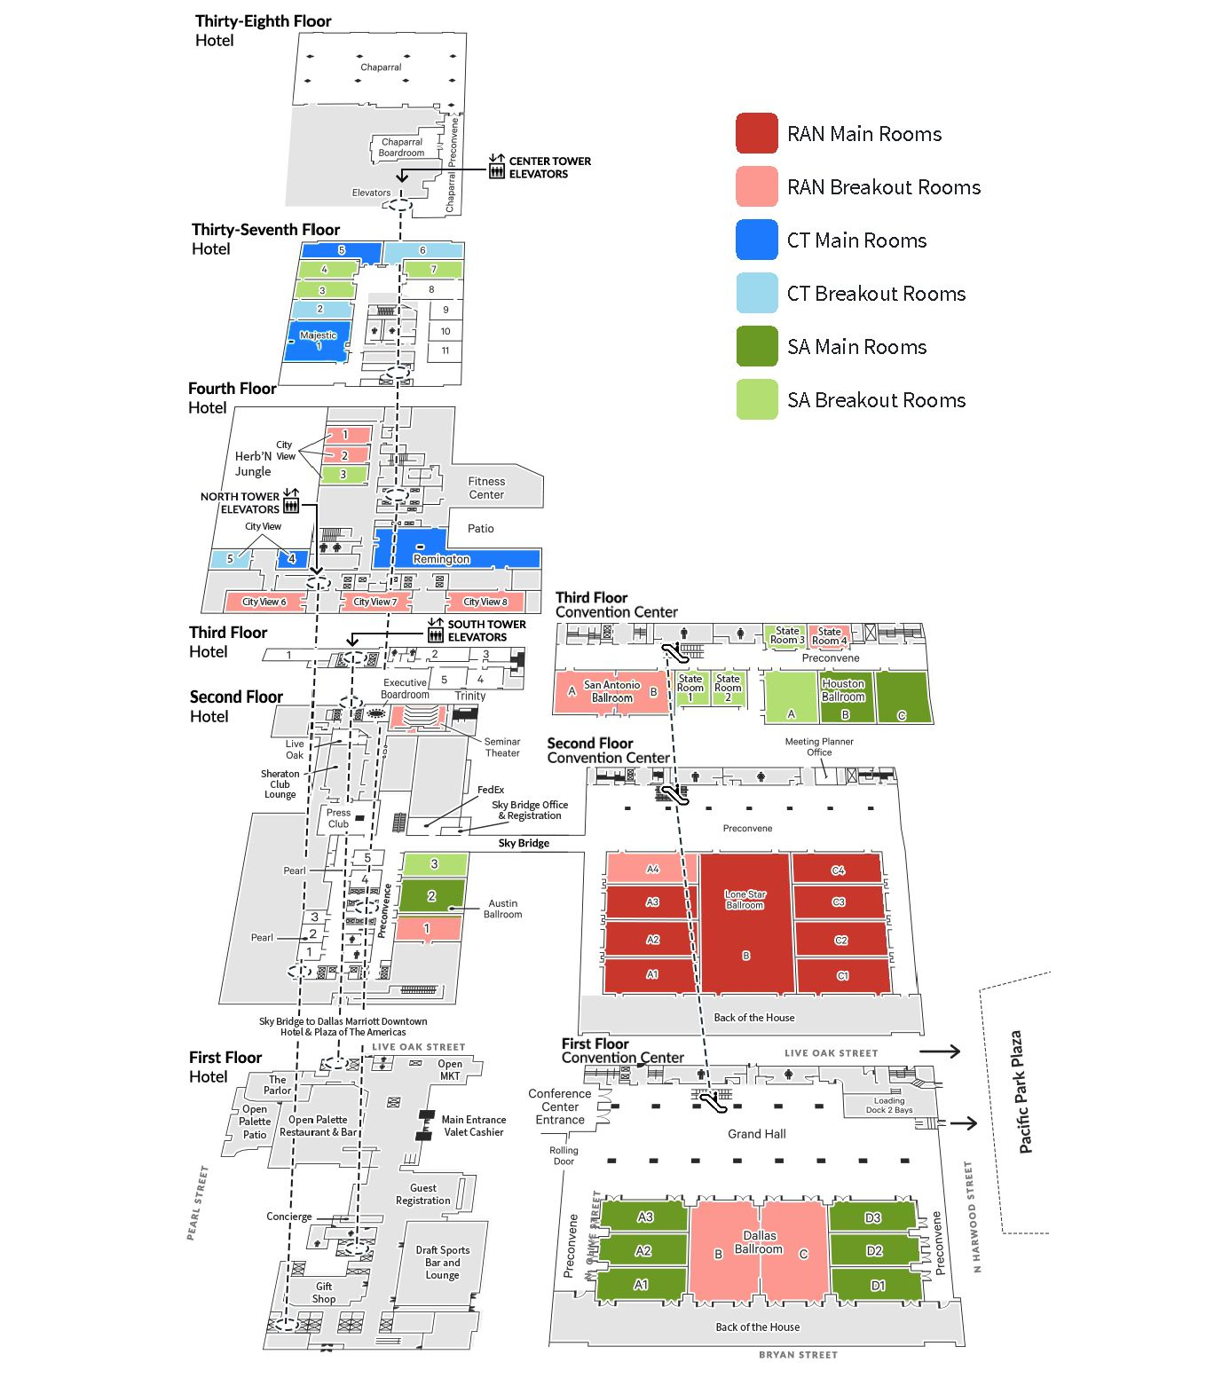
Sheraton Dallas Hotel & Convention Center - Layout
Notes:
Same for both hotels

Slide 14
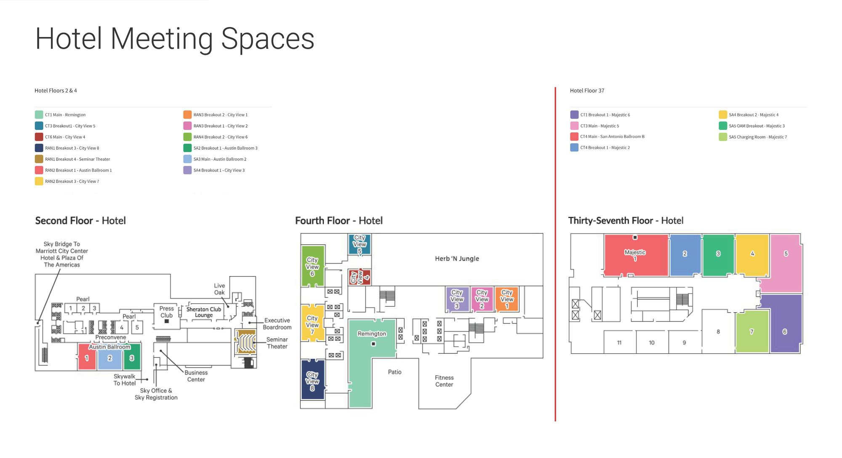
Sheraton Dallas Hotel Floor Plan
Notes:
Same for both hotels

Slide 15
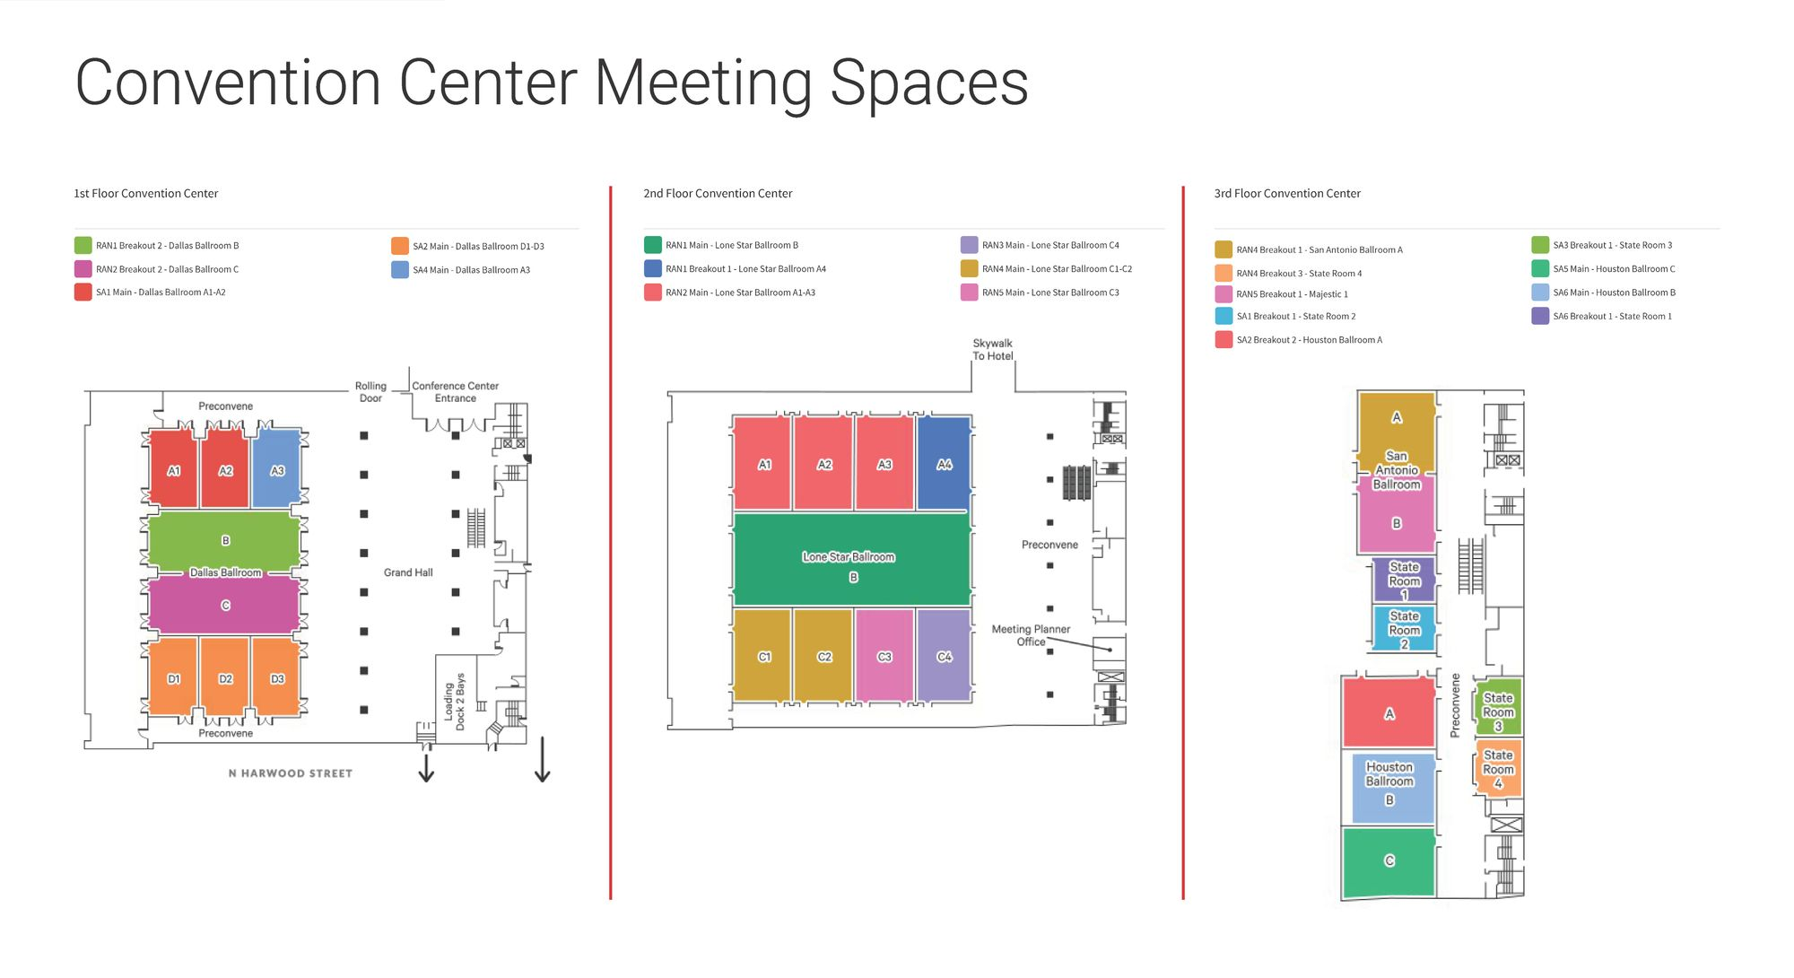
Sheraton Dallas Convention Center Floor Plan
Notes:
Same for both hotels

Slide 16
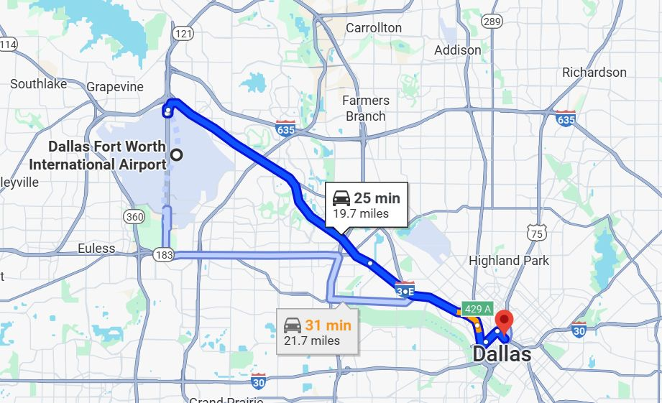
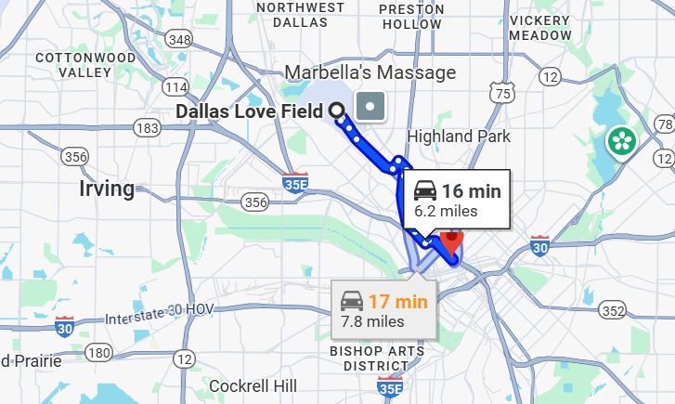
Airports to Sheraton Dallas Hotel
Sheraton Dallas Hotel: 400 Olive St
Dallas, TX 75201
Dallas Ft. Worth (DFW)
Dallas Love Field (DAL)
Notes:
Supplementary slide info

Slide 17
Airports to Sheraton Dallas Hotel
Sheraton Dallas Hotel: 400 Olive St
Dallas, TX 75201
DART – Public Transport
View Map
DFW Airport to St. Paul Station (60 min)
Take Orange Line Towards Parker Road
3 min walk to Sheraton Dallas Hotel
Notes:
Supplementary slide info

Slide 18
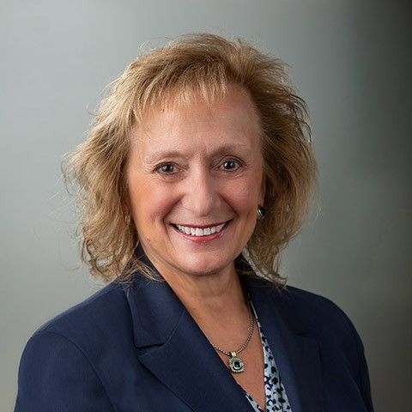
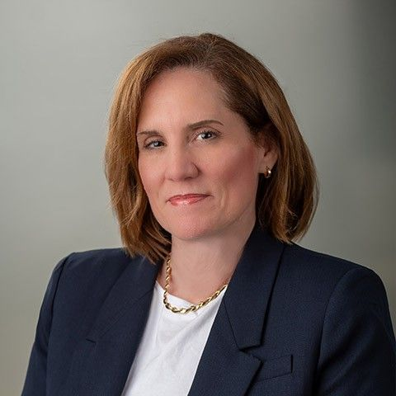
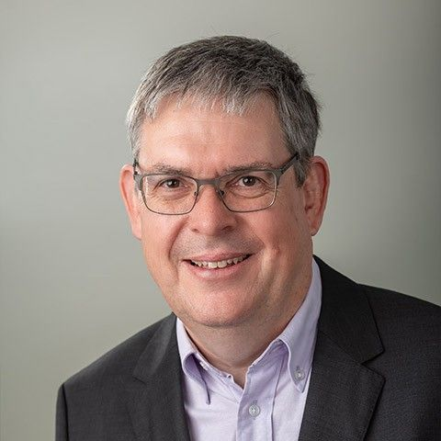
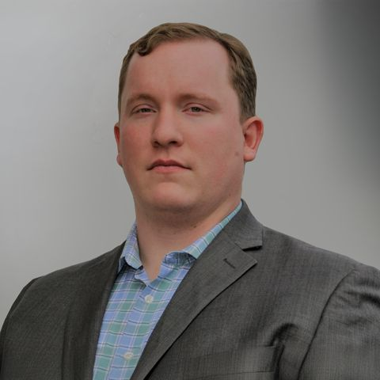
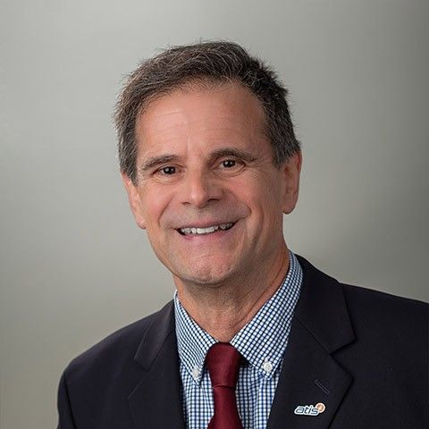
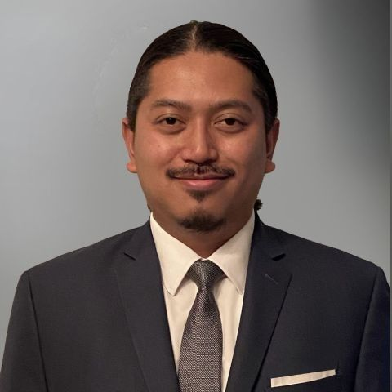
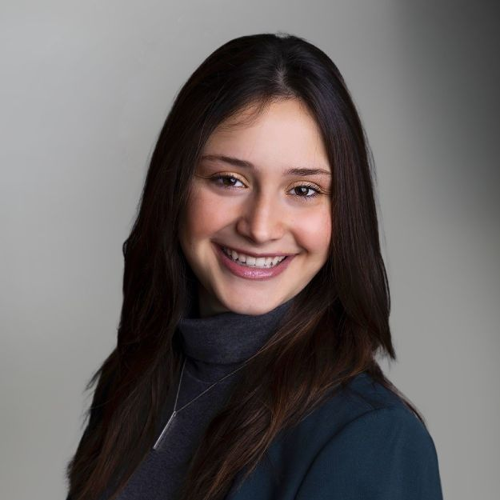
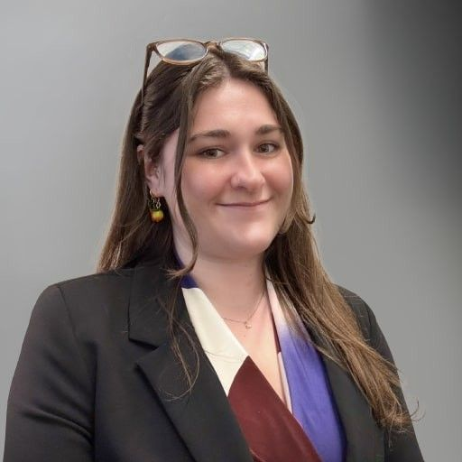
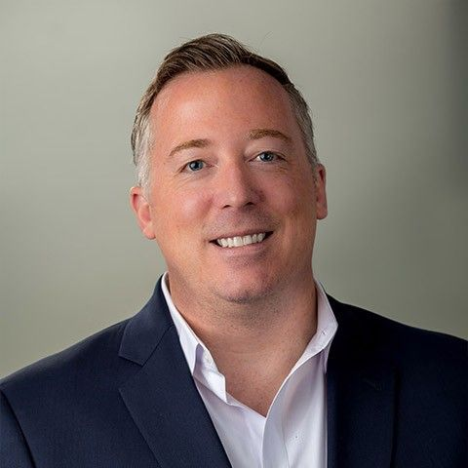
ATIS On-Site Team
Susan M. Miller
President and CEO
Lauren Layman
Vice President, Marketing and Public Relations
Iain Sharp
Principal Technologist
Jaydee Griffith
Managing Director, Next G Alliance
Rich Moran
Director, Membership
Christian Evangelista
Manager,
Meetings and Events
Jo Seibel
Coordinator,
Marketing, Legal, Policy
Kathryn Storm
Coordinator, Strategic Initiatives
Hank Daugherty
Senior Manager – Web and IT

Slide 19
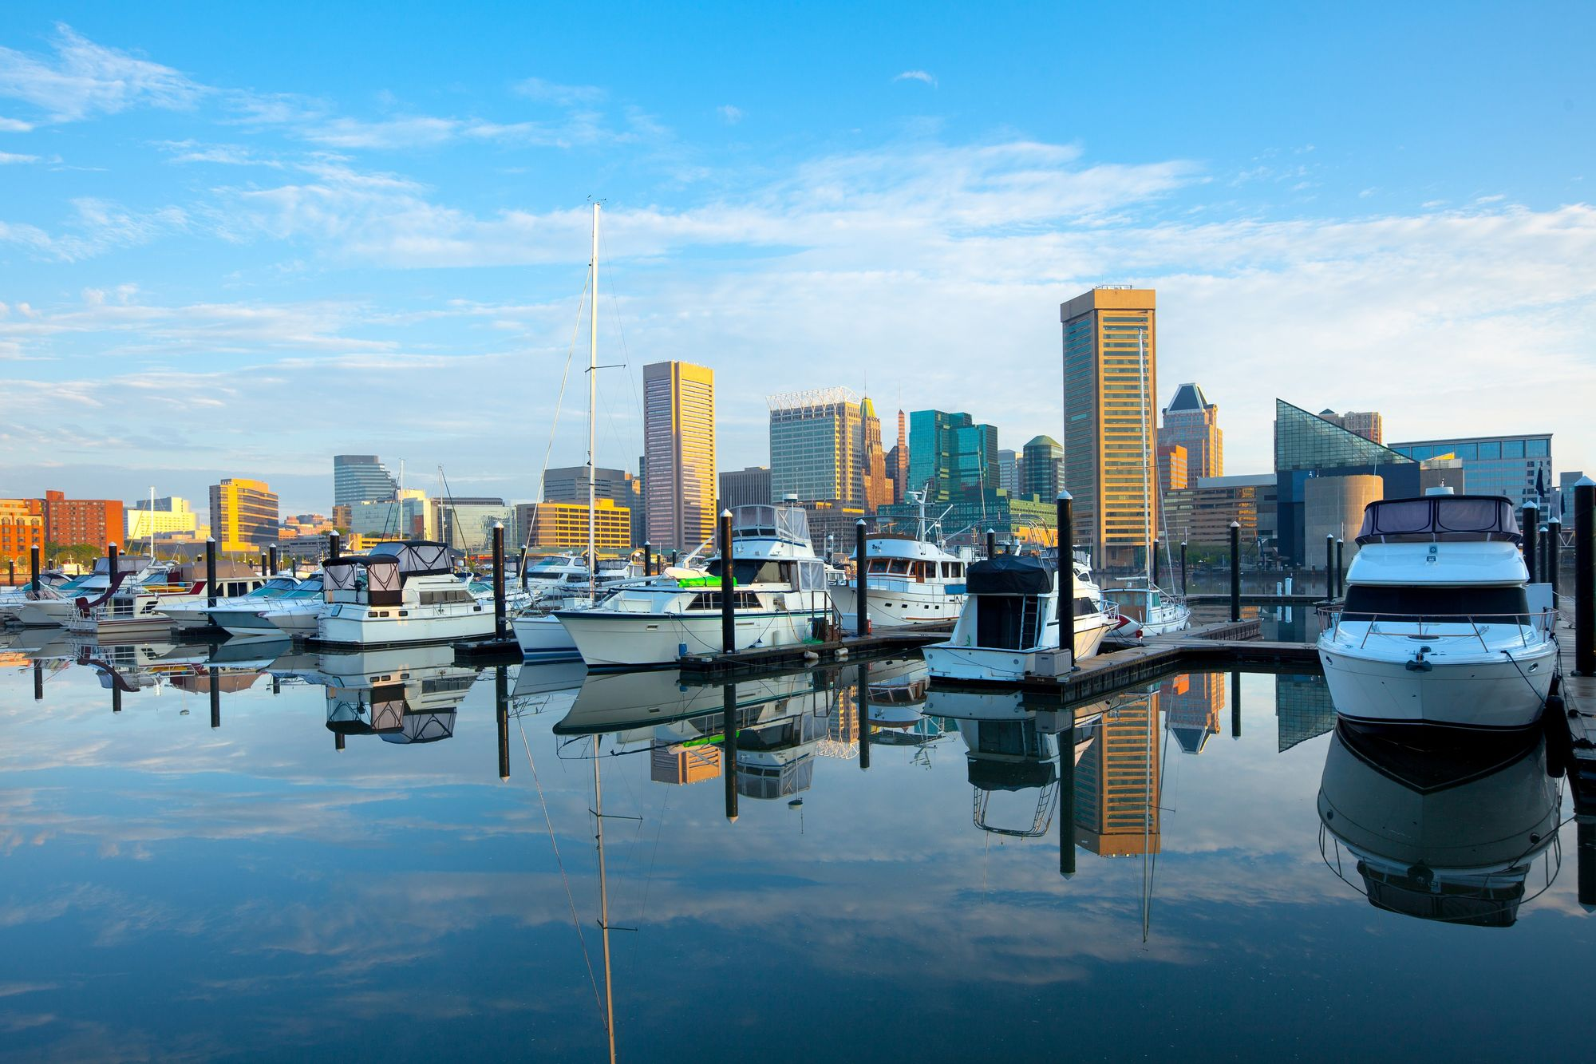

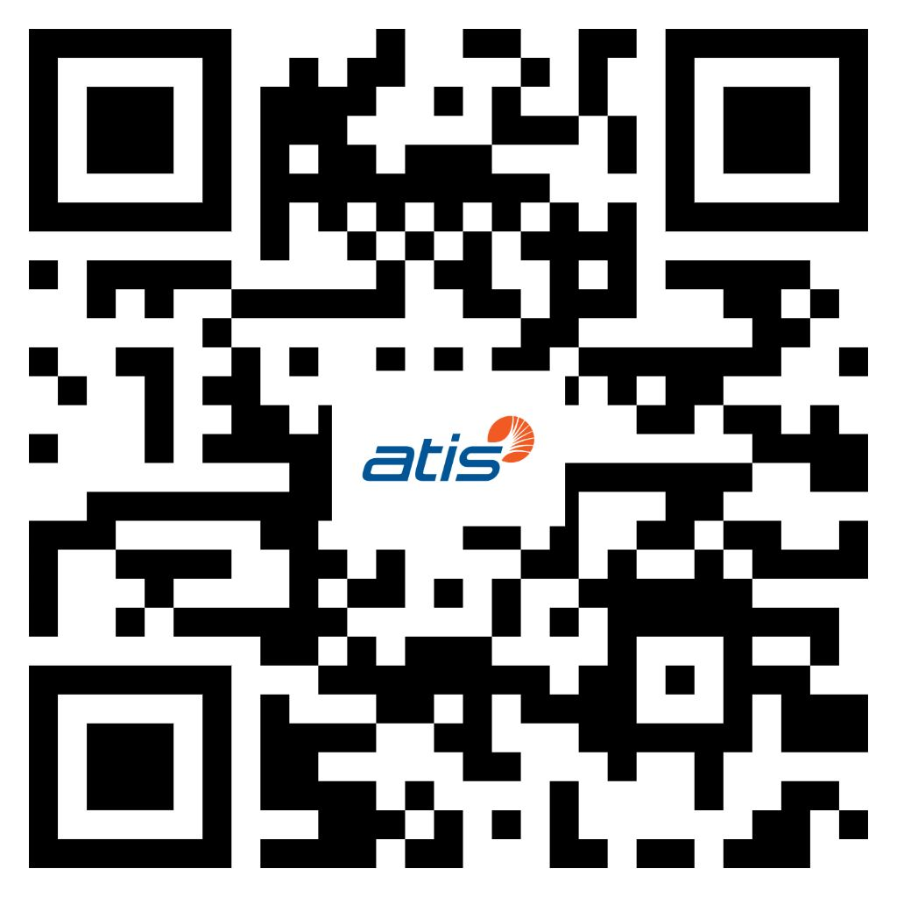
3GPP Plenary Meetings Baltimore December 8-12, 2025
Meeting Venue:
Baltimore Marriott Waterfront Hotel
  700 Aliceanna St, Baltimore, MD 21202
Visa Invitation Letter Request:
Delegates still requiring a visa letter for Baltimore are encouraged to apply immediately.
https://visas.3gppmeetings.atis.org/
Notes:
“if you need a visa apply now” delegates are encouraged to apply as soon as possible

Slide 20
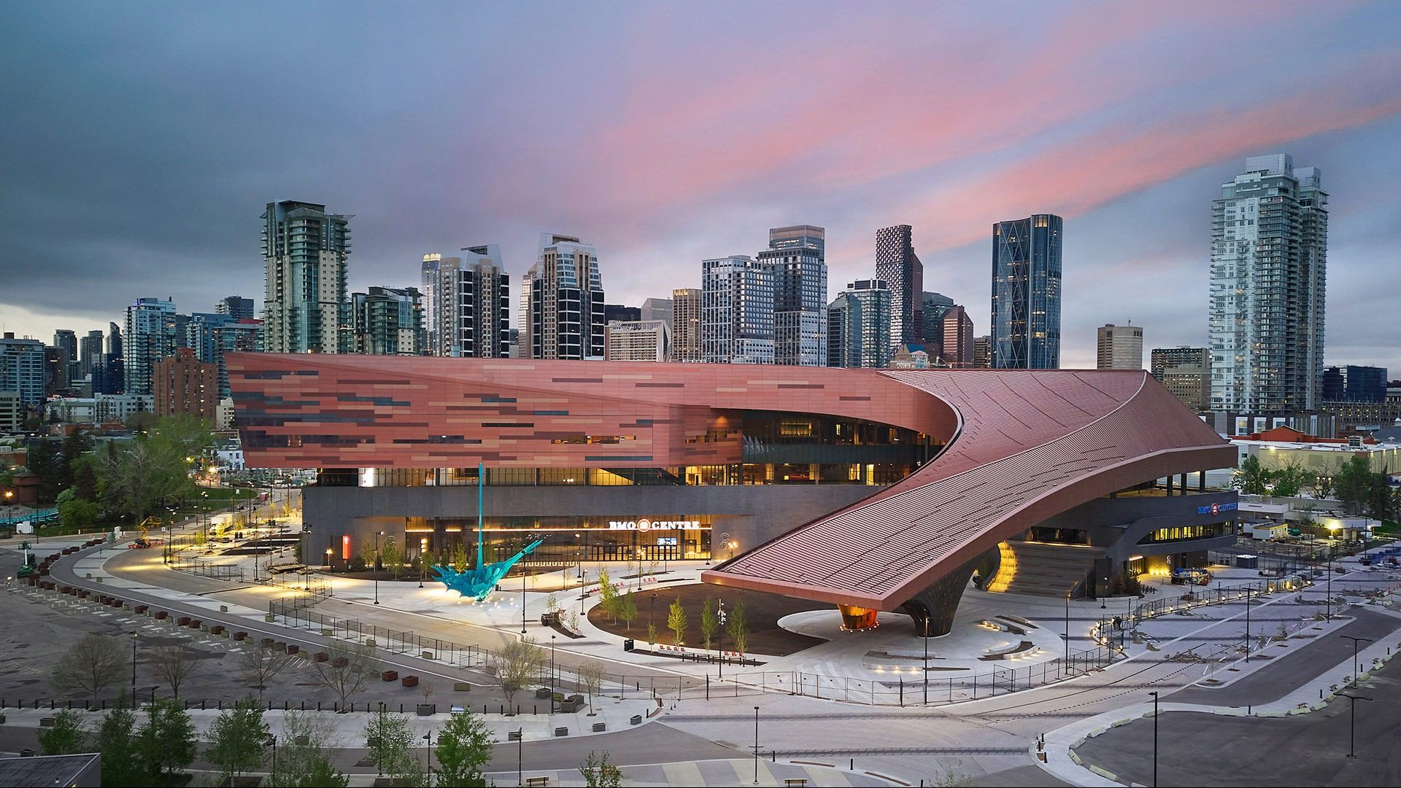
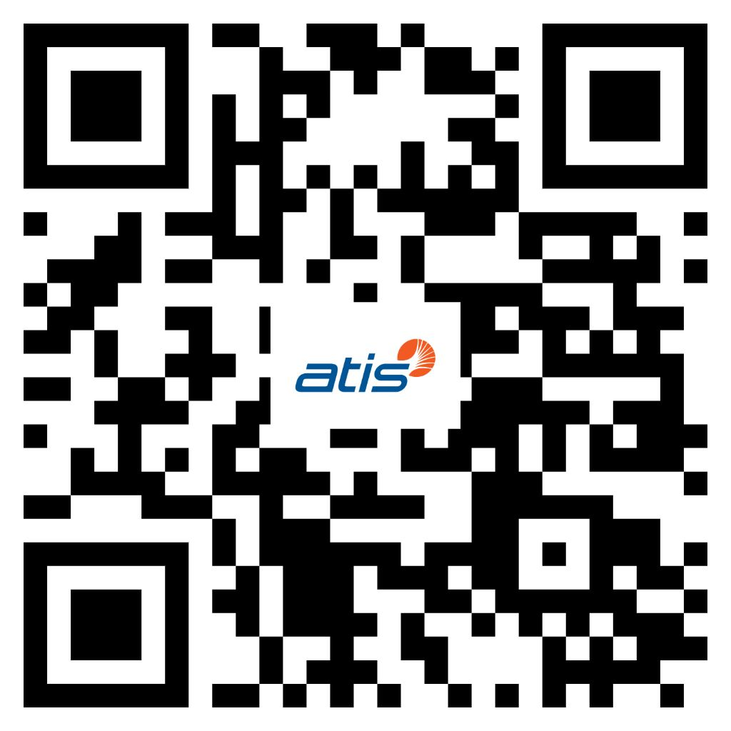
3GPP Working Group Meetings Calgary November 16-20, 2026
Meeting Venue:
BMO Centre at the Calgary Stampede
  1912 Flores Ladue Parade SE • Calgary, AB T2G 2W1, Canada
Some hotels are sold out. View website at the QR code above to view hotel availability.
Visa Invitation Letter Request:
Delegates requiring visas are encouraged to register via the 3GPP Portal apply for their visa letter as soon as possible
https://portal.3gpp.org/#/

Slide 21
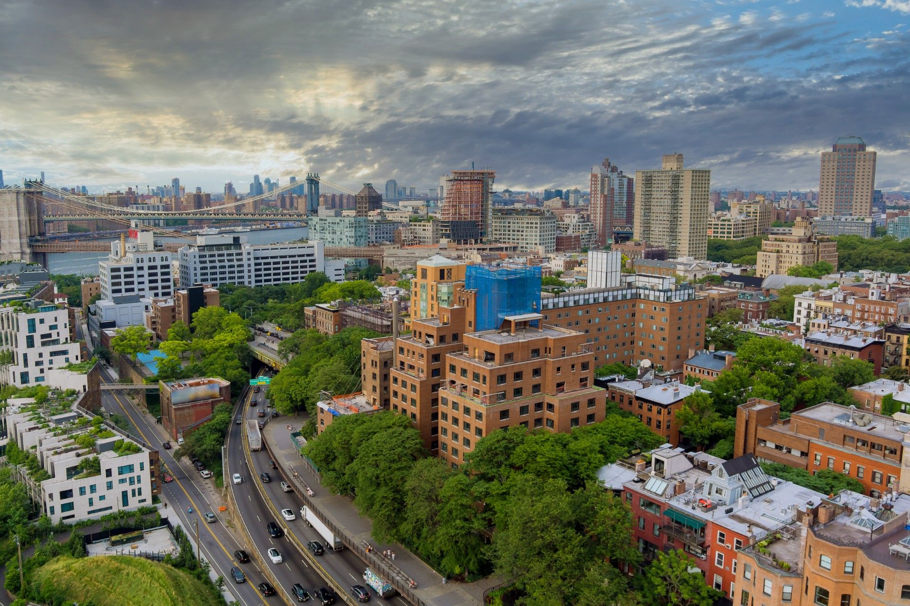
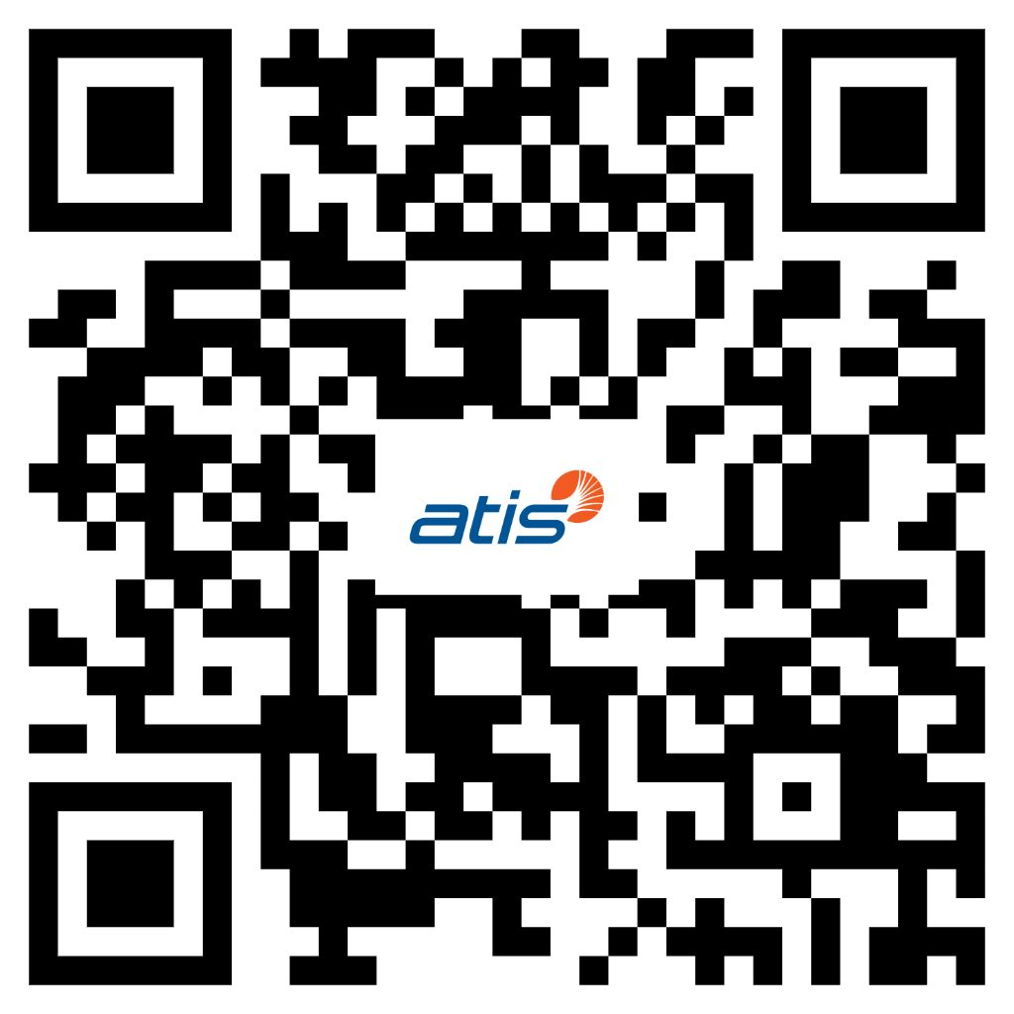
3GPP Plenary Meetings Boston December 7-11, 2026
Meeting Venue:
Hilton Boston Park Plaza
50 Park Plaza, Boston, MA 02116
If you require a visa letter to attend the December 2026 TSGs, please complete the below form at your earliest convenience.
  https://visas.3gppmeetings.atis.org/

Slide 22
ATIS Wishes 3GPP Delegates a Successful Meeting
Notes:
Same for both hotels

