Slide 1
R19 FS_AmbientIoT Drafting Session
Rapporteurs: Runze Zhou, Fei Lu

Slide 2

Agenda of the drafting session
Ambient IoT roaming scenarios
Based on slides of pre-meeting CC and DP in S2-2404489
Discuss proposals in S2-2404489
AIoT Device capability
Support of UICC
Storage (e.g. Volatile / non-volatile )
Comparison with RFID technology(S2-2404395, NEC)

Slide 3
Ambient IoT roaming scenarios
AIoT Service operation area is:
Private area, e.g. warehouse owned/accessed by a single enterprise
Shared area, e.g. warehouse shared/accessed by multiple enterprises
→Potential impact:
Who owns the Device credential?
What information contains in the Device ID?

Slide 4
Ambient IoT roaming scenarios
Where does the third party AF(enterprise) access its AIoT Device?
In a single area
Assuming a certain AIoT network the AF will request for AIoT service
In Multiple areas
Same or different AIoT network may be requested by the AF
→Potential impact:
How to fetch the Device credential, especially for “multiple area use case”?

Slide 5
Ambient IoT roaming scenarios- options
Discussion paper – S2-2404489
which options need to be supported in rel-19?
Way forward:
Which options NOT to be supported in rel-19?
Way forward:
Whether to capture the consensus in the TR (e.g. in Annex)?

Slide 6
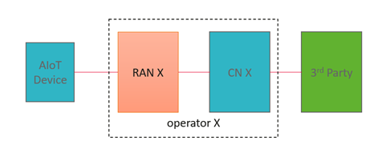
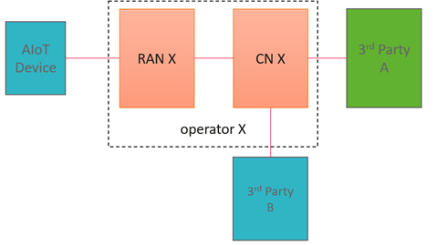
Ambient IoT roaming scenarios- options
Option 1: Single Network (non-roaming like)
Option 1A
Option 1B
Use case: 3rd party use CN X’s network to manage the AIoT devices somewhere in China.
- SLA between CN X and 3rd party. CN X authorize the request from 3rd party
- Device ID and the credentials are held in AUSF/UDM in CN X.
Use case: 3rd party A use CN X’s network to operate (e.g. read) the AIoT devices belongs to 3rd party B somewhere in China.
- SLA between 3rd party A, 3rd party B and CN X. CN X authorize the request from 3rd party A.
- Device ID and credentials are held in AAA in 3rd party B.

Slide 7
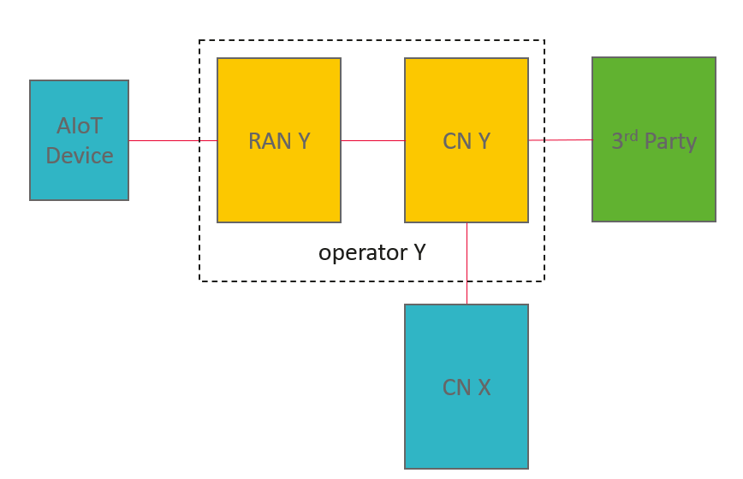
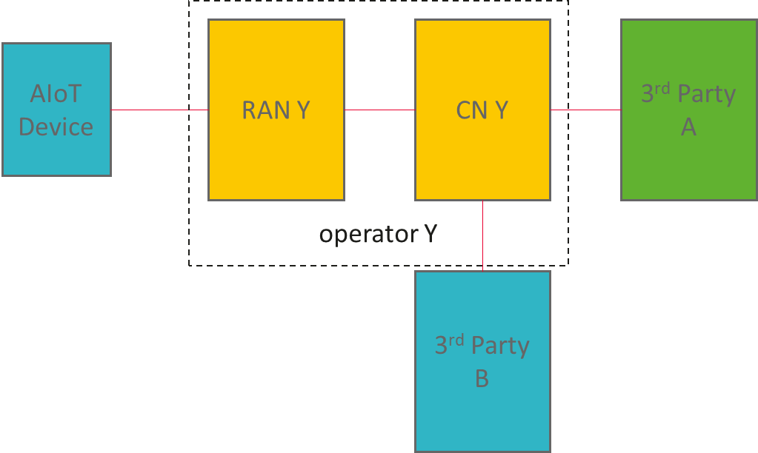
Ambient IoT roaming scenarios- options
Option 2: local breakout roaming (like)
Option 2A
Option 2B
Use case: 3rd party in China access CN Y’s network to manage the AIoT devices somewhere in Sweden.
- SLA between 3rd party and CN X for device credential in CN X.
- SLA between CN X and CN Y.
- SLA between 3rd party and CN Y. CN Y authorizes the request from 3rd party
- Device ID and the credentials are held in AUSF/UDM in CN X.
- Use case: 3rd party A use CN Y’s network to operate (e.g. read) the AIoT devices belongs to 3rd party B. The AIoT devices somewhere in Sweden which belong to 3rd party B.
- SLA between 3rd party A, 3rd party B and CN Y. CN Y authorize the request from 3rd party A.
- Device ID and credentials are held in AAA in 3rd party B.

Slide 8
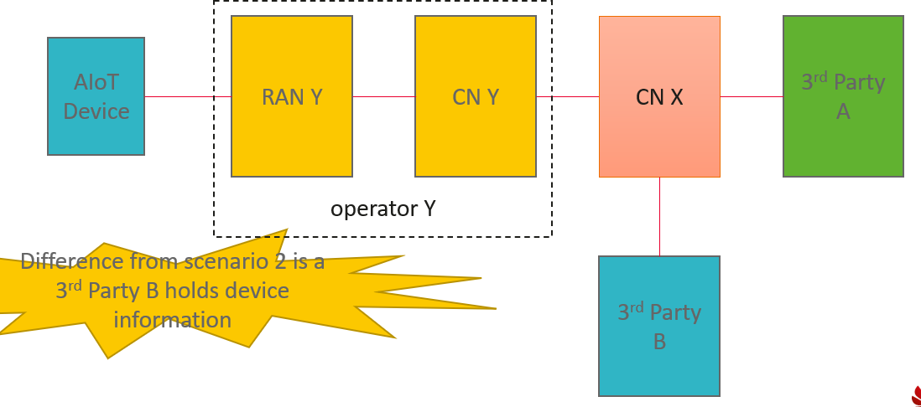
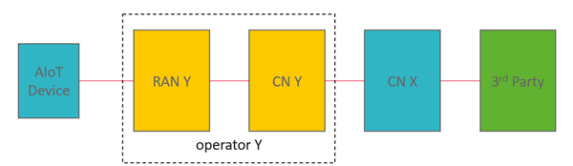
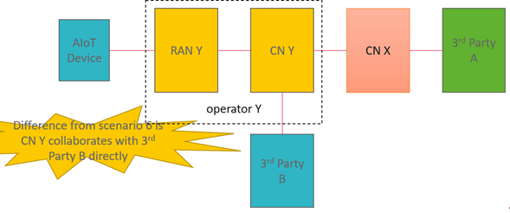
Ambient IoT roaming scenarios- options
Option 3: home routed roaming (like)
Option 3A
Option 3B
Option 3C

Slide 9
Ambient IoT Device Capability
Support of UICC
Storage (Volatile / non-volatile )
Other aspect?

Slide 10
Comparison with RFID technology (S2-2404395)
Motivation?

