Slide 1
EU 5G Scheme Development
  ENISA EU5G team
22
03
2023 - 3GPP SA Plenary, Rotterdam

Slide 2

Who we are
The European Union Agency For Cybersecurity is dedicated to achieving a high common level of cybersecurity across Europe.
    Acts as a centρε of expertise on cybersecurity
    Collects and provides independent, high quality technical advice and assistance to Member States and EU bodies on cybersecurity
    Contributes to developing and implementing the Union’s cyber policies
    Since 2004
    Athens ­­/ Heraklion / Brussels
Notes:
For more than 15 years.
In order to build a trusted and cyber secure Europe.

Slide 3
What is EU5g?
EU-wide cybersecurity certification scheme
    EU public authorities support and enhance cybersecurity of 5G
    Legally-supported way to highlight cybersecurity achievements
    Certify once, be accepted across EU
Voluntary
Contains
  Technical criteria for products and functions evaluation
Notes:
Comparability and repeatability of evaluation results is achieved through the scheme and supporting specs

Slide 4
EU 5G Scheme proposed structure
    The scheme will be organized into –at least- 3 different components:
GSMA NESAS
GSMA SAS SM/SAS UP
eUICC: updated Protection Profile
processes on provisioning
eUICC secure development
SGP 25 v03+ poss. enhancements
Notes:
The scheme will be organized into 3 different components:
Existing GSMA/3GPP schemes and structures on NESAS will be transformed into a relevant EU scheme, reusing the lessons learned from BSI implementation
eUICC certification will be based on the EUCC scheme with the appropriate Protection Profile(s) to allow also convergence with the eIDAS/wallet
Existing GSMA/3GPP schemes and structures on NESAS will be transformed into a relevant EU scheme, reusing the lessons learned from BSI implementation
SAS processes on SIM provisioning and eUICC secure development will be transformed to the possible extend into a relevant EU scheme, in close relation with the eUICC certification strategy

Slide 5
EU 5G Scheme preparation process
Background
Technical specifications
reference /Technical specifications coordination
Standards
💡
Reference
Ad-hoc working group
Cioordination
Cioordination
Advice
💡
NIS CG
Request for a European
Cybersecurity
Certification Scheme
📄
Draft Candidate
European
Cybersecurity
Certification Scheme
Candidate European
Cybersecurity
Certification Scheme
📄
ENISA
Opinion
…
ECCG
…
💡
Opinion
Advice
✓
Based on the URWP
Commission requests ENISA to
prepare a candidate scheme or
review an existing one
📄
Adoption by Comitology
📄
European Commission
📝
Draft URWP
Final URWP
📄
Draft Implementing
Act
EU 5G
scheme
SCCG
💡
Advice
Public Consultation

Slide 6
Developing Eu5G:
Thematic groups (TGs)
EU5G team
TG 1 | a.(Re-)structure a harmonized evaluation methodology allowing for comparable results in the NESAS audits
TG 2 | b. Further mapping to relevant assurance level for NESAS (initially TG 2)
TG 3 | Strategic communication and alignment with Standardization Organizations (SDOs)
TG 4 | Certification structure for NESAS
TG 5 | a. Certification structure for SAS-SM/SAS-UP
 | b. Guidance for eUICC evaluations and site audits under EUCC (initially TG 6)
TG 7 | eUICC PP analysis and updates
TG 8 | Accreditation harmonization
TG 9 | Anticipation of what has to be addressed in EU 5G scheme vs.2

Slide 7
CUrrent activitIes on EU 5G
EU5G drafting and status update
    ENISA plans a first draft of the scheme to be available for public review at mid 23
    The AHWG supporting ENISA has been maintained for phase 2, it is composed of a rich representation of relevant stakeholders (in total around 100 participants):
      eUICC and network products developers
      CABs
      MNOs
      standardisation organisations
      national authorities both telco and cybersecurity regulators

Slide 8
refering to standards:
Why And How?
Requirement of EU Law (Cybersecurity Act 2019/881)
  ➔ Meet EU public policy objectives, and
  Take into account industry- and community-driven, state of the art specifications
  Develop non-discriminatory certification schemes
  Take part in the conversation with all stakeholders (vendors, operators, users,…)
  Contribute to development and improvement of standards at international level

Slide 9
Principles and practices: status of documents
EU Law defines what standards the scheme can refer to
  Cybersecurity Act 2019, EU regulation 1025/2012
International or European Standards (EU Regulation 1025/2012)
  ISO, IEC, ITU-T
  CEN, CENELEC, ETSI
-> May qualify as “Technical specification” per EU regulation if
  market acceptance
  non-conflict with European standard
  development criteria
    openness, consensus, transparency, availability, quality, maintenance…
  …
Notes:
Technical specification according to CSA / 1025/2013 includes ETSI PAS

Slide 10
Example of Status Translation
EU 1025/2012 status
Evaluation methodology for GSMA NESAS (NESAS audits)
Evaluation methodology for EU5G (NESAS audits)
FS.15
TS “FS.15”
FS.16
TS “FS.16”
Successor
Precursor
FS.46
TS “FS.46”

Slide 11
TG 3 on Standards
“Strategic communication and alignment with standards organisations”
Ensure standards are available to cover EU5G reqts
Right documents
Right status
Right time
Main output: timeline of standards availability
Going from requirement to standard availability data
…not all requirements need to be covered by a reference to a standard

Slide 12
Specifics of TG 3 work
Facilitation
Commun-ication
Benefits of the certification scheme developers and standard developers
No published output
Alignment
EU5G development (TGs)
Mutual understanding
Trust and certainty
Not the place to make strategic decisions
SDOs, Technical committees

Slide 13
Expectations for 3GPP-
Open questions

Slide 14
Expectations-open questions
The difficult part of the discussion
Some change requests may be derived from findings and needs of the European certification context
EU Certification timetable may be distinct from 3GPP’s
Change requests may relate to different 3GPP releases (e.g. 17,18 or 19) based on industry-expressed needs
A structured inventory of specifications used for product evaluation (for evaluation comparability) is intended to be developed in EU 5G
“Proxy specification” (dynamic inventory of specifications used in the EU 5G scheme) proof of concept

Slide 15
“Proxy specification” document
Proxy specification proof of concept
EU5G
Certification scheme
  EU Legal document
  Updates:
  Major evolutions
  Infrequent
Standards / TS with stable ref.
latest version
Stable reference
Specific (dated) standard versions
“Library of pointers” Proxy TS
Stable reference
Frequent updates

Slide 16
THANK YOU!
QUESTIONS?
European Union Agency for Cybersecurity
14, Agamemnonos str.- Chalandri 15231, Attiki, Greece
+302814409530
Philippe.Magnabosco@enisa.Europa.eu/Vassiliki.Gogou@enisa.europa.eu
www.enisa.europa.eu

Slide 17
EU 5G Scheme -Backup slides
  ENISA EU5G team
22
03
2023

Slide 18
Participants input (timeline focused)
Timeline
TG input
Data | Notes
Requirement(s) to be covered | Requirement ID *
Document reference | TC’s own reference
SDO / TC | Identification at TC level
Stage (date of entry into stage) | As per stage mapping
Date of final availability | End of work for TC
Precursor | If any. TC’s name and reference
Successor OR Reference-ready (“ref-ready”) | Successor: TC’s name and reference
SDO / TC
input

Slide 19
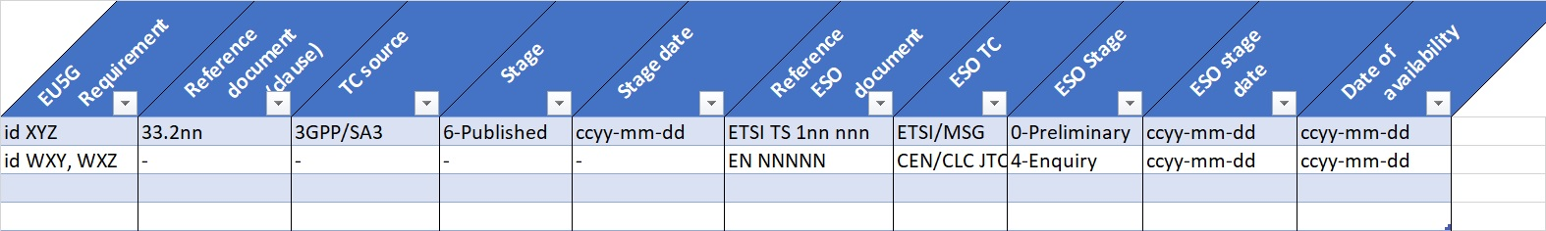
Requirement/Availability view

Slide 20
Principles and practices
Sources
  Legal requirements
  Established practices of SDOs and certification
May include
  Reference undated documents rather than specific, dated editions (legal requirement)
  Stage of development at which reference becomes permissible
  How to handle stable references across document versions
  Where/when/how to submit technical proposals for inclusion into standards

Slide 21
EU5G - SDO interaction toolbox
Visibility on status of ENISA and AHWG members within technical committees
How-to interact
  Points of contact
  Type and nature of possible submissions to TCs
Terms and processes
  Understanding of differences between terminologies of various organisations (e.g. types of document, stages in the development lifecycle etc…)

Slide 22
MAnaging reference stability
References in the Certification scheme are undated
  …and unspecific, i.e. does not point at specific clauses
  Certification scheme update cycle not congruent with the lifecycle of standards
There may be needs to point at a dated version of a document
  To be evaluated on a case-by-case basis
  Possible reasons: maturity of subject matter, technical consistency across references…
Possible solution: reference to a standardised “Pointer document(s)”
  Pointers inside document to be updated by regular maintenance
  Reference to pointer document(s) remains stable

Slide 23
Some OPEN QUESTIONS
Requirement identification?
  Name, description?
  Granularity of requirements needed for follow-up?
Document dependencies?
  Normative references: can they be a problem? When?
Reference to technical products?
  By standards, name?
Maturity of documents?
  When are we in a “safe zone” reg. document availability and content?

Slide 24
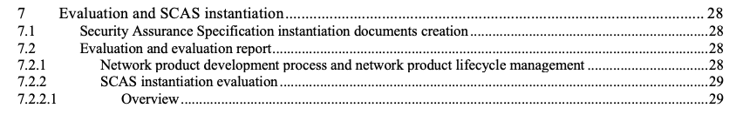
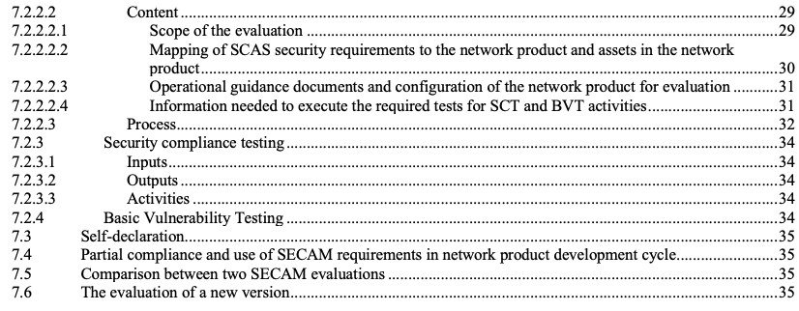
SCAS testing evaluation methodology
TR 33.916 ToC / parts will be reused

