Slide 1
Discussion on 5G NR CADC configuration handling in RAN5
3GPP TSG-RAN5 Meeting #94-e R5-221397
Electronic Meeting, Feb 21 – Mar 4, 2022
CMCC, Huawei, Hisilicon, Ericsson, China Unicom, China Telecom, Nokia, CAICT, Bureau Veritas, ZTE

Slide 2
The existing Tdocs on how to handle 5G NR CADC config. WIs in RAN5
No. | TDoc Number | TDoc Title
1 | R5-195406 (RAN5#83) | WF update for Rel-16 NR CADC band combinations WI
2 | R5-197600 (RAN5#84) | WF update for Rel-16 NR CADC band combinations WI
3 | R5-198048 (RAN5#85) | Discussion on how to update Rel-16 NR CA/DC band combinations WI
4 | R5-201917 (RAN5#87e) | Discussion on how to introduce Rel-16/15 NR CADC band combinations/new bands/new BWs into TS 38.521-1/-2/-3
5 | R5-212566 (RAN5#91e) | Way forward on how to bring contributions to "NR_CADC_NR_LTE_DC_R16-UEConTest“ WI and "NR_CADC_NR_LTE_DC_R17-UEConTest“ WI
6 | R5-215709 (RAN5#92e) | Handling of CA/DC basket WIs and HP (high power) WIs
7 | R5-217504 (RAN5#93e) | Way forward on how to bring contributions to "NR_CADC_NR_LTE_DC_R16-UEConTest“ WI and "NR_CADC_NR_LTE_DC_R17-UEConTest“ WI
8 | R5-217767 (RAN5#93e) | Checklist - NR CA; NR-DC and EN-DC configurations for RAN5#93-e (latest version)
9 | R5-217498 (RAN5#93e) | Checklist - Rel-17 NR CA; NR-DC and EN-DC configurations for RAN5#93-e (latest version)
Observation 1: As of RAN5#93-e, the guide on how to handle 5G NR CADC configuration WIs is scattered across all the Tdocs above and maybe more Tdocs in the future, which leads to hard collection of all the latest guidelines.
Proposal 1: To create a living RAN5 PRD to give guideline/checklist on how to handle 5G NR CADC configuration WIs and how to introduce new 5G NR CADC configuration into RAN5 specs basing on the existing 9 Tdocs (R5-195406/197600/198048/201917/212566/215709/217504/217767/217498).

Slide 3
The existing WIs in the scope of 5G NR CADC config. WIs in RAN5
UIC | WI Name | Prog. | Rapp.
760087 | UE Conformance Test Aspects - 5G system with NR and LTE Sub-WI: Rel-15 NR bands, NR CA/DC and EN-DC configurations |  | E///
830083 | UE Conformance Test Aspects - Rel-16 NR CA and DC; and NR and LTE DC Configurations | 7% | CMCC
900056 | UE Conformance - Rel-17 NR CA and DC; and NR and LTE DC Configurations | 7% | Huawei
911000 | UE Conformance - High power UE (power class 2) for EN-DC with 1 LTE band + 1 NR TDD band | 16% | CU
920065 | UE Conformance - SAR schemes for UE power class 2 (PC2) for NR inter-band Carrier Aggregation and supplemental uplink (SUL) configurations with 2 bands UL | 17% | China Telecom
920066 | UE Conformance - Rel-17 High power UE for NR inter-band Carrier Aggregation with 2 bands downlink and x bands uplink (x=1,2) | 16% | China Telecom
930051 | UE Conformance - Power Class 2 for EN-DC with x LTE bands + y NR band(s) in DL and with 1 LTE band +1 TDD NR band in UL (either x= 2, 3, y=1 or x=1, 2, y=2) | 5% | Ericsson
870062 | UE Conformance Test Aspects - High power UE (power class 2) for EN-DC (1 LTE TDD band + 1 NR TDD band) | 100% | CMCC
Observation 2: As of RAN5#93-e, the above 8 WIs are in the scope of 5G NR CADC config WIs, and 7 of the above WIs have already introduced “interested operators” into their WPs.
Proposal 2: The new RAN5 PRD proposed in Prop 1 will apply to all the 8 WIs (UIC=760087, 830083, 900056, 911000, 920065, 920066, 930051, 870062).

Slide 4
The existing NR bands WIs relate to 5G NR CADC config. WIs in RAN5
UIC | WI Name | Prog. | Rapp.
850062 | UE Conformance Test Aspects - New Rel-16 NR bands and extension of existing NR bands | 69% | Ericsson
900055 | UE Conformance - New Rel-17 NR licensed bands and extension of existing NR bands | 28% | Huawei
Observation 3: As of RAN5#93-e, the above 2 NR bands WIs relate to 5G NR CADC configuration WIs. As agreed in R5-195406, only after the Rel-16 new bands have been introduced into RAN5 Rel-16 test specs, the Rel-16 new band combos could be introduced into RAN5 Rel-16 test specs. The introduction of Rel-16 new bands is out of the scope of “NR_CADC_NR_LTE_DC_R16-UEConTest” WI.
Proposal 3: Only after the Rel-16/17 new bands have been introduced into RAN5 test specs, the Rel-16/17 new band combos could be introduced into RAN5 test specs. The introduction of Rel-16/17 new bands is out of the scope of “NR_CADC_NR_LTE_DC_R16-UEConTest” (UIC=830083) and “NR_CADC_NR_LTE_DC_R17-UEConTest” WI (UIC=900056).

Slide 5
The existing NR bands WIs relate to 5G NR CADC config. WIs in RAN5
UIC | WI Name | Prog. | Rapp.
850062 | UE Conformance Test Aspects - New Rel-16 NR bands and extension of existing NR bands | 69% | Ericsson
900055 | UE Conformance - New Rel-17 NR licensed bands and extension of existing NR bands | 28% | Huawei
Observation 3: As of RAN5#93-e, the above 2 NR bands WIs relate to 5G NR CADC configuration WIs. As agreed in R5-195406, only after the Rel-16 new bands have been introduced into RAN5 Rel-16 test specs, the Rel-16 new band combos could be introduced into RAN5 Rel-16 test specs. The introduction of Rel-16 new bands is out of the scope of “NR_CADC_NR_LTE_DC_R16-UEConTest” WI.
Proposal 3.1: Only after the Rel-16/17 new bands have been introduced into RAN5 test specs, the Rel-16/17 new band combos could be introduced into RAN5 test specs. The introduction of Rel-16/17 new bands is out of the scope of “NR_CADC_NR_LTE_DC_R16-UEConTest” (UIC=830083) and “NR_CADC_NR_LTE_DC_R17-UEConTest” WI (UIC=900056).
Proposal 3.2: The introduction of new NR bands and extension of existing NR bands shall follow the same process as configuration specific WIs to involve “Interested operator” also.

Slide 6
The existing feature specific WIs relate to 5G NR CADC config. WIs in RAN5 (1/3)
Observation 4.1: As of RAN5#93-e, the following 9 feature specific WIs relate to 5G NR CADC configuration WIs. Specific configurations will be used to complete the corresponding test cases in the following 9 WIs.
UIC | WI Name | Prog. | Rapp.
760087 | UE Conformance Test Aspects - 5G system with NR and LTE, Except for Sub-WI “Rel-15 NR bands, NR CA/DC and EN-DC configurations” |  | E///
870061 | UE Conformance Test Aspects - RF requirements for NR frequency range 1 (FR1) | 56% | Huawei
910098 | UE Conformance Test Aspects - NR RF requirement enhancements for frequency range 2 (FR2) | 48% | Nokia
911004 | UE Conformance Test Aspects - LTE-NR & NR-NR Dual Connectivity and NR CA enhancements | 6% | Nokia
870062 | UE Conformance Test Aspects - High power UE (power class 2) for EN-DC (1 LTE TDD band + 1 NR TDD band) | 100% | CMCC
911000 | UE Conformance - High power UE (power class 2) for EN-DC with 1 LTE band + 1 NR TDD band | 16% | CU
920065 | UE Conformance - SAR schemes for UE power class 2 (PC2) for NR inter-band Carrier Aggregation and supplemental uplink (SUL) configurations with 2 bands UL | 17% | CT
920066 | UE Conformance - Rel-17 High power UE for NR inter-band Carrier Aggregation with 2 bands downlink and x bands uplink (x=1,2) | 16% | CT
930051 | UE Conformance - Power Class 2 for EN-DC with x LTE bands + y NR band(s) in DL and with 1 LTE band +1 TDD NR band in UL (either x= 2, 3, y=1 or x=1, 2, y=2) | 5% | E///

Slide 7
The existing configuration specific WIs relate to 5G NR CADC config. WIs in RAN5 (2/3)
Observation 4.2: As of RAN5#93-e, the following 3 configuration specific WIs relate to 5G NR CADC configuration WIs. Configuration specific WIs aim for introducing configuration test cases into RAN5 specs, while feature specific WIs aim for introducing new feature test cases into RAN5 specs.
UIC | WI Name | Prog. | Rapp.
760087 | UE Conformance Test Aspects - 5G system with NR and LTE, Sub-WI “Rel-15 NR bands, NR CA/DC and EN-DC configurations” |  | E///
830083 | UE Conformance Test Aspects - Rel-16 NR CA and DC; and NR and LTE DC Configurations | 7% | CMCC
900056 | UE Conformance - Rel-17 NR CA and DC; and NR and LTE DC Configurations | 7% | HW

Slide 8
The existing feature specific WIs relate to 5G NR CADC config. WIs in RAN5 (3/3)
Proposal 4.1: Only the “Ongoing” or “Completed” configurations in Rel-16 configuration specific WI can be used to complete the Rel-16 feature specific WIs. Otherwise, one specific “Ongoing” or “Completed” configuration in Rel-17 and forward configuration specific WIs shall be used to complete the Rel-16 feature specific WI. The corresponding progress shall be reflected both in the Rel-16 feature specific WI WP and the PRD21 5G NR bands and CADC configurations list.
Proposal 4.2: Only the “Ongoing” or “Completed” configurations in Rel-17 configuration specific WI can be used to complete the Rel-17 feature specific WIs. Otherwise, one specific “Ongoing” or “Completed” configuration in Rel-18 and forward configuration specific WIs shall be used to complete the Rel-17 feature specific WI. The corresponding progress shall be reflected both in the Rel-17 feature specific WI WP and the PRD21 5G NR bands and CADC configurations list.
Proposal 4.3: Only the feature specific configurations can be introduced into RAN5 specifications under the feature specific WIs(UIC=760087/870061/910098/911004/870062/911000/920065/920066/930051). All the other configurations shall be introduced into RAN5 specifications under the configuration specific WIs(UIC=760087, 830083, 900056).
Notes:
When specific Rel-16 configurations are needed to be used to complete test cases introduced by Rel-16 feature specific WIs, the specific Rel-16 configurations shall be picked out among the “Ongoing” or “Completed” configurations in Rel-16 configuration specific WI. If there is no "Ongoing" or "Completed" configuration in Rel-16 configuration specific WI can be used to complete the test cases introduced by some Rel-16 feature specific WI, one specific “Ongoing” or “Completed” configuration in Rel-17 and forward configuration specific WIs shall be used to complete the test cases introduced by the Rel-16 feature specific WI, and shall be picked out by the Rel-16 feature specific WI rapporteur and the Rel-17 and forward configuration specific WI rapporteur together. The corresponding progress shall be reflected both in the Rel-16 feature specific WI WP and the PRD21 5G NR bands and CADC configurations list

Slide 9
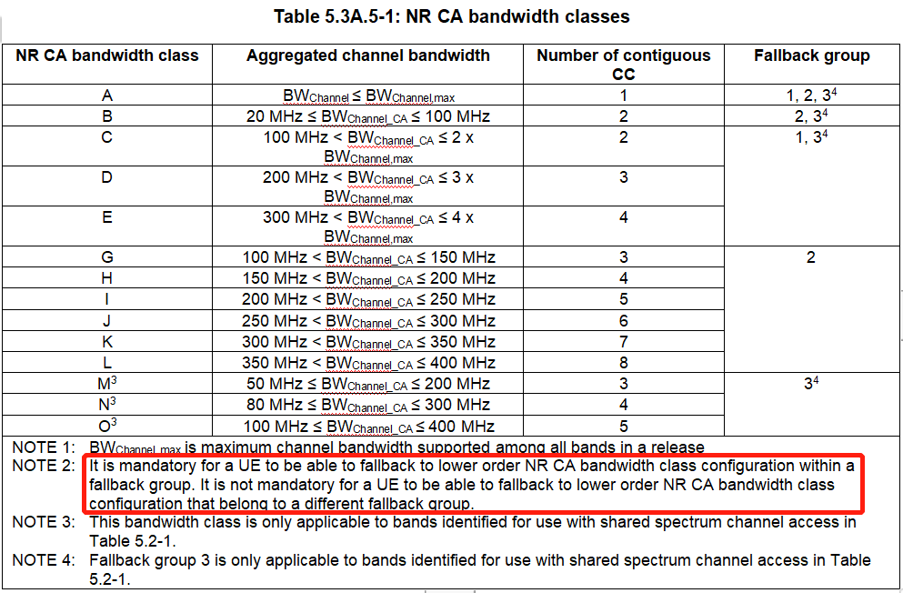
How to handle the 5G NR CADC fallback config. w/o interested operators
Observation 5: As per the discussion on R5-217339 during RAN5#93-e, there are 5G NR CADC fallback configurations without “interested operators” but still need to be completed as long as they are in the same fallback groups of the configurations with “interested operators”.
Proposal 5: For the 5G NR CADC fallback configurations without “interested operators”, as long as they are in the same “Fallback group” of the configurations with “interested operators”, they shall be tagged as “Ongoing (FB)” in the “Status” Column and are ready for accepting contributions. They also shall be tagged as “Completed (FB)” in the “Status” Column when they are 100% completed in the WPs. "Fallback group" applies to all intra-band contiguous band components in intra-band contiguous, intra-band non-contiguous or an inter-band configurations.

Slide 10
Completion of RAN5 NR bands and 5G NR CADC basket WIs and Tracking of status of NR bands and 5G NR CADC configurations in RAN5 (1/2)
Observation 6: At RAN5#93-e RAN5 endorsed a proposal for the minimum criteria of closing RAN5 LTE CA basket WIs and how to track status and declare completion of LTE CA configurations in R5-217086.
Proposal 6: It is proposed that same principles as endorsed for RAN5 LTE CA basket WIs are used for RAN5 NR band and 5G NR CADC basket WIs, that is:
  A RAN5 5G NR configuration list (attached to the new RAN5 PRD in proposal 1) is used to keep track of all the 5G NR CADC configurations covered by RAN5 NR bands and 5G NR CADC configuration basket Wis , including "Interested Operator" and the status of “Pending”, “Ongoing” and “Completed”
  RAN5 5G NR CADC configuration basket work items should focus on updating existing test cases and/or adding new test cases for the new type of 5G NR CADC configurations introduced by the work items
  The minimum criteria for closing a RAN5 5G NR CADC work item is that
    the associated RAN4 core work item(s) are completed
    all required new or existing test cases have been completed for at least one representative 5G NR CADC configuration
    all the 5G NR CADC configurations introduced by the associated RAN4 core work items are included in the RAN5 5G NR configuration list
  It is encouraged to keep RAN5 5G NR CADC configuration work items open until there are no “Ongoing” configurations in the 5G NR CADC configurations list for the work item.
  A “Completion Declaration Statement (CDS) + the WP attached” is used to formally declare RAN5 completed NR bands and 5G NR CADC configurations. The RAN5 TDOC number of the CDS would be recorded in the PRD21 list.
Notes:
A Completion Declaration Form + the WP attached. The RAN5 TDOC number of the completion declaration would be recorded in the PRD21 list

Slide 11
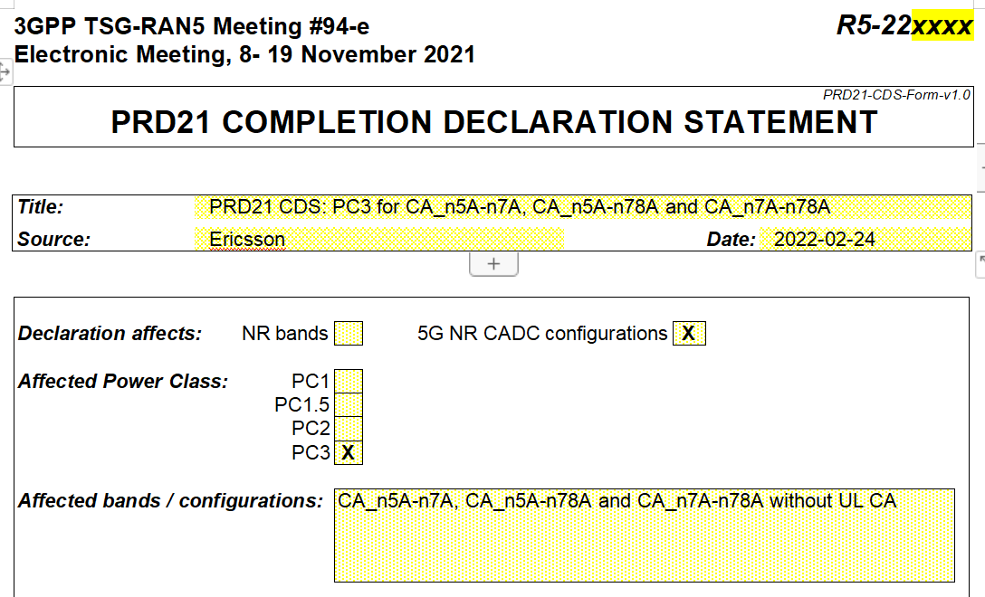
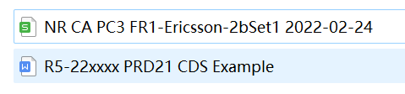
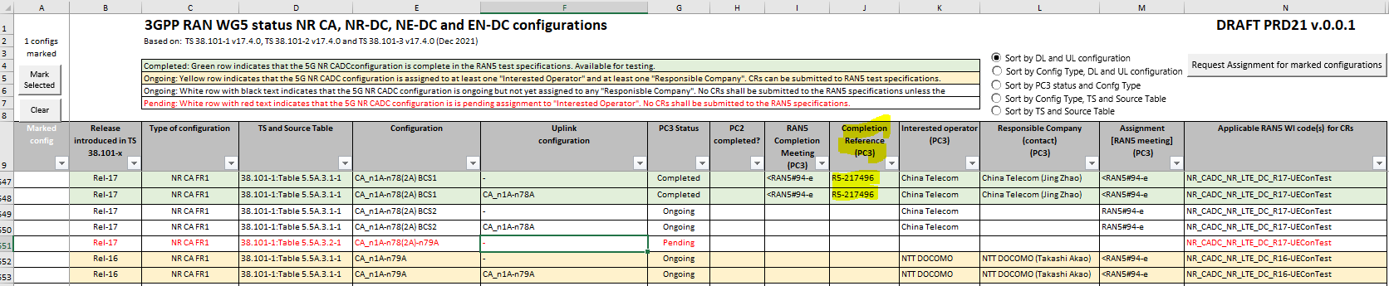
Completion of RAN5 NR bands and 5G NR CADC basket WIs and Tracking of status of NR bands and 5G NR CADC configurations in RAN5 (2/2)

Slide 12
Thank you!

