Slide 1
Introducing 3GPP
<Person, Title>

Slide 2
Content
The role of 3GPP
GSM roots
The 3GPP Eco-system
Organizing the work
…
Conclusions

Slide 3
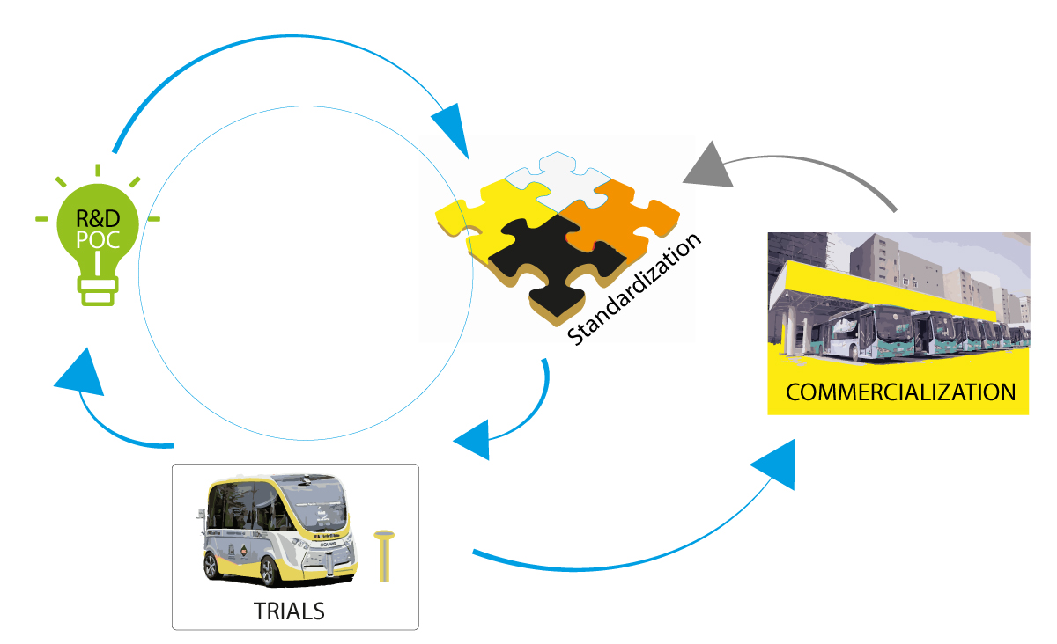

The role of 3GPP
Part of the invention, proof of concept, standardization, trials, commercialization …cycle
Specifications and Studies towards providing a complete system description for mobile telecommunications
The system description is characterized by a number of standardized interfaces, not a description of standardized deployment
This standardization approach enables an interoperable, multi-vendor approach to deployment and generates mass market economies of scale, without stifling innovation

Slide 4
Evolution …thanks to GSM
Generation | Systems
1G | Analogue technology, from the 1980s onwards (NMT, AMPS, TACS, A-Netz to E-Netz, Radiocom 2000, RTMI, JTACS and TZ-80n)
2G | First digital systems, deployed in the 1990s introducing voice, SMS and data services (GSM/GPRS & EDGE, CDMAOne, PDC, iDEN, IS-136 or D-AMPS).
3G | 3GPP evolved Global System for Mobile communication (GSM) with the evolution of General Packet Radio Service (GPRS) and Enhanced Data rates for GSM Evolution (EDGE), as well as further developments with the Universal Mobile Telecommunications System (UMTS) and High Speed Packet data Access (HSPA). 3G brought a global vision to the evolution of mobile networks, with the creation of the ITU's family of IMT-2000 systems which included EDGE, CDMA2000 1X/EVDO and UMTS-HSPA+ radio access technologies.
3G/4G | LTE and LTE-Advanced have crossed the “generational boundary” with high speed data, significant spectral efficiencies and adoption of advanced radio techniques, their emergence Evolution to LTE has been the direction of travel for [ all ] new mobile systems from Release 8 onwards.
5G | 5G brings another major technology step, with the creation of a 'New Radio' (NR), slated to be used alongside LTE-Advanced Pro in early 5G network launches.

Slide 5




3GPP standards eco-system
3GPP Organizational Partners (OPs)
The 3GPP Organizational Partners (OP) - 7 Standards Organizations - from China, Europe, India, Japan, Korea and the United States.
Participation in 3GPP by companies and organizations becoming Members of one of these 7 OPs.
Inputs on market requirements may come in to the Project via 3GPP Market Representation Partners (MRP).
There is a lot of additional external liaison activity…SDOs, Industry bodies, projects…
Official Liaisons on specification work:
450 MHz Alliance, AISG, Bluetooth, Broadband Forum (BBF), CableLabs, International Special Committee on Radio Interference (CISPR), CTIA, Digital Video Broadcasting (DVB) Project, Ecma, International, Expert Group for Emergency Access (EGEA), Eurescom, COST 273, European Radiocommunications Committee (ERC), Fixed Mobile Convergence Alliance (FMCA), GCF, Global TD-LTE Initiative (GTD), GPS Industry Council, GSM Association, HomeRF Forum, IDB Forum, IEEE, Internet Engineering Task Force (IETF), IrDA, International Multimedia Telecomunications Consortium (IMTC), Internet Streaming Media Alliance, ISO-ITU expert group, ISO MPEG / JPEG, ITU-T SG2, JAIN tm (Javatm APIs for Integrated Networks), The Java Community Process (JCP), Liberty Alliance Project, Metro Ethernet Forum (MEF), NENA, NGMN (Next Generation Mobile Networks), oneM2M, OMA (Open Mobile Alliance ), Open Networking Foundation (ONF), Open IPTV Forum, Object Management Group (OMG), PCS Type Certification Review Board (PTCRB), Portable Computer and Communications Association (PCCA), Presence and Availability Management (PAM) Forum, RSA Laboratories, SDR Forum, Sun Micro Systems Inc., Steerco, SyncML Initiative, Trusted Computing Group (TCG), TeleManagement Forum (TMF), TCCA, TIA /TR45, TIA/TR47, ITU, TV-anytime Forum, Voice eXtensible Mark-up Language (VXML) Forum, Wi-Fi Alliance, Wireless Broadband Alliance (WBA), WLAN Smart Card Consortium, Wireless World Research Forum (WWRF), World Wide Web Consortium (W3C)
(Source: extract from https://www.3gpp.org/about-3gpp/15-bodies-with-which-3gpp-has)
700+ companies
3GPP Market Representation Partners (MRPs)
5G Projects
Certification Bodies

Slide 6
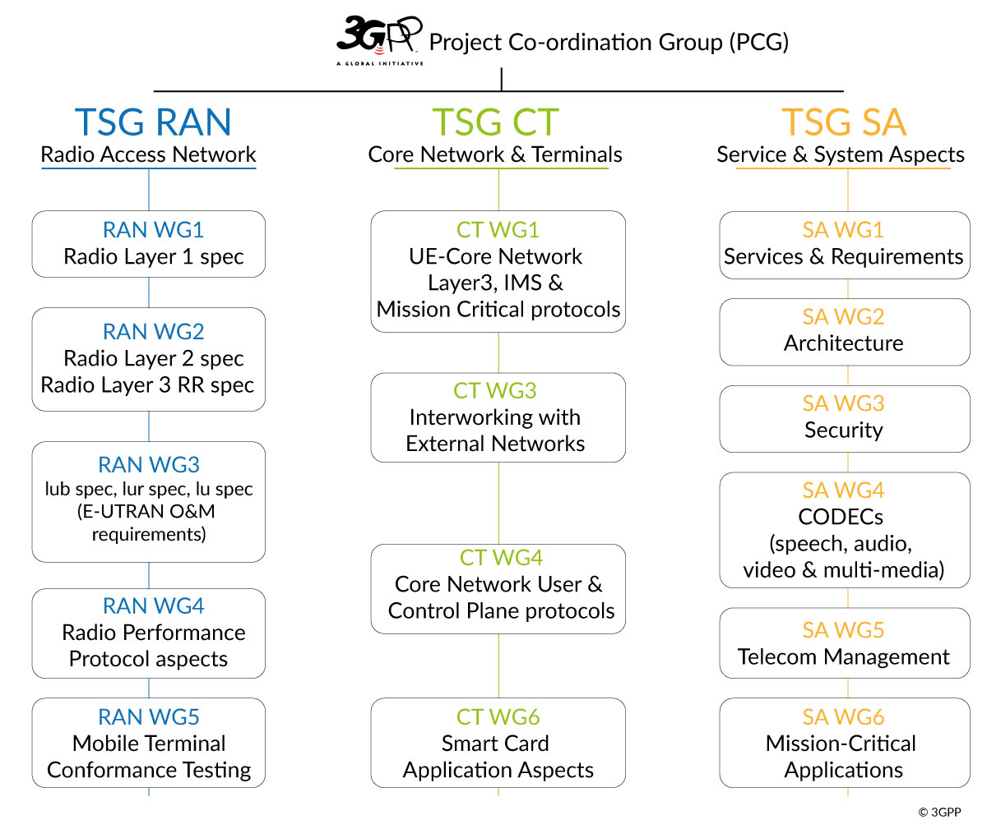
Specification Groups
The TSGs prepare, approve and maintain the 3GPP Technical Specifications and Technical Reports.
They are responsible for the detailed time frame and management of the work’s progress;
Management of work items;
Technical Co-ordination;
Proposal and approval of work items within the agreed scope and terms of reference of the TSG
The TSG Chairman is responsible for the overall management of the technical work within the TSG and its Working Groups.
The WG Chairman is responsible for the overall management of the technical work within the WG and its sub-groups.

Slide 7
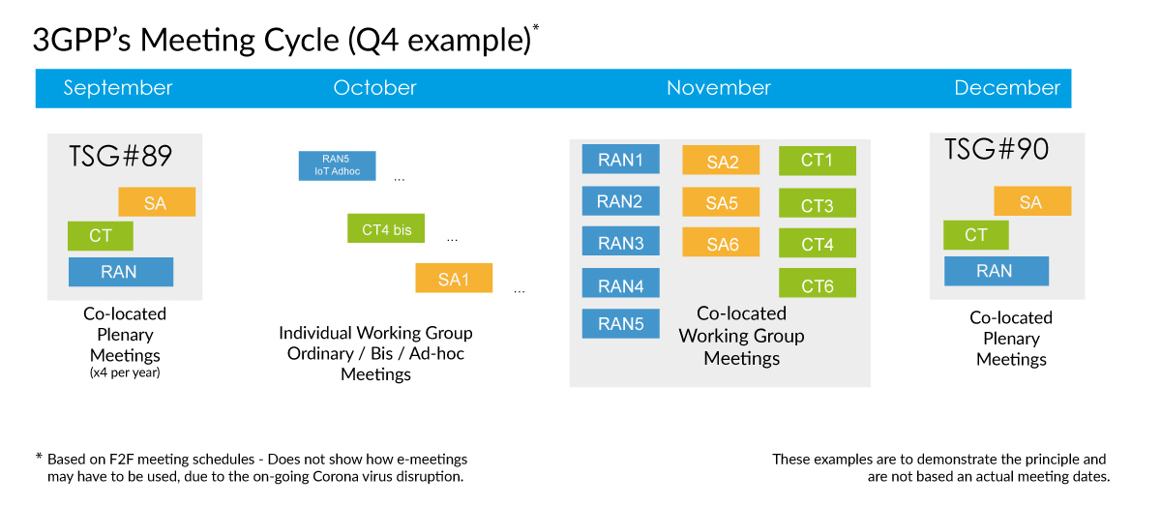
Work Schedule driven by technical meetings
New work initiated by member companies via Work Items as Tdocs at meetings
Work Items prioritised and allocted time for discussions in meetings
3GPP member companies contribute on equal terms to any work item
3GPP seeks consensus on all technical matters (but has mechanisms if consensus cannot be reached)
Release deadline respected, unfinished work deferred to a later release

Slide 8
Three stage approach
time
Stage 1 Requirements: Overall service description from the user’s standpoint.
SA1
Requirements
RAN
Radio Access
Stage 2
Architecture: Overall description of the organization of the network functions to map service requirements into network capabilities.
SA2
Architecture
SA3
Security
SA4
Media
SA5
OAM
SA6
Apps/MC
Stage 3
Protocols: The definition of switching and signalling capabilities needed to support services defined in Stage 1.
CT – Protocols & Coding

Slide 9
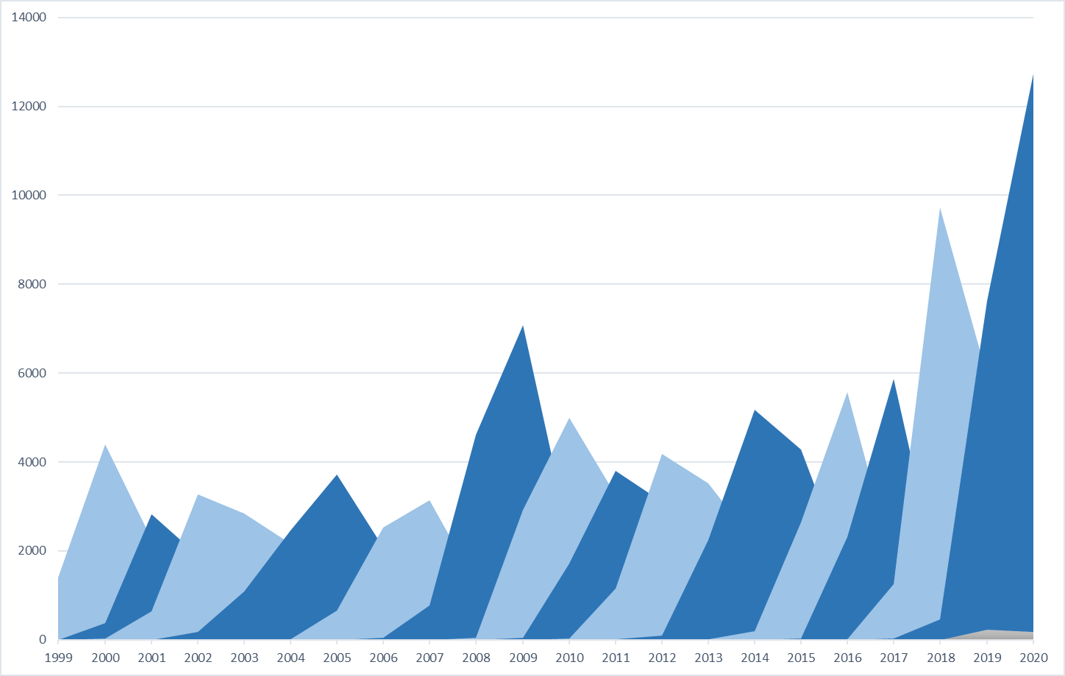




3GPP Work Plan
Release-based work
Releases are major packages of Features (new Release ~ every 15 – 24 months)
Strong commitment to time-lines guarantees reliable planning and time-to-market
Work plan built using Work Items that deliver the Features
Work Item Description exists for each of these
WI may cover more than one specification
WI may cover more than one TSG or WG
WI Description document exists for each WI
Multiple releases maintained in parallel
3GPP Work Plan:
http://www.3gpp.org/Work-Plan
R99
R4
R5
R6
R7
R8
R9
R10
R11
R12
R13
R14
R15
R16
R17
‘Change Requests’ per year by Release

Slide 10
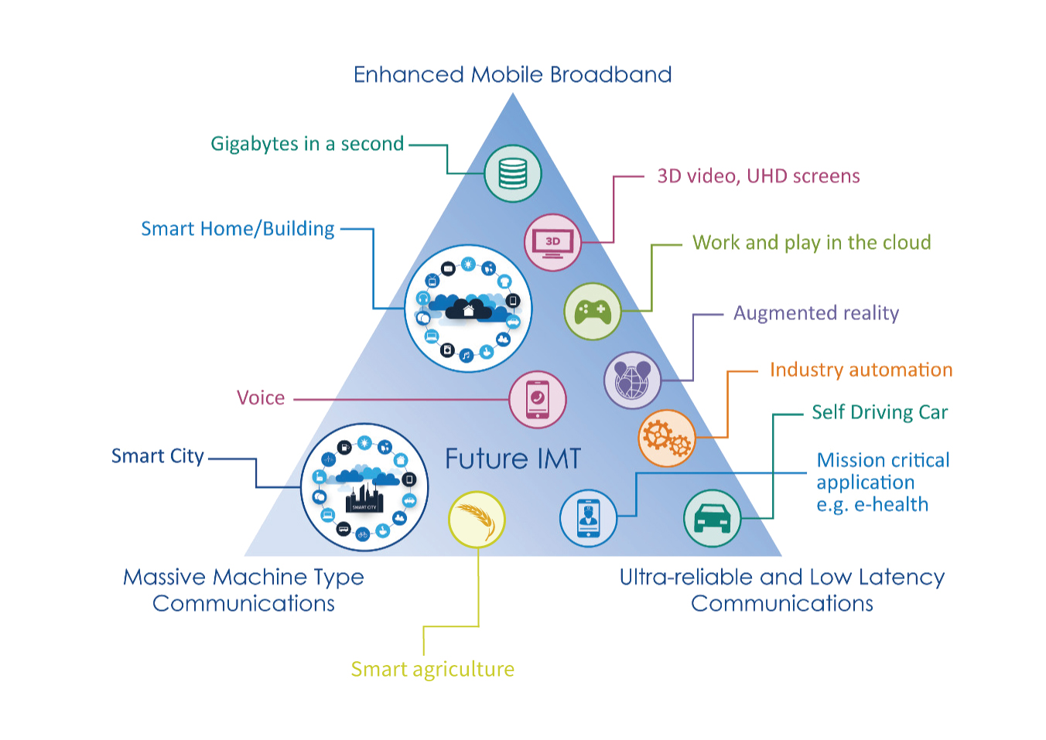
5G – brings new growth
Perfect storm of technology trends:
Availability of a reliable low latency radio and a fully flexible network
Artificial Intelligence and Automation
Device revolution for Augmented Reality and Virtual reality
The Vertical industries going cellular

Slide 11
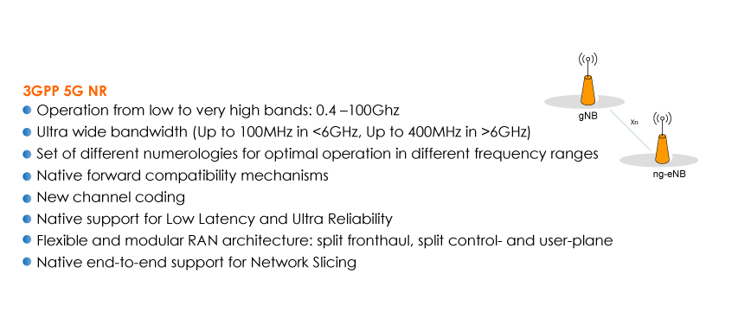

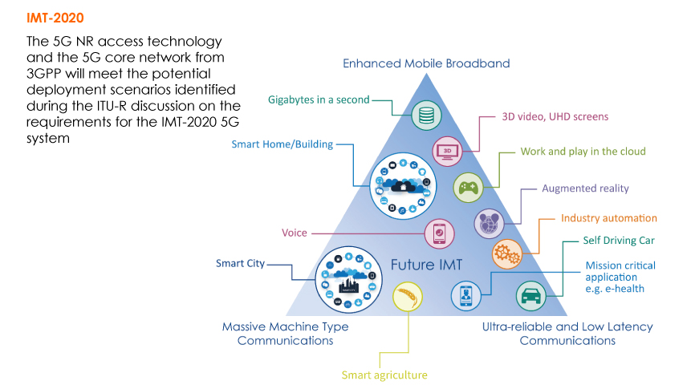
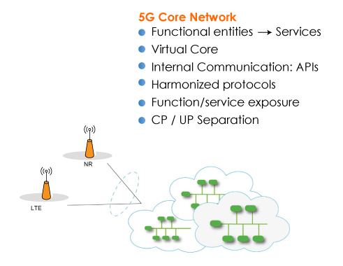
IMT-2020

Slide 12

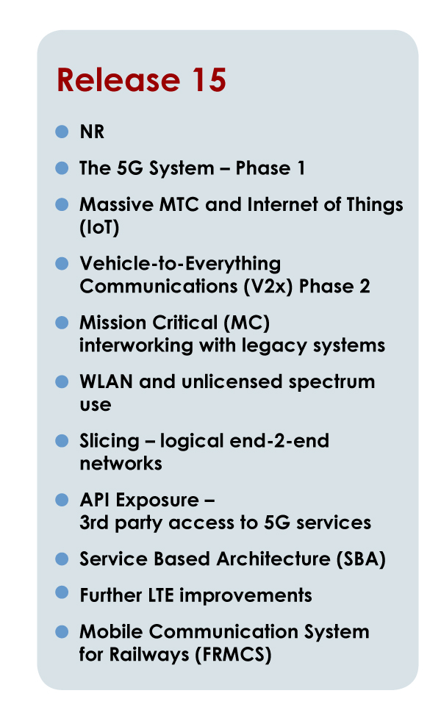
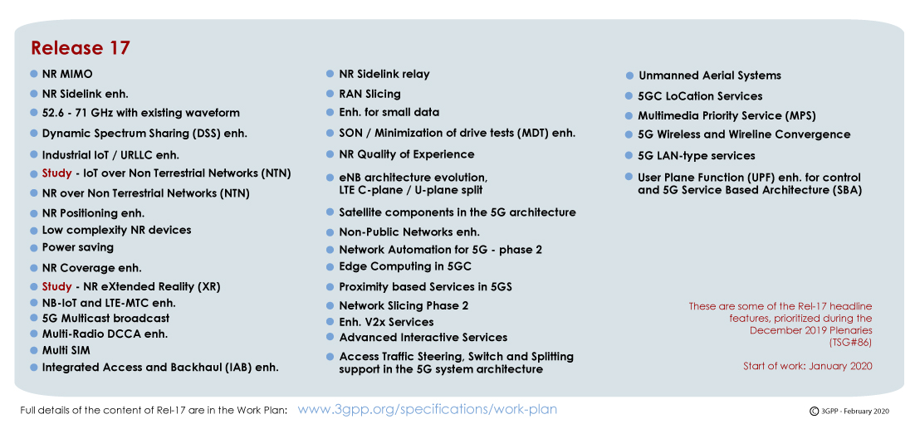
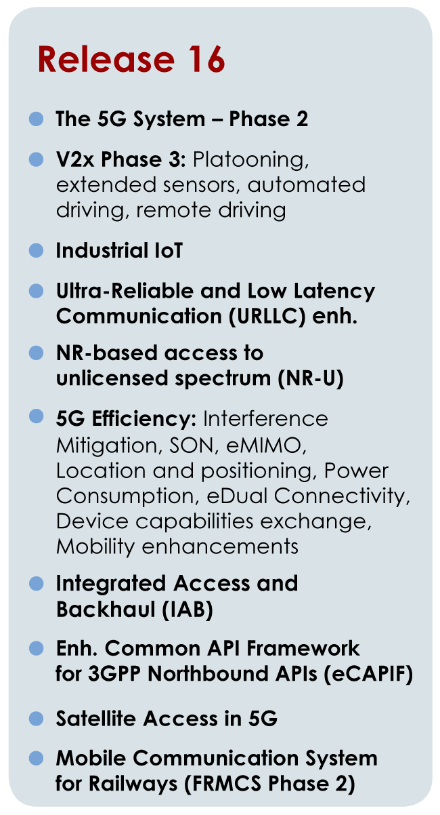
Feature rich ‘Releases’

Slide 13


3GPP 5G Timeline
Release timing
Phases for the normative 5G work:
Phase 1 (Rel-15) addresses the more urgent subset for commercial deployments
Phase 2 (Rel-16) Completes the 3GPP IMT 2020 submission (ITU-R) and addresses all identified use cases & requirements…
Release 17 and Release 18 are 5G Releases too…
5G Study
Release 18
Release 15
Release 16
Release 17
Phase 1
Phase 2
Notes:
10/31/16

Slide 14
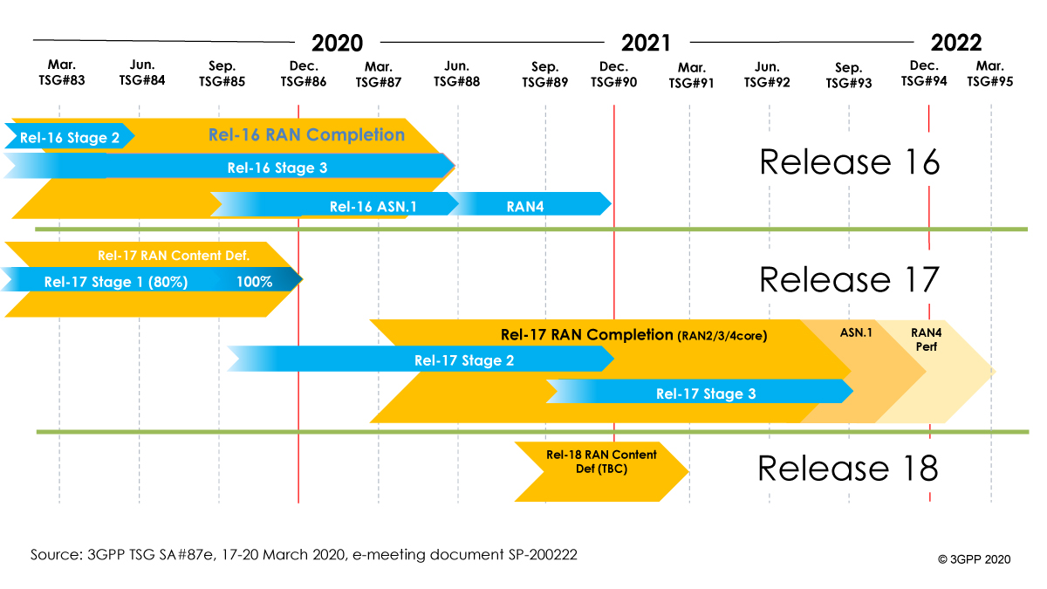
Release 17 Schedule
Massive effort to complete Rel-16 on time in 2020.
E-meetings and COVID-19 have challenged the ability of the groups to meet the December 2019 timelines (right)
During TSG SA#89-e the TSG Chairs (CT, RAN and SA) confirmed that their groups will continue to study the situation, to arrive at the best common decision possible at the next Plenaries (December 7 – 11).
A firm decision on a delay to the freeze date of 3GPP Release 17 will be made in December 2020.

Slide 15
Conclusions
3GPP is industry driven - Standardization of interfaces enables an interoperable, multi-vendor approach to deployment
5G new radio (nr) remains high focus for RAN groups
The 3GPP processes are necessarily complex, but we need to adapt to bring new sectors in to the work
Release 17 focus will continue to expand towards new use cases and new sectors…with particular progress on IoT
5G will be a multi-Release technology (beyond Release 17)

Slide 16
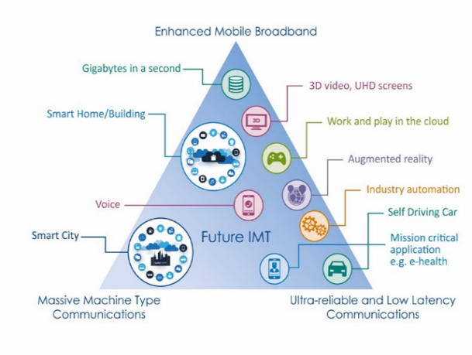
Bringing the work in to the groups
3GPP Specifications and Reports:
Requirements | 21 series
Service aspects ("stage 1") | 22 series
Technical realization ("stage 2") | 23 series
Signalling protocols ("stage 3") - user equipment to network | 24 series
Radio aspects | 25 series
CODECs | 26 series
Data | 27 series
Signalling protocols ("stage 3") -(RSS-CN) and OAM&P and Charging (overflow from 32.- range) | 28 series
Signalling protocols ("stage 3") - intra-fixed-network | 29 series
Programme management | 30 series
Subscriber Identity Module (SIM / USIM), IC Cards. Test specs. | 31 series
OAM&P and Charging | 32 series
Security aspects | 33 series
UE and (U)SIM test specifications | 34 series
Security algorithms | 35 series
LTE (Evolved UTRA), LTE-Advanced, LTE-Advanced Pro radio technology | 36 series
Multiple radio access technology aspects | 37 series
Radio technology beyond LTE | 38 series
Use Case diversity
High or Low data rates
Higher user mobility
Improved coverage
Overall Goals
Enable new business
Greater efficiency
More flexibility – not one-size-fits-all systems

