Slide 1
3GPP TSG-RAN WG4 Meeting #95-e Electronic Meeting, 25 May – 5 June, 2020
R4-2008664
WF on requirements for RSTD and UE Rx-Tx time difference measurement
Huawei, HiSilicon

Slide 2
Definition of intra/inter-frequency measurement
Do not define intra/inter-frequency definition for PRS-RSTD
Note: Accuracy may be different depending whether the measurements are done on the same positioning frequency layer or not.
Do not define intra/inter-frequency definition for PRS-RSRP
Note: Classification of accuracy requirements is FFS (e.g. whether to define different accuracy for measurements on different frequencies)
Do not define intra/inter-frequency definition for UE Rx-Tx timing difference
Note: Classification of accuracy requirements is FFS (e.g. whether to define different accuracy for measurements on different frequencies)

Slide 3
Scenarios for the requirements
RAN4 requirements are to be defined only for the case where PRS is measured with configured measurement gap
This applies for RSTD, PRS-RSRP and UE Rx-Tx time difference
For UE Rx-Tx time difference, RAN4 requirements are to be defined at least for the case where the positioning SRS resource is on the same band as PRS frequency layer
FFS: if requirements are to be defined for the case where the positioning SRS resource is in a different band from PRS frequency layer

Slide 4
Measurement period for RSTD

Slide 5
Measurement period for UE Rx-Tx time difference

Slide 6
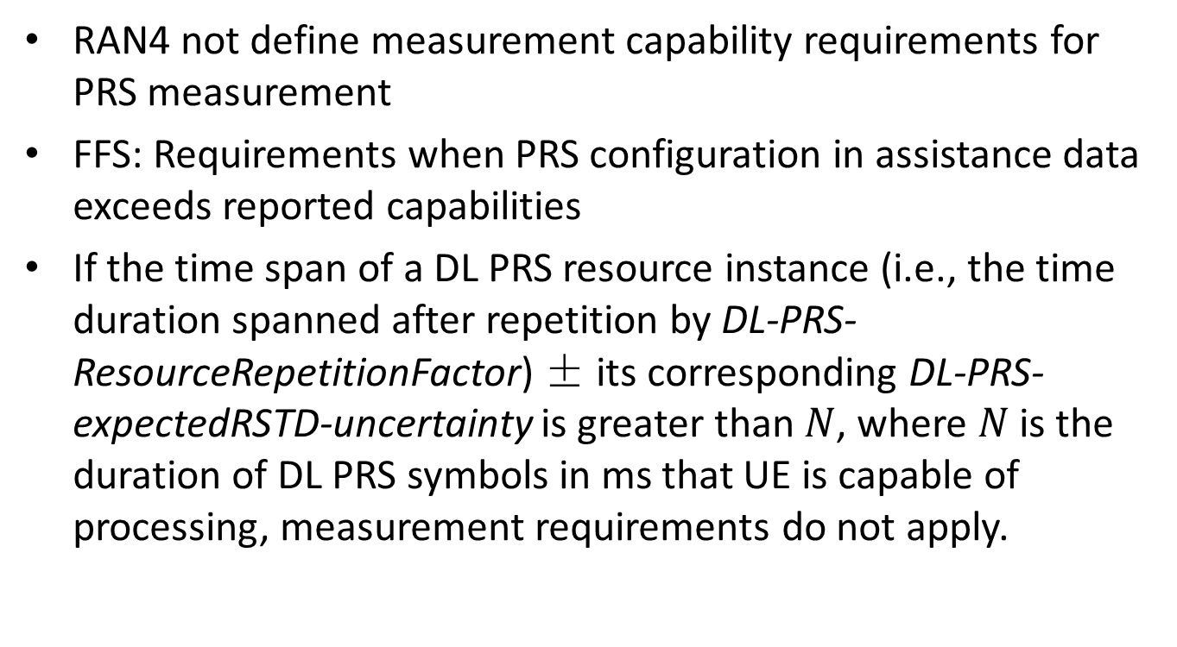
Measurement capability
RAN4 not define measurement capability requirements for PRS measurement
FFS: Requirements when PRS configuration in assistance data exceeds reported capabilities
If the time span of a DL PRS resource instance (i.e., the time duration spanned after repetition by DL-PRS-ResourceRepetitionFactor) ± its corresponding DL-PRS-expectedRSTD-uncertainty is greater than $N$, where $N$ is the duration of DL PRS symbols in ms that UE is capable of processing, measurement requirements do not apply.

Slide 7
Reporting criteria
Ecat = 1 for RSTD per positioning session, which includes RSTD measurements and PRS-RSRP measurements (if configured with RSTD and supported by UE).
Ecat = 1 for UE Rx-Tx time difference per positioning session, which includes UE Rx-Tx time difference measurements and PRS-RSRP measurements (if configured with UE Rx-Tx time difference and supported by UE).

Slide 8
Side condition
FFS: Side condition for RSTD measurement in FR2
Option 1. PRS SNR of reference cell to be -3 dB and the side condition for PRS SNR of neighbor cells to be -10 dB.
Option 2. Side conditions for PRS RSTD measurements in FR2 are defined same as those in FR1, i.e. -13dB for neighbour cell and -6dB for serving cell.

Slide 9
Measurement accuracy (1)
Number of samples for RSTD accuracy: 1
1 sample includes resource repetitions within the PRS occasion
Number of samples for UE Rx-Tx time difference accuracy: 1
1 sample includes resource repetitions within the PRS occasion
FFS: Whether RSTD accuracy is agnostic to comb
Companies are encouraged to study the impact of number of symbols within a slot
Applicable RSTD accuracy requirement is not impacted by HO
FFS: Assumption on antenna panel in defining accuracy requirements

Slide 10
Measurement accuracy (2)
FFS: Serving vs. neighbour for Rx-Tx time difference accuracy
Option 1. Only one set of accuracy requirements applicable to both serving and neighbor cells to be defined.
Option 2. Specify UE Rx-Tx time difference accuracy requirements for serving cell and for neighbor cell separately
UE Rx-Tx time difference accuracy requirements do not apply with TA change during the measurement period
UE Rx-Tx time difference accuracy requirements do not apply with HO during the measurement period

Slide 11
Report mapping

Slide 12
MG and Scheduling restriction
It is up to UE implementation to request measurement gaps for PRS measurement.
If UE requested measurement gaps for PRS measurement but the gaps are not configured, UE is not expected to measure PRS
If UE did not request measurement gaps for PRS measurement, UE is expected to process DL PRS in the same OFDM symbol where other DL signals and channels are transmitted to the UE

