Slide 1
WF for CA MPR table format for FR2 NC UL CA
3GPP TSG-RAN WG4 Meeting # 95-e R4-2008489
Electronic Meeting, 25 May – 5 June 2020
Qualcomm Incorporated

Slide 2
Background – Rel-15 UE
Define Bidirectional spectrum: UL/DL common spectrum in which the UE supports the configuration of uplink or downlink CCs
  UL spectrum = DL Spectrum for Rel-15 UE
Define Frequency spread ‘FSp’: frequency spectrum from the lowest edge of the lowest configured CC to the upper edge of the highest configured CC in bidirectional spectrum. FSp is a generalized term created to cover
  frequency separation, for NC CA
  aggregated chan. BW, for contiguous CA
CA MPR for UE depends on 2 bandwidth considerations:
  UL FSp (due to RF signal BW considerations)
  BW of UL signal in baseband
  Define UL BW = MAX(UL FSp, BW of UL signal in baseband) as driver of MPR

Slide 3
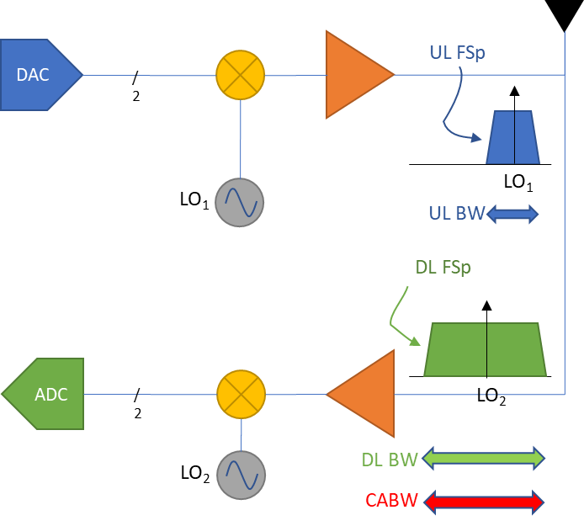
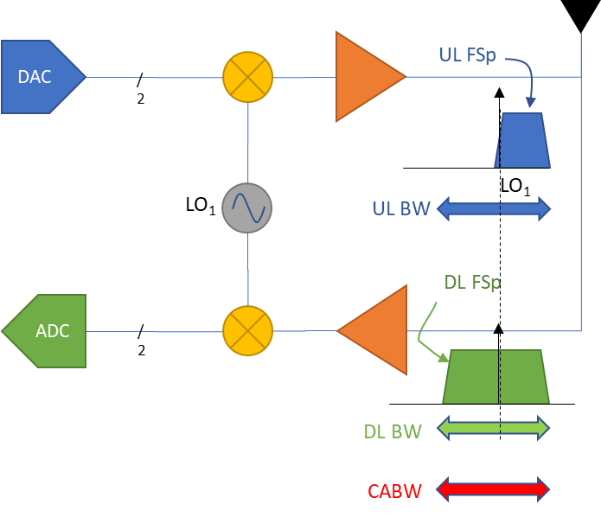
Background – Rel-15 UE
CA MPR for Rel-15 UE is defined in architecture agnostic manner
CA MPR driver ‘UL BW’ depends on LO architecture for Rel-15 UEs:
  Separate R/T LO: depends on UL FSp
  Common R/T LO: depends on MAX(DL FSp, UL FSp)
CABW represents the wider of UL BW for both architecture types, so it was chosen as MPR driver
Note that DL BW, or DL FSp also captures UL BW for both architectures in Rel-15 UEs

Slide 4
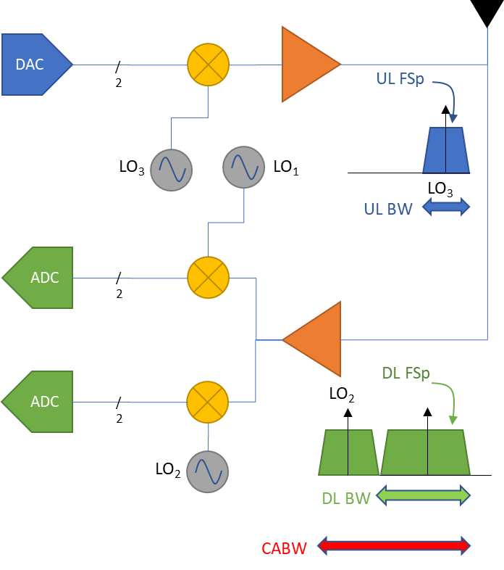
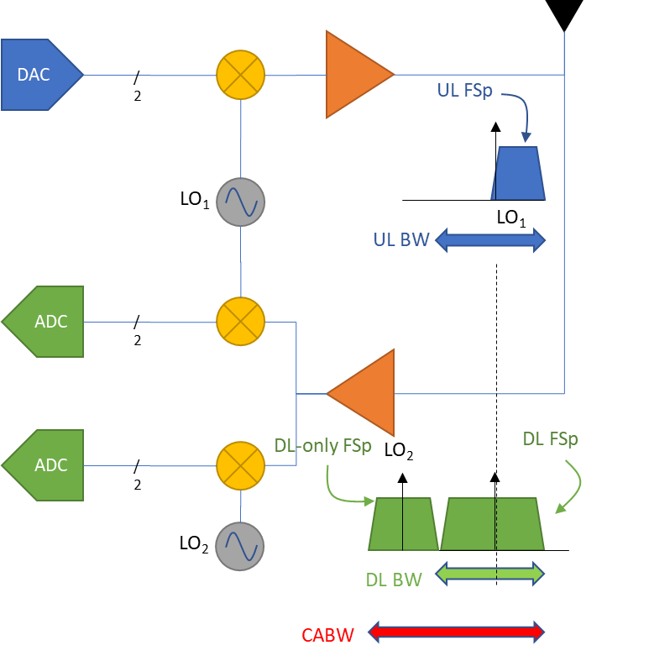
Background – Rel-16 UE may support DL-only spectrum
CA MPR driver ‘UL BW’ depends on LO architecture for Rel-16 UEs:
  Separate R/T LO: Depends on UL FSp
  Common R/T LO: depends on MAX(DL FSp, UL FSp)
    Does not depend on DL-only spectrum (DL-only FSp)
CABW does not represent UL BW for either architecture type in Rel-16, if DL-only spectrum present
  CABW is not a suitable driving parameter for CA MPR in Rel-16

Slide 5
Background – CA MPR dependence for Rel-16 UEs
 |  | MPR dependence parameter(s)
UE type |  | Only contiguous UL CA supported | Non-contiguous UL CA supported
Separate R/T LO | DL-only spectrum supported (non-zero Fsd) | UL agg. chan. BW {=UL FSp} | UL FS {=UL FSp}
 | DL-only spectrum not supported (Fsd undefined) | UL agg. chan. BW {=UL FSp} | UL FS {=UL FSp}
Common R/T LO | DL-only spectrum supported (non-zero Fsd) | MAX(UL agg. chan. BW, DL FSp) {=MAX(UL FSp, DL FSp)} | MAX(UL FS, DL FSp) {=MAX(UL FSp, DL FSp)}
 | DL-only spectrum not supported (Fsd undefined) | MAX(UL agg. chan. BW, DL FSp) {=MAX(UL FSp, DL FSp)} | MAX(UL FS, DL FSp) {=MAX(UL FSp, DL FSp)}
Frequency spread ‘FSp’: frequency spectrum from the lowest edge of the lowest configured CC to the upper edge of the highest configured CC in bidirectional spectrum. FSp is a generalized term to cover
  = frequency separation, for NC CA
  = aggregated chan. BW, for contiguous CA

Slide 6
WF 1: on CA MPR table for Rel-16 UEs
CA MPR remains UE architecture agnostic for Rel-16
  UEs with a common R/T LO can retain MAX (UL FSp, DL FSp) as CA MPR driver
  CA MPR for UEs with separate R/T LOs depend on UL FSp
    Can adopt MAX (UL FSp, DL FSp) as CA MPR driver
    MPR for > 1400 MHz same as 800 MHz ≤ MPR ≤ 1400 MHz because UL FSp limited to 1400 MHz in Rel-16
For Rel-16 UEs, CA MPR depends on MAX (UL FSp, DL FSp)
MAX (UL FSp, DL FSp) is simplified to ‘DL frequency separation’
  DL FSp ≥ UL FSp for Rel-15, Rel-16. Also, DL FSp:
    = DL BW_{channel_CA} in case DL CA is contiguous
    = DL frequency separation in case DL CA is non-contiguous
Frequency spread ‘FSp’: frequency spectrum from the lowest edge of the lowest configured CC to the upper edge of the highest configured CC in bidirectional spectrum. FSp is a generalized term to cover
  = frequency separation, for NC CA
  = aggregated chan. BW, for contiguous CA

Slide 7
WF2: on Special Handling of MPR in case of contiguous ULCA and DLCA
Special Handling of MPR for contiguous UL CA and DL CA from clause 6.2A in TS38.101-2 contains CABW wording:
  ‘In case of a contiguous RB, DFT-s-BPSK or DFT-s-QPSK UL allocation in a single CC of a CA configuration whose cumulative aggregated BW ≤ 400 MHz, and all UL CCs use the same SCS, MPR_{WT_C_CA} shall be derived instead as MAX(MPR1, MPR2)’
‘cumulative aggregated BW’ is replaced by bandwidth of configured contiguous DL CA
  MPR depends on MAX (UL FSp, DL FSp)
  For contiguous DL CA case, DL FSp = DL BW_{channel_CA}
  ‘In case of a contiguous RB, DFT-s-BPSK or DFT-s-QPSK UL allocation in a single CC of a CA configuration whose DL BW_{channel_CA} ≤ 400 MHz, and all UL CCs use the same SCS, MPR_{WT_C_CA} shall be derived instead as MAX(MPR1, MPR2)’

