Slide 1
WF on DC location for intra-band CA
3GPP TSG-RAN WG4 #95-e
May 25th – June 5th, 2020
Electronic meeting
R4-2008467
Huawei, HiSilicon, [ ]

Slide 2
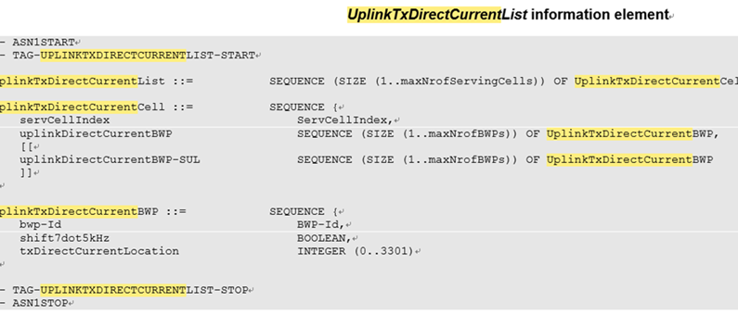
Background
In Rel-15:
  DC location is allowed to signal with 3300 or 3301 for intra-band CA which is agreed in R1-1900849 and R4-1915361
    For the case of intra-band CA with some CCs activated/deactivated, resulting in variable UE TX DC location.
  CR on carrier leakage and IQ image measurements for 3300 or 3301 indicating is approved in RAN4
In RAN4 and RAN5 discussion, for UE indicating 3300 or 3301 for intra-band CA, it is assumed UE can reach general IBE requirement on the location of DC and IQ image. It will lead to high challenge on UE implementation.
DC location reporting architecture in TS 38.331
  DC location is indicated in RRC signaling, and indicates per serving cell per configured BWP
  E.g. with 2 UL serving cells, UE will indicate DC location for 4(max,) configured BWPs on CC1 and 4(max,) configured BWPs on CC2 respectively
  The DC location indicated for each BWP can be outside the BWP bandwidth, in any position within the carrier bandwidth
DC location for BWP1 can be outside the BWP, in any position within the carrier
CC1
BWP1

Slide 3
WF on DC location for intra-band CA
DC location for intra-band CA
  For UE indicated 1PA architecture
    When both UL CCs are activated, the actual DC location is positioned at the center frequency of the DC locations indicated of 2 active BWPs
      The center frequency can be the corresponding RE or RB position of the center frequency
    When there is only one CC activated, the actual DC location is positioned as UE indicating to the network per serving cell per configured BWP
  For UE indicated 2PA architecture
    The actual DC location is positioned as UE indicating to the network per serving cell per configured BWP
  UE is also allowed to indicate the DC location in the center of carrier bandwidth, i.e. the DC location depends on the whole carrier bandwidth and position

