Slide 1
RAN4#113 meeting schedule
3GPP TSG-RAN WG4 Meeting #113
Orlando, US, 18th – 22nd November, 2024
Agenda Item: 2
RAN4 Chair: Xizeng Dai
Vice Chair: Gene Fong, Shan Yang

Slide 2
Monday
Venue Time | RAN4 Main | RAN4 RRM (RAN4 Breakout1) | RAN4 BDaT (RAN4 Breakout2 ) | Ad hoc room (RAN4 Breakout3) | Offline room （RAN4 Ad hoc Magnolia）
9:00-9:20 | 1. Opening of the meeting 2. Approval of the agenda 3. Letters / reports from other groups / meetings
9:30-10:30 | Rel-19 spectrum [103] R18_UERF_maintenance_Part2 (only FR2 PC8 issue) [107] HPUE_NR_bands (3) [108 ] LTE_NR_HPUE_FWVM (3) [109] HPUE_Basket_EN-DC (4) [110] HPUE_Basket_Intra-CA_TDD (28) | Rel-19 [219] NR_RRM_Ph5_Part2 (19) [218] NR_RRM_Ph5_Part1 (32) | Rel-19 Demod [321] NR_demod_Ph5_Part1_General_BS (15) | RRM Ad-hoc: [201] [202] Maintenance_up_to_R16 and R17, Chaired by Li Zhang (Huawei) | Main
11:00-12:30 | [111] LTE_NR_Other_basket (20) [112] NR_LTE_TN_Bands(15) [113] NR_IoT_NTN_Bands (25, only short time triggering discusisons) | [218] NR_RRM_Ph5_Part1 (32) Cont. | [321] NR_demod_Ph5_Part1_General_BS (15) (cont) [320] NR_SCM (19) | BDaT Ad-hoc: SBFD [306] NR_duplex_evo_General [307] NR_duplex_evo_BSRF Chaired by Jackson Wang (Samsung) and Xiang Gao (Huawei) | Main
12:30-14:00 | Lunch break
14:00-16:30 | [114] NR_n28_PC2_40MHz (11) [115] NR_mmWave_protect (14) [125] NR_PC2_RedCap_UE (8) Rel-19 non-spectrum [132] FS_Ambient_IoT_solutions_part1 (23) | [214] NR_FR1_lessthan_5MHz_BW_Ph2 (12) [217] NR_ATG_enh (7) 15:30 - 16:30 [224] Netw_Energy_NR_enh_Part1 (20) Coffee break: NR_RRM_Ph5_Part2 | [322] NR_demod_Ph5_Part2_UE (13) | Main Ad-hoc(14:00~16:00): [119] FS_NR_IMT Chaired by Thomas Chapman (Ericsson) | RRM
17:00-18:00 | [133] FS_Ambient_IoT_solutions_part2 (36) | [224] Netw_Energy_NR_enh_Part1 (20) Cont. [225] Netw_Energy_NR_enh_Part2 (14) | NGSO testing [323] NTN_testing_NGSO_channel_model (10) Rel-19 HAPS and NTN [316] HAPS_operating bands (2) | Main Ad-hoc (16:00~18:00): [117] NR_ENDC_RF_Ph4_part2 Chaired by Tina(Yuanyuan) Zhang (Samsung) Main Ad-hoc: [118] NR_ENDC_RF_Ph4_part3 Chaired by Ron (AT&T) | RRM
18:00-19:30 | Main Ad-hoc: [129/130] NR_AIML_air #1 Chaired by Vali (Qualcomm) | RRM Ad-hoc: [211][212] Rel-18 NR_pos_enh2, Chaired by Iana Siomina (Ericsson) | BDaT Ad-hoc: BSRF E-EIRP [302] NR_BS_RF_Part1_E_EIRP, Chaired by Fei Xue (ZTE) | RRM Ad-hoc: [221] [222] NR_MIMO_Ph5, Chaired by Yanze Fu (Samsung) | RRM
Note:
Offline room is used for offline discussion rather than official ad hoc for each session.
No ad hoc is scheduled in offline room unless there is a big conflict

Slide 3
Tuesday
Venue Time | RAN4 Main | RAN4 RRM (RAN4 Breakout1) | RAN4 BDaT (RAN4 Breakout2 ) | Ad hoc room (RAN4 Breakout3) | Offline room （RAN4 Ad hoc Magnolia）
8:30-10:30 | [118] NR_ENDC_RF_Ph4_part3 (35) [117] NR_ENDC_RF_Ph4_part2 (35) | Rel-19 [213] NR_ENDC_RF_Ph4 (1) [215] NonCol_intraB_ENDC_NR_CA_Ph2 (5) [233] Reply_LS (6) [226] NR_LPWUS (29) Coffee break: NR_XR_Ph3 | Rel-19 UE RF NTN [310] NR_NTN_Ph3_UE_RF (14) [311] NR_IoT_NTN_less_than_5MHz_UERF (25) | RRM Ad-hoc: Chaired by Qiming Li (Apple) [227] [228] Rel-19 NR_Mob_Ph4 [208] Rel-18 NR_Mob_enh2 (if time allows) | BDaT
11:00-12:30 | [116] NR_ENDC_RF_Ph4_part1 (35) | [220] FS_NR_AIML_Mob (31) | Rel-19 UE & SAN RF NTN [314] NR_NTN_Ku_Band_UE_SAN_RF (12) (UE RF only) [314] NR_NTN_Ku_Band_UE_SAN_RF (12) (SAN RF only) [312] NR_IoT_NTN_less_than_5MHz_BSRF (6) | BDaT Ad-hoc: SCM [320] NR_SCM, chaired by Alexander Hamilton (Nokia) | BDaT
12:30-14:00 | Lunch break
14:00-16:30 | [122] NR_FR1_5MHz_BW_Ph2 (12) [119] FS_NR_IMT (49) [120] NR_SL_intraB_CA_ITS_part1 (7) [121] NR_SL_intraB_CA_ITS_part2 (2) [134] NR_LPWUS_UERF (41) | Quick check: NR_RRM_Ph5_Part2 [223] NR_duplex_evo (28) 15:30 - 16:30 Add topic(s) for the 1st ad-hoc slot on Wednesday Rel-18 Maintenance [204] FR2_multiRx (15) [205] NR_RRM_enh3 (13) [206] NR_MG_enh2 (14) [208] NR_Mob_enh2 (30) | Rel-19 IoT NTN [317] IoT_NTN_TDD (8) [315] IoT_NTN_Ph3 (5) Ku band [313] NR_NTN_Ku_Band_General (27) | BDaT Ad-hoc(14:00~16:00) [308] NR_LPWUS, Chaired by Leo (Huawei) [TBD] | BDaT
17:00-18:00 | [134] NR_LPWUS_UERF (Cont) | Rel-18 Maintenance Cont. [209] NR_MIMO_evo_DL_UL (7) [210] Netw_Energy_NR (13) [207] NR_NTN_enh (18) | Rel-19 BSRF [305] NR_ATG_enh (2) [303] NR_BS_RF_Part2_CLTA (8) | Main Ad-hoc(16:00~18:00): [132/133] FS_Ambient_IoT_solutions_part1/2 Chaired by Xiaoran Zhang | Main
18:00-19:30 | Main Ad-hoc: [118] NR_ENDC_RF_Ph4_part3 Chaired by Ron (AT&T) Main Ad-hoc (16:00~18:00): [117] NR_ENDC_RF_Ph4_part2 Chaired by Tina(Yuanyuan) Zhang (Samsung) | RRM Ad-hoc: [218][219] NR_RRM_Ph5, Chaired by Jerry Cui (Apple) | BDaT Ad-hoc: Ku band [313] NR_NTN_Ku_Band_General, Chaired by Moray Rumney (Eutelsat) | BDaT Ad-Hoc: Rel-19 demod [321] NR_demod_Ph5_Part1_General_BS chaired by Hannu Vesala (MTK) [322] NR_demod_Ph5_Part2_UE Chaired by Karsten Petersen (Nokia) | Main

Slide 4
Wednesday
Venue Time | RAN4 Main | RAN4 RRM (RAN4 Breakout1) | RAN4 BDaT (RAN4 Breakout2 ) | Ad hoc room (RAN4 Breakout3) | Offline room （RAN4 Ad hoc Magnolia）
8:30-10:30 | [129] NR_AIML_air (72) | Rel-19 [221] NR_MIMO_Ph5_Part1 (11) [222] NR_MIMO_Ph5_Part2 (11) | BDaT Online/Ad-Hoc: TBD | RRM Ad-hoc: Reserved | RRM
11:00-12:30 | [123] NonCol_intraB_ENDC_NR_CA (27) [124] FS_NR_DL_Frag_Carrier (23) | [228] NR_Mob_Ph4_Part2 (13) [216] NR_IoT_NTN_req_test_enh (10) | [308] NR_LPWUS (10) Rel-19 OTA [325] TRP_TRS_Ph3 (24) | RRM Ad-hoc: [234] RRM_Spec_Improvement, Chaired by Yang Tang (Apple) | RRM
12:30-14:00 | Lunch break
14:00-16:30 | [131] NR_MIMO_Ph5_UE (11) [128] NR_ATG_enh (15) Rel-19 non-spectrum (NTN) [126] NR_IoT_NTN_HPUE_part1 (31) | [232] IoT_NTN_Ph3 (3) [230] NR_NTN_Ph3_Part1 (13) [231] NR_NTN_Ph3_Part2 (12) | [325] TRP_TRS_Ph3 (24) (cont) [326] MIMO_OTA_Ph3 (9) [327] NR_FR2_OTA (6) Rel-19 BSRF (start at 15:30) [302] NR_BS_RF_Part1_E_EIRP (25) [304] NR_BS_RF_Part3_OTA_TRP (8) | Main Ad-hoc (14:00~16:00): [104] NR_Baskets_Part_1 Chaired by Iwo Angelow [105] NR_Baskets_Part_2 Chaired by Per Lindell | BDaT
17:00-18:00 | [127] NR_IoT_NTN_HPUE_part2 (13) | [231] NR_NTN_Ph3_Part2 (12) Cont. RAN Task [234] RRM_Spec_Improvement (16) | Rel-19 BSRF (cont) | Main Ad hoc (16:00~18:00): [134] NR_LPWUS_UERF Chaired by Ruixin Wang (vivo) | BDaT
18:00-19:30 | Main Ad-hoc: [129/130] #2 NR_AIML_air Chaired by Vali (Qualcomm) | RRM Ad-hoc: [224] [225] Netw_Energy_NR_enh, Chaired By Zhixun Tang (Ericsson) | BDaT Ad-Hoc: OTA [325] TRP_TRS_Ph3, [326] MIMO_OTA_Ph3 Chaired by Ruixin Wang (vivo) | Main Ad-hoc: [116] NR_ENDC_RF_Ph4_part1 Chaired by Leo(Ye) Liu (Huawei) | BDaT

Slide 5
Thursday
Venue Time | RAN4 Main | RAN4 RRM (RAN4 Breakout1) | RAN4 BDaT (RAN4 Breakout2 ) | Ad hoc room (RAN4 Breakout3) | Offline room （RAN4 Ad hoc Magnolia）
8:30-10:30 | Rel-19 spectrum (NTN) [113] NR_IoT_NTN_Bands (25) Rel-19 basket WI [104] NR_Baskets_Part_1 (41) [105] NR_Baskets_Part_2 (54) [106] LTE_Baskets (4) | Rel-18 [211][212] Rel-18 NR_pos_enh2 (37) Rel-19 [227] NR_Mob_Ph4_Part1 (29) | BDaT LS reply (if any) [328] LS_BDaT (1) Rel-19 SBFD [306] NR_duplex_evo_General (22) | RRM Ad-hoc: Reserved | RRM
11:00-12:30 | [136] UERF_Spec_Improvement (26) | [229] NR_XR_Ph3 (16) | Rel-19 SBFD BSRF [307] NR_duplex_evo_BSRF (21) | Main Ad hoc: [126/127] NR_IoT_NTN_HPUE_part1/2 Chaired by Haijie Qiu | RRM
12:30-14:00 | Lunch break
14:00-16:30 | [136] UERF_Spec_Improvement (Cont) [135] NR_reply_LS_UE_RF (?) Maintenance [101] Upto_R17_UERF_maintenance (78) [102] R18_UERF_maintenance_Part1 (46) [103] R18_UERF_maintenance_Part2 (25) | Up to Rel-18 [201] Maintenance_up_to_R16 (61) [202] Maintenance_R17 (87) [203] Maintenance_R18 (27) 15:30 - 16:30 Early Return to | Maintenance [301] BSRF_Maintenance (63) [318] Demod_Maintenance_Part1 (42) [318] Demod_Maintenance_Part2 (36) [324] OTA_Maintenance_Part2 (10) | BDaT Ad-hoc(14:00~16:00): TBD | BDaT
17:00-18:00 | Early Return to Rel-19 topics [130] NR_AIML_air (36) | Early Return to | Maintenance (cont) Early return to | Main Ad-hoc(16:00~18:00): [124] FS_NR_DL_Frag_CarrierChaired by Henry Fu (Mediatek) | BDaT
18:00-19:30 | [130] NR_AIML_air (36, Cont.) | Early Return to or Ad-hoc | BDaT Ad-hoc: BSRF E-EIRP (2nd ad-hoc if needed) [302] NR_BS_RF_Part1_E_EIRP, Chaired by Fei Xue (ZTE) | BDaT Ad-Hoc: TBD | Main

Slide 6
Friday
Venue Time | RAN4 Main | RAN4 RRM | RAN4 BDaT | Ad hoc room
8:00-10:30 | Return to (no NTN topic) | Return to | Return to [310] NR_NTN_Ph3_UE_RF ( ) [314] NR_NTN_Ku_Band_UE_SAN_RF ( ) (UE RF only) [311] NR_IoT_NTN_less_than_5MHz_UERF ( ) [315] IoT_NTN_Ph3 [317] IoT_NTN_TDD Return to (Other topics)
11:00-12:30 | Return to (start with NTN topics) | Return to | Return to [324] OTA_Maintenance ( ) [325] TRP_TRS_Ph3 ( ) [326] MIMO_OTA_Ph3 ( ) [327] NR_FR2_OTA ( ) Return to (Other topics)
12:30-13:30 | Lunch break
13:30-15:00 | Return to (final round) | Return to (final round) | Return to (final round)
15:00- before 16:00 | 12 New or revised Rel-19 WID/SID 13 Any other business 14 Close of the meeting

Slide 7
Appendix

Slide 8
General Aspects
The face-to-face meeting will take place during November 18th ~ 22nd, 2024.
Three sessions in three separate rooms: Main, RRM, BDaT(BSRF_Demod_test). 2-Way GoToWebinar (GTW) conference calls will be set each session and 2-way MS teams will be set for ad hoc. A number of ad hoc sessions will be arranged (refer to meeting schedule).
Moderator will be designated to provide the summary for a topic before the meeting. In online discussions, session chairs will handle topics based on the moderator summary. Moderator does not need update the summary by collecting comments during the meeting.
Deadline for Tdoc request & submission deadline: November 8th (Friday) 2024, 23:59 UTC.
Other deadlines can be found in the following slides.
Please find one picture for meeting flow below and details in the corresponding slides.
For chairs
For moderator
For delegates
Pre-meeting (November 11~15)
Quiet Period
1st round (November 18~21)
2nd round (Nov 21, 22)
Quiet Period
Post-meeting process (November 25~28)
Mon
Tue
Wed
Thu
Fri
Sat/Sun
Mon
Tue
Wed
Thu
Fri
Sat/Sun
Mon
Tue
Wed
Thu
NWM flag process Slide #16
Moderators trigger nwm for maintenance before Sunday
Flag for maintenance @nwm
WF/CR template
Draft TS/TR
Slide #9
Slide #15
Pre-RAN Action
MCC 3GU parsing tool
Slide #10/11
Slide #18
Topic Moderator & summary: slide #5
Moderator assignment before Mon
Draft summary for topics
Summary review & comments
Formal tdoc of summary submission by Saturday
Online discussions &
GTW conference call (US/China meeting)
Upload CR for maintenance 2:30pm on Thursday
TOHRU (US/China meeting)
Tdoc request (new&revision)
Upload tdocs (10.10.10.10) &
How to access contributions
List of email threads for post-meeting
Submission of tdoc of post-meeting
Comments
Approve tdocs for post-meeting
Slide #7
Slide #12
Post-meeting process: slide #14
Registration
Slide #13
Initial list for block approval for basket
Deadline for flag for block approval
updated list for block approval
Slide #8
Slide #17
Tdoc number request & submission
Slide #3/4
Basket WIs Block approval: slide #6
Meeting schedule & Ad hoc chair assignment
Provided before meeting
Update of meeting notes per day
Tdoc allocation
Check-in
Slide #13
Slide #18/21
Slide #8
Slide #22
Meeting room
Quiet Period (0:00 am ~ 7:00 am meeting venue Local time
No email are expected in RAN4 reflector

Slide 9
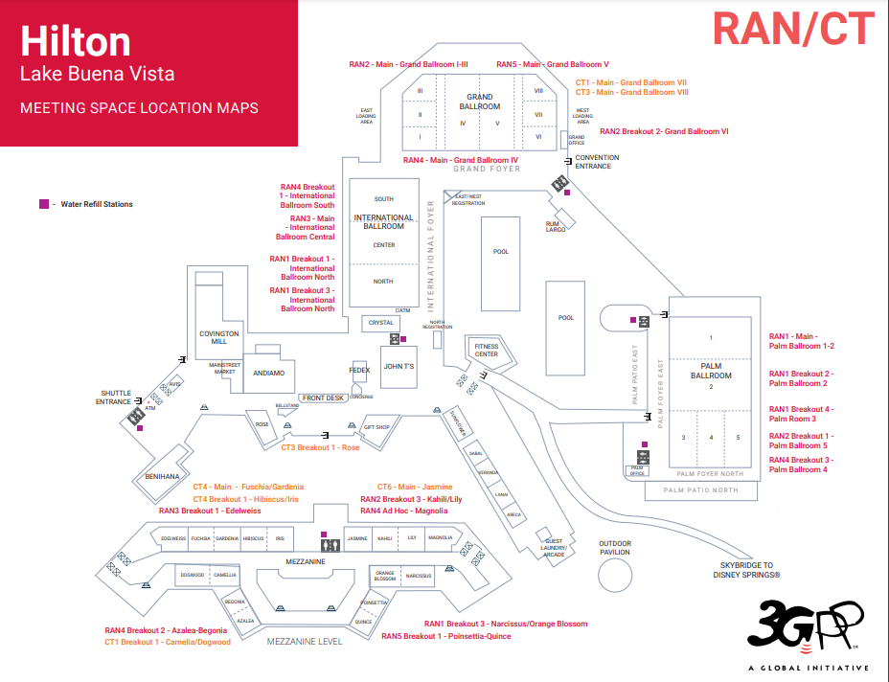
Meeting rooms for RAN4#113
RAN4 meeting rooms:
Main session: Grand Ballroom IV
RRM session: RAN4 Breakout1 – International Ballroom South
BDaT: RAN4 Breakout2 – Azalea-Begonia
Ad hoc session: RAN4 Breakout 3 – Palm Ballroom4
Offline room: RAN4 Ad hoc Magnolia
Clear map can be found at
https://3gppmeetings.atis.org/wp-content/uploads/2024/10/hilton_lbv_meeting_space_1_map.pdf

