Slide 1
RAN4#112bis meeting schedule
3GPP TSG-RAN WG4 Meeting #112bis
Hefei, Anhui, China 14th – 18th October, 2024
Agenda Item: 2
RAN4 Chair: Xizeng Dai
Vice Chair: Gene Fong, Shan Yang

Slide 2
Monday
Venue Time | RAN4 Main | RAN4 RRM | RAN4 BDaT | Ad hoc room
9:00-9:20 | 1. Opening of the meeting 2. Approval of the agenda 3. Letters / reports from other groups / meetings Date when Rel-19 spec are available R4-2416393 Discussion on the support of Microsoft Office formats Rohde & Schwarz
9:30-10:30 | Rel-19 spectrum [105] HPUE_NR_band (6) [106] LTE_NR_HPUE_FWVM (2) [107] HPUE_Basket_EN-DC (12) [108] HPUE_Basket_Intra-CA_TDD (15) | [218] NR_Mob_Ph4_Part1 (15) | Rel-19 Demod [319] NR_demod_Ph5_Part1_General_BS (14) | RRM Ad-hoc: [202][203] Rel-18 NR_pos_enh2, Chaired by Iana Siomina (Ericsson)
11:00-12:30 | [109] LTE_NR_Other_basket (24) [110] NR_LTE_TN_Bands(77) [111] NR_IoT_NTN_Bands (21, only short time triggering discusisons) | [218] NR_Mob_Ph4_Part1 Cont. [219] NR_Mob_Ph4_Part2 (13) | [319] NR_demod_Ph5_Part1_General_BS (14) (cont) [318] NR_SCM (20) | BDaT Ad-hoc: SBFD [306] NR_duplex_evo_General [307] NR_duplex_evo_BSRF Chaired by Jackson Wang (Samsung) and Xiang Gao (Huawei)
12:30-14:00 | Lunch break
14:00-15:30 | [112] NR_n28_PC2_40MHz (13) [113] NR_mmWave_protect (19) [123] NR_PC2_RedCap_UE (9) | [224] Reply_LS (2) [205] NR_FR1_lessthan_5MHz_BW_Ph2 (9) Coffee break: [205] NR_FR1_lessthan_5MHz_BW_Ph2 | [320] NR_demod_Ph5_Part2_UE (12) | Main Ad-hoc: [117] FS_NR_IMT Chaired by Thomas Chapman (Ericsson)
16:00-18:00 | Rel-19 non-spectrum [129] FS_Ambient_IoT_solutions_part1 (23) [130] FS_Ambient_IoT_solutions_part2 (40) | [215] Netw_Energy_NR_enh_Part1 (23) [216] Netw_Energy_NR_enh_Part2 (14) | NGSO testing [321] NTN_testing_NGSO_channel_model (8) Rel-19 HAPS and NTN [316] HAPS_operating bands (4) [309] NR_NTN_Ph3_General_SAN_RF (3) | Main Ad-hoc: [115] NR_ENDC_RF_Ph4_part2 Chaired by Tina(Yuanyuan) Zhang (Samsung)
18:00-19:30 | Main Ad-hoc: [127] NR_AIML_air #1 Chaired by Vali (Qualcomm) | RRM Ad-hoc: [202][203] Rel-18 NR_pos_enh2, Chaired by Iana Siomina (Ericsson) | BDaT Ad-hoc: BSRF E-EIRP [302] NR_BS_RF_Part1_E_EIRP, Chaired by Fei Xue (ZTE) | RRM Ad-hoc: [212] [213] NR_MIMO_Ph5, Chaired by Yanze Fu (Samsung)

Slide 3
Tuesday
Venue Time | RAN4 Main | RAN4 RRM | RAN4 BDaT | Ad hoc room
8:30-10:30 | [116] NR_ENDC_RF_Ph4_part3 (44) [115] NR_ENDC_RF_Ph4_part2 (38) | [217] NR_LPWUS (27) Coffee break: [220] NR_XR_Ph3 | Rel-19 UE RF [310] NR_NTN_Ph3_UE_RF (14) [311] NR_IoT_NTN_less_than_5MHz_UERF (19) | RRM Ad-hoc: [218] [219] Rel-19 NR_Mob_Ph4, Chaired by Qiming Li (Apple)
11:00-12:30 | [114] NR_ENDC_RF_Ph4_part1 (38) | [209] NR_RRM_Ph5_Part1 (31) | [314] NR_NTN_Ku_Band_UE_SAN_RF (7) (UE RF only) [314] NR_NTN_Ku_Band_UE_SAN_RF (4) (SAN RF only) [312] NR_IoT_NTN_less_than_5MHz_BSRF (5) | BDaT Ad-hoc: SCM [318] NR_SCM, chaired by Alexander Hamilton (Nokia)
12:30-14:00 | Lunch break
14:00-15:30 | [117] FS_NR_IMT (53) | [209] NR_RRM_Ph5_Part1 Cont. [210] NR_RRM_Ph5_Part2 (15) | [315] IoT_NTN_Ph3 (4) Rel-19 BSRF [305] NR_ATG_enh (8) [308] NR_LPWUS (7) | Main Ad-hoc: [116] NR_ENDC_RF_Ph4_part3 Chaired by Ron (AT&T)
16:00-18:15 | [114] NR_ENDC_RF_Ph4_part1 (Topic 3) [131] NR_LPWUS_UERF (37) | [204] NR_ENDC_RF_Ph4 (4) [206] NonCol_intraB_ENDC_NR_CA_Ph2 (7) [211] FS_NR_AIML_Mob (32) | [313] NR_NTN_Ku_Band_General (22) | Main Ad-hoc: [129/130] FS_Ambient_IoT_solutions_part1/2 Chaired by Xiaoran Zhang
18:30-20:00 | Social Event Time: 18:30-20:00, 15 October, 2024 (Tuesday) Venue：InterContinental Ballroom 1 （洲际宴会1厅）, 3F Sponsored by: Xiaomi | RRM Ad-hoc: [202] Maintenance_R18 Chaired by Yang Tang (Apple) | BDaT Ad-hoc: [317] Demod_Maintenance, Chaired by Axel Mueller (Nokia) | Main Ad-hoc: [117] NR_ENDC_RF_Ph4_part2 Chaired by Tina(Yuanyuan) Zhang (Samsung)

Slide 4
Wednesday
Venue Time | RAN4 Main | RAN4 RRM | RAN4 BDaT | Ad hoc room
8:30-10:30 | [127] NR_AIML_air (103, slot#1) | [212] NR_MIMO_Ph5_Part1 (11) [213] NR_MIMO_Ph5_Part2 (11) Coffee break: LP-WUS | Rel-19 BSRF E-EIRP [302] NR_BS_RF_Part1_E_EIRP (20) | RRM Ad-hoc: [202][203] Rel-18 NR_pos_enh2, Chaired by Iana Siomina (Ericsson)
11:00-12:30 | [121] NonCol_intraB_ENDC_NR_CA (22) [122] FS_NR_DL_Frag_Carrier (29) | [208] NR_ATG_enh (7) | Rel-19 OTA [323] TRP_TRS_Ph3 (25) [324] MIMO_OTA_Ph3 (7) | RRM Ad-hoc: [225] RRM_Spec_Improvement, Chaired by Yang Tang (Apple)
12:30-14:00 | Lunch break
14:00-15:30 | [128] NR_MIMO_Ph5_UE (9) [118] NR_SL_intraB_CA_ITS_part1 (3) [119] NR_SL_intraB_CA_ITS_part2 (3) [120] NR_FR1_5MHz_BW_Ph2 (12) | Discuss the topic for the reserved RRM adhoc on Thursday morning [223] IoT_NTN_Ph3 (5) [207] NR_IoT_NTN_req_test_enh (10) Coffee break: AI mobility | [325] NR_FR2_OTA (4) Rel-18 OTA [322] NR_FR1_TRP_TRS_enh_Maint (5) | Main Ad-hoc: [102] NR_Baskets_Part_1 Chaired by Iwo Angelow Main Ad-hoc: [103] NR_Baskets_Part_2 Chaired by Per Lindell
16:00-18:00 | [126] NR_ATG_enh (15) Rel-19 non-spectrum (NTN) [124] NR_IoT_NTN_HPUE_part1 (30) [125] NR_IoT_NTN_HPUE_part2 (9) | [221] NR_NTN_Ph3_Part1 (13) [222] NR_NTN_Ph3_Part2 (17) | BDaT Ad-Hoc: Rel-19 demod [319] NR_demod_Ph5_Part1_General_BS [320] NR_demod_Ph5_Part2_UE Chaired by Jingzhou Wu (CTC) and Karsten Petersen (Nokia) | 16:00 – 17:30 Main Ad hoc: [131] NR_LPWUS_UERF Chaired by Ruixin Wang (vivo)
18:00-19:00 | Main Ad-hoc: [122] FS_NR_DL_Frag_CarrierChaired by Henry Fu (Mediatek) | RRM Ad-hoc: [209][210] NR_RRM_Ph5, Chaired by Jerry Cui (Apple) | BDaT Ad-Hoc: OTA [323] TRP_TRS_Ph3, Chaired by Ruixin Wang (vivo) | 17:30 – 19:00 Main Ad-hoc: [114] NR_ENDC_RF_Ph4_part1 Chaired by Leo(Ye) Liu (Huawei)
RAN4 group dinner

Slide 5
Thursday
Venue Time | RAN4 Main | RAN4 RRM | RAN4 BDaT | Ad hoc room
8:30-10:30 | Rel-19 spectrum (NTN) [111] NR_IoT_NTN_Bands (21) Rel-19 basket WI [102] NR_Baskets_Part_1 (26) [103] NR_Baskets_Part_2 (85) [104] LTE_Baskets (8) [132] NR_reply_LS_UE_RF (14) | [202][203] Rel-18 NR_pos_enh2 (53) [225] RRM_Spec_Improvement (16) Coffee break: NR_duplex_evo | Rel-18 Maintenance/TEI/LS reply [326] LS_BDaT (2) Rel-19 BSRF CLTA [303] NR_BS_RF_Part2_CLTA (5) Rel-19 SBFD [306] NR_duplex_evo_General (21) | RRM Ad-hoc: 8:30-9:30 NR_RRM_Ph5 9:30-10:30 TBD
11:00-12:30 | [133] UERF_Spec_Improvement (37) | [220] NR_XR_Ph3 (17) | Rel-19 SBFD BSRF [307] NR_duplex_evo_BSRF (19) | Main Ad hoc: [124/125] NR_IoT_NTN_HPUE_part1/2 Chaired by Haijie Qiu
12:30-14:00 | Lunch break
14:00-15:30 | Maintenance [101] R18_UERF_maintenance_Part2 (17) | [214] NR_duplex_evo (13) | BDaT Ad-hoc: Demod SCM [318] NR_SCM chaired by Alex | BDaT Ad-hoc: Ku band [313] NR_NTN_Ku_Band_General, Chaired by Moray Rumney (Eutelsat)
16:00-18:00 | Early Return to Rel-19 topics [127] NR_AIML_air (103, slot#2) Start from around 17:00 | Early Return to | Early return to BDaT Ad-Hoc: SBFD (Start at 17:00) [306] NR_duplex_evo_General chaired by Jackson | Main Ad-hoc: [122] FS_NR_DL_Frag_CarrierChaired by Henry Fu (Mediatek)
18:00-19:30 | Main Ad-hoc: [127] NR_AIML_air Chaired by Vali (Qualcomm) | RRM Ad-hoc: [215] [216] Netw_Energy_NR_enh, Chaired By Zhixun Tang (Ericsson) | BDaT Ad-Hoc: TBD | BDaT Ad-Hoc: [308] NR_LPWUS, Chaired by Leo

Slide 6
Friday
Venue Time | RAN4 Main | RAN4 RRM | RAN4 BDaT | Ad hoc room
8:00-10:30 | Return to (no NTN topic) | Return to | Return to [310] NR_NTN_Ph3_UE_RF ( ) [314] NR_NTN_Ku_Band_UE_SAN_RF ( ) (UE RF only) [311] NR_IoT_NTN_less_than_5MHz_UERF ( ) [315] IoT_NTN_Ph3 Return to (Other topics)
11:00-12:30 | Return to (start with NTN topics) | Return to | Return to [322] NR_FR1_TRP_TRS_enh_Maint ( ) [323] TRP_TRS_Ph3 ( ) [324] MIMO_OTA_Ph3 ( ) [325] NR_FR2_OTA ( ) Return to (Other topics)
12:30-13:30 | Lunch break
13:30-15:00 | Return to (final round) | Return to (final round) | Return to (final round)
15:00- before 17:00 | 12 New or revised Rel-19 WID/SID 13 Any other business 14 Close of the meeting

Slide 7
Appendix

Slide 8
General Aspects
The face-to-face meeting will take place during October 14th ~ 18th, 2024.
  Three sessions in three separate rooms: Main, RRM, BDaT(BSRF_Demod_test). 1-Way GoToWebinar (GTW) conference calls will be set each session and 1-way MS teams will be set for ad hoc. A number of ad hoc sessions will be arranged (refer to meeting schedule).
  Moderator will be designated to provide the summary for a topic before the meeting. In online discussions, session chairs will handle topics based on the moderator summary. Moderator does not need update the summary by collecting comments during the meeting.
  Deadline for Tdoc request & submission deadline: October 7th (Monday) 2024, 17:00 UTC.
  Other deadlines can be found in the following slides.
Please find one picture for meeting flow below and details in the corresponding slides.
For chairs
For moderator
For delegates
Pre-meeting (October 7~11)
Quiet Period
1st round (October 14~17)
2nd round (Oct 17, 18)
Quiet Period
Post-meeting process (October 21~24)
Mon
Tue
Wed
Thu
Fri
Sat/Sun
Mon
Tue
Wed
Thu
Fri
Sat/Sun
Mon
Tue
Wed
Thu
NWM flag process Slide #16
Moderators trigger nwm for maintenance before Sunday
Flag for maintenance @nwm
WF/CR template
Draft TS/TR
Slide #9
Slide #15
Pre-RAN Action
MCC 3GU parsing tool
Slide #10/11
Slide #18
Topic Moderator & summary: slide #5
Moderator assignment before Mon
Draft summary for topics
Summary review & comments
Formal tdoc of summary submission by Saturday
Online discussions &
GTW conference call (US/China meeting)
Upload CR for maintenance 2:30pm on Thursday
TOHRU (US/China meeting)
Tdoc request (new&revision)
Upload tdocs (10.10.10.10) &
How to access contributions
List of email threads for post-meeting
Submission of tdoc of post-meeting
Comments
Approve tdocs for post-meeting
Slide #7
Slide #12
Post-meeting process: slide #14
Registration
Slide #13
Initial list for block approval for basket
Deadline for flag for block approval
updated list for block approval
Slide #8
Slide #17
Tdoc number request & submission
Slide #3/4
Basket WIs Block approval: slide #6
Meeting schedule & Ad hoc chair assignment
Provided before meeting
Update of meeting notes per day
Tdoc allocation
Check-in
Slide #13
Slide #18/21
Slide #8
Slide #22
Meeting room
Quiet Period (0:00 am ~ 7:00 am meeting venue Local time
No email are expected in RAN4 reflector

Slide 9
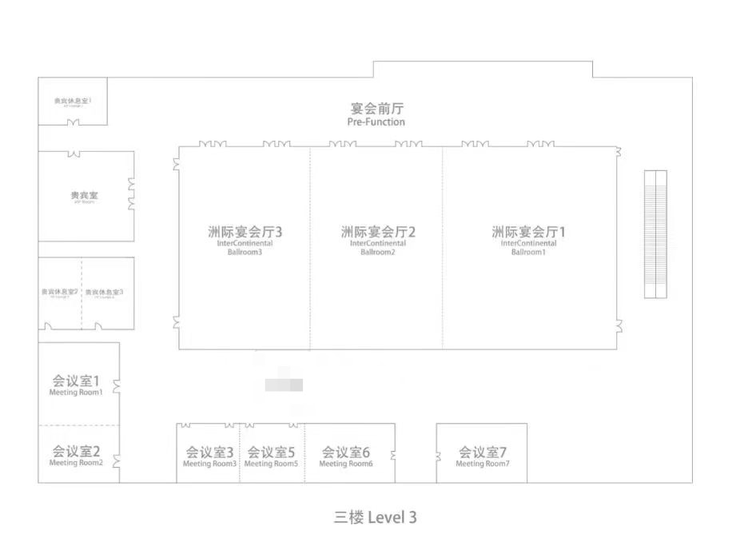
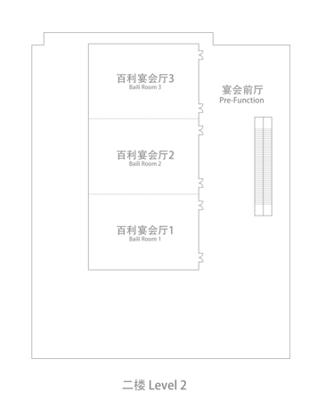
Meeting rooms
    RAN4 meeting rooms:
  Main session: InterContinental Ballroom 2+3（Level 3）/320
  RRM session: BaiLi Room 2(Level 2)/100
  BDaT: BaiLi Room 3(Level 2)/100
  Ad hoc session: BaiLi Room 1(Level 2)/50
BDaT session
RRM session
Ad hoc session
Main session
Social Event
Tuesday

