Slide 1
RAN4#111 meeting schedule
3GPP TSG-RAN WG4 Meeting #111
Fukuoka, JP, 20th – 24th May, 2024
Agenda Item: 2
RAN4 Chair: Xizeng Dai
Vice Chair: Gene Fong, Shan Yang

Slide 2
Monday
Venue Time | RAN4 Main | RAN4 RRM | RAN4 BDaT | Ad hoc room
9:00-9:20 | 1. Opening of the meeting 2. Approval of the agenda 3. Letters / reports from other groups / meetings
9:30-10:30 | [109] LTE_NR_HPUE_FWVM AI 6.14 (24) [110] HPUE_Basket_EN-DC AI 6.15 (16) [111] HPUE_Basket_Intra-CA_TDD AI 6.16 (6) | [221] NR_MIMO_evo_DL_UL (39) [224] NR_SL_relay_enh (5) [222] NR_SL_enh2 (2) [218] NR_DualTxRx_MUSIM (16) Coffee break: NR_HST_FR2_enh, Chaired by Jackson Wang (Samsung) | Rel-18 BSRF [302] NR_ATG_BSRF_Maintenance (3) – no moderator summary [303] NR_FR1_lessthan_5MHz_BW_BSRF_Maint (5) [308] NR_netcon_repeater_RF (13) [309] NR_netcon_repeater_RFConformance (14) [310] NR_mobile_IAB_RF (4) | RRM Ad-hoc: Maintenance_up_to_R17, Chaired by Li Zhang (Huawei) RRM Ad-hoc: NR FR2 multi-Rx chain WI, Chaired by Qian Yang (vivo)
11:00-12:30 | [112] HPUE_Basket_inter-CA_SUL AI 6.17 (30) [113] HPUE_Basket_FDD AI 6.18, 6.19 (59) [114] LTE_NR_Other_WI AI 6.20 (11) | [219] NR_NTN_enh (52) | Rel-18 NTN [305] NR_NTN_enh_Part1 (2) – no moderator summary [306] NR_NTN_enh_Part2 (24) [307] NR_NTN_enh_Part3 (4) | BDaT Ad-hoc (Demod) [324] NR_demod_enh3_Part1 chaired by Jingzhou Wu (CTC) [326] NR_cov_enh2_demod chaired by Jingzhou Wu (CTC)
12:30-14:00 | Lunch break
14:00-16:30 | [115] NR_3Tx-4Rx_WI AI 5.2.3, 6.21 (12) Non-spectrum related [119] NR_MC_enh_UERF_R18 AI 7.13, 7.13.1 (4) Tdoc R4-2408136 [124] NR_ENDC_RF_Ph4_part1 AI 10.1, 10.1.1, 10.1.1.1, 10.1.1.3 (34) [125] NR_ENDC_RF_Ph4_part2 AI 12.2, 10.1.1.2 (84) [134] FS_Ambient_IoT_solutions_part1 AI 10.13, 10.13.1, 10.13.2 (26) | [203] FR2_multiRx_part1 (22) [204] FR2_multiRx_part2 (27) [210] NR_HST_FR2_enh (16) [216] NR_Mob_enh2_part1 (49) [217] NR_Mob_enh2_part2 (32) Coffee break: NR_Mob_enh2_part1 (reply to RAN2 LS), Chaired by Qiming (Apple) | Demod [317] RF_FR1_enh2_Demod (18) [318] NR_RF_FR2_req_Ph3_Demod (6) [319] NR_FR2_multiRx_DL_Demod (5) [321] NR_HST_FR2_enh_Demod (6) [323] NR_FR1_lessthan_5MHz_BW_demod (22) | RRM Ad-hoc: R18 NR Positioning Chaired by Iana Siomina (Ericsson)
17:00-18:00 | [125] NR_ENDC_RF_Ph4_part2 AI 12.2, 10.1.1.2 (cont.) [126] NR_ENDC_RF_Ph4_part3 AI 10.1.1.4 (50) [135] FS_Ambient_IoT_solutions_part2 AI 10.13.3 (32) | [224] NR_SL_relay_enh (5) [222] NR_SL_enh2 (2) [218] NR_DualTxRx_MUSIM (16) [221] NR_MIMO_evo_DL_UL (39) | BDaT Ad-hoc (<5 MHz demod) [323] NR_FR1_lessthan_5MHz_BW_demod chaired by Dimitri Gold (Nokia) | RRM Ad-hoc: NR FR2 multi-Rx chain WI, Chaired by Qian Yang (vivo) RRM Ad-hoc: Maintenance_up_to_R17, Chaired by Li Zhang (Huawei)
18:00-19:30 | Main Ad-hoc: [127] FS_NR_IMT Chaired by Thomas Chapman (Ericsson) | RRM Ad-hoc: NR_NTN_enh Chaired by Haijie Qiu | BDaT Ad-hoc (OTA) [337] NR_MIMO_OTA_enh chaired by Siting Zhu (CAICT) | BDaT Ad-hoc (Demod) [325] NR_NTN_enh_SAN_UE_demod chaired by Tricia Li (Huawei)

Slide 3
Tuesday
Venue Time | RAN4 Main | RAN4 RRM | RAN4 BDaT | Ad hoc room
8:30-10:30 | [136] NR_LPWUS_UERF AI 10.14, 10.14.1, 10.14.2 (36) | [216] NR_Mob_enh2_part1 (49) [217] NR_Mob_enh2_part2 (32) [203] FR2_multiRx_part1 (22) [204] FR2_multiRx_part2 (27) Coffee break: Reply_LS - Missing Test Parameters for RAN5, Chaired by Jackson Wang (Samsung) | Demod [326] NR_cov_enh2_demod (18) [327] NR_netcon_repeater_Demod (8) [328] NR_MIMO_evo_DL_UL_demod (29) [329] NR_SL_enh2_demod (8) [330] NR_redcap_enh_demod (12) | RRM Ad-hoc: R18 NR Positioning Chaired by Iana Siomina (Ericsson)
11:00-12:30 | NTN [116] IoT_NTN_extLband AI 8.2 (4) [120] NR_NTN_enh_UERF_R18 AI 7.16.5 (24) [137] NR_NTN_Ph3_UERF AI 10.15, 10.15.2 (14) | [207] NR_MG_enh2_part1 (29) [208] NR_MG_enh2_part2 (41) | [331] NR_mobile_IAB_demod (10) [332] Netw_Energy_NR_demod (1) – no mod summary [324] NR_demod_enh3_Part1 (26) | BDaT Ad-hoc (OTA) [336] NR_FR1_TRP_TRS_enh chaired by Ruixin Wang
12:30-14:00 | Lunch break
14:00-16:30 | [131] NR_SL_ intraB_CA_ITS_part2 AI 10.9.3 (9) Start from 15:00 [133] NR_AIML_air AI 10.11 (55) | [219] NR_NTN_enh (52) Cont. (1hour) [215] NR_MC_enh (5) [209] NR_BWP_wor (16) [209] NR_BWP_wor (16) [215] NR_MC_enh (5) [223] NR_redcap_enh (9) Coffee break: R18 IoT_NTN_enh, Chaired by Hsuanli Lin (MediaTek) | [325] NR_NTN_enh_SAN_UE_demod (34) [333] NR_DSS_enh (12) | Main Ad-hoc: [105] NR_Baskets_Part_1 Chaired by Dominique Brunel (Skyworks) Main Ad-hoc: [120] NR_NTN_enh_UERF_R18 Chaired by Fei Xue (ZTE)
17:00-18:00 | [133] NR_AIML_air AI 10.11 (Cont) | [226] Netw_Energy_NR (37) | More demod or demod ad-hoc | RRM Ad-hoc: Maintenance_up_to_R17, Chaired by Li Zhang (Huawei)
18:00-19:30 | Main Ad-hoc: [133] NR_AIML_air Chaired by Vali (Qualcomm) | RRM Ad-hoc: Measurement gap Chaired by Ato Yu (MediaTek) | BDaT Ad-hoc (TBD)

Slide 4
Wednesday
Venue Time | RAN4 Main | RAN4 RRM | RAN4 BDaT | Ad hoc room
8:30-10:30 | [134] FS_Ambient_IoT_solutions_part1 AI 10.13, 10.13.1, 10.13.2 (26) [135] FS_Ambient_IoT_solutions_part2 AI 10.13.3 (32) [124] NR_ENDC_RF_Ph4_part1 AI 10.1, 10.1.1, 10.1.1.1, 10.1.1.3 (34) [126] NR_ENDC_RF_Ph4_part3 AI 10.1.1.4 (50) | [225] NR_mobile_IAB (4) [220] NR_netcon_repeater (2) [230] Reply_LS (14) [211] NR_FR1_lessthan_5MHz_BW (15) [229] NR_LPWUS (16) Coffee break: Quick check for RRM UE features (Chaired by Shan) Note: Moderators to upload the proposed UE features after ad-hoc/offline discussion in [200] folder | Rel-18 OTA [336] NR_FR1_TRP_TRS_enh (30) | RRM Ad-hoc: NR_Mob_enh2 Chaired by Qiming Li (Apple)
11:00-12:30 | [127] FS_NR_IMT AI 10.3 (53) | [201] Maintenance_up_to_R17 (234) | Rel-19 OTA [337] NR_MIMO_OTA_end (24) [338] TRP_TRS_MIMO_OTA (28) | RRM Ad-hoc: NR_MIMO_evo_DL_UL Chaired by Yanze Fu (Samsung)
12:30-14:00 | Lunch break
14:00-16:30 | [118] NR_FR1_lessthan_5MHz_BW_R18 AI 7.8, 7.8.1, 7.8.2 (15) [132] NR_FR1_5MHz_BW_Ph2 AI 10.10 (13) [117] FR1_enh2_R18 AI 7.1, 7.1.1 (12) [121] NR_cov_enh2_R18 AI 7.17, 7.17.1 (10) [122] NR_SL_enh2_UERF_R18 AI 7.20, 7.20.1 (11) | [227] IoT_NTN_enh (16) [205] NR_RRM_enh3_part1 (26) [206] NR_RRM_enh3_part2 (3) [228] NR_RRM_Ph5 (19) | Rel-19 OTA [338] TRP_TRS_MIMO_OTA (28) [339] NR_FR2_OTA (7) Rel-18 OTA [337] NR_MIMO_OTA_end (24) | Main Ad-hoc: [120] NR_NTN_enh_UERF_R18 Chaired by Fei Xue (ZTE) Main Ad-hoc: [105] NR_Baskets_Part_1 Chaired by Dominique Brunel (Skyworks)
17:00-18:00 | [130] NR_SL_ intraB_CA_ITS_part1 AI 10.9.1, 10.9.2 (10) | [201] Maintenance_up_to_R17 (234) Cont. [202] Maintenance_R18 (31) | BDaT Ad-hoc (eMIMO demod) [328] NR_MIMO_evo_DL_UL_demod chaired by Lili Wang (Samsung) | RRM Ad-hoc: Netw_Energy_NR chaired Zhongyi Shen (Huawei)
18:00-19:30 | Main Ad-hoc: [134/135] FS_Ambient_IoT_solutions selected topics Chaired by Xiaoran Zhang (CMCC) | RRM Ad-hoc: chaired by Andrey Chervyakov [212] NR_pos_enh2_part1 (45) [213] NR_pos_enh2_part2 (31) [214] NR_pos_enh2_part3 (9) | BDaT Ad-hoc (Demod maintenance) [316] Demod_Maintenance chaired by Axel Mueller (Nokia) | RRM Ad-hoc: Reserved

Slide 5
Thursday
Venue Time | RAN4 Main | RAN4 RRM | RAN4 BDaT | Ad hoc room
8:30-10:30 | [128] NonCol_intraB_ENDC_NR_CA AI 5.2.7.1, 10.7 (31) [129] NR_ATG_enh AI 5.2.6.1, 10.8.1, 10.8.2 (26) Basket WIs [105] NR_Baskets_Part_1 AI 6.1, 12.3 (53) [106] NR_Baskets_Part_2 AI 6.3 – 6.8 (43) [107] NR_Baskets_Part_3 AI 6.9 – 6.13 (79) [108] LTE_Baskets AI 8.1 (9) | Return to Ad-hoc minutes | Rel-19 [311] NR_BS_RF (21) [312] NR_ATG_enh (6) | RRM Ad-hoc: Reserved
11:00-12:30 | [139] UERF_Spec_Improvement AI 12.1.1 (21) [140] RRM_Spec_Improvement AI 12.1.2 (18) | RRM Ad-hoc: Reserved | Rel-19 [313] NR_duplex_evo (24) [314] NR_LPWUS (8) [315] NR_NTN_Ph3 (8)
12:30-14:00 | Lunch break
14:00-16:30 | Maintenance [101] Upto_R17_UERF_maintenance_Part1 AI 4.1 (138) [102] Upto_R17_UERF_maintenance_Part2 AI 4.7 (23) [103] R18_UERF_maintenance_Part1 AI 5.1, 5.2.1, 5.2.2.1, 5.2.4, 5.2.5 (34) [104] R18_UERF_maintenance_Part2 AI 5.2.8, 5.2.8.1, 5.3 (14） | Early return to | Maintenance [301] BSRF_Maintenance (55) [316] Demod_Maintenance (36) [335] OTA_Maintenance (2) | Main Ad-hoc: reserved
17:00-18:00 | [123] NR_LTE_Rel-18_feature_list AI 9 (6) Early return to | Early return to | Early return
18:00-19:30 | Main Ad-hoc: [124/125/126] NR_ENDC_RF_Ph4_partX selected topics Chaired by Leo Liu (Huawei) | Early return to | BDaT Ad-hoc: Reserved

Slide 6
Friday
Venue Time | RAN4 Main | RAN4 RRM | RAN4 BDaT | Ad hoc room
8:30-10:30 | Return to | Return to | Return to
11:00-12:30 | Return to | Return to | Return to
14:00-16:00 | Return to (final round) | Return to (final round) | Return to (final round)
16:00-17:00 | 12 New or revised Rel-19 WID/SID 13 Any other business 14 Close of the meeting

Slide 7
Appendix

Slide 8
General Aspects
The face-to-face meeting will take place during May 20th ~ 24th, 2024.
  Three sessions in three separate rooms: Main, RRM, BDaT(BSRF_Demod_test). 1-Way GoToWebinar (GTW) conference calls will be set each session and 1-way MS teams will be set for ad hoc. A number of ad hoc sessions will be arranged (refer to meeting schedule).
  Moderator will be designated to provide the summary for a topic before the meeting. In online discussions, session chairs will handle topics based on the moderator summary. Moderator does not need update the summary by collecting comments during the meeting.
  Deadline for Tdoc request & submission deadline: May 13th (Monday) 2024, 17:00 UTC.
  Other deadlines can be found in the following slides.
Please find one picture for meeting flow below and details in the corresponding slides.
For chairs
For moderator
For delegates
Pre-meeting (May 13~17)
Quiet Period
1st round (May 20~23)
2nd round (May 23, 24)
Quiet Period
Post-meeting process ( May 27~30)
Mon
Tue
Wed
Thu
Fri
Sat/Sun
Mon
Tue
Wed
Thu
Fri
Sat/Sun
Mon
Tue
Wed
Thu
NWM flag process Slide #16
Moderators trigger nwm for maintenance before Sunday
Flag for maintenance @nwm
WF/CR template
Draft TS/TR
Slide #9
Slide #15
Pre-RAN Action
MCC 3GU parsing tool
Slide #10/11
Slide #18
Topic Moderator & summary: slide #5
Moderator assignment before Mon
Draft summary for topics
Summary review & comments
Formal tdoc of summary submission by Saturday
Rel-18 feature list/UE capability
Online discussions &
GTW conference call (US/China meeting)
Upload CR for maintenance 2:30pm on Thursday
TOHRU (US/China meeting)
Tdoc request (new&revision)
Upload tdocs (10.10.10.10) &
How to access contributions
Rel-18 feature list/UE capability
List of email threads for post-meeting
Submission of tdoc of post-meeting
Comments
Approve tdocs for post-meeting
Slide #22
Slide #7
Slide #12
Post-meeting process: slide #14
Registration
Slide #13
Initial list for block approval for basket
Deadline for flag for block approval
updated list for block approval
Slide #8
Slide #17
Tdoc number request & submission
Slide #3/4
Basket WIs Block approval: slide #6
Meeting schedule & Ad hoc chair assignment
Provided before meeting
Update of meeting notes per day
Tdoc allocation
Check-in
Slide #13
Slide #18/21
Slide #8
Slide #23
Meeting room
Quiet Period (0:00 am ~ 7:00 am meeting venue Local time
No email are expected in RAN4 reflector

Slide 9
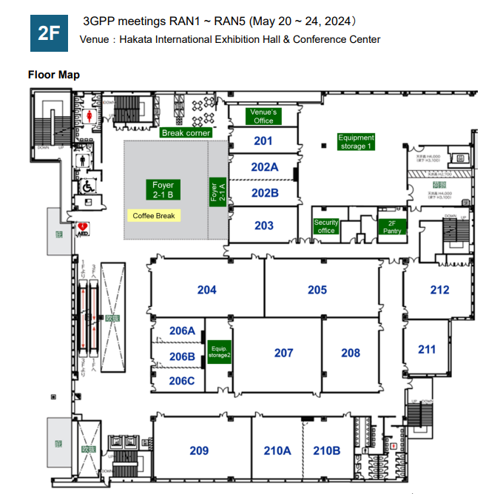
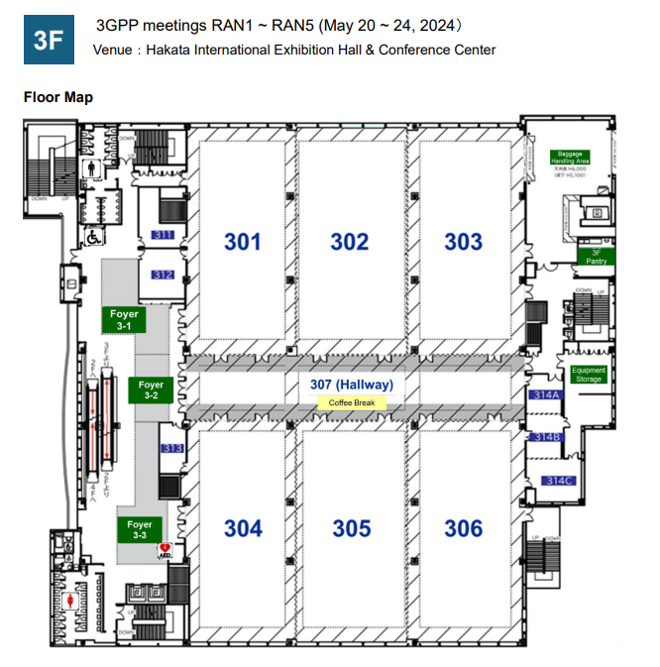
Meeting rooms
    RAN4 meeting rooms: @ Hakata International Exhibition Hall & Conference Center
  Main session: (301+302)/302 @ 3F (95~295 persons)
  RRM session: 207 @ 2F (100 persons)
  BDaT: 301 @ 3F (95 persons)
  Ad hoc session: 206ABC @ 2F (50 persons)
RRM session: 207
Main session: 302
Ad hoc session: 206ABC
BDaT session: 301

