Slide 1
RAN4#109 meeting Arrangements and Guidelines
3GPP TSG-RAN WG4 Meeting #109
Chicago, US, November 13 – 17, 2023
Agenda Item: 2
R4-23xxxxx
RAN4 Chair: Xizeng Dai
Vice Chair: Gene Fong, Shan Yang

Slide 2
General Aspects
The face-to-face meeting will take place during November 13th ~ November 17th, 2023.
  Three sessions in three separate rooms: Main, RRM, BSRF_Demod_test(BDaT). GoToWebinar (GTW) conference calls will be set each session. And the two-way remote participant can be supported. TOHRU will be used. A number of ad hoc sessions will be arranged (see Slide #7).
  Moderator will be designated to provide the summary for a topic before the meeting. In online discussions, session chairs will handle topics based on the moderator summary. Moderator does not need update the summary by collecting comments during the meeting.
  Deadline for Tdoc request & submission deadline: November 3rd (Friday) 2023, 23:59 UTC.
  Other deadlines can be found in the following slides.
One picture of meeting flows. See details in the corresponding slides.
For chairs
For moderator
For delegates
Pre-meeting (Nov 6~10)
Quiet Period
1st round (Nov 13~16)
2nd round (Nov 16~17)
Quiet Period
Post-meeting process ( Nov 20~23)
Mon
Tue
Wed
Thu
Fri
Sat/Sun
Mon
Tue
Wed
Thu
Fri
Sat/Sun
Mon
Tue
Wed
Thu
Tdoc number request & submission
Slide #3/4
NWM flag process Slide #16
Moderator trigger nwm: feedback maintenance & spectrum related
Flag maintenance & spectrum @nwm
WF/CR template
Draft TS/TR
Slide #9
Slide #15
Pre-RAN Action
MCC 3GU parsing tool
Slide #18/21
Slide #10/11
Slide #18
Topic Moderator & summary: slide #5
Moderator assignment before Mon
Draft summary for topics
Summary review & comments
Formal tdoc of summary submission by Friday
Rel-18 feature list/UE capability
Online discussions &
GTW conference call
Upload CR for maintenance 2:30pm on Thursday
TOHRU
Tdoc request (new&revision)
Upload tdocs (10.10.10.10) &
How to access contributions
Rel-18 feature list/UE capability
List of email threads for post-meeting
Submission of tdoc of post-meeting
Comments
Approve tdocs for post-meeting
Slide #23
Slide #7
Slide #12
Post-meeting process: slide #14
Initial list for block approval for basket
Deadline for flag for block approval
updated list for block approval
Slide #8
Registration
Slide #17
Slide #13
Basket WIs Block approval: slide #6
Meeting schedule & Ad hoc chair assignment
Update of meeting notes per day
Tdoc allocation
Check-in
Slide #13
Provided before meeting
Slide #22
Meeting room
Slide #8
Quiet Period (0:00 am ~ 7:00 am meeting venue Local time
No email are expected in RAN4 reflector

Slide 3
Tdoc number request & submission
The tdoc request and submission deadline is November 3rd (Friday) 2023, 23:59 UTC. Tdoc which is requested and/or submitted after deadline will not be treated. (the following guidance applies if the corresponding agenda(s) are set)
  Please refer to RAN4 Meeting Efficiency Improvements (R4-2114691) for tdoc submission and handling, where the principle is applied for Rel-18.
  CRs/Big CRs/TP/Revised WIDs are allowed this meeting. Please follow additional restrictions in the frozen agenda.
  In the ordinary meeting preceded by a bis meeting, if further change(s) were needed on top of the agreed CR/endorsed draft CR in the bis meeting, the new CR/draft CR should be based on the latest version of specifications and to capture the agreed CRs/endorsed draft CRs in the previous bis meeting with change marks in the new CR.
  For Rel-15/16 maintenance, please submit formal CRs.
  For Rel-17 and Rel-18 maintenance, please submit formal CRs and follow additional guidance from RAN4 Chair in the meeting agenda
  See the guidance on Slide #5 in R4-2114691, which are copied below
    Maximum one discussion paper per AI per company/organization
    No limit on the number of non-editorial CRs as along as the CRs are to make essential corrections. Additional restrictions for selected AIs may be applied subject to RAN4 Chair decision.
  For all maintenance CRs,
  Companies should submit the Cat-F CRs with the corresponding Cat-A CRs in the same agenda to ensure that the CRs can be easily tracked. If no Cat-A CRs were submitted in the same agenda, the CRs may just be endorsed or postponed.
  For easily tracking the changes, it expected that one batch of CRs (Cat-F/A/…) should just cover a single topic rather than multiple topics.
  When reserving tdoc number and submitting contributions, please add [WI_code] in the beginning of titles for both discussion files and CRs to facilitate handling of moderators and session chairs

Slide 4
Tdoc number request & submission (cont.)
  For Rel-18 on-going SI/WI
  For all the non-spectrum SI/WIs, rapporteur shall provide RAN4 work plan for each of RF/RRM/Demod sessions prior to the start of the actual work.
    The details can be found in RAN4 Meeting Efficiency Improvements (R4-2114691).
    It is encouraged that companies discuss and agreed on the work splitting first.
  For all the spectrum related WIs, rapporteur needs follow the guidance below
    Reserve the tdoc numbers for revised WID/draft TR/big CRs before each ordinary meeting
    Reserve the tdoc numbers for draft TR/big draft CRs before each bis meeting
  For Rel-18 WIs, the limit of submitted tdoc follows the principle in RAN4 Meeting Efficiency Improvements (R4-2114691)
    Maximum one discussion paper per lowest level agenda item (AI) per company/organization.
    The big CR approach is applicable. In principle, no formal CR is allowed, except for Rel-18 WIs to be closed and the spectrum related WIs.
      Companies shall follow CR work split and formal big CRs shall be submitted only by the assigned companies according to work split.
      Please use title starting with "Big CRs …”or "Draft Big CR" when you reserve a Tdoc number for a big CRs to facilitate work of MCC.
      The other companies are expected to submit draft CRs based on the latest version of specifications with change marks in bis meeting.
    When WIs/SIs are to be closed in the following-up RAN plenary, rapporteur needs get the TR number from MCC before the WG meeting and reserve the tdoc numbers for draft TR/TS to merge all the agreement.
  Deadline for a new band combination request
  Same deadline as RAN4 Tdoc submission.
    No request of adding new band combinations into basket WIs will be handled for bis-meeting and ad hoc meeting.
    No new band combination is allowed to be requested after the deadline
      It is allowed to only correct the missing fallback and add more supporting companies for the proposed band combinations.

Slide 5
Topic Moderator & summary
List of topics will be provided by session chair
  A number will be assigned for each topic, e.g., [109][10x] XXX for main session, which is similar to the number of email thread
  The intention is to facilitate the online/offline discussions
  MCC will create the sub-folder for each topic in /inbox/drafts
Topic Moderator will be designated to provide the summary for a topic before the meeting
  Before November 5 (Monday): Session chairs will provide the list of topics with moderator assignments.
  November 8 (Wednesday), 17:00 UTC: Moderators provide the initial summary for a topic
  November 9 (Thursday), 17:00 UTC: Deadline for companies review of initial summary
  November 10 (Friday), 17:00 UTC: Moderators submit the formal tdoc of summary for a topic
  November 12 (Sunday): Session chairs share the initial meeting notes taking moderators summary in consideration
  In online discussions, session chairs will handle topics based on the moderator summary.
  Online discussions will be organized based on the moderator summary topic by topic + presentation of the selected contributions
  Delegates do not need write comments in the summary document and moderator does not need update the summary during the meeting.

Slide 6
Basket WIs Block approval
Draft CRs/TPs for basket WIs (AI 9.1 for LTE, AI 7.3–7.13 for NR) will be handled following procedures/timelines below.
Procedures and timelines
  November 8 (Wednesday): Basket WI moderator will provide a list of contributions for flagging.
  November 10 (Friday), 17:00 UTC: Flag deadline. Companies can use the basket email thread title and specific reason(s) for flag in the email, e.g.,
  November 13 (Monday): Basket WI moderator will provide the updated list of contributions in which
    Those that were not flagged will be considered as "agreeable”.
    Those that were flagged will be revised. The authors are encouraged to share the revisions as soon as possible for further comments.
  November 14 ~ November 17 (Tuesday ~ Friday): The flagged tdocs will be discussed during the meeting.
    Ad hoc session(s) may be scheduled pending on Chair arrangement
    Online time slots will be scheduled for discussions and to make decisions for each flagged tdoc
    if the revision is agreeable by addressing received comments).
  November 21 (Tuesday), 17:00 UTC: Updated TRs/draft TSs need be available for post-meeting email process.
    No technique discussions are expected during post-meeting process.
Tdoc | Title | Reason for discussion | Source company
R4-2xxxxxx | xxxx | xxxx | xxxx

Slide 7
Online discussion & GTW conference call
During three online sessions, the two-way GTW conference calls will be set. For ad hoc session, MS teams will be provided.
  Remote participating with two-way GTW is allowed and supported and two-way remote participants will be able to listen and comment
  No official objection from remote participants is allowed
  Please register timely to be eligible to take part in the GTW conference calls
During online discussions
  Session chairs will organize discussions based on the moderator summary topic by topic + presentation of the selected contributions if needed
  Tdocs for approval including CR/draftCR/TP/draft TS/draft TR/Lsout will be handled online
  WF will be allocated by session chair during the online discussions
    Please not reserve Tdoc number for WF before the meeting
  Ad hoc sessions
  Ad hoc sessions will be scheduled by session chairs for detailed technique discussions for (a) special topics
  Ad hoc chairs will be designated by session chairs and the ad hoc minutes with recommendation are expected after ad hoc sessions
  The two-way GTW or other type of conference calls may be provided for ad hoc sessions
  Offline discussions
  The sub-folder for each topic will be created by MCC in the inbox folder, which is similar to those for email threads in e-meeting
    Companies can use the sub-folder to upload the new tdocs and/or revised tdocs, including WF/CR/draft CR/TPs…
  No official email discussion will be arranged for this topic
    When authors of WF/draft CR/LSout or other delegates trigger the offline discussions by email, please use the subject of [109][xxx] XXX for Main/RRM/BSRF_Demod_Test(BDaT) sessions, where XXX corresponds to topic name
  For maintenance topics, please upload the formal CRs of revision, if any, before 2:30pm (local time) on Thursday

Slide 8
Tdoc request & allocation
During the meeting, the tdoc number for revision or new tdoc will be allocated by session chairs according to the requests
  Based on the online discussions, session chairs with help of MCC will allocate tdoc numbers
  During coffee break, the delegates can request the tdoc in person from session chairs
  Email thread like “[1xx][X00] XXX_Session - tdoc request”WON´T be used for tdoc request and allocation since it is difficult for session chairs to handle email during face-to-face meeting.
For basket WIs, maintenance or other special topics, session chairs will allocate the Tdoc number for revision or new tdocs based on the recommendation in the topic moderators´ summary.
For TEI, if you plan to trigger a new topic which has no corresponding WI code and have to submit CR(s) with TEI-xx as the work item code for this topic, please contact session Chairs first, because TEI topics are under monitoring by RAN
  Please submit the CRs by providing a TEI identifier and include it in the title of CRs.
    Example of TEI identifier: [n77 Canada]
  The first CRs of one TEI topic to introduce a new should be prepared as Cat-B CRs. The CRs which correct the specification for the previous TEI topics should be submitted as Cat-F or Cat-A.
  Please refer to RP-222624 for the rule of TEI.

Slide 9
CR/WF template
  The latest CR-Form template can be found at
  https://www.3gpp.org/ftp/tsg_ran/WG4_Radio/TSGR4_109/Template
  By using the official CR coversheet template you ensure that only official 3GPP styles go into your CR (For an insight into the styles please review the latest 3GPP drafting rules 21.801).
  3GU tool
  There is a tool in 3GU which allows you to use the 3GU automatic pre-filled coversheet, so no need to fill in by hand all the CR details every time:
  If you go to the tdoc listing in 3GU (not the Excel Tdoc list but the "online" listing of Tdocs), and select a CR (the spectacles logo), and if that CR is not yet uploaded, there is a small logo next to the "Status: reserved" field which says "(Download prefilled cover page)".
  Using the 3GU automatic pre-filled coversheet can also make sure your data in 3GU must match your coversheet data.
  New clauses
  You are encouraged to used "other comments" on the CR coversheet to provide additional information for where you would like a new clause to be placed in the spec, if you have a preference.
  Others
  Companies are encouraged to write the CR based on the sequential order of clauses affected.
  Please use the appropriate bullet styles
  The WF template is provided in the server https://www.3gpp.org/ftp/tsg_ran/WG4_Radio/TSGR4_109/Templates
  The clean version of final formal WF Tdoc is expected.
  No green highlighted is expected

Slide 10
Correctly preparation for TR and TS
  Capture the new TR/TS in the table for “New specifications” in the approved WID/SID
  Keep the TS/TR number as 3Y.XXX, e.g., 38.xxx for NR
  Usually for SID, the title of TR is the same as the title of SID
  Rapporteur and numbers for TR/TS
  Please contact with WG Chair to decide the rapporteur for TR/TS
  Please contact WG secretary for TR/TS number after WID/SID capturing new TS/TR is approved in RAN and before submission to RAN for approval
  Update draft TR/TS in WG meetings
  Before formally approved in RAN plenary, the draft TR/TS is maintained by rapporteur in WG. TP is expected to be used to add or change technique contents for draft TR/TS.
  The rapporteur of draft TR/TS is expected to merge all the approved TPs and provide the updated draft TR/TS in the next meeting.
  The version number for the draft TR/TS should start with v.0.X.0, e.g., v.0.1.0, and X will increase meeting by meeting
  Submission and formally approve TR/TS to RAN plenary
  According to the target date, the draft TR/TS is expected to be submitted to RAN plenary for information and/or approval.
  Only the rapporteur of TR/TS is able to reserve tdoc number and upload tdoc for RAN plenary.
  Before submitting TR/TS to RAN plenary, please provide the drafts to RAN MCC to perform 3GU upload checker
  When submitting TR/TS, please use the template provided by RAN secretary. The template includes both presentation cover and specifications. Please put presentation cover and specifications in one zip file with proper tdoc number.
    Please find example in 3GPP_TS-TR_Template.zip and Spec_Submit.zip (presentation cover)
  Please use version number v1.0.0 for the firs time submission to RAN plenary (for information or for one-step approval), and use version number v.2.0.0 for the second time (e.g., for formal approval after submission for information in the previous RAN)

Slide 11
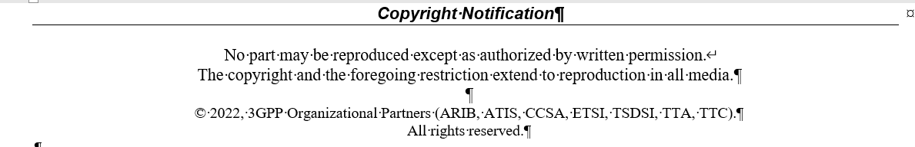
Correctly preparation for TR and TS (cont.)
  CR for formally approved TR/TS
  After formally approved, TR/TS is under control of MCC. Please use CR for any kinds of change for TR/TS.
  Update of copyright date in draft TR/TS
  Please update the date of draft TR/TS. The example is given below.
2023

Slide 12
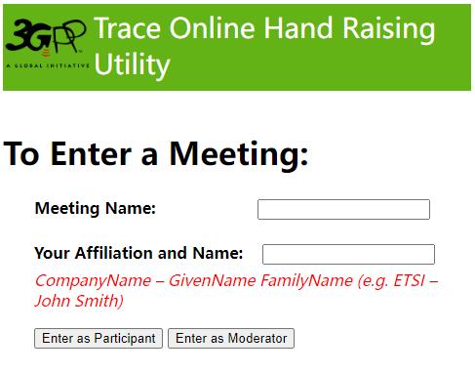
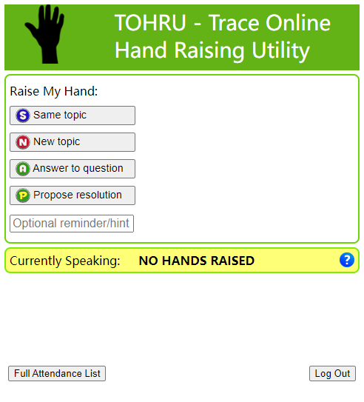
Guidance of TOHRU for GTW
  TOHRU (Trace Online Hand Raising Utility) will be used
  3GPP TOHRU will be used in this meeting for three online sessions
  Hyperlink: https://tohru.3gpp.org/
  Together with the invitation for the GotoWebinar MCC provides you with a "Meeting name" individually after your registeration
  Meeting name (TOHRU Meeting IDs):
    Main session: RAN4_Main
    RRM session: RAN4_RRM
    BSRF_Demod_testing session: RAN4_BSRF
    NOTE: Ad hoc session: MS teams will be provided
  Enter your name
    <represented company>, <first name> <family name>
    e.g.: XY Telecom - Peter Mustermann
  Need to manually push "Refresh Queue" or use "Automatically refresh queue every 3 seconds", since this is different from the original TOHRU tool.
  The other buttons are similar as the previous external TOHRU tool
  Please find references at
  https://www.3gpp.org/ftp/tsg_ran/WG4_Radio/TSGR4_109/Invitation

Slide 13
Register and check-in
  The registration deadline is November 6th, 2023 (Monday), 07:00 UTC
  Changes to the working procedures and please refer to updated 3GPP working procedure (especially F.2) for more details
  Attendance at ordinary e-meetings now counts towards accrual and maintenance of voting rights
  The new rules apply for future meetings starting from meetings after TSG#95-e. Past e-meetings do not count towards voting rights
  A delegate is deemed to have attended a given meeting if they confirm their participation by check in. If a delegate does not check in during the meeting, it shall be assumed that the individual did not attend.
  Please note that the delegates need to check in themselves between the start and the end of the meeting.
  For face-to-face (ordinary) meeting, please check in via 10.10.10.10 during the meeting
  Remote participants will not be able to check in for RAN4 meeting when it is a face-to-face (ordinary) meeting
  No voting rights will be accrued through remote participants
  For e-meeting, please follow the guidance below to check in
  Option 1: Through registration email, click the direct link (only if you registered after the deadline of registration for this meeting)
  Option 2: Through registration email, copy/paste token into the registration link (if you registered after the deadline of registration for this meeting)
  Option 2-Bis: Through registration email, copy/paste token into the registration link (if you registered before the deadline of registration for this meeting)
  Option 3: Through the 3GU portal (You need to be logged in)
    Click on the meeting you wish to check-in to
    then, click on “Presence Token” link
  Note: although the date of registration to a given meeting is not the cut-off date when the new rules start to apply, it is still expected for delegates to register before the deadline of registration to be eligible to take part in the GTW conference calls.

Slide 14
Post-meeting email process procedures/timelines
Tdocs under post-meeting email process:
  Big CRs for Rel-18 on-going WIs
  Big CRs/Revised WIDs/TRs for Rel-18 basket WIs
  Other tdocs based on Chairs guidance
Procedures and timelines:
  November 20 (Monday), 17:00 UTC: Session chairs will provide the list of tdocs for post-meeting email process.
  November 21 (Tuesday), 17:00 UTC: Authors of tdocs need share the drafts and submit them into inbox for review.
  November 23 (Thursday), 13:00 UTC: Companies provided comments if any and author should provide necessary revisions
  November 23 (Thursday), 17:00 UTC: Based on the summary, session chair will announce decisions.
  Other guidance:
  We would like to remind all delegated to upload all Cat A draft CRs/CRs timely. In case Cat A draft CRs/CRs are not available before close of meeting on November 17 (Friday) 17:00 (local time), the respective Draft CRs may be postponed and not implemented.
  Delegates are strongly encouraged to participate in review on Big CRs during post-meeting email process procedures

Slide 15
Pre-RAN action (TS/TR/SR review) after ordinary meeting
  Please WI/SI rapporteurs share draft SR(status report) and revised WID (RAN4 led WIs）if any in RAN4 reflector no later than November 23 (Thursday) 17:00 UTC ；Guidance from MCC for SR and revised WID submission
  1. WIs with target December 2023 and % complete <100% mean a request to stop the WI,
    In such a case CRs will be requested to de-implement changes already in the specs and introduced under this WI
  2. Status report target dates have to match the target dates submitted in rev WIDs to the same TSG meeting
  3. Revised WIDs have to show revision marks relative to the last approved WID
  Please do not submit the formal SR/revised WID to upcoming RAN plenary, before RAN4 Chair(s) check the draft SR and revised WID and send the feedback, to facilitate the treatment in RAN
  NOTE: According to offline feedback from MCC, it is suggested to clarify the rule that all the fallback modes for each proposed band combinations should be finalized before the work on those band combinations is done in the Rel-18 basket WIDs
  For draft TS/TR which planned to be submitted to RAN plenary for approval, please share the draft version to Carolyn for pre-check no later than November 21 (Tuesday) 17:00 UTC
  If you want to close a item, please make sure that you submit all the necessary documents including TS/TR to RAN plenary.

Slide 16
NWM flag process
  Because a large numbers of CRs/contributions are submitted for early release maintenance and some spectrum related topics, we would like to improve the efficiency to handle those tdoc-s in face-to-face meeting
  Previously only after tdocs are handled online in the first round, the proponents can know who have comments. And there may be no comments for some CRs, which can be directly endorsed/agreed and actually no online time would be needed.
  For those tdocs on which companies have comments, earlier offline discussions would be helpful to save online time in face-to-face meeting.
  The proponent(s) should know which companies have comment and then have offline discussion with them earlier.
  So we would like to provide a scheme to help the proponents/moderators identify which companies will have comments or concerns.
  NWM flag process: Use NWM tool to trigger early offline discussions
  Before November 12 (Sunday): For topic threads which need nwm flag process, moderators will provide the NWM link, where delegates can flag the tdocs/CRs with brief reasons
    NWM flag process is just for maintenance and some spectrum related items with many CRs
    Format of NWM would be simple
      Only the tdoc numbers and titles are listed
  By November 14 (Tuesday), 18:00 (local time): Delegates flag the tdocs in the list
    Flag process would be simple
      Fill in the feedback form with a brief description of reason, like “Company A flag R4-23xxxxx because XYX”，or with delegate name who flags tdoc like “Company A Aaron flags R4-23xxxxx because XYZ”.
      The purpose is to let the proponents know who they need to talk to.
  During the online treatment, session chairs will treat those tdocs as usual manner and can directly treat the revision(s).

Slide 17
How to upload and access contributions
Upload/download tdocs during the meeting
  10.10.10.10 as local server in F2F, which will be sync-up by MCC to https://www.3gpp.org/ftp/Meetings_3GPP_SYNC/RAN4
Folder access | Before the meeting | Up to end of Pre-meeting, during the F2F meeting, and post-meeting | Comments
https://www.3gpp.org/ftp/tsg_ran/WG4_Radio/TSGR4_109/Inbox/ | Used for the upload of documents (same as during an e-meeting) | Used the same as during an e-meeting for pre-meeting and post-meeting contributions | As usual, the meeting contributions are to be uploaded to 3GU till Deadline For the pre-meeting contributions, the FTP server can be used for uploading Topic summaries, etc. into the inbox MCC will backup all available files from FTP server to the local FTP server (10.10.10.10) and provide the credentials required to access the local FTP server remotely when they become available by ETSI IT. The FTP server should be used again during post-meeting. MCC will backup all available files from local FTP server (10.10.10.10) to the FTP server after the F2F meeting close and before the 3GPP local WIFI have been dismantled.
FTP local server (10.10.10.10) |  | Used by F2F participants in the meeting location. | The local FTP server (10.10.10.10) is used by both F2F delegates (once connected to the 3GPP local WIFI) and remote participants (note: not until the credentials required to access the local FTP server remotely becomes available by ETSI IT) The upload of any documents during the F2F meeting should be done using the local FTP server (10.10.10.10)
The credentials that is required to access the local FTP server 10.10.10.10 remotely to remote participants. |  | Should only be used by remote participants.
https://www.3gpp.org/ftp/Meetings_3GPP_SYNC/RAN4/ |  | Used for any delegate who would like to only read contributions | Please note that the Meetings_3GPP_SYNC/RAN4 server is always provided as read only and delegates are not able to upload contributions to this server. The RAN4 sync server has a delay and occurs around every 10 minutes Access to the RAN4 sync server does not start until the meeting set-up have been done by ETSI IT. The RAN4 sync server access starts before the start of the meeting. The RAN4 sync server stops after the meeting close and the 3GPP local WIFI have been dismantled

Slide 18
MCC 3GU parsing tool
  MCC 3GU parsing tool will be used to identify the problem of CR, especially for CR cover page. The CR which does not pass the MCC 3GU parsing tool will not be included in the CR pack for RAN plenary formal approval.
  Before the meeting starts, the author and MCC will receive the feedback of checking via MCC 3GU parsing tool, and based on the information shared by author or MCC the Session chairs or MCC will handle the problem identified by the tool
  The revision may or may not be needed to fix the problem depending on the Session chairs guidance.
    For some draft CRs, the revision may not be urgent before the online treatment.
  During the meeting, session chairs may not have information on whether the revised CRs pass the MCC 3GU parsing tool or not, so the problem of CR parsing will be fixed in the post-meeting email process.
  At the beginning of the post-meeting process, the Session chairs will provide the list of the revised CRs which did not pass the MCC 3GU parsing tool checking and need be further revision.

Slide 19
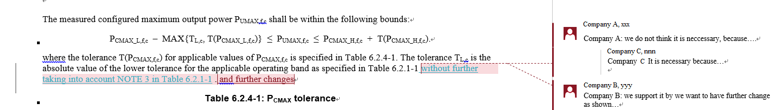
Other guidelines
Notes on email
  Each email thread needs to use a clear and consistent thread title for easy tracking (the thread title will be announced)
    E.g., if not done appropriately, after a while an email thread may become something like:
      RE: xxxx
      RE: RE: xxxx
      回复:RE: xxxx
      [External] RE: xxxx … etc.
      which makes it very hard to track. PLEASE fix it to RE: xxxx!
    Some instruction how to get“RE:”in word:
      https://www.extendoffice.com/documents/outlook/4495-outlook-reply-subject-prefix.html
  Please follow above naming nomenclature when providing your comments on Tdoc for revised WFs/CRs/LS, …for other easy tracking.
    For CR/draft CR, provide comments for CRs by adding New comments and suggested changes with Markup in revised CRs

Slide 20
Other guidelines (cont.)
    Role of moderators
  Moderator is a neutral technical competent facilitator of discussion and is expected to provide summaries timely and impartially, and try their best way to drive progress.
  Moderator is expected to drive the progress based on the consensus and continue organizing the discussions in the 2nd round if there are concerns received from companies.
  Feedback on moderator performance is expected to be given privately to the Chair.
  Tdoc of a moderator summary is sourced as “Moderator (company name)”.
    NWM
  Please refer to the following document for NWM tool at https://www.3gpp.org/ftp/tsg_ran/WG4_Radio/TSGR4_109/Invitation/
    To facilitate the GTW and future face-to-face meeting arrangement, it is highly encouraged that experts do not cover multiple areas across Main, RRM and BSRF_Demod_Test sessions
  Sessions chairs will try to do proper schedule to avoid conflict of sessions for experts, but with more and more delegates covers multiple areas it is challenging for session chairs to do it.

Slide 21
Other guidelines (cont.)
    Guidance for Tdoc “type”, ”For”and other information when you request a tdoc
Tdoc to be requested | Type | For | Other information
Discussion paper | Discussion | Discussion
Paper with proposals to be approved | Other | Approval
Way forward | Other | Approval
(Reply) LS on …. | LS out | Approval | Release, Related WIs, Reply to (if available), to, CC
CR on… | CR | Agreement | Release, Spec (latest version), Version, Related WIs, Is revision of (if it is a revision of previous agreed CR), CR category
Big CR on … | CR | Agreement | Release, Spec (latest version), Version, Related WIs, Is revision of (if it is a revision of previous agreed CR), CR category
Draft CR on… | draftCR | Endorsement | Release, Spec (latest version), Version, Related WIs, CR category
Draft big CR on … | draftCR | Endorsement | Release, Spec (latest version), Version, Related WIs, CR category
TP for … | pCR | Approval | Release, Spec (latest version), Version, Related WIs
TR 3x.xxx… | draft TR | Agreement | Release, Spec (latest version), Version, Related WIs
(New) TS 3x.xxx | draft TS | Agreement | Release, Spec (latest version), Version, Related WIs

Slide 22
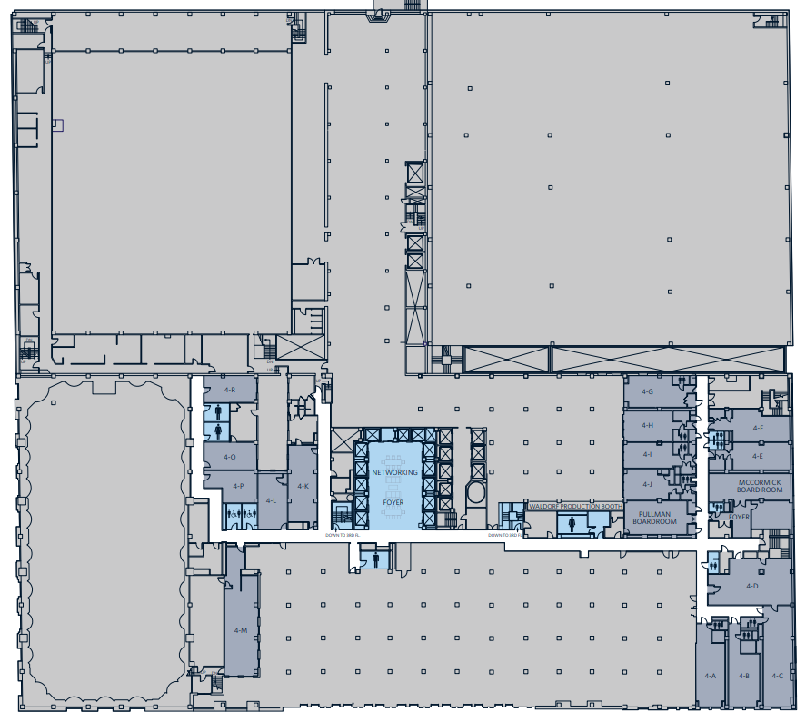
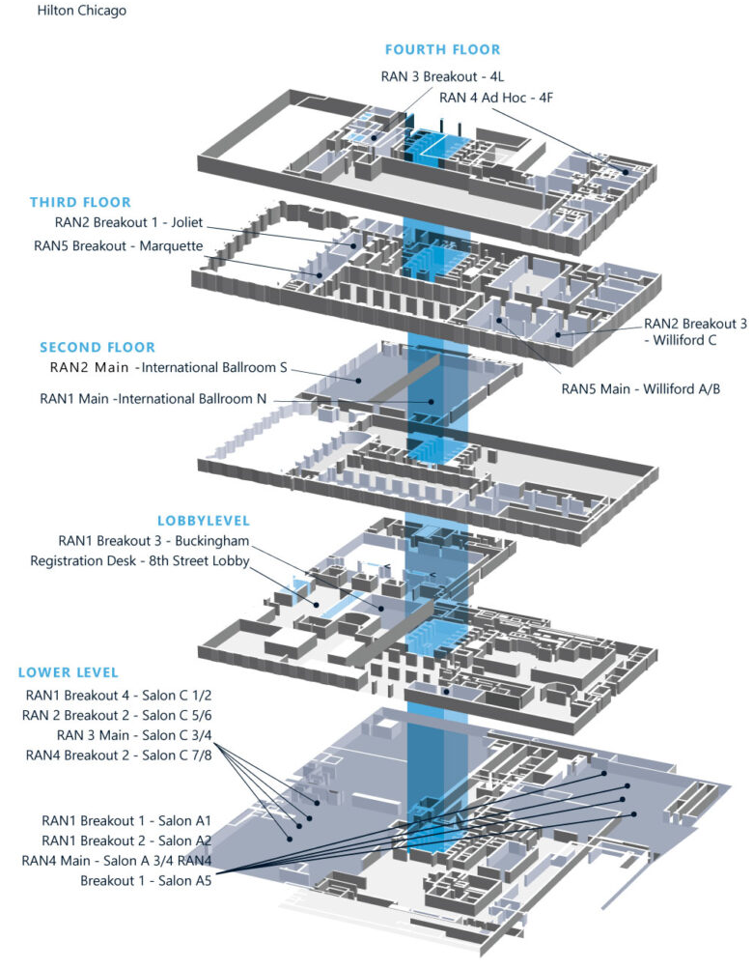

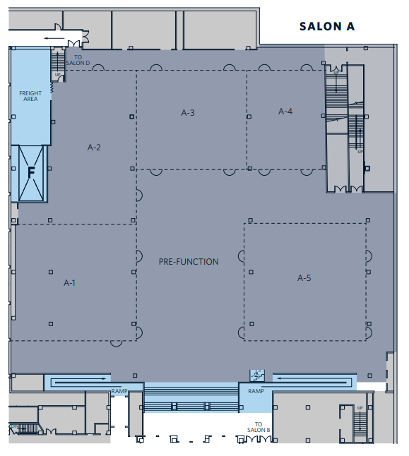
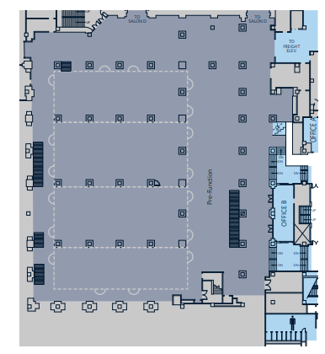
Meeting rooms
    RAN4 meeting rooms: @ Hilton Chicago Lower level + 4th floor
  Main Session: Salon A5 (240)
  RRM Session: Salon A3 (150)
  BDaT Session: Salon A4 (100)
  Ad hoc room #1: Salon C 7/8 (80)
  Ad hoc room #2: 4F (24)
Ad hoc Room#2
RRM session
BDaT session
Ad hoc Room#1
Main session

Slide 23
Rel-18 feature list/UE capability
  Discussions on Rel-18 feature list/UE capabilities
  The dedicated agenda for Rel-18 feature list/UE capability will be set, and the topic thread & moderator will be assigned
  Moderator will provide the template for Rel-18 feature list/UE capabilities before the meeting
  For the newly proposed UE capabilities
    The proponents need submit the contribution with details to the agenda of the corresponding WI, and the decision should be made under the agenda of the individual WI.
    The proponents also need submit the contribution to the dedicated agenda for Rel-18 feature list/UE capability. After the decision is made under the agenda of the individual WI, the corresponding UE capability will be captured in the Rel-18 feature list.
    If there is no corresponding agenda, the proponents can directly submit the contributions with technique details in the dedicated agenda for Rel-18 feature list/UE capability, and the decision will be made under the dedicated agenda.
  For the previous agreed UE capabilities,
    The rapporteur or other interested companies can submit the contributions with all the details following the template under the dedicated agenda for Rel-18 feature list, and the review and necessary discussion will be held under the dedicated agenda.
  During the meeting, the feature list will be reviewed and will be discussed in the joint sessions.

Slide 24
Thanks!
Wish a successful RAN4 meeting

