Slide 1
RAN4#105 meeting schedule
3GPP TSG-RAN WG4 Meeting #105
Toulouse, France, November 14th – November 18th , 2022
Agenda Item: 2
R4-22xxxxx
RAN4 Chair: Xizeng Dai
Vice Chair: Haijie Qiu, Andrey Chervyakov,

Slide 2
Monday
Venue Time | RAN4 Main (Ground floor) | RAN4 RRM (RAN1 Brk 2, 1st floor) | RAN4 BSRF_Demod_Test (RAN4 Brk 1, Ground floor)
9:00-9:30 | 1. Opening of the meeting 2. Approval of the agenda 3. Letters / reports from other groups / meetings Join session topic n28 access failure R4-2218650, R4-2218772
9:40-10:30 | Spectrum related [105][111] NR_LTE_V2X_PC5_combos: AI 7.14 (10) [105][112] LTE_NR_HPUE_FWVM: AI 7.15 (8) [105][113] HPUE_Basket_EN-DC: AI 7.17 (7) [105][114] HPUE_Basket_Intra-CA_TDD: AI 7.18, 7.21 (11) [105][115] HPUE_Basket_inter-CA_SUL: AI 7.19 (24) [105][116] HPUE_Basket_FDD: AI 7.20, 7.22 (10) | Rel-17 RRM [105][208] NR_feMIMO_RRM_1: AI 6.5.1 (15) [105][209] NR_feMIMO_RRM_2: AI 6.5.2 (15) | Rel-17 Demod [105][318] NR_NTN_Demod_Part1: AI 6.2.6.1, 6.2.6.3 (16) [105][319] NR_NTN_Demod_Part2: AI 6.2.6.2 (26)
11:00-13:00 | [105][117] LTE_NR_Other_WI: AI 7.23, 7.24, 7.25, 7.26 (18) [105][118] NR_600MHz_APT_part1: AI 7.27, 7.27.1, 7.27.2 (15) AI 7.27.3 BS RF requirements and conformance testing (10) AI 7.27.4 RRM requirements (1) | [105][206] NR_ext_to_71GHz_RRM_1: AI 6.3.4 (11) [105][207] NR_ext_to_71GHz_RRM_2: AI 6.3.5 (19) [105][211] NR_redcap_RRM_1: AI 6.6.2 (19) | [105][320] NR_exto71GHz_Demod_Part1: AI 6.3.6.3 (22) [105][321] NR_exto71GHz_Demod_Part2: AI 6.3.6.2 (30)
14:00-16:00 | [105][120] NR_unlic_enh: AI 7.28 (15) [105][121] R18_LTE_TDD_1.6GHz: AI 9.3 (16) [105][122] LTE_terr_bcast_bands_UERF: AI 9.4, 9.4.1, 9.4.2, 9.4.3 (9) | [105][210] NR_redcap_RRM_2: AI 6.6.3 (16) [105][212] NR_IIOT_URLLC_enh: AI 6.7.2 (16) [105][213] NR_SmallData_INACTIVE: AI 6.8.2 (6) [105][203] R17_maintenance_RRM: AI 5.3 (39) | [105][322] NR_cov_enh_Demod: AI 6.4.2 (20) [105][323] NR_FeMIMO_Demod: AI 6.5.3 (11) [105][324] NR_RedCap_Demod: AI 6.6.4 (7) [105][325] NR_IIOT_URLLC_enh_Demod: AI 6.7.3 (9)
16:30-18:20 | RAN4-led non spectrum [105][123] FS_NR_eff_BW_util: AI 8.1 (12) including CRs R4-2218811, R4-2218814, R4-2218817 and Cat A CRs. [105][124] FS_NR_700800900: AI 8.2 (34) | [105][203] R17_maintenance_RRM: AI 5.3 (cont.) RAN tasks [105][232] RAN_task_RRM (13) | Rel-17 RF Conformance [105][306] NR_exto71GHz_BSRF: 6.3.2, 6.3.3 (23)
18:20 – 19:20 (evening ad hoc) | Ad hoc for R15/16 UE RF maintenance Chaired by Jinqiang Xing (OPPO) | Ad-hoc for Rel-18 Further enhancements on NR and MR-DC measurement gaps and measurements without gaps WI Chaired by Ato Yu (MediaTek) | Ad-hoc for Rel-18 NTN (focus on Ka band definition) Chaired by Gene (Qualcomm)

Slide 3
Tuesday
Venue Time | RAN4 Main (Ground floor) | RAN4 RRM (RAN1 Brk 2, 1st floor) | RAN4 BSRF_Demod_Test (RAN4 Brk 1, Ground floor)
8:00-10:30 | [105][125] FS_SimBC: AI 8.3 (11) [105][126] FR1_enh2_part1: low MSD AI 8.6, 8.6.1 8.6.4 (21) | Rel-17 RRM (continue, if needed) Rel-15/Rel-16 RRM maintenance [105][201] R15_maintenance_RRM: AI 4.4 (27) [105][202] R16_maintenance_RRM: AI 4.4 | [105][302] NR_Repeater_RFMaintenance: AI 6.1.1, 6.1.2 (13) [105][303] NR_Repeater_RFConformance: AI 6.1.3 (13) [105][304] NTN_Solutions_RF_Maintenance: 6.2.1 (14) [105][305] NTN_Solutions_RFConformance: AI 6.2.2 (18)
11:00-13:00 | [105][127] FR1_enh2_part2: 4 Tx AI 8.6.2 (10) [105][128] FR1_enh2_part3: 8Rx AI 8.6.3 (11) | Rel-18 RRM [105][220] NR_MG_enh2_part1: AI 8.10, 8.10.1-2 (31) [105][221] NR_MG_enh2_part2: AI 8.10.3 (24) | Rel-18 RF [105][312] NR_NTN_enh_Part1:AI 8.23.1, 8.23.3 SAN RF (14) [105][313] NR_NTN_enh_Part2: AI 8.23.2 (6)
14:00-16:00 | [105][129] FR2_enh_req_Ph3_part1: BC initial/inactive AI 8.7, 8.7.1, 8.7.3 (29) [105][130] FR2_enh_req_Ph3_part2: FR2 UL256QAM AI 8.7.2 () [105][131] FR2_multiRx_UERF_part1: AI 8.8.2 8.8.2.2 () [105][132] FR2_multiRx_UERF_part2: AI 8.8.2.1 (9) | [105][224] NR_ATG_RRM: AI 8.13.4 (36) [105][230] NR_netcon_repeater_RRM: AI 8.25.3 (5) | [105][316] IoT_NTN_Co-existence_SANRF: AI 9.5.3, 9.5.4 (18) [105][310] FS_NR_duplex_evo_Part1: AI 8.18 except 8.18.2.1 (29)
16:30-18:20 | [105][133] NonCol_intraB: AI 8.11.1, 8.11.2 (11) [105][134] NR_HST_FR2_enh_UERF: AI 8.12.1, 8.12.2, 8.12.3 (2) [105][135] NR_ATG_UERF_part1: co-exist. AI 8.13, 8.13.1 (16) [105][136] NR_ATG_UERF_part2: UE RF AI 8.13.2 (10) | LS reply [105][233] Reply_LS_1: AI 10.1.1, 10.2.5, 10.2.4.2 (12) [105][234] Reply_LS_2: AI 10.2.1, 10.2.2 (37) | [105] [310] continue [105][311] FS_NR_duplex_evo_Part2: AI 8.18.2.1 (12)
18:20 – 19:20 (evening ad hoc) | Ad hoc for R17 maintenance Chaired by Dominique Everaere (Ericsson) | Ad-hoc for Rel-18 NR FR2 multi-Rx chain DL reception WI Chaired by Valentin Gheorghiu (Qualcomm) | Ad-hoc for FR2-2 BS RF conformance (focused on MU calculation) Chaired by Michal (Huawei)

Slide 4
Wednesday
Venue Time | RAN4 Main (Ground floor) | RAN4 RRM (RAN1 Brk 2, 1st floor) | RAN4 BSRF_Demod_Test (RAN4 Brk 1, Ground floor)
8:00-10:30 | LS reply [105][143] NR_reply_LS_UE_RF: UE RF LS AI 10.1, 10.2, 10.3 | Rel-18 RRM [105][223] NR_HST_FR2_enh_RRM: AI 8.12.4, 8.12.5 (18) [105][222] NonCol_intraB_ENDC_NR_CA_RRM: AI 8.11.3 (8) | [105][307] FS_NR_BS_RF_evo: AI 8.4 (15) [105][308] NR_ATG_BSRF: 8.13.3 (6) [105][309] NR_LTE_EMC_enh: 8.16 (4) [105][315] LTE_terr_bcast_bands_BSRF: 9.4.4 (4)
11:00-13:00 | WI/SI-led by other WGs [105][137] FS_NR_pos_UERF: AI 8.19.1, 8.19.2 8.19.3 (8) [105][138] NR_MC_enh_UERF: AI 8.20.1, 8.20.2 (21) | [105][215] FR2_multiRx_RRM_part1 / AI 8.8.3.1-3 (42) [105][216] FR2_multiRx_RRM_part2 / AI 8.8.3.4 (10) [105][217] FR2_multiRx_RRM_part3 / AI 8.8.3.5 (8) | [105][314] NR_netcon_repeater: AI 8.25.1, 8.25.2 (7) Rel-15/16/17 BS RF maintenance [105][301] BSRF_maintenance : AI 4.2, 5.1, 5.5 (29)
14:00-16:00 | [105][140] NR_cov_enh2_part1: high power AI 8.24, 8.24.1 (10) [105][141] NR_cov_enh2_part2: reduce MPR/PAR AI 8.24.2 (16) AI 6.3.2 R17 NTN UE RF [105][139] NR_NTN_enh_UERF: AI 8.23.4 (6) | [105][227] NR_Mob_enh2_part1 / AI 8.21, 8.21.1, 8.21.3 (41) [105][228] NR_Mob_enh2_part2 / AI 8.21.2 (12) | Rel-18 OTA [105][329] FS_NR_FR2_OTA_enh: AI 8.5 (13) [105][330] NR_FR1_TRP_TRS_enh: AI 5.6, 8.14 (28)
16:30-18:20 | [105][142] LTE_NBeMTC_NTN_UERF: AI 9.5.1, 9.5.2, 9.5.5 (27) | [105][226] NR_MC_enh_RRM: AI 8.20.3 (15) [105][225] FS_NR_pos_enh2_RRM: AI 8.19.4 (12) | 8.14 continued [105][331] NR_MIMO_OTA_enh: AI 8.14 (24)
18:20 – 19:20 (evening ad hoc) | Ad hoc for [105][106] NR_Baskets_Part_1 Chaired by Dominique Brunel (Skyworks) | Ad-hoc for Rel-18 Even Further RRM enhancement WI Chaired by Jerry Cui (Apple) | Ad-hoc for Duplex Evolution SI (Focused on interference modelling, RAN1 LS reply) Chaired by Jackson Wang (Samsung)

Slide 5
Thursday
Venue Time | RAN4 Main (Ground floor) | RAN4 RRM (RAN1 Brk 2, 1st floor) | RAN4 BSRF_Demod_Test (RAN4 Brk 1, Ground floor)
8:00-10:30 | RAN task [105][144] RAN_task_UERF_part1: 2Rx exception U6G AI 11.2 (6) [105][145] RAN_task_UERF_part2: intra EN-DC, Canada/US n77 AI 11.3, 11.4 (30) | Rel-18 RRM [105][218] NR_RRM_enh3_part1: AI 8.9, 8.9.1-2 (28) [105][219] NR_RRM_enh3_part2: AI 8.9.3 (8) | Rel-18 Demod [105][326] RF_FR1_enh2_Demod: AI 8.6.6 (9) [105][327] NR_demod_enh3: AI 8.17.1 (11) [105][328] IoT_NTN_Demod: AI 9.5.8 (4)
11:00-13:00 | Basket WI [105][106] NR_Baskets_Part_1: AI 7.1 (34) [105][107] NR_Baskets_Part_2: AI 7.3~7.8 (75) [105][108] NR_Baskets_Part_3: AI 7.9, 7.13 (13) [105][109] NR_Baskets_Part_4: AI 7.10, 7.11, 7.12 (78) [105][110] LTE_Baskets: AI 9.1 (3) | [105][229] NR_DualTxRx_MUSIM: AI 8.22 (36) [105][231] LTE_NBeMTC_NTN_RRM: AI 9.5.6, 9.5.7 (18) | Rel-15/16/17: Demod maintenance: [105][317] Demod_Maintenance: AI 4.5, 5.4 (33)
14:00-16:00 | Basket WI (continue) Maintenance [105][101] Upto_R16_UERF_maintenance：AI 4.1 (70) [105][102] R17_UERF_maintenance: AI 5.2 (41) [105][103] NR_ext_to_71GHz: AI 6.3.1 (4) [105][104] NR_cov_enh_maintenance: AI 6.4.1 (3) [105][105] NR_RedCap: AI 6.6.1 (?) | Reserved | Reserved Early return to Rel-17 RF conformance and Demod
16:30-18:20 | Maintenance (continue) Return to | Return to | Return to
18:20 – 19:20 (evening ad hoc) | Reserved for Ad-hoc (Topic TBD) | Reserved for Ad-hoc (Topic TBD) | Reserved for Ad-hoc (TBD)

Slide 6
Friday
Venue Time | RAN4 Main (Ground floor) | RAN4 RRM (RAN1 Brk 2, 1st floor) | RAN4 BSRF_Demod_Test (RAN4 Brk 1, Ground floor)
8:00-10:30 | Return to | Return to | Return to
11:00-13:00 | Return to | Return to | Return to
14:00-16:00 | Return to (final round) | Return to (final round) | Return to (final round)
16:00-17:00 | 13 Future meetings 14 Any other business Social event for resuming f2f meeting

Slide 7
Thanks!
Wish a successful RAN4 meeting

Slide 8
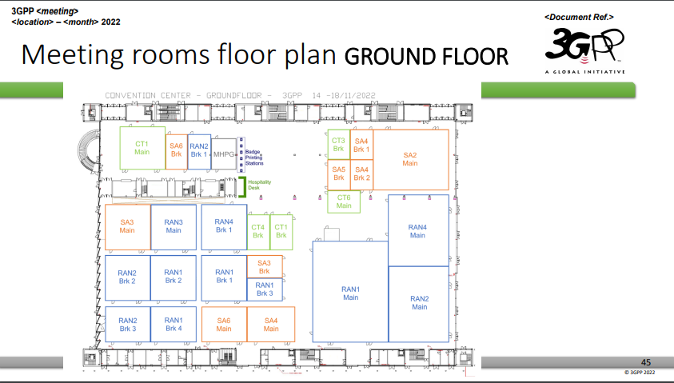
Annex I: meeting rooms (1/2)

Slide 9
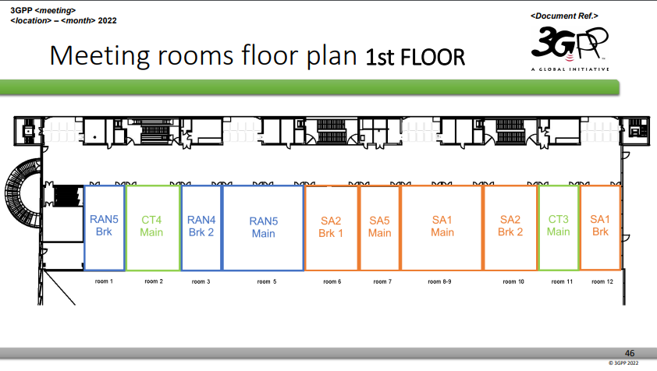
Annex I: meeting rooms (2/2)

Slide 10
Annex II: Upload/download tdocs during the meeting
Upload/download tdocs during the meeting
  For experts attending F2F meeting
    10.10.10.10 as local server
  For experts not attending F2F meeting and join online via GTW
    3GPP_Sync from website https://www.3gpp.org/ftp/Meetings_3GPP_SYNC/RAN4
3GPP Network Information
  3GPP Wireless LAN
    SSID: 3GPPWIFI
    Password: 3GPP3GPPM (CAPITAL LETTERS!)
    IP address: 10.10.10.10

