Slide 1






BasketBall Friendly Match
RAN3 vs RAN2
For win
We want you!

Slide 2
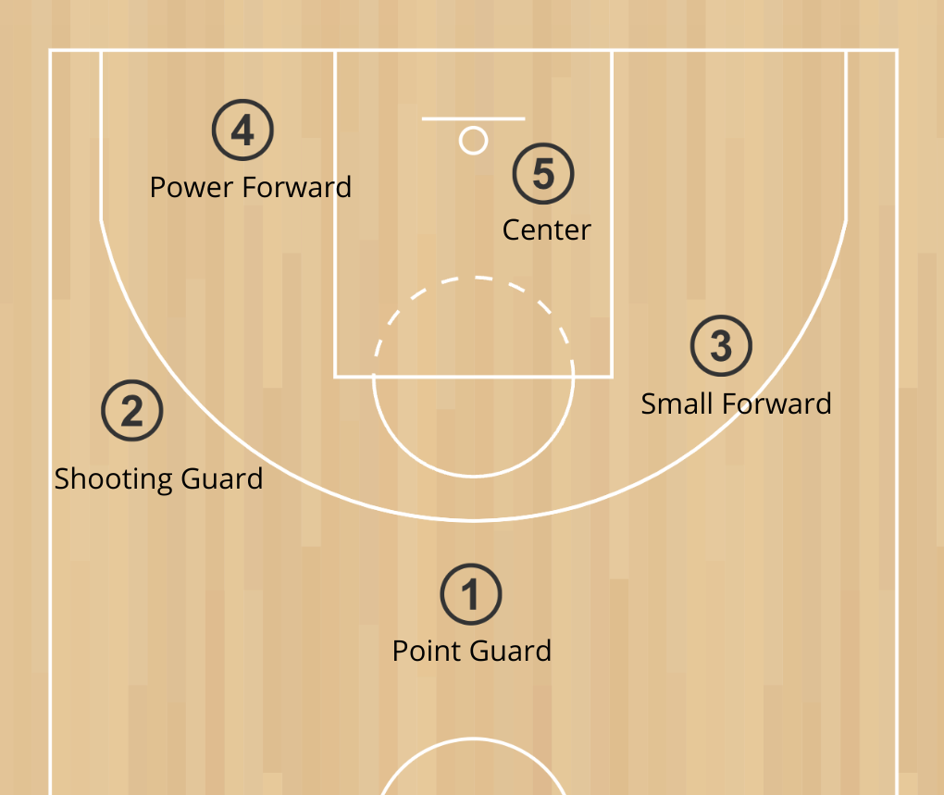
What is Basketball?

Slide 3
Playing basketball requires a combination of physical and technical skills, same as in RAN3!
• Ball Handling:The ability to dribble the ball with control,using both hands,while moving at different speeds and changing directions.
• Shooting:The skill to accurately throw the ball into the basket from various distances and positions on the court.
• Passing:The ability to effectively pass the ball to teammates using chest passes,bounce passes,and overhead passes.
• Rebounding:The skill to secure the ball after a missed shot,either offensively(to regain possession)or defensively(to prevent the opponent from scoring).
• Defense:The ability to guard an opponent effectively,using techniques like footwork,positioning,and timing to block shots or intercept passes.
• Speed and Agility:Quickness and the ability to change direction rapidly,which is crucial for both offense and defense.
• Endurance:The stamina to play at a high intensity for the duration of the game without tiring.
• Vertical Jump:The ability to jump high,which is important for shooting over defenders,blocking shots,and grabbing rebounds.
• Court Awareness:Understanding the game's flow,knowing where teammates and opponents are on the court,and making smart decisions quickly.
• Communication:The ability to effectively communicate with teammates during the game,calling out plays,defenses,and adjustments.

Slide 4
RAN3 is the best! Welcome to be the RAN3vsRAN2 game sponsor, your company name will be printed on the basketball uniforms! Contact person: chen.jiajun1@zte.com.cn

