Slide 1
Status Report RAN WG1
RP-251893
3GPP RAN WG1 Chair
Xiaodong Xu

Slide 2
Executive Summary
RAN1#122bis | Oct. 13th – 17th, 2025 | Prague，Czech | Release 20 , R19&Pre-R19 LTE/NR maintenance
RAN1#123 | Nov. 17th – 21st, 2025 | Dallas，USA | Release 20 , R19&Pre-R19 LTE/NR maintenance
RAN#110 | Dec. 8th – 11th, 2025 | Baltimore, USA
Rel-20 study/work items: Overall, Rel-20 5G-A discussions are progressing adequately, 6GR has made reasonable progress in waveform, channel coding, evaluation assumption, as well as identification of AI/ML use cases.
Rel-19 work items: RAN1 specifications were stabilizing well，UE features were almost done, TU for Rel-19 maintenance was reduced.
Pre-Rel-19: RAN1 endorsed a few CRs.

Slide 3
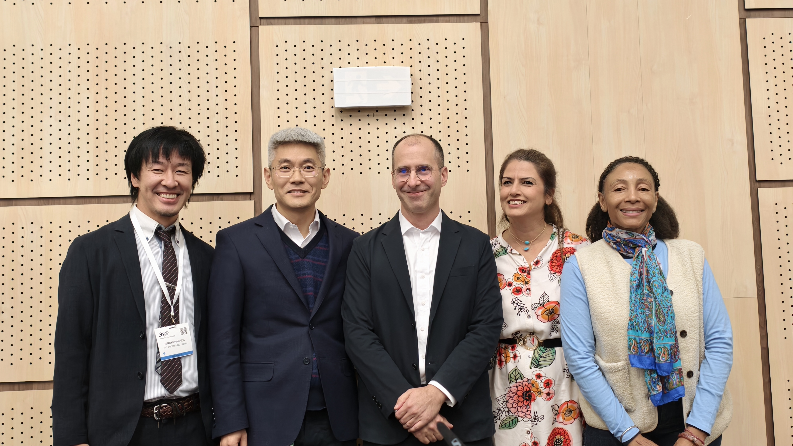
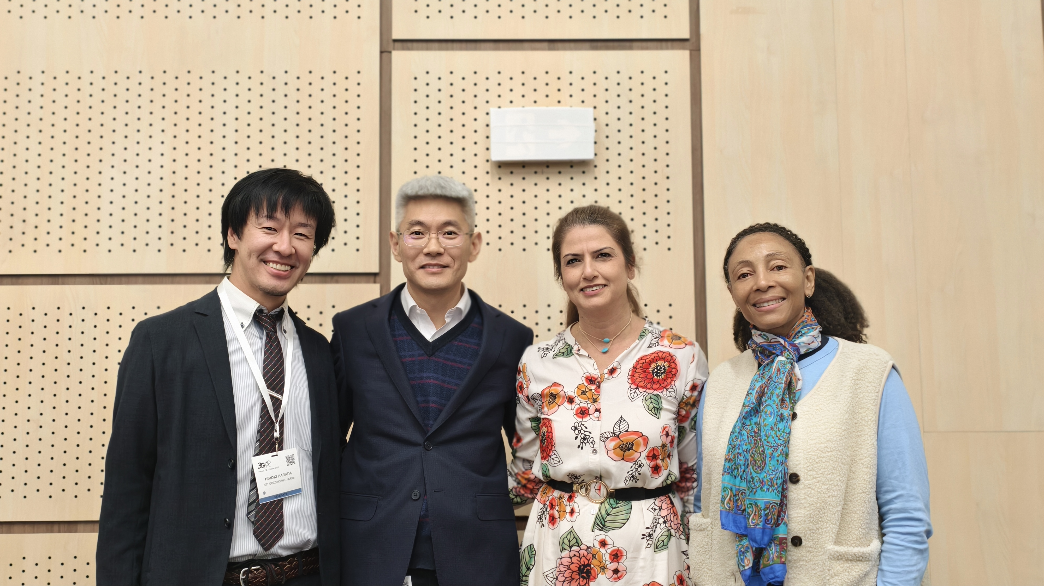
Transition of RAN1 leadership and technical officer
Technical officer, Mrs. Carolyn Taylor from MCC
RAN1 Chair, Dr. Xiaodong XU from CMCC (CCSA)
RAN1 VC, Dr. Sorour FALAHATI from Ericsson (ETSI)
RAN1 VC, Dr. Hiroki Harada from NTT DOCOM (ARIB)

Slide 4
Delegates in RAN1
RAN1 continues to have large number of attendees. (RAN1#122b: 718, RAN1#123: 655)
Attended
participants

Slide 5
Tdocs submitted to RAN1
RAN1 continues to have large number of tdocs. (RAN1#122b: 1563, RAN1#123:1332)
tdocs

Slide 6
Online/Offline sessions
Up to 3 parallel sessions were used for online discussions in RAN1#122b and RAN1#123
Up to 2 parallel sessions were used for organized offline discussions in RAN1#122b and RAN1#123
Online/offline time allocation were done in consideration of the TU allocation in RAN while considering the level of completion for each study/work item
Rel-20 WI/SIs | 6G SI | 5G-A AI/ML | 5G-A MIMO | 5G-A NTN GNSS Resilient （SI） | 5G-A A-IoT （SI） | 5G-A ISAC | 5G-A coverage | Maintenance (incl. R19 UE features)
RAN assigned TUs (RAN1#122b) | 8 | 2 | 1 | 1 | 3.5 | 1 | 0.5 | 12
Online time in RAN1#122b | 1860 | 385 | 240 | 240 | 840 | 240 | 180 | 1610 (660)
Offline time in RAN1#122b | 1440 | 240 | 210 | 160 | 500 | 160 | 90 | 380
RAN assigned TUs (RAN1#123) | 10 | 2 | 1 | 1 | 3.5 | 1 | 0.5 | 8
Online time in RAN1#123 | 1920 | 440 | 290 | 410 | 970 | 290 | 240 | 1200 (240)
Offline time in RAN1#123 | 2170 | 260 | 190 | 200 | 480 | 160 | 140 | 110

Slide 7
Other Information on RAN1 for 2025.Q4
Additional effort was spent by RAN1 on post meeting email discussions for the following purposes
  Review and endorsement of RAN1 CRs for submission to RAN
  Review and endorsement of Rel-19 RRC parameters and corresponding outgoing LSs
  Review and endorsement of Rel-19 updated UE feature list and corresponding outgoing LSs
  Email discussion on coverage evaluation results of link budget analysis, link-level simulation for R20 A-IoT study （RAN1#122b）
  Email discussion for endorsement of TR 38.769 update for R20 A-IoT study （RAN1#123）
  Email discussion on coverage evaluation results of link budget analysis, link-level simulation for R20 A-IoT study （RAN1#123）
  Email discussion for endorsement of TR 38.765 for R20 ISAC study（RAN1#123）
  Email discussion on sensing evaluation results for R20 ISAC study（RAN1#123）
  Email discussion for Rel-20 NR-NTN（RAN1#123）
  Email discussion for collecting inputs on the values from companies for link budget template（RAN1#123）

Slide 8
E-UTRA

Slide 9
LTE Summary
Rel-19 LTE
  RAN1 specifications of all three Rel-19 LTE work items (NTN for IoT Phase 3, IoT-NTN TDD mode, and LTE-based 5G Broadcast) have been quite stable
  Rel-19 UE feature list was updated and forwarded to RAN2
  RAN1 CRs on Rel-19 LTE have been submitted to RAN for approval
Pre-Rel-19 LTE specifications
  Only 1 CR for alignment was endorsed.

Slide 10
5G NR

Slide 11
5G NR Summary
Rel-19 NR
  RAN1 specifications of 5G NR work/study have been gradually stable
  Rel-19 UE feature list was updated and liaised to RAN2
  RAN1 CRs on Rel-19 NR have been submitted to RAN for approval
Pre-Rel-19 5G NR
  Pre-Rel-17: 1 alignment CR for R16 is endorsed
  Rel-17: 1 alignment CR for R17 is endorsed
  Rel-18: 12 Cat-F CRs were endorsed
  TEI (Next page)

Slide 12
TEI
Tdoc | Title | Source | Release | Spec | Related WIs | CR | CR category | Impacted WG(s) | TSG CR Pack
R1-2509691 | Correction on combination of carrier-switching SRS and UL carrier aggregation [Simul_SRSCS] | Nokia | Rel-19 | 38.214 | TEI19 | 0728 | F | No | RP-25XXXX
R2-2509690 | Maintenance on UL Tx switching for TEI19 [TxSwitch_R19] | Nokia | Rel-19 | 38.214 | TEI19 | 0727 | F | No | RP-25XXXX
R1-2509714 | SR triggered SSSG switching [SRTrig_SSSGSwitch] | Samsung | Rel-19 | 38.213 | TEI19 | 0747 | F | No | RP-25XXXX
R1-2509715 | Introduction of PDCCH repetitions for Type0-PDCCH CSS set in TNs [Common_PDCCH_Rep_TN] | Samsung | Rel-19 | 38.213 | TEI19 | 0748 | B | No | RP-25XXXX
R1-2509698 | Introduction of Rel-19 early CSI acquisition for L3 handover to TS 38.212 [EarlyCSI_L3HO] | Huawei | Rel-19 | 38.212 | TEI19 | 0236 | B | RAN2 | RP-25XXXX

Slide 13
6GR

Slide 14
6GR Summary
Rel-20 6GR
  Waveform and Channel coding are in good shape where core part are almost confirmed while further studying necessary enhancement of Polar code and LDPC code beyond 5G NR range.
  Comprehensive discussion on general evaluation assumptions, traffic models, network and UE power consumption model
  Categorize the AI/ML use cases and identify where to discuss each use case when suitable and possible

Slide 15
Rel-20 NR/6GR Study/Work Item List
 | Disputed
red | Proposal for change
Title | RAT |  | RAN1 work completed? | SR
Study on 6G Radio | 6GR | SI | NO | RP-252475
Study on Integrated Sensing And Communication (ISAC) for NR | NR | SI | NO | RP-252200
Study on GNSS resilient NR-NTN operation | NR | SI | NO | RP-251934
Study on enhancements for solutions for Ambient IoT (Internet of Things) in NR outdoor for active devices | NR | SI | NO | RP-252344
Solutions for Ambient IoT (Internet of Things) in NR Phase 2 | NR | WI | NO | RP-252361
NR MIMO Phase 6 | NR | WI | NO | RP-252509
Coverage enhancements for NR Phase 3 | NR | WI | NO | RP-252571
Artificial Intelligence (AI)/Machine Learning (ML) for NR air interface enhancements | NR | WI | NO | RP-252447

Slide 16
Attention
  Problematic adoption of multiple models
    Adopting Multiple models in some cases may introduce divergent observations, divergent solutions, sometimes, which may violate the spirit of avoiding multiple solutions, in the worst case, it can be foreseen that some of the divergence has no way to harmonize.

Slide 17
Future Meetings
RAN1 will have one meeting in 2026.Q1
  RAN1#124 (Feb. 9th ~ 13th, Gothenburg, SE)

Slide 18
Concluding Remarks
RAN1#122b and RAN1#123 focused on
  Discussion R20 6GR and R20 5G-A study/work items
  Maintenance on critical issues of R19&Pre-R19 study/work items
  Responses to incoming LSs
Highly appreciate:
  Carolyn Taylor for her efficient and excellent support in RAN1 management, and special support as a native speaker
  Vice-chairs Sorour Falahati and David Mazzarese sharing the meeting management in RAN1#122b
  Vice-chairs Sorour Falahati and Hiroki Harada sharing the meeting management in RAN1#123
  , Editors Brian Classon (TS36.212), Vijay Nangia (TS36.213), Satoshi Nagata (TS38.201), Alexandros Manolakos (TS38.202), Sorour Falahati (TS 37.213), Stefan Parkvall (TS36.211, TS38.211), Yan Cheng (TS38.212), Aris Papasakellariou (TS38.213), Mihai Enescu (TS38.214), Daewon Lee (TS38.215), Matthew Web（TS38.291）
  Ralf Bendlin and Naoya Shibaike for leading UE features discussions
  All feature leads/moderators for leading discussions in each respective feature
  All delegates for active and enthusiastic discussion, and being constructive in driving consensus
  Special thanks to ETSI and ATIS for hosting the RAN1 meetings in Prague and Dallas, respectively

