Slide 1

Study on Application layer support for Personal IoT and Residential Networks (PIRateAPP)
2021.11

Slide 2





CONTENTS
01.
02.
03.
Aspects
Requirements, Scenarios, Motivations
Objects

Slide 3

PIRate network introduction (clause 6.38, TS 22.261)
  PIRates = PIN (Personal IoT Networks) + 5G Residential (CPN, customer premise network)
  CPNs and PINs have in common that in general they are owned, installed and/or (at least partially) configured by a customer of a public network operator.
  Personal IoT Networks (PINs) and Customer Premises Networks (CPNs) provide local connectivity between UEs and/or non-3GPP devices in PIRates network.
    CPN:
      via eRG (evolved Residential Gateway), provide access to 5G network
      Via PRAS (Premises Radio Access Station), UEs can get access to the CPN and/or 5G network services.
    PIN:
      via PIN elements with Gateway capability, provide access to 5G network; Can communicate with PIN Elements that are not within range to use PIN Direct Connection.
      PIN elements communicate each other using PIN Direct Connection;
UE & Devices
Gateway Accesses
PRAS
eRG
5GS
PEGC
PIRATES

Slide 4
Aspects within Personal IoT and Resident networks
  Types of gateway
    PIN Element with Gateway Capabilities (PEGC) (e.g., relay UE)
    Premises Radio Access Station (PRAS)
    evolved Residential Gateway (eRG)
  Personal IoT Network (PIN)
    Localized with PEGC (at least one within a PIN)
    Direct 5GS access (not localized)
  Customer Premises Network (CPN)
    Localized with eRG
    Localized with PRAS
    Localized with PRAS+eRG
5GS
PRAS
eRG
PEGC
PIN
(localized)
CPN
CPN
PIN Element
(not localized)
PIN Element
(not localized)

Slide 5
CONTENTS
01.
02.
03.
Aspects
Requirements, Scenarios, Motivations
Objectives

Slide 6
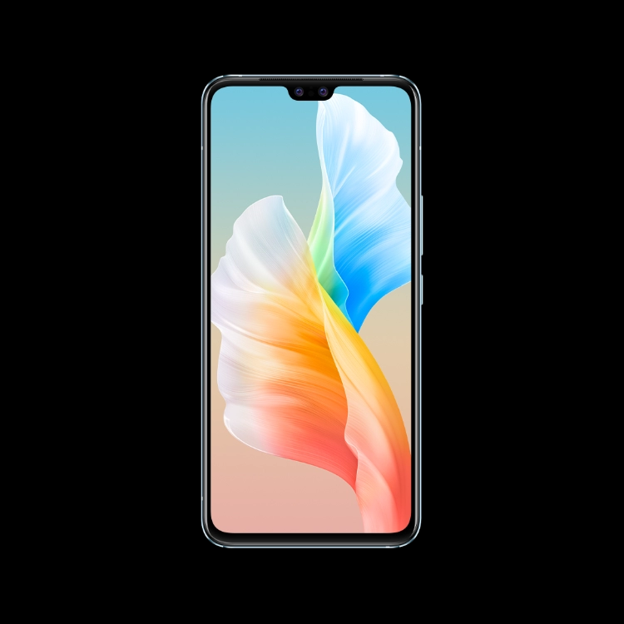

Scenarios and Motivations
PIRates direct communication
UE inside PIRates network:
  UE inside PIRate network discovers a printer and this printer’s service
  UE has direct communication with PIRates element and delivers the picture to this printer
  UE triggers the application to print the picture
External communication
UE A inside PIRate
5GS
UE outside PIRates network:
  UE outside PIRate network discovers a printer and this printer’s service via 5GS.
  5GS does potential Authentication and authentication
  For allowed UE, UE delivers the picture to this printer via 5GS
  For allowed UE, UE triggers the application to print the picture via 5GS
PIRates element: printer
UE B outside PIRate
PIRate Network
Figure: Application and service discovery
Note: SA2 focus on UE/PIN elements discovery, and SA6 focus on service/application discovery in PIRates

Slide 7




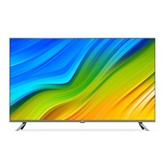
Scenarios and Motivations
PIRates direct communication
UE A move into room
server
Service flow for UE A outside
When UE A located outside of room, the UE display the video on UE screen.
When UE A move inside the room, the UE may have the actions below:
  UE discovers the PIRates elements and applications which can display the video in room
  UE switches the video from UE to the PIRate elements
  The application in PIRate network interacts with server and display the video.
Service flow for UE A inside
5GS
UE A move from outside to inside room
UE A outside room
UE A inside room
Localized Network
Figure: Service switch in when UE moves inside

Slide 8
Potential Architecture to support PIRatesAPP
Notes:
Interface to 3GPP: network exposure
Existing capability: PIN elements topography, N6 Traffic Routing requirements, network topography, UE ID, UE location …

Slide 9
CONTENTS
01.
02.
03.
Aspects
Requirements, Scenarios, Motivations
Objectives

Slide 10
Objectives
  Analyse the Stage 1 specifications (TS 22.261, TS 22.101) to determine which requirements of PIRates have potential application level impacts; For example, service discovery, service switch
  Develop key issues, corresponding architecture requirements and solution recommendations to enable the application layer support for PIRates services over 3GPP systems
      Application layer architecture to support PIRates network
      Information and support from 3GPP network to PIRates network
      Service or applications discovery within a PIRates network or by outside UE via 3GPP network.
      Service or applications authorization and access control
      To study the application layer service continuity when path switch happens between PIRates entity.

Slide 12
Annex

Slide 13


Requirements from SA1
Application connection and service discovery
Requirements from TS 22.261 of connection:
  The 5G system shall allow PIN Elements to communicate when there is no connectivity between a PIN Element with Gateway Capability and a 5G network.
  The 5G system shall support applications on an Application Server connected to a CPN or PIN.
  Subject to regulatory requirements and operator policy, the 5G system shall support an efficient data path within the CPN for intra-CPN communications.
Requirements from TS 22.261 of service discovery:
  The 5G system shall efficiently support service discovery mechanisms where a UE or non-3GPP device in a CPN or PIN can discover, subject to access rights:
    availability and reachability of other entities (e.g. other UEs or non-3GPP devices) on the CPN or PIN;
    capabilities of other entities on the CPN or PIN (e.g. eRG, relay UE, connection types) and/or;
    services provided by other entities on the CPN or PIN (e.g. the entity is a printer).The 5G system shall support a mechanism for the PIN user to indicate whether a PIN element is discoverable by other PIN elements of the same PIN.
  The 5G system shall support a mechanism for the PIN user to indicate whether a PIN element is discoverable by UEs that are not members of the PIN.
UE outside
PIN
UE outside
PIN
PIN
(localized)
PEGC
PIN Element
(not localized)
PIN Element
(not localized)
5GS
PRAS
eRG
CPN
CPN
PIN

