Slide 1
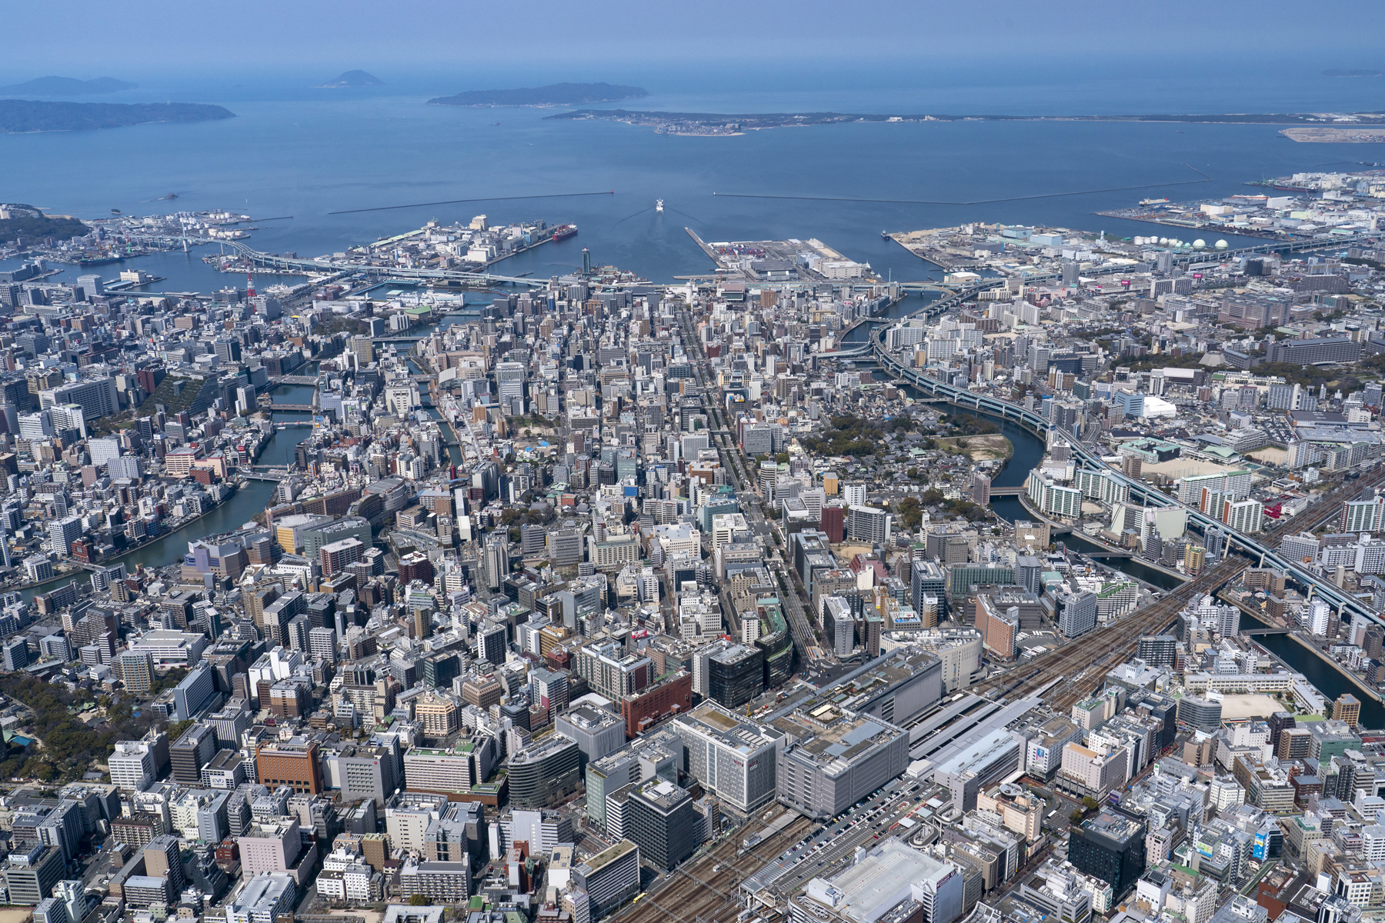

Welcome to Fukuoka
3GPP SA1#110, SA2#169, SA3#122, SA4#132, SA5#161, SA6#67
The Japanese Friends of 3GPP warmly welcome all of you to Fukuoka, Japan.
Photograph(s) provided by Fukuoka City.

Slide 2
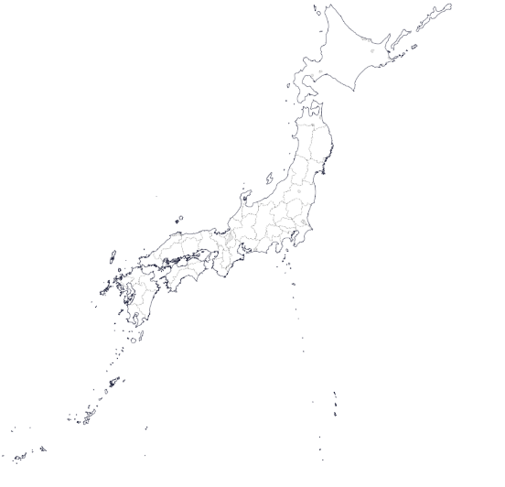
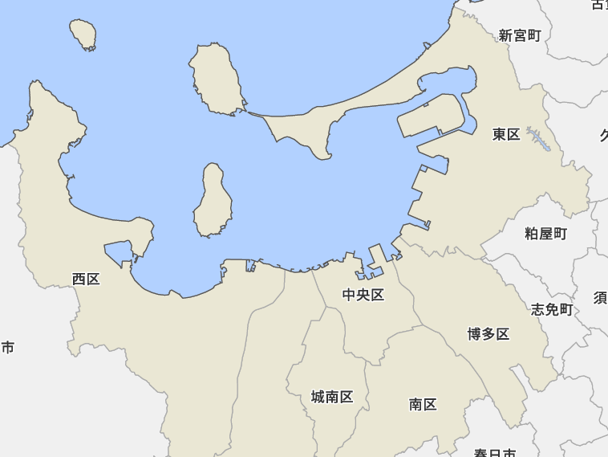
Hakata and Fukuoka City
Hakata was founded as a trading and diplomatic port with China and Korea in the 8th century .
Fukuoka City was founded as a castle city of Lord Kuroda in the 17th century. Hakata was positioned as a commercial district within Fukuoka City.
Hakata is still the center of Fukuoka City's traditional culture and festivals, Dontaku(Zondag) held on May 3rd and Yamakasa on July 15th.
The meeting venue this time is located in the Hakata area.
Osaka
Tokyo
Fukuoka city
Hakata
Source: Portal Site of Official Statistics of Japan website (https://www.e-stat.go.jp/),GSI Maps Vector

Slide 3

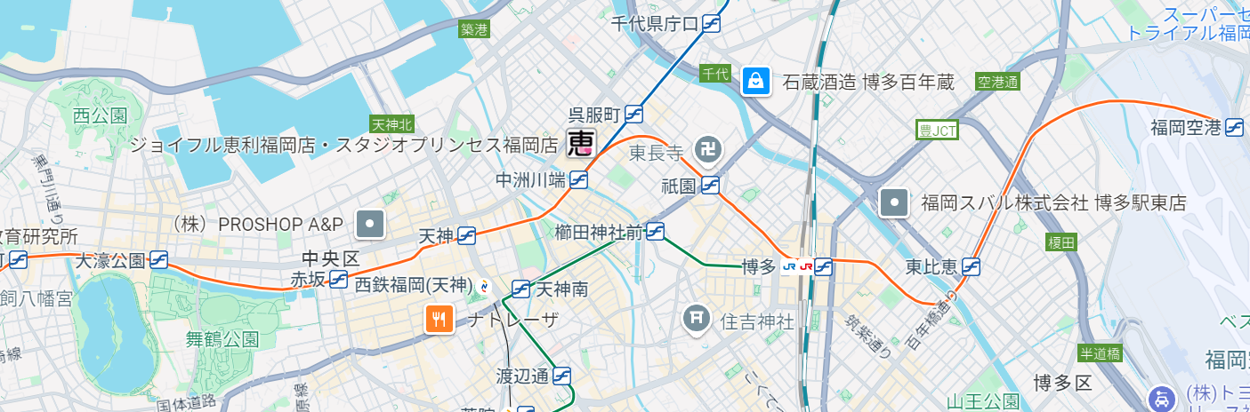
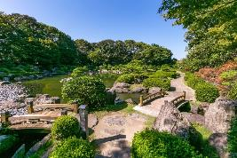
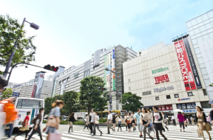
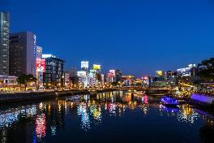
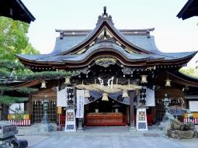
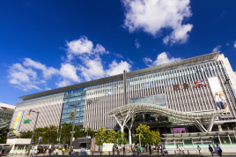
Tourist spots of Fukuoka City
※Card touch payment can be used at subway gates with the ripple mark .
Meeting
Venue
Airport-
Subway St.
Subway
Line.
②
③
④
⑤
①
①Ohori Park
②Tenjin Shopping Street
③Nakasu
④Kushida Shrine
⑤Hakata Station

Slide 4
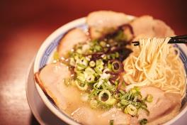
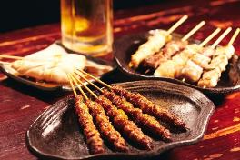
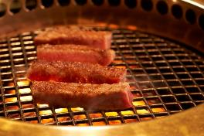
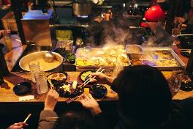
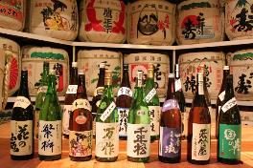
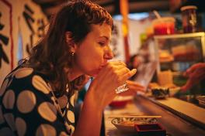
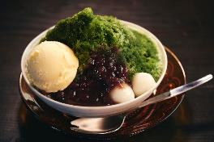

Food
Enjoy a lot of delicious food in Fukuoka.
Ramen, Yakitori, Wagyu, Oden, Sake, Matcha, Amao-Strawberries, etc.
Hakata Ramen
Yakitori-Chicken&Pork
Wagyu-Beef
Oden-Fisk Cake pot-au-feu
Sake-Rice Wine
Yatai-Food Stall
Matcha-Geen Tea Sweats
Amao-Strawberries
© Fukuoka Prefecture Tourism Association

Slide 5
Meeting Room
Hakata International Exhibition Hall & Conference Center
Regular Opening/Closing Time
07:45 – 19:30 JST local time
(Access to the meeting room will not be permitted on Sunday, May 18)
The venue closes at 21:00 even if extended, so kindly ask you to close the meeting before 20:30 at the latest.

Slide 6
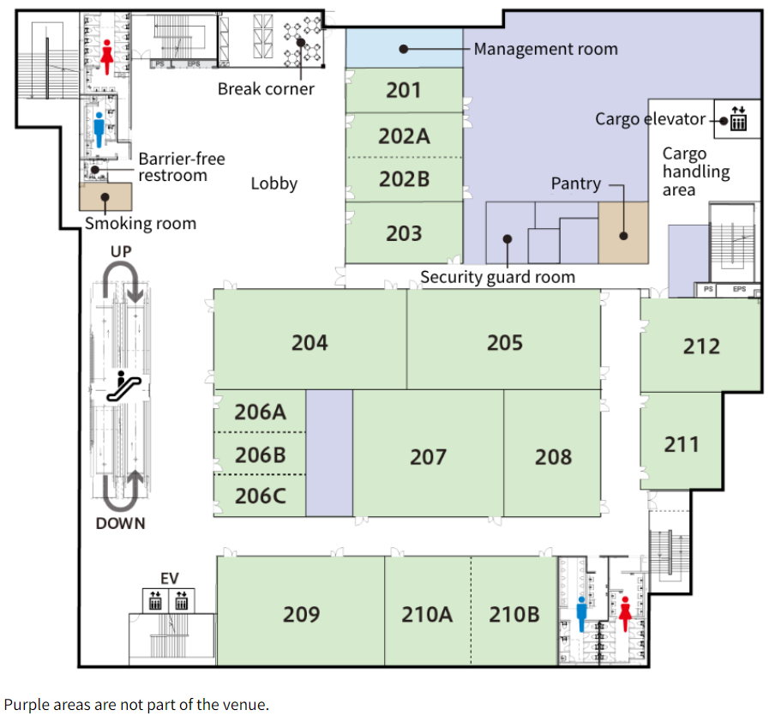
Meeting rooms (2F)
SA5 OAM
Breakout
Coffee break corner
Please contact the meeting coordinators at the “Info. desk”, if you have any questions!
IT desk
Info. desk
SA2-3 Breakout
SA5 Plenary+OAM
SA3 Breakout
SA6
Breakout
SA5 SWG Charging
SA6
Main
SA4-3 Breakout
SA4-2 Breakout
SA1 Breakout

Slide 7
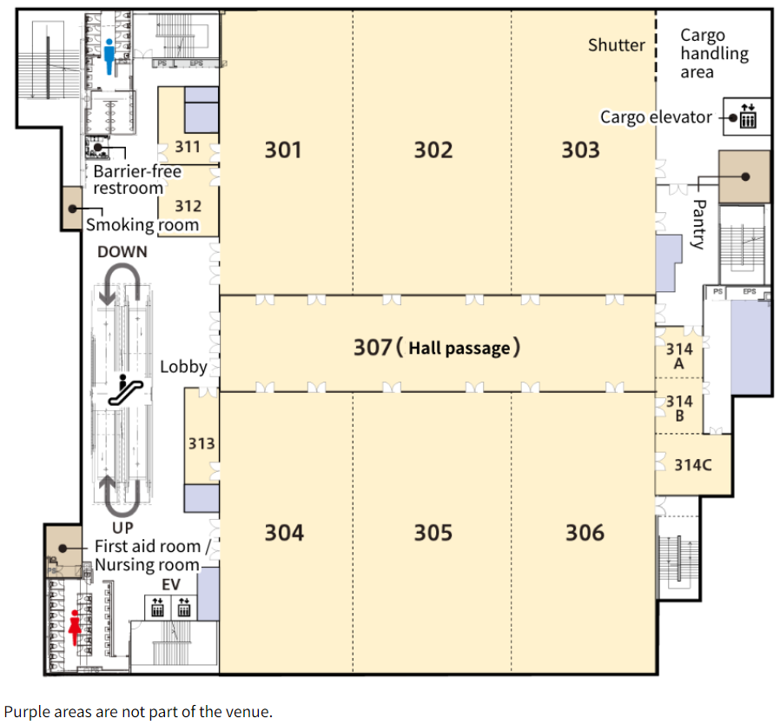
Meeting rooms (3F)
SA2
Main
Smoking
room
SA1
Main
Coffee break corner
Please contact the meeting coordinators at the “Info. desk”, if you have any questions!
Down
Info. desk
SA4
Main
SA2-2
Breakout
SA3
Main

Slide 8
Wi-Fi info
Wireless LAN：
SSID: 3GPPWIFI
Password: 3GPP3GPPM(CAPITAL LETTERS!)
IP address: 10.10.10.10
--> USUAL SETTING

Slide 9
Attention, please!
Please wear your badge at all times in the venue.
Smoking is ONLY allowed in the smoking room.
Please do not leave your personal belongings and PCs unattended when you leave the meeting room.
It is possible to eat and drink inside the venue, but please throw away cans and bottles in separate designated trash bags on each floor.
No Food Delivery Services are permitted at the venue (e.g. Uber Eats), due to the instruction from the Public Health Center.
Please contact meeting coordinators at the “Info. desk” on each floor if you have any questions!

Slide 10
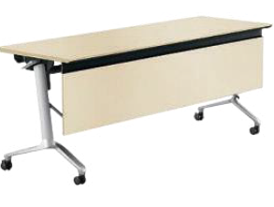







Trash Collection Point
Please separate burnable waste and bottles/cans into different trash bags on each floor.
Trash
collection point
Bottle & Can
Burnable waste

Slide 11
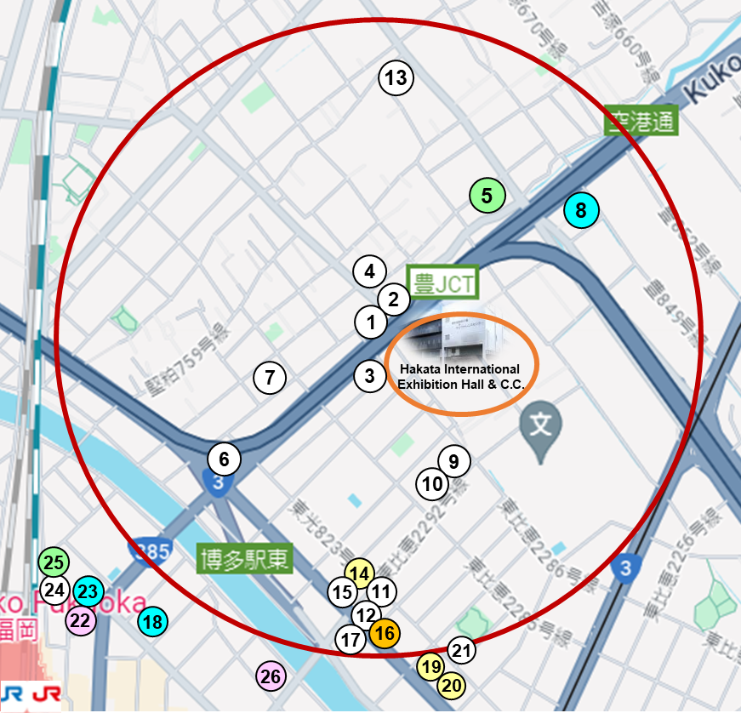
This red circle represents a 10-minute walking radius.
Roadside Restaurants Map & List
＃ | Type of Food | Restaurant Name | Restaurant - URL -
1 | Udon noodles | West | https://www.shop-west.jp/store/26.html
2 | set meal menu | Yayoiken | https://www.yayoiken.com/en/
3 | Japanese cuisine | Hakata Fuyo | https://www.fuyo.net/hakatafuyo-ippan/
4 | Soba (Buckwheat noodles) | Shinano-an | https://retty.me/area/PRE40/ARE128/SUB12806/100000735390/
5 | Indian cuisine | Dippalace | https://fbu6200.gorp.jp/
6 | Café | Thoroughbred
7 | Soba (Buckwheat noodles) | Ganko soba | https://tabelog.com/fukuoka/A4001/A400101/40011635/
8 | Sushi | Hakatazushi | http://hakatazushi.com/#shop
9 | Café | Sakuranoki | https://www.cookdoor.jp/dtl/14092245993/
10 | Café | Ranzan
11 | Café | Lug-Time
12 | set meal menu | Musha-Musha Shokudo | https://tabelog.com/fukuoka/A4001/A400101/40057347/
13 | Casual Dining | Joyfull | https://www.joyfull.co.jp/menu/
14 | Ramen Noodles | Nagahamen | https://tabelog.com/fukuoka/A4001/A400101/40047881/
15 | Udon noodles | Mura | https://tabelog.com/fukuoka/A4001/A400101/40009896/
16 | Chinese cuisine | Fukutatei | https://tabelog.com/fukuoka/A4001/A400101/40047906/
17 | Casual Dining | Gusto | https://www.skylark.co.jp/en/gusto/menu/index.html
18 | Sushi | Sushi Murasaki | https://retty.me/area/PRE40/ARE126/SUB12802/100000269488/
19 | Ramen Noodles | Matsuo | https://retty.me/area/PRE40/ARE128/SUB12804/100001334727/
20 | Ramen Noodles | Kanade | https://tabelog.com/fukuoka/A4001/A400101/40041152/
21 | Vietnamese cuisine | Au Viet Restaurant | https://tabelog.com/fukuoka/A4001/A400101/40059290/
22 | Italian cuisine | Salvatore Cuomo | https://www.salvatore.jp/restaurant/hakata/
23 | Sushi | Yataizushi | https://yossix-shop.com/detail/4092/
24 | Japanese cuisine | Washoku Kiyu | https://www.kiyu-wasyoku.com/
25 | Indian cuisine | Kathmandu curry shop | https://kathmandu4seasons.owst.jp/
26 | Italian cuisine | Fio | https://fio.owst.jp/en/

Slide 12
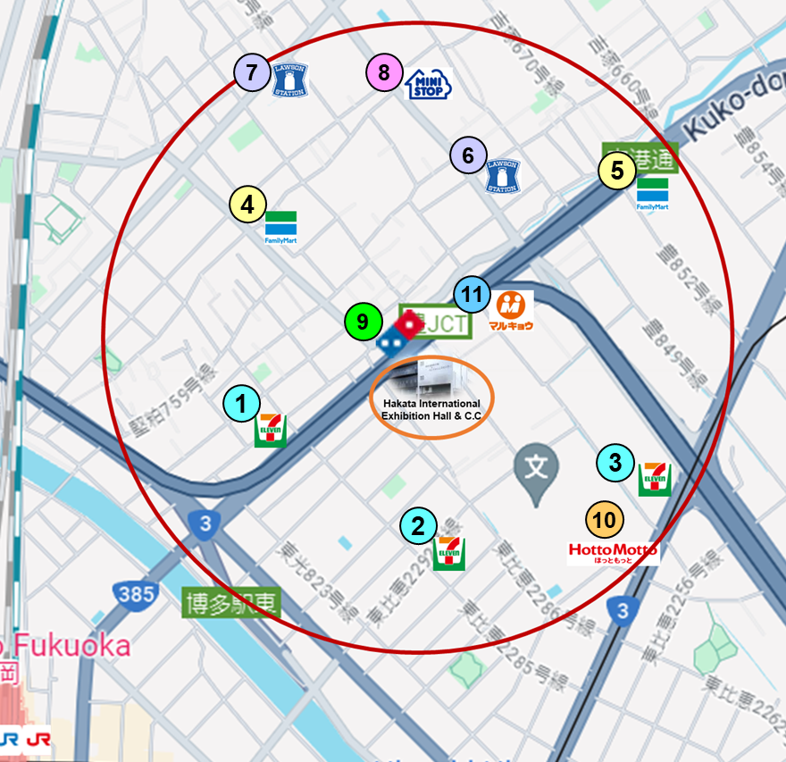
This red circle represents a 10-minute walking radius.
Take-out Stores Map & List
＃ | Type of Store | Shop Name | Shop - URL - | Location Map - URL -
1 | Convenience store | 7-Eleven |  | https://maps.app.goo.gl/xPFm8dGxDs5mWfnF6
2 | Convenience store | 7-Eleven |  | https://maps.app.goo.gl/cKKprTGVGFQNzWCx6
3 | Convenience store | 7-Eleven |  | https://maps.app.goo.gl/c4zomt6xpmDC1Px47
4 | Convenience store | FamilyMart |  | https://maps.app.goo.gl/w65vsk3qXmpSehPY9
5 | Convenience store | FamilyMart |  | https://maps.app.goo.gl/oxuRKskvUcQLr6sn9
6 | Convenience store | Lawson |  | https://maps.app.goo.gl/Mek3QUG3iLU1CJNB8
7 | Convenience store | Lawson |  | https://maps.app.goo.gl/3VqNqRT7avxpik3u5
8 | Convenience store | Ministop |  | https://maps.app.goo.gl/kDkGd8j4ERtZa2xX7
9 | Pizza store | Domino Pizza | https://www.dominos.jp/en/menu | https://maps.app.goo.gl/wqpCCN8U1RAGyc22A
10 | Bento shop | Hotto Motto | https://www.hottomotto.com/menu_list/index/40 | https://maps.app.goo.gl/TAD9P9AM8NoKGMoB6
11 | Supermarket | Marukyo | https://www.marukyo-web.co.jp/shop/395/ | https://maps.app.goo.gl/uP5CHKxvyY46bgFw9

Slide 13
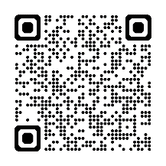
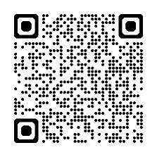
Please don’t miss to check
[Fukuoka City]
Fukuoka City Official Tourist Guide
(Fukuoka City)
https://gofukuoka.jp/
[Fukuoka Prefecture]
VISIT FUKUOKA
(Fukuoka Prefecture Tourism Association)
https://www.crossroadfukuoka.jp/en

Slide 14
Enjoy your stay
and
have a successful meeting!

