Slide 1
Release-18/19 Time Plan Proposal for OAM
SA5#148e, 17 April – 25 April, 2023
Zou Lan, SA5 Vice-Chair, HUAWEI
Thomas Tovinger, 3GPP SA5 Chair, ERICSSON

Slide 2
Background
Rel-18 and Rel-19 release schedule was discussed in SA and RAN plenary in SA#99. We need to align the SA5 work plan with the overall 3GPP release schedule.
This tdoc uses the following references:
  SA#98e: 3GPP Work Plan review at Plenary #98e (SP-221352)
  SA#98e: 3GPP SA, RAN, CT Rel-18 Timeline (SP-221317 endorsed)
  SA#98e: Rel-19 Planning (SP-221353 endorsed)
  SA#86 3GPP Newcomer Orientation.pdf
  SA#99 3GPP Work Plan review at Plenary #99 (SP-230382)

Slide 3
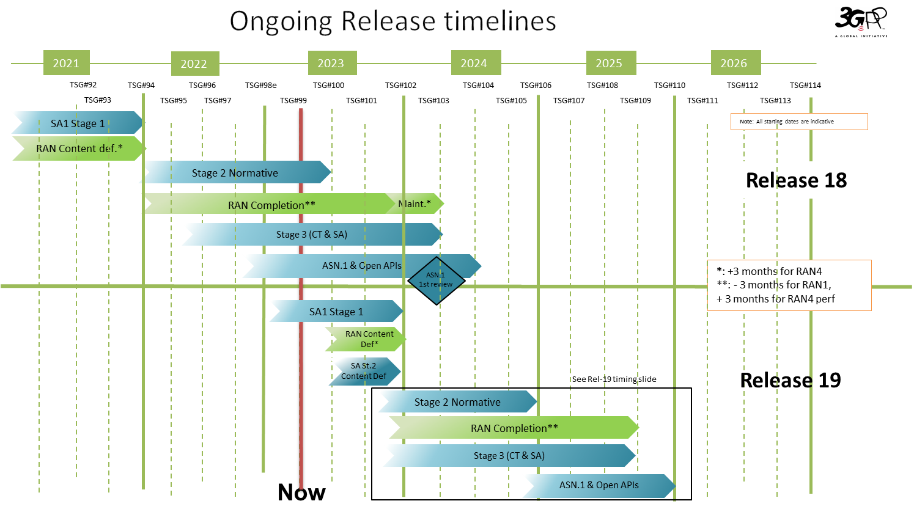
Background information from latest 3GPP Work Plan review at Plenary #99
Rel-18 Highlights:
<Stage2 normative> is planned to be freeze in Jun.2023.
<Stage 3(CT&SA)> and <RAN completion> are planned to be freeze in Mar.2024.
Rel-19 Highlights:
<Stage 2 normative is planned to be freeze in Dec.2024.
<Stage 3(CT&SA)> and <RAN completion> are planned to be freeze in Sep.2025.
Ref: SP-230382.ppt

Slide 4
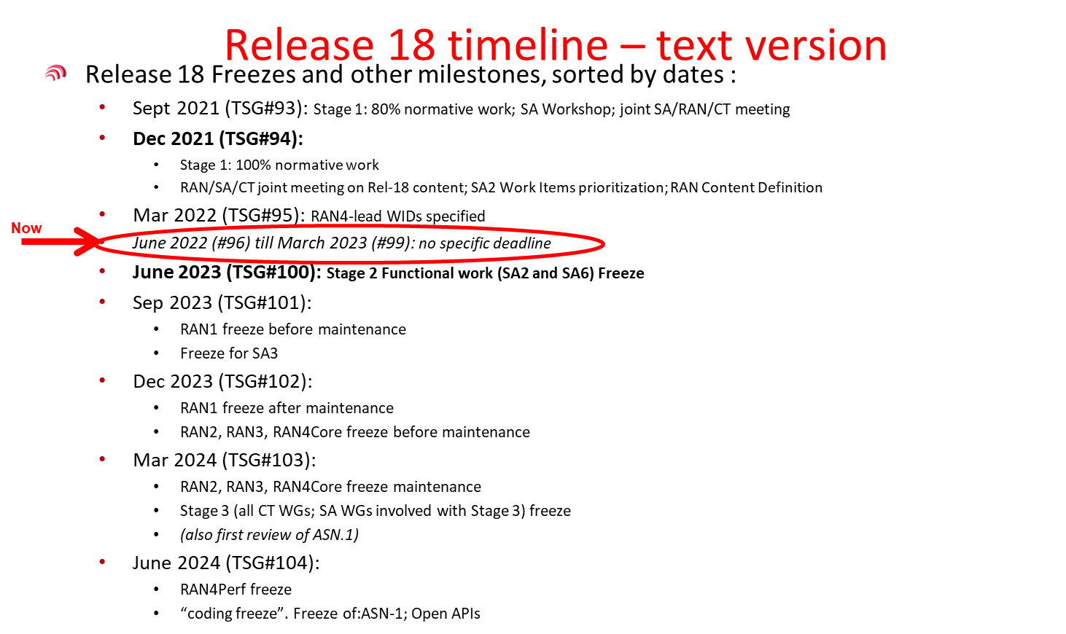
Background information from latest 3GPP Work Plan review at Plenary #99- Release 18
Ref: SP-230382.ppt

Slide 5

Release 18 timeline– figure with SA5 OAM
2022
2023
2024
TSG#93-e
TSG#94-e
TSG#95-e
TSG#96
TSG#97-e
TSG#98
TSG#99
TSG#100
TSG#101
TSG#102
TSG#103
TSG#104
TSG#105
Sep.
Dec.
Mar.
Jun.
Sep.
Dec.
Mar.
Jun.
Sep.
Dec.
Mar.
Jun.
Sep.
Release 18
SA1 Stage 1 100%
RAN Content def.
RAN4
content def.
Stage 2 (SA2, SA6,…) Normative
Studies (SA5 OAM)
Stage 1 (SA5 OAM)
SA5 OAM Rel-18 Timeline
Stage 2 Functional and stage 3 work (OAM/CN related),
provide inputs to CT
Stage 2 Functional and stage 3 work (RAN related)
RAN1
Maint.
RAN Completion (RAN2/3/4core)
Maint.
RAN4_Perf
Stage 3 (CT & SA)
Note: All starting dates are indicative
ASN.1 & Open APIs
ASN.1
1st review
Now
Ref: S5-232763 updated

Slide 6

Release 18 timelines – with SA5 OAM text
Release 18 Freezes and other milestones, sorted by dates :
  Sept 2021 (TSG#93): Stage 1: 80% normative work; SA Workshop; joint SA/RAN/CT meeting
  Dec 2021 (TSG#94):
    Stage 1: 100% normative work
    RAN/SA/CT joint meeting on Rel-18 content; SA2 Work Items prioritization; RAN Content Definition
  Mar 2022 (TSG#95): RAN4-lead WIDs specified
  June 2022 (#96) till March 2023 (#99): no specific deadline
  June 2023 (TSG#100): Stage 2 Functional work (SA2 and SA6) Freeze
  Sep 2023 (TSG#101):
    RAN1 freeze before maintenance
    Freeze for SA3
  Dec 2023 (TSG#102):
    RAN1 freeze after maintenance
    RAN2, RAN3, RAN4Core freeze before maintenance
  Mar 2024 (TSG#103):
    RAN2, RAN3, RAN4Core freeze maintenance
    Stage 3 (all CT WGs; SA WGs involved with Stage 3) freeze
    (also first review of ASN.1)
  June 2024 (TSG#104):
    RAN4Perf freeze
    “coding freeze”. Freeze of:ASN-1; Open APIs
SA5 OAM Release 18 Freezes and other milestones, sorted by dates :
  Mar 2022 (TSG#95): SA5 SIDs/WIDs specified
  Mar 2023 (TSG#99) and Jun 2023(TSG#100): SA5 SID concluded and Rel-18 WID started if needed
  Sep 2023 (TSG#101): Stage 1 work freeze
  Dec 2023 (TSG#102): Stage 2 Functional work Freeze and stage 3(OAM/CN related), provide inputs to CT
  Mar 2024 (TSG#103): Stage 2 Functional work Freeze and stage 3 (RAN related)
Now
Now
Support of SA2, provide inputs to CT
Support of RAN
Updated at SA5#146bis-e
Ref: updated of S5-232763 according to SA#99 inputs

Slide 7
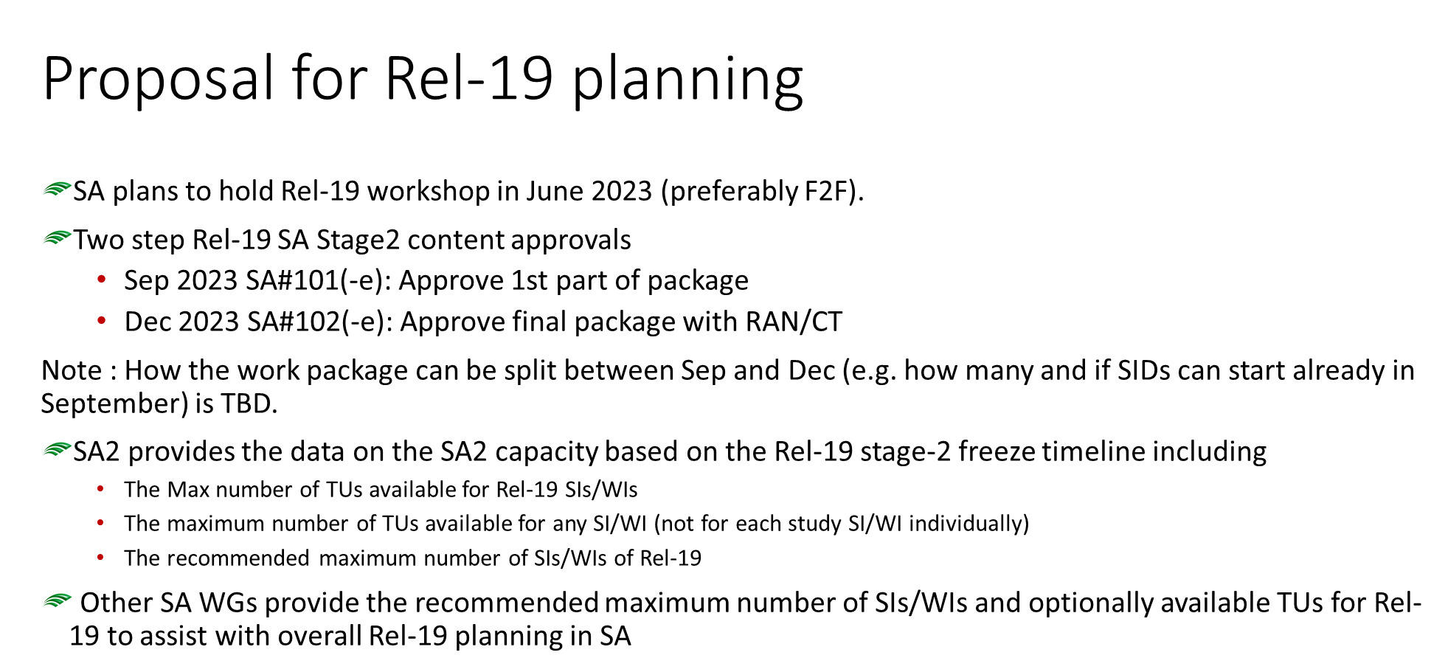
Background information from endorsed Rel-19 planning workshop at Plenary #98e
Ref: SP-221353

Slide 8
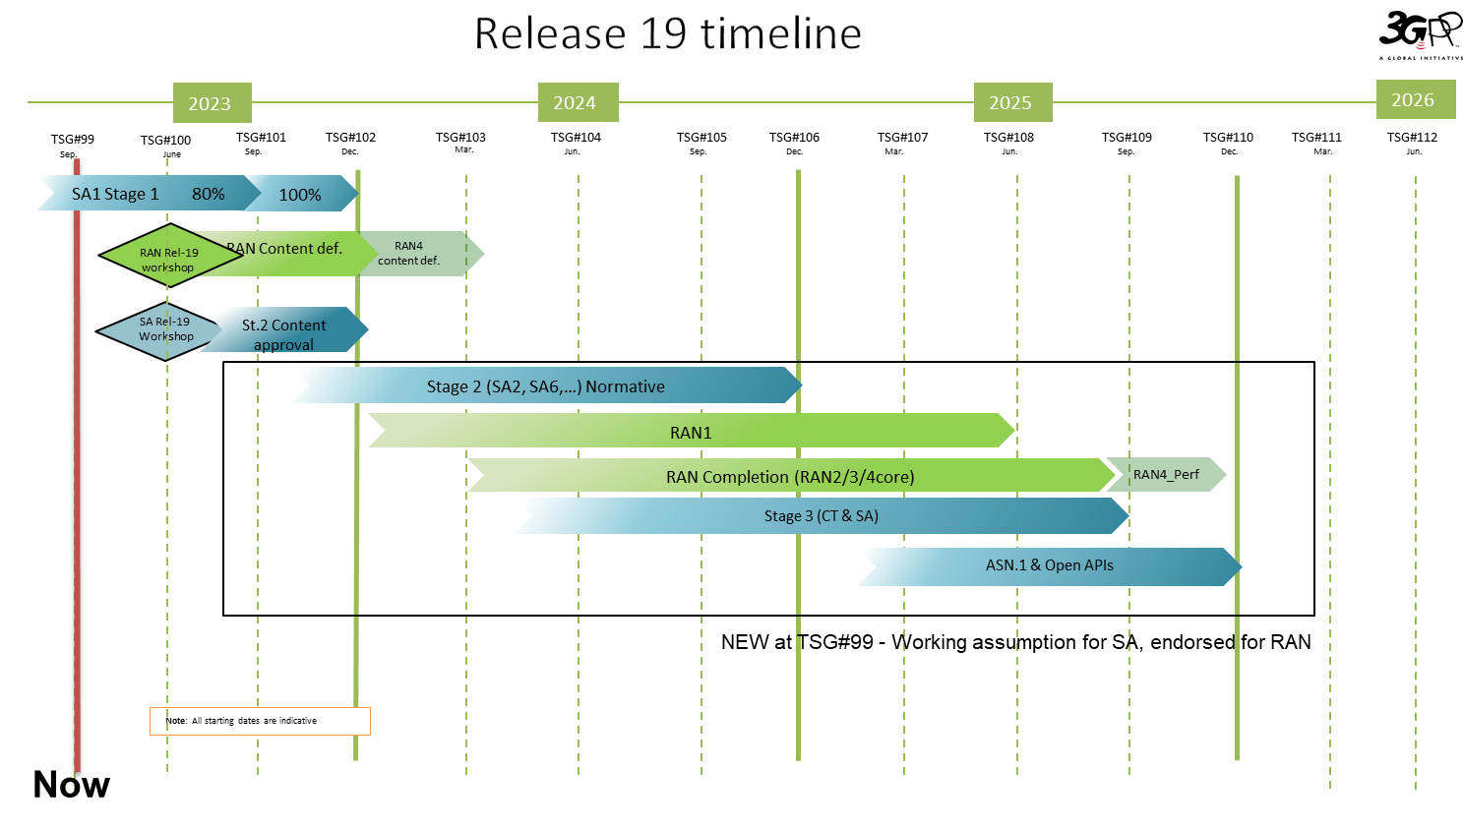
Release 19 timeline– figure with SA5 OAM
SA5 OAM Rel-19 preparation
Rel-19 planning
SA Rel-19 workshop
SA stage2
1st package
SA stage2
final package
SA5 will collect the potential work area and provide inputs to SA workshop in Jun.2023

Slide 9
Background information from latest 3GPP Work Plan review at Plenary #99 - Release 19 (1/2)
Ref: SP-230382.ppt

Slide 10
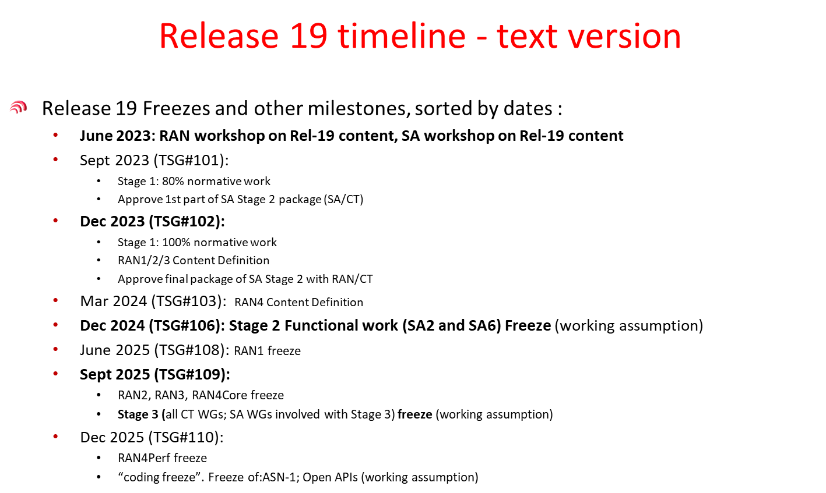
Background information from latest 3GPP Work Plan review at Plenary #99 – Release 19 (2/2)
Ref: SP-230382.ppt

Slide 11
Release 19 timeline– figure with SA5 OAM (considering of sync with SA2/SA6)
2023
2024
2025
2026
TSG#99
TSG#100
TSG#101
TSG#102
TSG#103
TSG#104
TSG#105
TSG#106
TSG#107
TSG#108
TSG#109
TSG#110
TSG#111
TSG#112
Sep.
June
Sep.
Dec.
Mar.
Jun.
Sep.
Dec.
Mar.
Jun.
Sep.
Dec.
Mar.
Jun.
SA1 Stage 1 80%
100%
RAN Content def.
RAN4
content def.
④ 6 months
RAN Rel-19 workshop
⑤ 12 months
SA Rel-19
Workshop
St.2 Content approval
Categorization of SA5 work:
Standalone OAM
SA2/6 related OAM
RAN/CT related OAM
Key milestone and potential sync consideration:
① Dec.2023(TSG#102): Rel-19 SIs should be ready, to catch up with SA overall plan.
② Mar.~Jun. 2024 (TSG#103/104): SA2/SA6 related OAM WIs should be ready, to be able to sync with SA2/SA6 discussion.
③ Jun.~Sep. 2024 (TSG#104/105): RAN related OAM Wis should be ready, to be able to sync with RAN/CT.
④ Jun~Dec,2024 (TSG#104~106): potential sync with SA2/SA6.
⑤ Sep,2024~Sep,2025 (TSG#105~109): potential sync with RAN/CT.
Stage 2 (SA2, SA6,…) Normative
RAN1
RAN Completion (RAN2/3/4core)
RAN4_Perf
Stage 3 (CT & SA)
ASN.1 & Open APIs
NEW at TSG#99 - Working assumption for SA, endorsed for RAN
①
New SIDs discussion
Studies (SA5 OAM)
Studies (SA5 OAM)
②
New WIDs discussion package 1
Stage 1 (SA2/SA6 related OAM)
Stage 2 Functional work (SA2/6 related OAM)
stage 3 work (CT related OAM)
③
New WIDs discussion
package2
Stage 1 (Standalone OAM/SA5 RAN/CT related OAM)
Note: All starting dates are indicative
Stage 2 Functional and stage 3 work (standalone OAM/RAN+CT related OAM)
Now
SA5 OAM Rel-19 Timeline
Stage 2 Functional and stage 3 work (standalone OAM/RAN+CT related OAM)
Studies 6 months
Work item 15 months

Slide 12
Release 19 timeline– figure with SA5 OAM(with limited time on sync with SA2/SA6)
2023
2024
2025
2026
TSG#99
TSG#100
TSG#101
TSG#102
TSG#103
TSG#104
TSG#105
TSG#106
TSG#107
TSG#108
TSG#109
TSG#110
TSG#111
TSG#112
Sep.
June
Sep.
Dec.
Mar.
Jun.
Sep.
Dec.
Mar.
Jun.
Sep.
Dec.
Mar.
Jun.
SA1 Stage 1 80%
100%
④ 3 months
RAN Content def.
RAN4
content def.
⑤ 12 months
RAN Rel-19 workshop
Categorization of SA5 work:
Standalone OAM
SA2/6 related OAM
RAN/CT related OAM
Key milestone and potential sync consideration:
① Dec.2023(TSG#102): Rel-19 SIs should be ready, to catch up with SA overall plan.
② Jun.~Sep. 2024 (TSG#104/105): All OAM Wis should be ready, leave 12 months for normative work.
④ Sep~Dec,2024 (TSG#104~106): limited sync time with SA2/SA6.
⑤ Sep,2024~Sep,2025 (TSG#105~109): potential sync with RAN/CT.
SA Rel-19
Workshop
St.2 Content approval
Stage 2 (SA2, SA6,…) Normative
RAN1
RAN Completion (RAN2/3/4core)
RAN4_Perf
Stage 3 (CT & SA)
ASN.1 & Open APIs
NEW at TSG#99 - Working assumption for SA, endorsed for RAN
①
New SIDs discussion
Studies (SA5 OAM)
②
New WIDs discussion
Stage 1 (SA5 OAM)
Stage 2 Functional and stage 3 work (OAM/CN related), provide inputs to CT
SA5 OAM Rel-19 Timeline
Stage 2 Functional and stage 3 work (RAN related)
Note: All starting dates are indicative
9 months
Now
12 months

Slide 13
Release 19 timelines – with SA5 OAM text
Release 19 Freezes and other milestones, sorted by dates :
  June 2023: RAN workshop on Rel-19 content, SA workshop on Rel-19 content
  Sept 2023 (TSG#101):
    Stage 1: 80% normative work
    Approve 1st part of SA Stage 2 package (SA/CT)
  Dec 2023 (TSG#102):
    Stage 1: 100% normative work
    RAN1/2/3 Content Definition
    Approve final package of SA Stage 2 with RAN/CT
  Mar 2024 (TSG#103): RAN4 Content Definition
  Dec 2024 (TSG#106): Stage 2 Functional work (SA2 and SA6) Freeze (working assumption)
  June 2025 (TSG#108): RAN1 freeze
  Sept 2025 (TSG#109):
    RAN2, RAN3, RAN4Core freeze
    Stage 3 (all CT WGs; SA WGs involved with Stage 3) freeze (working assumption)
  Dec 2025 (TSG#110):
    RAN4Perf freeze
    “coding freeze”. Freeze of:ASN-1; Open APIs (working assumption)
To be updated based on the discussion on slides 11/12
SA5 OAM Release 19 Freezes and other milestones, sorted by dates :
  Dec 2023 (TSG#102): SA5 SIDs specified
  Sep 2024 (SA#105) : SA5 SID concluded and Rel-19 WID started
  Mar 2025 (TSG#107): Stage 1 work freeze
  Jun 2025 (TSG#108): Stage 2 Functional work Freeze and stage 3(OAM/CN related), provide inputs to CT
  Sep 2025 (TSG#109): Stage 2 Functional work Freeze and stage 3 (RAN related)
Support of SA2, provide inputs to CT
Support of RAN

Slide 14

Leaders’ recommendation for SA5 OAM time planning for endorsement
SA5 OAM Release 18 planning：
Mar 2022 (TSG#95): SA5 SIDs/WIDs specified
Mar 2023 (TSG#99) and Jun 2023(TSG#100): SA5 SID concluded and Rel-18 WID started if needed
Sep 2023 (TSG#101): Stage 1 work freeze
Dec 2023 (TSG#102): Stage 2 Functional work Freeze and stage 3(OAM/CN related), provide inputs to SA2 and CT
Mar 2024 (TSG#103): Stage 2 Functional work Freeze and stage 3 (RAN related)
SA5 OAM Release 19 planning workshop：
June 2023 SA Rel-19 workshop: Provide SA5 relevant Rel-19 inputs/planning to Jun SA workshop
Sep 2023 (TSG#101): Submit Rel-19 1st package following 3GPP timelines
Dec 2023 (TSG#102): Submit Rel-19 final package following 3GPP timelines
SA5 OAM Release 19 planning:
Dec 2023 (TSG#102): SA5 SIDs specified
Sep 2024 (TSG#105) : SA5 SID concluded and Rel-19 WID started
Mar 2025 (TSG#107): Stage 1 work freeze
Jun 2025 (TSG#108): Stage 2 Functional work Freeze and stage 3(OAM/CN related), provide inputs to CT
Sep 2025 (TSG#109): Stage 2 Functional work Freeze and stage 3 (RAN related)
Note:
We should strictly follow the 3GPP release timelines (especially to align the stage 3 freeze date).
For the CT related features, we need to provide inputs to CT as early as possible.
Management aspects which have no CN/RAN dependency or which needs to influence CN/RAN should be addressed as early as possible.
Avoid exception requests as much as possible, and in case the work could not be completed according to the time plan, either narrow down the scope of the work, or postpone the work to next release.
Now
Now

Slide 15
Change History
SA5 #141e | S5-221173 SA5 Rel-18 time plan proposal for OAM
SA5 #146 | S5-226377(endorsed) Rel-18&Rel-19 Time Plan Proposal for OAM
SA5#146bis-e | S5-231032(endorsed) Rel-18&Rel-19 Time Plan Proposal for OAM
SA5#147 | S5-232446 Rel-18&Rel-19 Time Plan Proposal for OAM Editorial update and add provide inputs to SA2 in slide 9
SA5#147 | S5-232763(endorsed) Rel-18&Rel-19 Time Plan Proposal for OAM Update slide 8
SA5#148e | S5-233263 Rel-18&Rel-19 Time Plan Proposal for OAM Updated according to SA#99, SA5 Rel-19 time plan is added

Slide 16
Thank you!

Slide 17
Consideration on SA5 OAM R18&R19 time planning(1/2)
General considerations as agreed in S5-221173:
1. We should strictly follow the 3GPP release timelines (especially to align the stage 3 freeze date).
2. For the CT related features, we need to provide inputs to CT as early as possible.
3. Management aspects which have no CN/RAN dependency or which needs to influence CN/RAN should be addressed as early as possible.
4. Avoid exception requests as much as possible, in case the work could not be completed according to the time plan, either narrow down the scope of the work, or postpone the work to next release.
Concrete time planning consideration:
Rel-18 studies:
  For the topics which target to start corresponding work items in Rel-18, the studies need to be closed and corresponding work items be initiated no later than Jun, 2023. This is to leave enough time to produce high quality standardization specification within Rel-18 timeframe. For the leftover work which could not be finalized in the study, it could be considered for potential Rel-19 work.
  It’s also allowed to use the full Rel-18 time for the approved study items if there is no plan for standardization in Rel-18.
Rel-18 work items: all the work items are to be finished strictly following the 3GPP overall time schedule. Rapporteurs are requested to consider reasonable Rel-18 scope and coordinate the work with best utilizing the time.
Rel-19 studies/work items: closely following the SA Rel-19 discussion and provide SA5 relevant inputs if they are available.

Slide 18
Consideration on SA5 OAM R18&R19 time planning(2/2)
Mar.2023&Jun.2023
(check point-1 for SA R19 preparation activities)
Dec.2023
(check point-2)
Now
A. Rel-18 approved SIs
A-1: Keep study only in Rel-18
A-2: Close study and Initiate Rel-18 corresponding WI
A-2: Rel-18 corresponding WI starts
①
potential R19 topics and join the SA R19 workplan
A-3: Close study with no Rel-18 corresponding WI
B. Rel-18 approved WIs
B-1. Objectives which reached consensus, produce Rel-18 specifications, Rel-18 closed
C. Potential Rel-19 topics
B-2.Objectives which need more time for discussion
②
C. New ideas for Rel-19
③

Slide 19
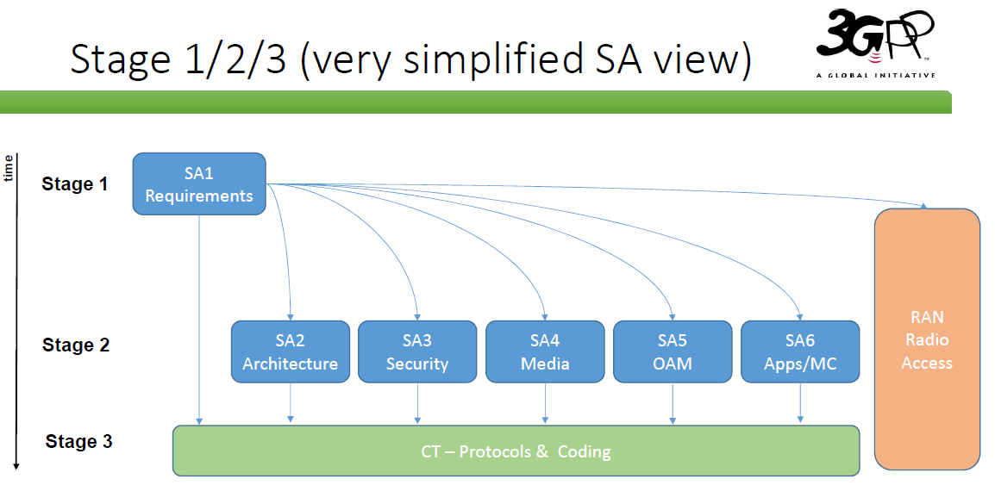
Ref: SA#86 3GPP Newcomer Orientation.pdf

Slide 20
Detailed view of SA5 OAM relation with other groups
GSMA GST
ETSI ZSM
1. SA1 Management requirements refer to SA5 specifications.
2. Take GSMA GST deliverables as input
3. Align the MnS with ZSM
4. ONAP reuses SA5 MnS
5. Collaboration with SA2 on architecture and CN management
6. Collaboration with SA4 on QoE
7. O-RAN reuse SA5 MnS
8. Provide inputs to CT
9. Collaboration with RAN on RAN management
10. Collaboration with SA6 on exposure and edge computing
11. Collaboration with SA3 on security aspects
time
SA1
Requirements
Stage 1
1
2
3
SA5 OAM
Stage 1
9
5
10
RAN
Radio Access
11
SA5 OAM
Stage 2
ONAP
O-RAN
6
8
4
7
Stage 2
SA2
Architecture
SA3
Security
SA4
Media
SA5 OAM
Stage 3
SA6
Apps/MC
Stage 3
CT – Protocols & Coding
Ref: SA5#141e S5-221173
Note: To be updated with working progress in Rel-18

