Slide 1
Using Forge in SA5
(updated for SA5 #146-bis)
Nokia, Nokia Shanghai Bell

Slide 2
Background/Problem
updated for 146 bis
A simple guide of Forge usage with screenshot for newcomers:
  Basic Forge environment
    Forge environment: tools provided
    Basic operations
    Create branches
    Create merge request
  Web IDE for editing, reviewing changes, commit change set
  Generating word CR (code change part) automatically with a Draft merge request
Advanced user tips
  Rebase with command line
  Merge with conflictions

Slide 3
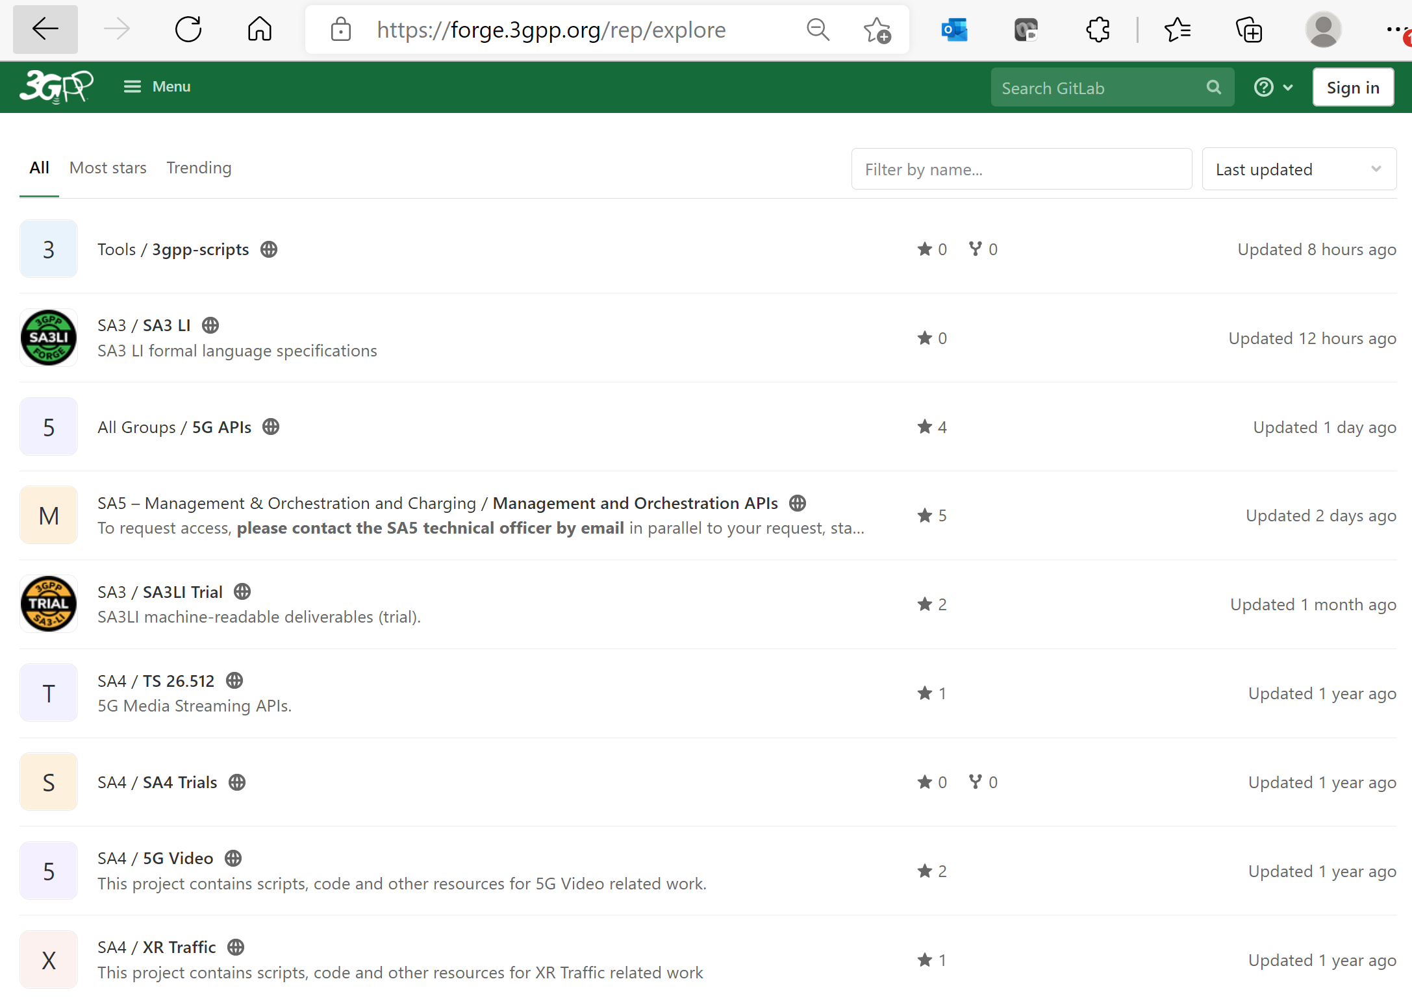
Basic Forge environment
Common validation scripts used in SA5
Forge is built with GitLab Enterprise Edition.
Using forge requires understanding of basic knowledge of git. More material could be found here:
  Git (git-scm.com) or
  Index · User · Help · GitLab (3gpp.org)
SA5 Repository is here

Slide 4
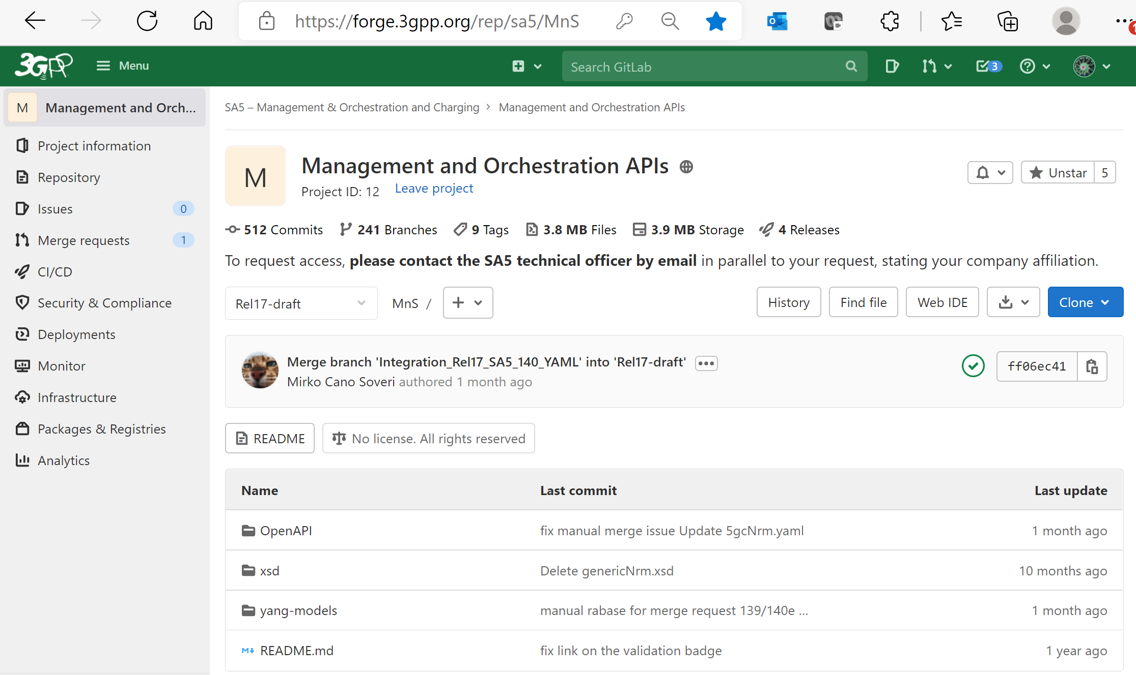
Basic Forge environment for SA5
“Repository” is to find branches/commits
The “Web IDE” is very powerful tool for code changes/review, commit
“+” is to add new file/create branches
“History” is to find commit history
Indicates which branch is, could select branch/tag to switch between branches
Green V indicating validation is ok
OpenAPI Solution set
YANG Solution set

Slide 5
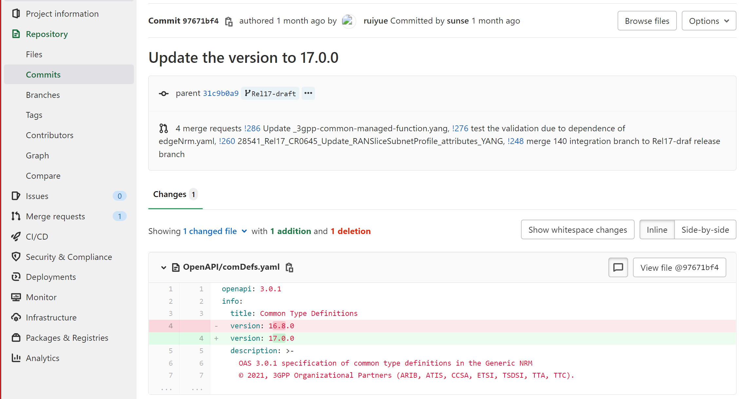
Basic Forge environment for commit
What service provided by Forge: check details of commit
target branch
Change details: line by line
Summary of total changes in this commit

Slide 6
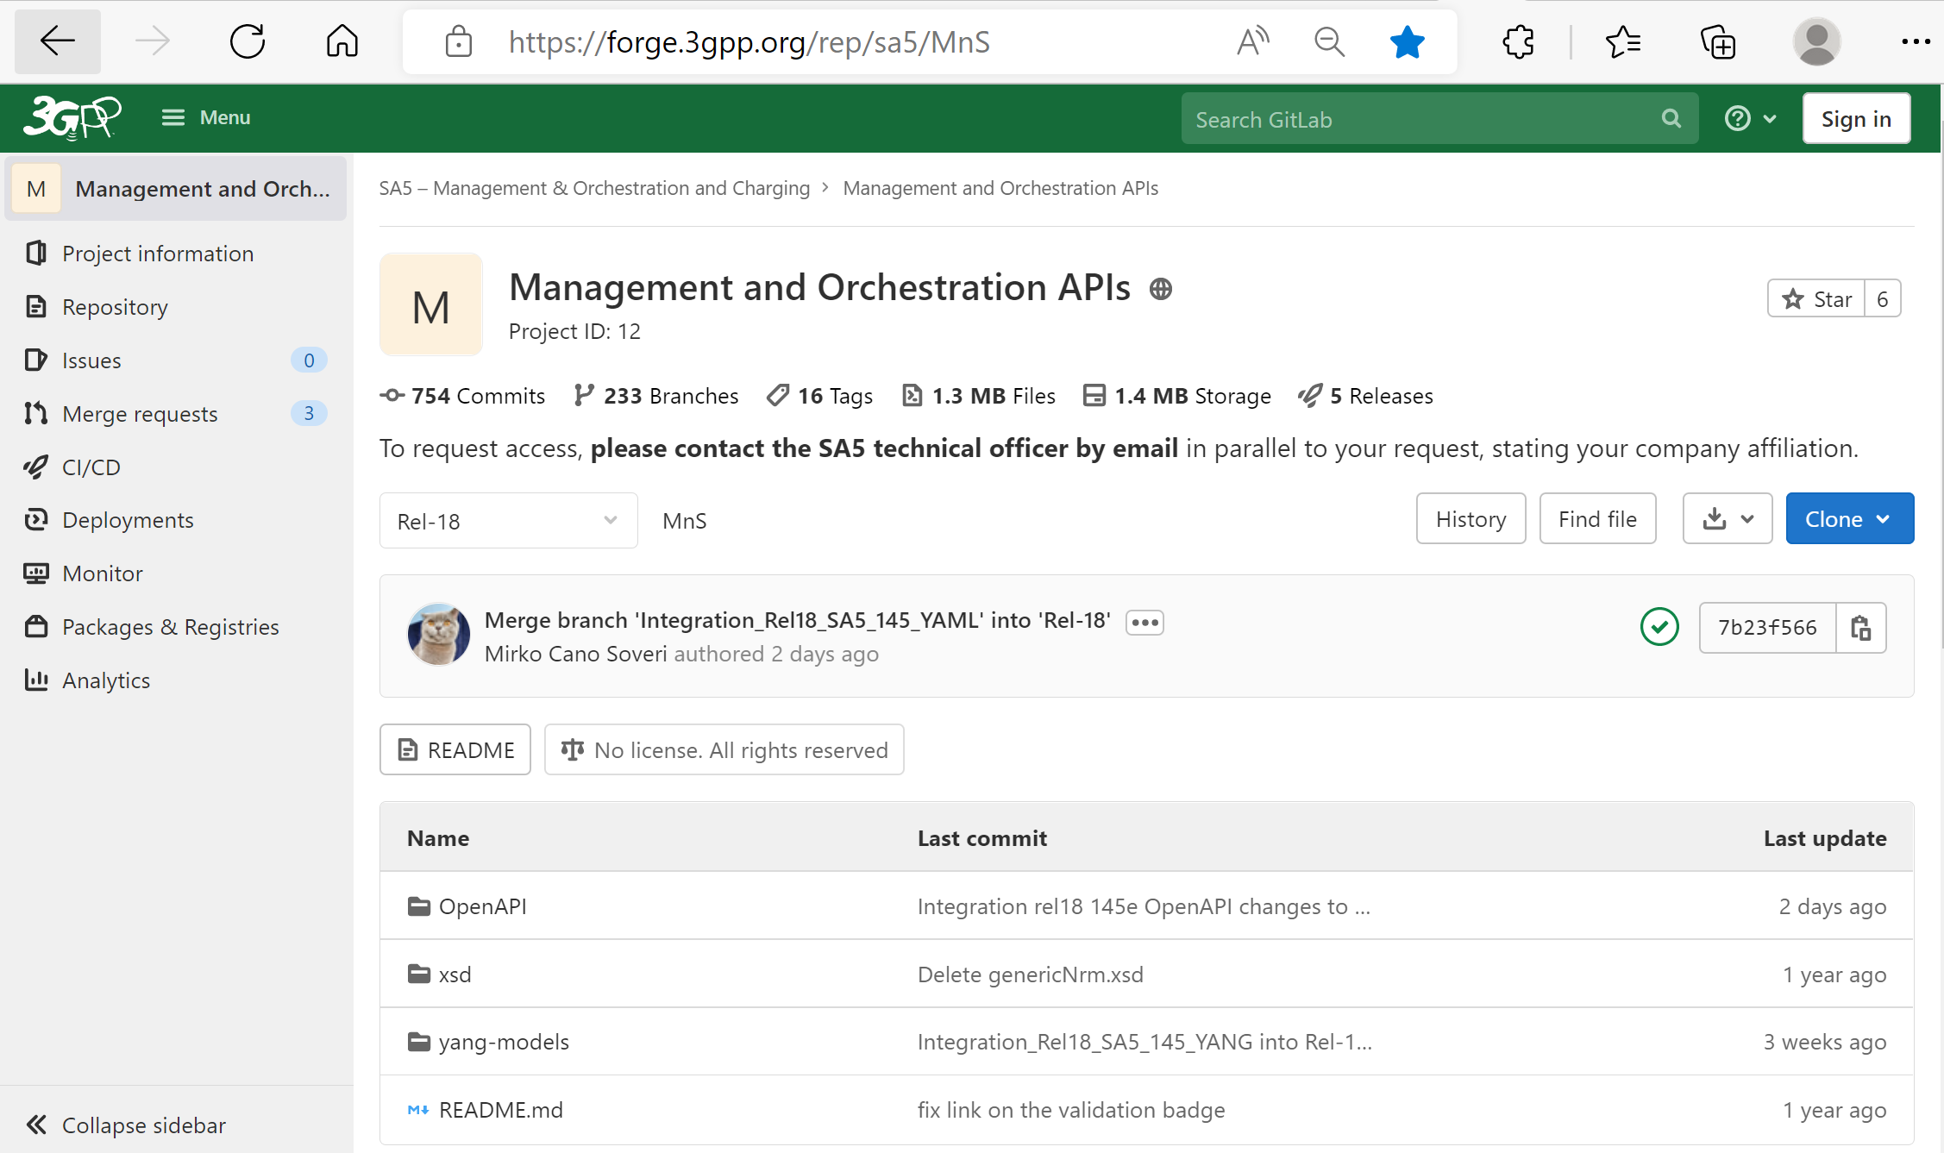
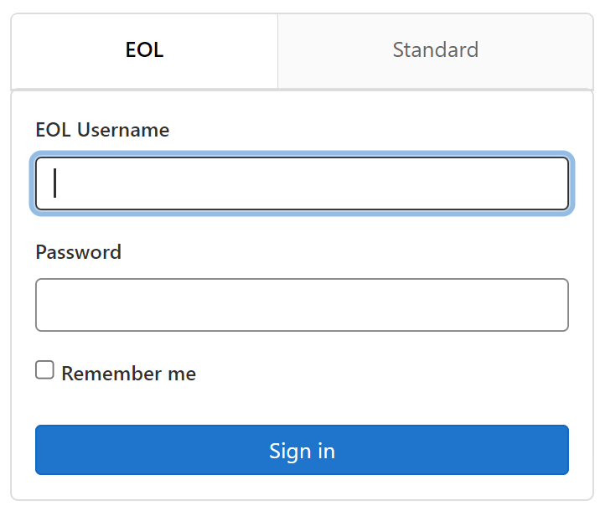
Forge: main entry and login
https://forge.3gpp.org/rep/sa5/MnS
After login, first to select your branch or create a CR branch, then code change can be done by open the code file directly or use the Web IDE tool.
Note: if you do not have the write access, send email to MCC to apply the access. (Credential is the same as that for portal.)

Slide 7
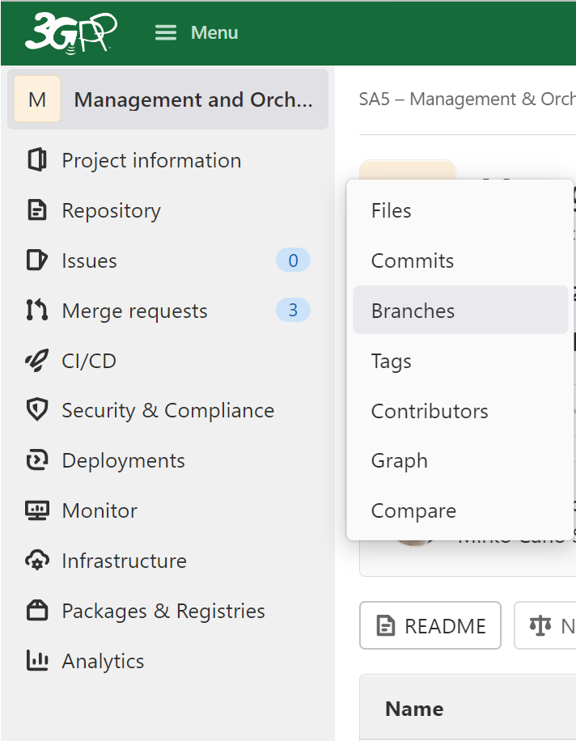
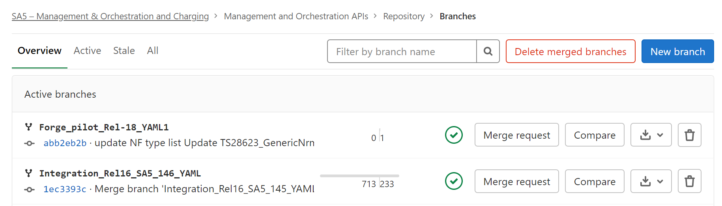
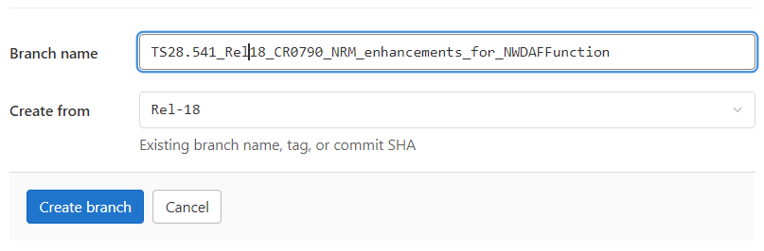
Forge: create branch
3
1
2
4. Follow the branch name rules (in working procedure) for a branch name
5. Select the right base branch, normally from release branch
6

Slide 8
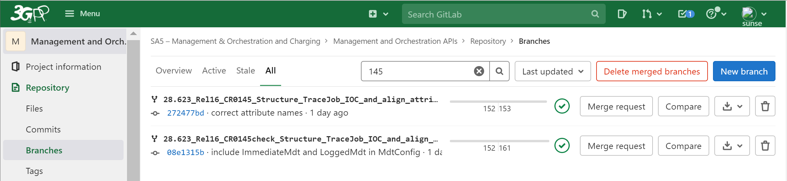
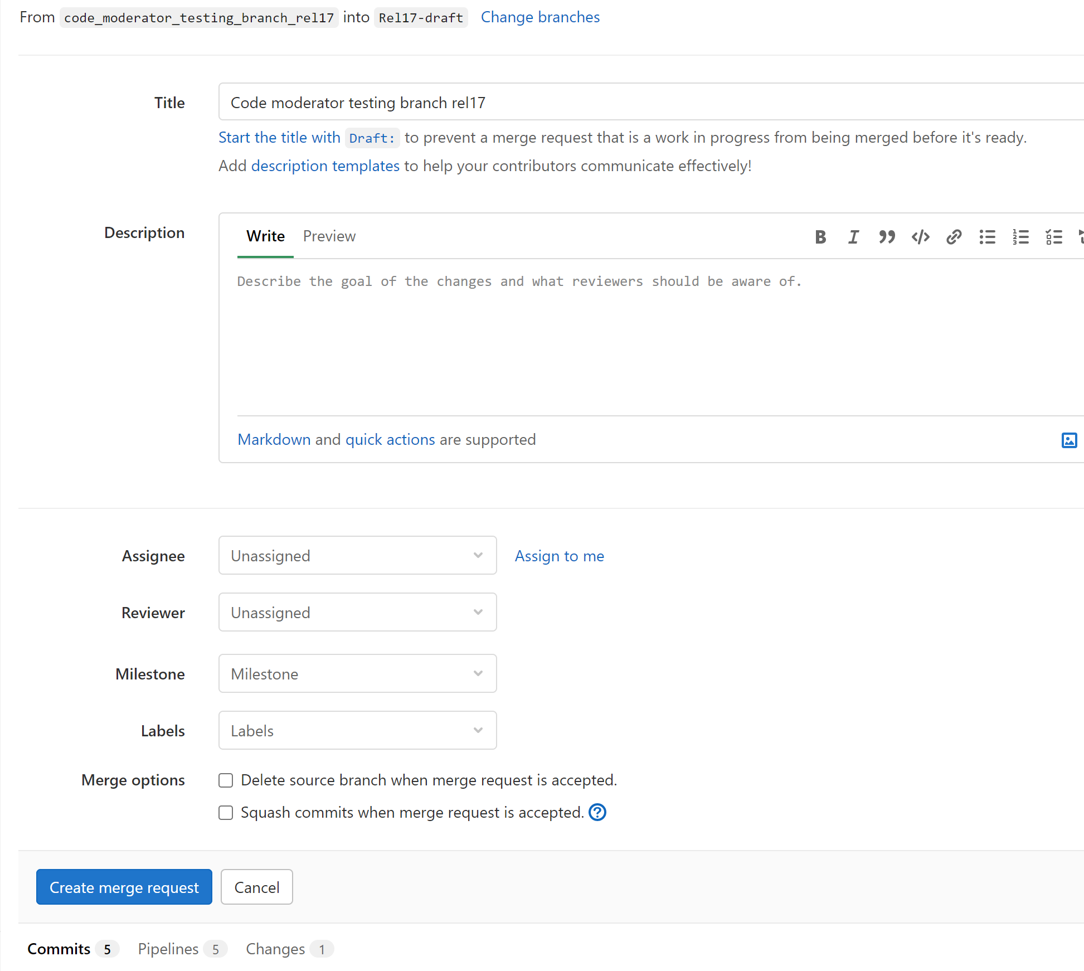
Forge: creating Merge request
udpated for 146 bis
Step 1: Find you Branch with part (or full) of branch name
Step 2: Click Merge Request button
Step 3: Update target Branch (if not correct): normally should be integration branch: like: Integration_Rel17_SA5_141_YAML
Step 4: "Optionally" add some description about the merge request to Title or Description. It's always good to add CR number and key summary of change set.
Note: Contribution author creates a merge request towards the Integration branch before meeting start. At this stage the MR shall be marked as a draft MR. If a CR includes both YANG and YAML changes, two separate MRs are needed. The MR Forge link(s) shall be added to the MS Word CR's cover page 'Other Comments' section."
Step5: uncheck this option. The plan is to delete source branch 6 months later
Step6: click "create merge request", then done

Slide 9
Forge workflow
Branch handling: what action needed and at when (for details to check working procedure)
SA5 base branch, Normally release branch (i.e., Rel-17)
Base branch with e.g., 138e contents
CR author to create CR development branch from latest release branch
139e CR1 branch
139e CR2 branch
139e CRn branch
CR author to initiate the Merge request: once approved at SA5 level
Code Moderator handle merger request: validation passed
(Code Moderator creates integration branch from release branch)
139e integration branch
Code moderator to initiate the Merge request (after SA plenary meeting)
Code Master (MCC) address merge request
SA5 release branch (i.e., Rel-17)

Slide 10
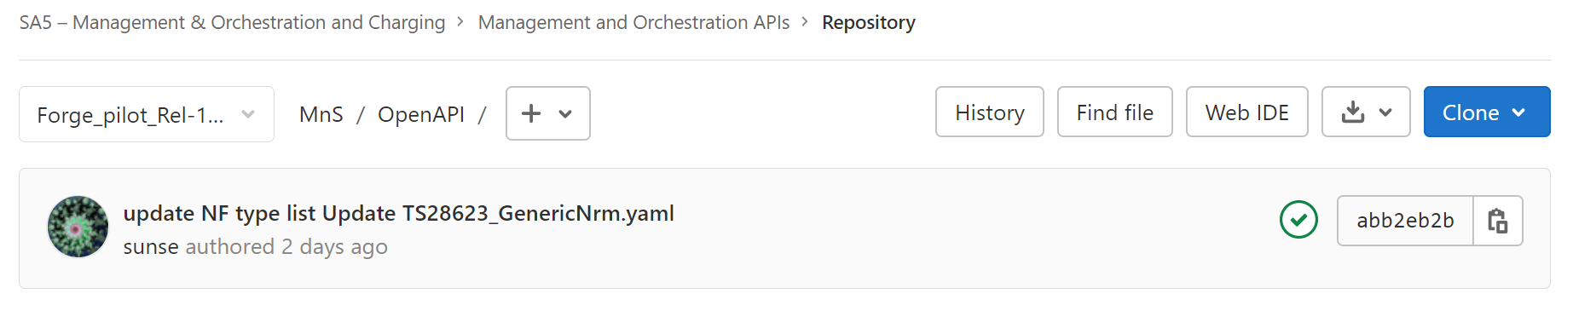
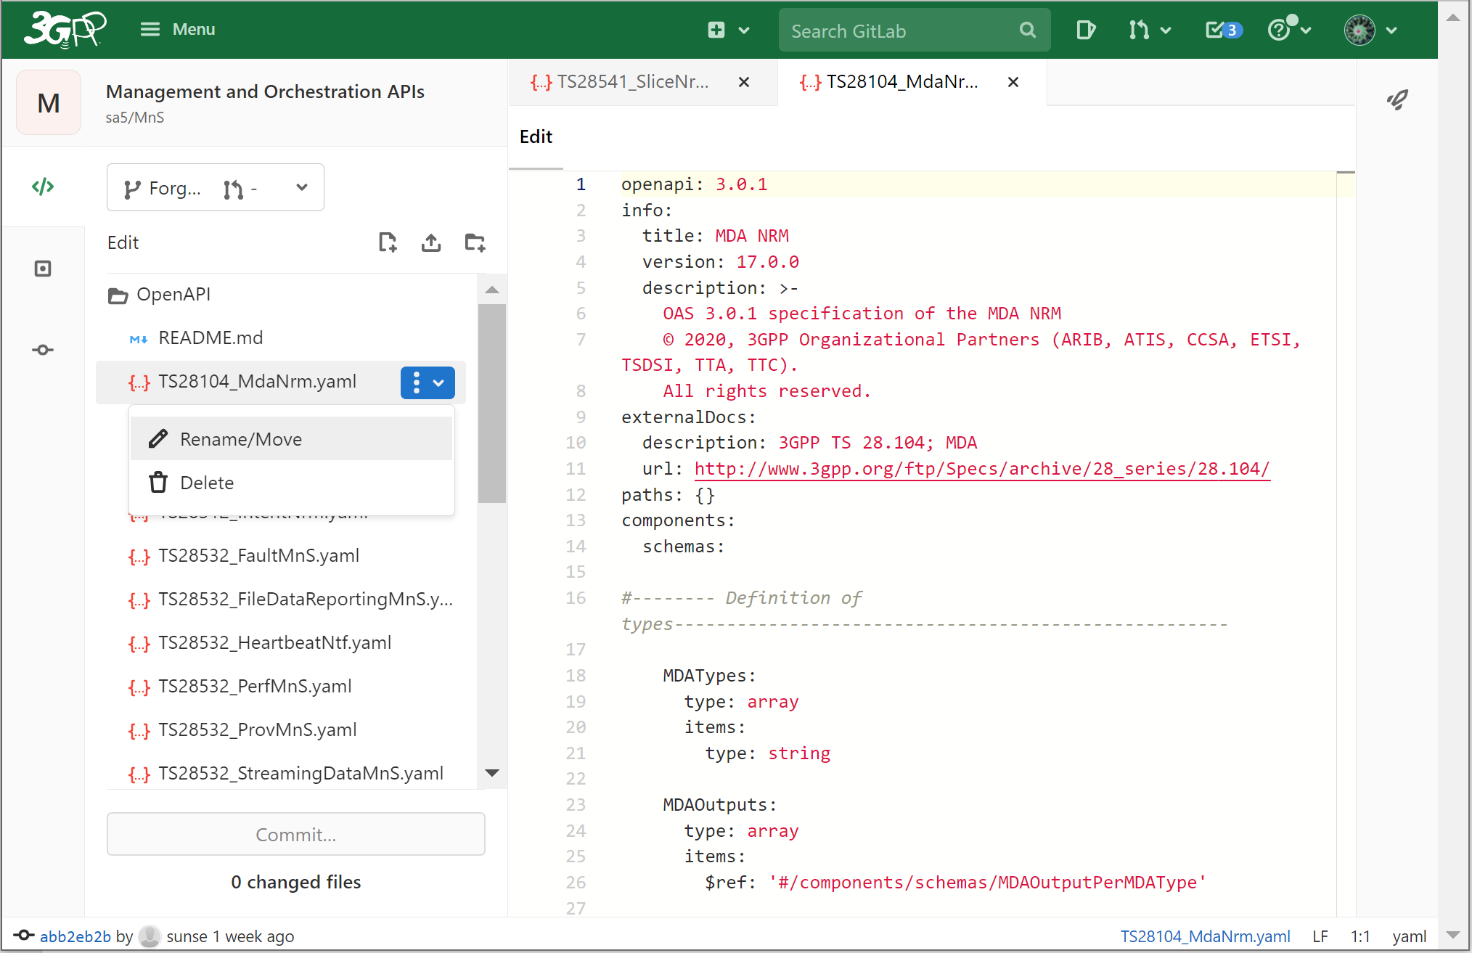
Forge: Web IDE editor
First Step : click “Web IDE” to start web IDE
Select one file for stage 3 contribution
In the right, it’s the editing window.
Edit
Review
Commit
means to change file name or move between folders

Slide 11
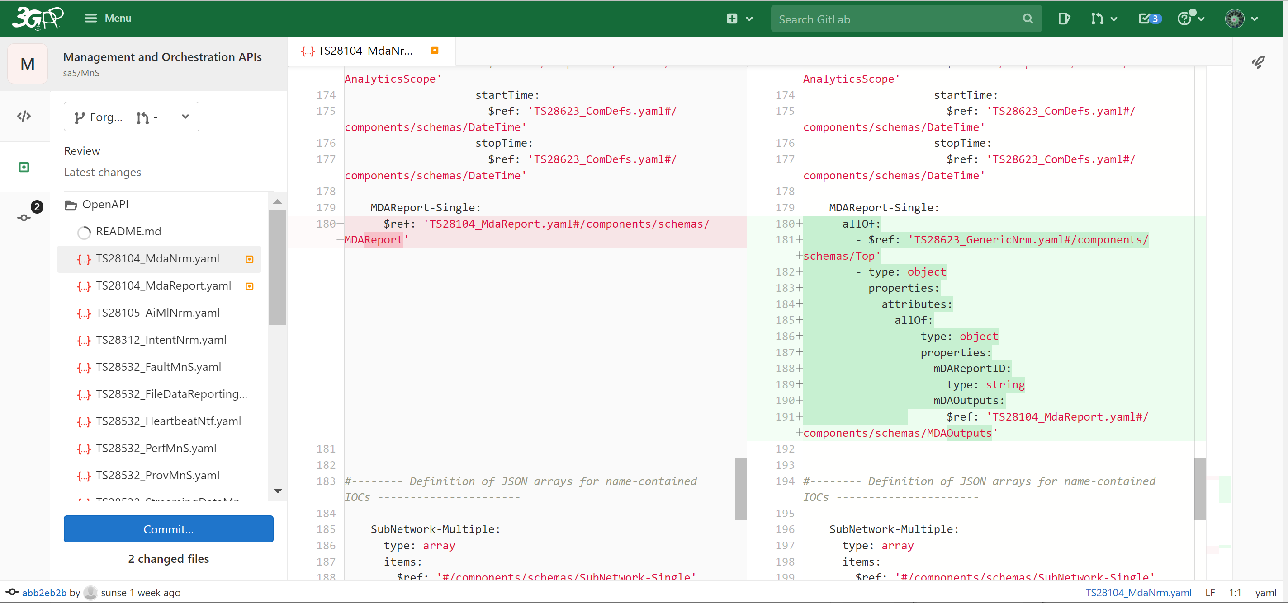
Forge: Web IDE (Review)
First Step : click “Web IDE” to start web IDE
2 indicates number of file changed
Line by line change comparison

Slide 12
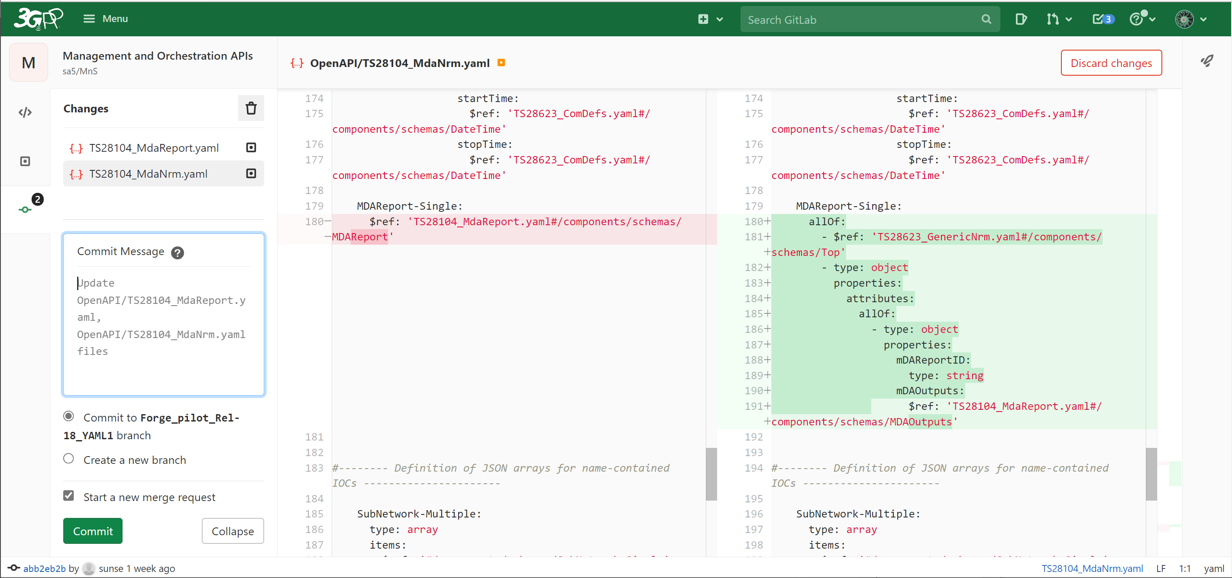
Forge: Web IDE for commit
“2” indicates number of file changed
Commit message: for what purpose for this commit, good practice is to include CR number
Note: if the validation is not green, fixed the code and commit till the validation is green.

Slide 13
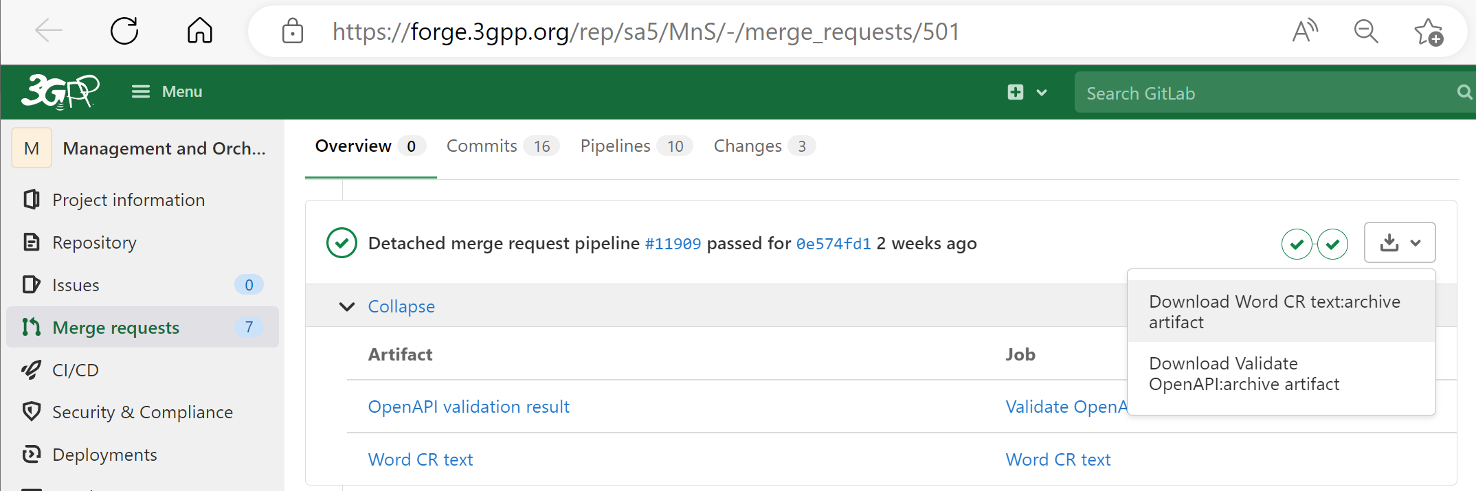

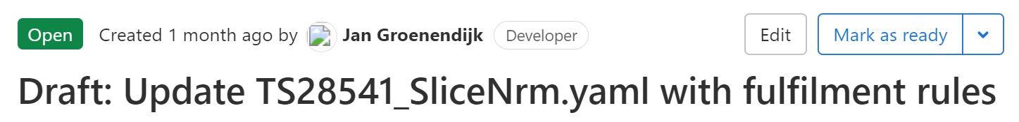
Forge: Generating word CR (code change part) with a Draft merge request
Added for 146 bis
This function is newly introduced function from Forge in late 2022.
Note 1: Contribution author creates a merge request towards the Integration branch before meeting start. At this stage the MR shall be marked as a draft MR. If a CR includes both YANG and YAML changes, two separate MRs are needed. The MR Forge link(s) shall be added to the MS Word CR's cover page 'Other Comments' section."
Step1: open the merge request
Step 2: Click first option (“Download Word CR text:archive artifact)
The automatically generated word artifact is a Word file with line-by-line stage 3 change track per Yaml file (for YANG, it’s a YANG file). The content may be used directly in Word CR (by adding your CR cover page)
Note 2: before CR is approved in SA5 closing plenary meeting, the merge request shall be in status “Draft” by clicking “Mark as draft” button. When in draft status, the title of merge request starts with “Draft:”, see example below.
Click “Mark as ready” button to make it ready for merge (e.g., when CR is approved in closing plenary meeting).

Slide 14
Forge: advanced tips
Rebase and command line rebase
Merge confliction handling
Note:
> Only for advanced user or code moderators.
> Assumed the user has good experience with git and has a local git environment as well as some common tools for code editing, comparison, etc.

Slide 15
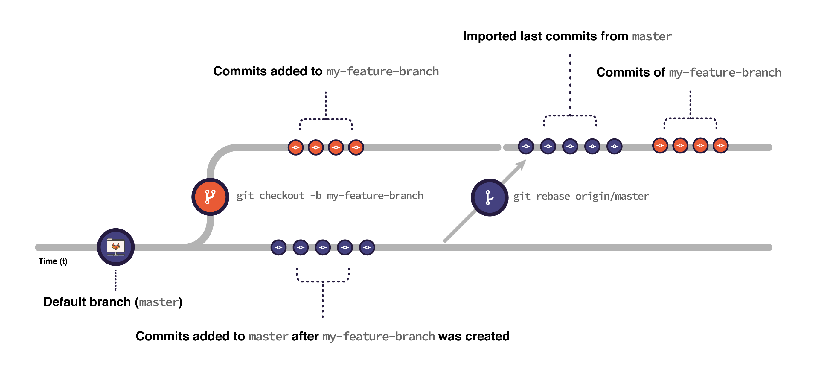
Git: Rebase
When you rebase:
Git imports all the commits submitted to main after the moment you created your feature branch until the present moment.
Git puts the commits you have in your feature branch on top of all the commits imported from main:
Figure is from: Introduction to Git rebase and force-push | GitLab
Command line example for rebased
git fetch origin
git fetch origin Rel17-draft
git checkout "Integration_Rel17_SA5_140_YAML"
git pull
## --- backup 140_yaml branch & switch back --
>> git checkout -b "Integration_Rel17_SA5_140_YAML_rebaseBK26Jan2022"
>> git checkout "Integration_Rel17_SA5_140_YAML"
git rebase "origin/Rel17-draft"
git pull
git push origin "Integration_Rel17_SA5_140_YAML"
Command to create a backup branch, which has all contents before rebase, could be used for recovery anytime
This command is to push commit (rebase) in local branch to remote repo
Notes:
It’s safer to back up your branch before rebasing to make sure you don’t lose any changes. For example, consider a feature branch called my-feature-branch:
Open your feature branch in the terminal:
>> git checkout my-feature-branch
Checkout a new branch from it:
>> git checkout -b my-feature-branch-backup
Go back to your original branch:
>> git checkout my-feature-branch
Now you can safely rebase it. If anything goes wrong, you can recover your changes by resetting my-feature-branch against my-feature-branch-backup:
Make sure you’re in the correct branch (my-feature-branch):
>> git checkout my-feature-branch
Reset it against my-feature-branch-backup:
>> git reset --hard my-feature-branch-backup
Note that if you added changes to my-feature-branch after creating the backup branch, you lose them when resetting.

Slide 16
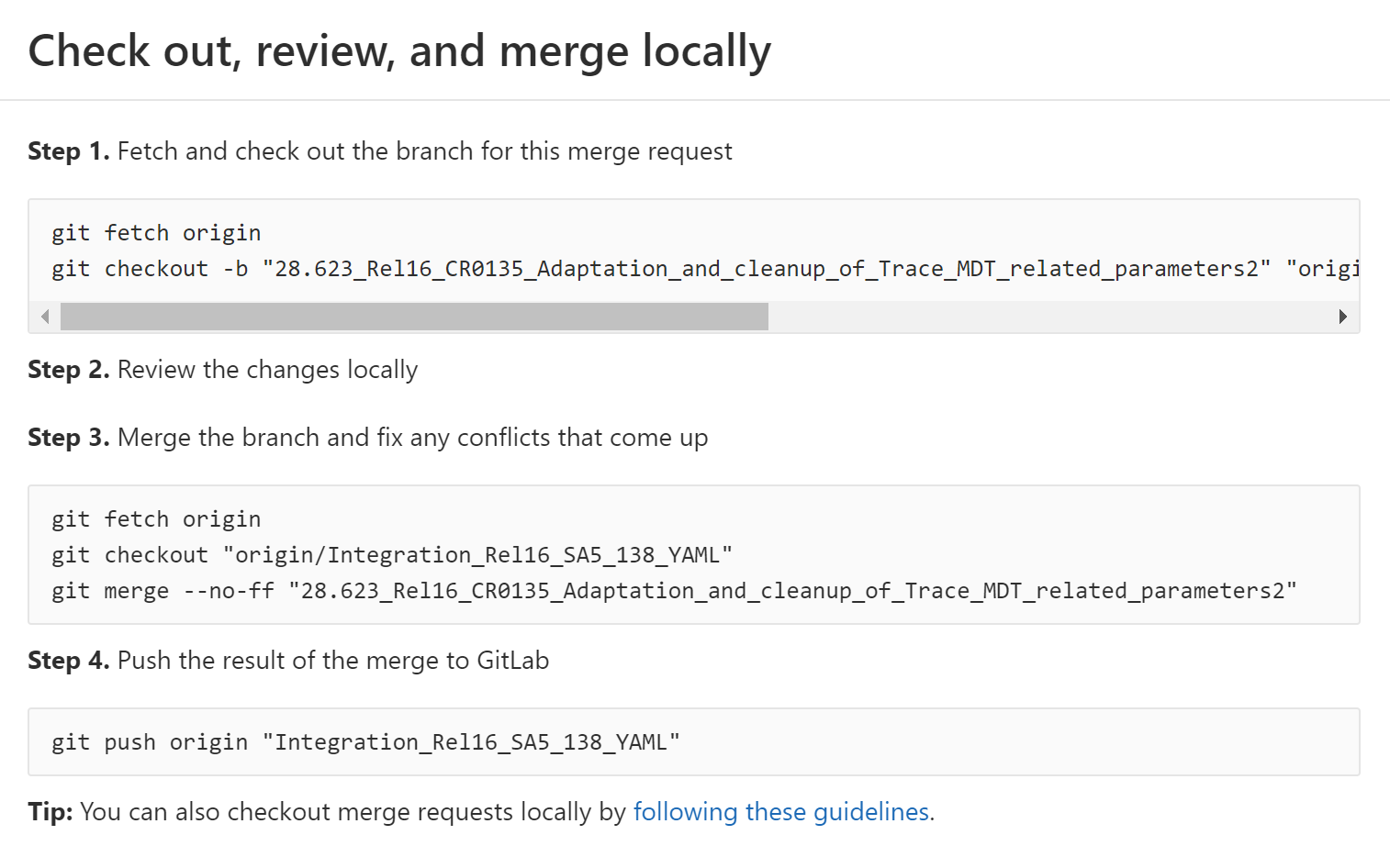
Git: Merge Request handling
Fetch origin copies all branches from remote refs/heads name space and store them to local refs/remotes/origin name space
Create a local branch from remote branch and switch to local branch 28.623_xx
(Note: Same branch name is used)
Alternatively, 2nd command can be:
git checkout -b "Integration_Rel16_SA5_138_YAML" "origin/Integration_Rel16_SA5_138_YAML“
Use some tools (vim, VSC, WinMerge, etc.) to resolve confliction, then “git add x, git commit x”
## ---- Example for CR0584
git fetch origin
git checkout -b "TS28.541_CR0584_Enhance_NRM_to_support_local_NEF_selection" "origin/TS28.541_CR0584_Enhance_NRM_to_support_local_NEF_selection"
git checkout "Integration_Rel17_SA5_139_YAML"
git merge --no-ff "TS28.541_CR0584_Enhance_NRM_to_support_local_NEF_selection"
git push origin "Integration_Rel17_SA5_139_YAML"
Notes:
git fetch origin
git checkout -b "28.541_Rel17_CR0630_Stage3_update_for_UPF_and_PCF" "origin/28.541_Rel17_CR0630_Stage3_update_for_UPF_and_PCF"
git fetch origin
git checkout -b “Integration_Rel16_SA5_138_YAML” “origin/Integration_Rel16_SA5_138_YAML“ or integration已经有了
git checkout "Integration_Rel17_SA5_140_YAML"
git merge --no-ff "28.541_Rel17_CR0630_Stage3_update_for_UPF_and_PCF“
git push origin "Integration_Rel17_SA5_140_YAML"
## ---- Example for CR0584
git fetch origin
git checkout -b "TS28.541_CR0584_Enhance_NRM_to_support_local_NEF_selection" "origin/TS28.541_CR0584_Enhance_NRM_to_support_local_NEF_selection"
git checkout "Integration_Rel17_SA5_139_YAML"
git merge --no-ff "TS28.541_CR0584_Enhance_NRM_to_support_local_NEF_selection"
git push origin "Integration_Rel17_SA5_139_YAML"

Slide 17
Thanks

