Slide 1
SA5 OAM&P Exec Report
SA5#143e, 9 – 17 May, 2022 e-meeting
Zou Lan, SA5 Vice-Chair, HUAWEI
Thomas Tovinger, SA5 Chair, ERICSSON
Mirko Cano Soveri, MCC

Slide 2
Incoming LSs
Tdoc | Title | Source | Decision | Reply In
S5-223020 | LS on Logical relationship between query parameters | C4-222302 | Replied | S5-223517
S5-223021 | Response to request for TM Forum AN Use Case material at Joint Workshop 23rd February 2022 and updated slides meeting 16th March 2022- LS22-0003 | TM Forum | Noted
S5-223022 | Ls ccSA5 Request to clarify whether there are IPR issues with using 3GPP terminology and information objects and names in code contributed to ONAP | ONAP | Noted
S5-223026 | Reply LS to ETSI MEC ccSA5 on MEC Federation and interest to collaborate | S6-220931 | Noted
S5-223515 | LS on Issues Network Slice information delivery to a 3rd party | S6-220975 | Replied | S5-223516
S5-223015 | Resubmitted Reply LS to SA5 on beam measurement reports | R3-221383 | Replied | S5-223524
S5-223016 | Resubmitted LS on configuration updates of MDT M1, M8 and M9 in RAN3 specifications | R3-221445 | Replied | S5-223583
S5-223017 | Resubmitted LS on RAN3 agreements for NR QoE | R3-222890 | Postponed
S5-223018 | Resubmitted LS Reply on QoE configuration and reporting related issues | S4-220309 | Replied | S5-223518
S5-223019 | Resubmitted LS on TS 28.404/TS 28.405 Clarification | S4-211234 | Replied | S5-223519
S5-223025 | LS on FS_eEDGEAPP, Solution for Dynamic EAS instantiation | S6-220848 | Postponed
S5-223027 | LS on network slice LCM consumption and use cases | S6-220932 | Replied | S5-223521

Slide 3
Outgoing LSs
Tdoc | Title | To | Cc | ReplyTo
S5-223517 | Reply LS on Logical relationship between query parameters (Huawei) | CT4 | CT3, CT1, SA4 | S5-223020
S5-223516 | Reply LS on Issues Network Slice information delivery to a 3rd party | SA6 | SA1, SA2, SA | S5-223515
S5-223518 | Reply LS on QoE configuration and reporting related issues | SA4, RAN3 | RAN2 | S5-223018
S5-223519 | Reply LS on TS 28.404/TS 28.405 Clarification |  |  | S5-223019
S5-223521 | Reply LS on network slice LCM consumption and use cases | SA6 | SA2, SA1 | S5-223027
S5-223522 | LS on Study on KQIs for 5G service experience | 3GPP SA4, ITU-T SG12
S5-223524 | Reply LS on beam measurement reports |  |  | S5-223015
S5-223525 | LS on Inclusive language updates related to BBF TR-196 | Broadband Forum (BBF)
S5-223583 | Reply LS on configuration updates of MDT M1, M8 and M9 in RAN3 specifications | 3GPP RAN3 |  | S5-223016

Slide 4
Revised Rel-17 Work Items / Study Items
Tdoc | Type | Release | Title | Source
The following Rel-17 WI are agreed to postpone to Rel-18
eQoE: Enhancement of QoE Measurement Collection
MSAC: Access control for management service
eNETSLICE_PRO: Network slice provisioning enhancement

Slide 5
Agreed new Rel-18 Work Items / Study Items
Tdoc | Type | Release | Title | Source | Potential related groups

Slide 6
Documents endorsed by OA&M
TDoc | Title | Source | Potential related topics and related groups

Slide 7

OAM General Topics (Rel-18 prioritization and Work Package)
Info about WoP:
  We need to start the Rel-18 work at SA5#142e – all SA-approved Rel-18 WI/SIs should be on the agenda.
  Definition of the complete set of WoPs for each Rel-18 WID/SID should be proposed by the work item rapporteurs as input contributions to SA5#142e and agreed there, which means that the WoPs can and should then be used as basis for selection of subsets of the WoPs on the agenda for SA5#143e.
  Therefore we need some other less formal way of reducing the agenda for SA5#142e, if we want that – like a leaders recommendation of what to focus on, e.g. initial skeleton proposals and/or DPs. Maybe this will come natural anyway for a first Rel-18 meeting, so we did not decide on any such leaders recommendation yet (but I still ask everyone to consider that, to avoid a huge overload of Rel-18 contributions at the same time as we need to finish the Rel-17 work items with approved exceptions as well as the earlier Rel-17 studies that continue into Rel-18).
  The WoPs shall in no way modify the content or meaning of the objectives in the approved WID/SIDs – they are only allowed to identify clearly defined subsets of the objectives, typically one WoP per “main bullet” in the WID/SID Objectives, or in some cases subsets of a bullet if it’s clearly separable.
  The SA5#142e-agreed complete set of WoPs for each Rel-18 WID/SID should be documented as an “SA5-local WID/SID update with WoPs” (no need to send them to SA for approval).
  Then we ask the rapporteurs to propose a subset of all agreed WoPs to be recommended to the leaders to be put on the agenda for next meeting, which means that contributions to the next meeting (143e) are only allowed to address the selected WoPs. We don’t spend time on this selection during the meeting, as the agreed WoPs are not known until the end of the meeting but also to save time for the tdoc discussions and conclusions in the meeting.
  We will add the selection of subsets of WoPs to the real meeting agenda as “level 4 (or 5)” agenda item (e.g. 6.3.4.1 for WoP no. 1 in agenda 6.4.3) so that this has to be used for tdoc agenda allocation in 3GU. This is possible in 3GU according to Mirko. The next meeting’s draft agenda shall be sent out for email review asap after the meeting, and then it will be decided by the leaders after any comments have been considered. Thus the WoP selection for SA5#143e should be known soon after SA5#142e finished, for everyone to be able to plan and prepare contributions for SA5#143e as early as possible.
  This also means that the leaders have “full control” to decide about the WoP selection in the agenda for next meeting (like we always have for the agenda), and it is not possible to contribute to any other WoPs than the selected ones.
  This also has the big advantage that we can follow the “statistics of number of tdocs for every WoP” at every meeting to see an indication of the progress for each WoP and at the end of the release check if all objectives (WoPs) have been addressed with some contributions (and how many were agreed).
S5-223014 Collection of Rel-18 3GPP SA5 OAM WoPs
  We ask every rapporteur to provide proposal to update the WoP if needed.

Slide 8
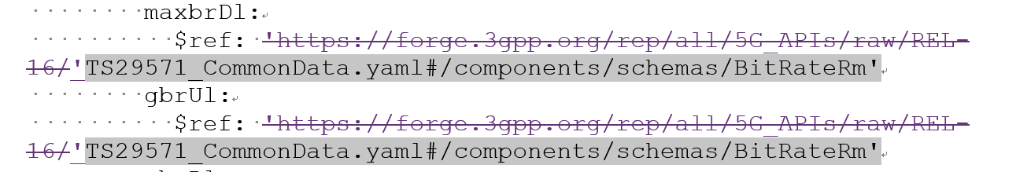
OAM General Topics (Forge collaboration with CT) (1/2)
Forge collaboration background information:
SA approved forge structure: SP-220341 Proposed recommendations on Storage of 3GPP OpenAPI specification files in 3GPP Forge
Request from CT Chair and CT expect:
A. Update the file names to start with TS number, Correct internal references to common defs (and other SA5 spec) to take into account the file name update
B. Use relative URIs to refer to external specifications (e.g. TS29571)
C: “comDefs.yaml" and “"coslaNrm.yaml"
Summary of the update in SA5#142e&#143e: All requests related to A-B-C from CT Chair and CT expert are completed.
  A. SA5 OpenAPI file name is fully aligned with the naming convention as CT, see the following examples how it look like.
    TS28541_5GcNrm.yaml TS28541_NrNrm.yaml
    TS28532_FaultMnS.yaml TS28541_SliceNrm.yaml
    TS28532_FileDataReportingMnS.yaml TS28550_PerfMeasJobCtrlMnS.yaml
    TS28532_HeartbeatNtf.yaml TS28623_ComDefs.yaml
    TS28532_PerfMnS.yaml TS28623_GenericNrm.yaml
    TS28532_ProvMnS.yaml TS29512_Npcf_SMPolicyControl.yaml
    TS28532_StreamingDataMnS.yaml TS29514_Npcf_PolicyAuthorization.yaml
    TS28536_CoslaNrm.yaml TS29571_CommonData.yaml
    (Also the reference inside will also be updated)
  B. Relative URIs are used to external specifications, see the following example in S5-223048.
  C. YAML syntax issues in “comDefs.yaml" and "coslaNrm.yaml“ are corrected.

Slide 9
OAM General Topics (Forge collaboration with CT) (2/2)
Progress in SA5#142e:
1. List of SA5#142e agreed tdocs:
Collaboration with CT on Forge (TS 32.312&28.532&28.536&28.538&28.541&28.550&28.622&28.623):
[SA5#142e], 6.3-MAINT, S5-222384 Rel-17 CR TS 28.312 OpenAPI file name and dependence change-intentNrm
[SA5#142e], 6.3-MAINT, GROUP#1 (S5-222580/S5-222502) Draft CR 28.532 OpenAPI file name and dependence change
[SA5#142e], 6.3-MAINT, S5-222382 Rel-16 CR TS 28.536 OpenAPI file name and dependence change-coslaNrm
[SA5#142e], 6.3-MAINT, S5-222385 Rel-17 CR TS 28.538 OpenAPI file name and dependence change-edgeNrm
[SA5#142e], 6.3-MAINT, GROUP#2 (S5-222581/S5-222582/S5-222583) TS 28.541 OpenAPI file name and dependence change-5gcNrm-nrNRM-SliceNrm.yaml
[SA5#142e], 6.3-MAINT, S5-222518 CT OpenAPI file relative-path URI references and dependence change for 5gcNrm.yaml
[SA5#142e], 6.3-MAINT,S5-222503 Rel-16 Draft CR 28.550 OpenAPI file name and dependence change
[SA5#142e], 6.3-MAINT, GROUP#3 (S5-222584/S5-222585) TS 28.623 OpenAPI file name and dependence change-comDefs-genericNRM.yaml
2. Issues have been addressed in SA5#142e (corresponding to the requests A-B-C above from CT Chair and CT expect):
A. Filename alignment:
a) Add TS number: Rel-16 related draftCRs have been updated and agreed.
B. Absolute/relative URI: Rel-16 related draftCRs have been updated and agreed.
Progress in SA5#143e :
1. List of SA5#143e agreed tdocs:
[SA5#143e], 6.3-MAINT, GROUP#1 (S5-223527/S5-223528/S5-223529/S5-223530/S5-223531/S5-223532) CR TS 28.541 OpenAPI file name and dependence change-5gcNrm-nrNRM-SliceNrm
[SA5#143e], 6.3-MAINT, GROUP#2 (S5-223533/S5-223534/S5-223535/S5-223536) CR TS 28.623 OpenAPI file name and dependence change-comDefs- genericNrm
[SA5#143e], 6.3-MAINT, GROUP#3 (S5-223068/S5-223069) CR TS 28.536 OpenAPI file name and dependence change- coslaNrm
[SA5#143e], 6.3-MAINT, S5-223537 Rel-17 CR TS 28.538 OpenAPI file name and dependence change-edgeNrm
[SA5#143e], 6.3-MAINT, GROUP#4 (S5-223314/ S5-223317) CR 28.550 OpenAPI file name and dependence change
[SA5#143e], 6.3-MAINT, GROUP#5 (S5-223312/ S5-223313/ S5-223315/ S5-223316) CR 28.532 OpenAPI file name and dependence change- part1/part2
[SA5#143e], 6.3-MAINT, GROUP#6 (S5-223538/ S5-223126) CR 28.623 yaml indentation correction for comDefs.yaml
[SA5#143e], 6.6.3-IDMS_MN, GROUP#1 (S5-223628) pCR TS 28.312 OpenAPI file name and dependence change-intentNrm
[SA5#143e], 6.7 S5-223048 Rel-16 TS 28.541 CT OpenAPI file relative-path URI references and dependence change for 5gcNrm.yaml
[SA5#143e], 6.7 S5-223049 Rel-17 TS 28.541 CT OpenAPI file relative-path URI references and dependence change for 5gcNrm.yaml
2. Issues have been addressed in SA5#143e (corresponding to the requests A-B-C above from CT Chair and CT expect):
A. Filename alignment:
a) Add TS number: Block approve of Rel-16 CRs and Rel-17 mirror CRs based on agreed draftCRs.
b) Lowercase/Uppercase: Rel-16 and Rel-17 contributions to address this issue.
B. Absolute/relative URI: Block approve of Rel-16 CRs and Rel-17 CRs agreed draftCRs.
C. issues “comDefs.yaml" and “"coslaNrm.yaml“
Collaboration plan with CT after SA5#143e:
After 3GPPSA5#143-e, we will have to copy the SA5 OpenAPI files into the draft release branches right before TSG#96.
As the draft versions of the specifications sent to TSG#96 for approval should be available at the end of the week 21, I would propose to use May 27 as the targeted date for copying the SA5 files in the draft branches of 5G-APIs.
Of course, they can also be made available in week 22 but the sooner will be the better for having all the files available, to have more time to generate CRs if needed after error detection during the final sanity check.

Slide 10
Overview of Rel-17 SA5 OAM WIs/SIs
 | Rel-17 Operations, Administration, Maintenance and Provisioning (OAM&P)
1 | (finished) Additional NRM features | adNRM | 870026
2 | (finished) Enhancements of 5G performance measurements and KPIs | ePM_KPI_5G | 880025
3 | (finished) Management of MDT enhancement in 5G | e_5GMDT | 870025
4 | (Exception)-> (postpone to Rel-18)Enhancement of QoE Measurement Collection | eQoE | 870027
5 | (finished) Management Aspects of 5G Network Sharing | MANS | 900021
6 | (finished) File Management | FIMA | 910030
7 | (Exception)->(postpone to Rel-18) Access control on management service | MSAC | 930010
8 | (finished) Enhancement of service-based management architecture | NSA_SBMA | 930009
9 | (finished) Autonomous network levels | ANL | 880027
10 | (Exception) -> (finished)Intent driven management service for mobile networks | IDMS_MN | 810027
11 | (Exception) -> (finished)Enhanced Closed loop SLS Assurance | eCOSLA | 870030
12 | (finished) Network policy management for 5G mobile networks | NPM | 860024
13 | (Exception) -> (finished)Enhancements of Management Data Analytics Service | eMDAS | 850028
14 | (finished) Enhancements of Self-Organizing Networks (SON) for 5G networks | eSON_5G | 870028
15 | (finished) Generic Plug and connect | PACMAN | 910029
16 | (finished) Enhancement of Handover Optimization | E_HOO | 880029
17 | (finished) Enhancements on EE for 5G networks | EE5GPLUS | 870022
18 | (finished) Discovery of management services in 5G | 5GDMS | 820035
19 | (Exception) -> (finished)Management data collection control and discovery | MADCOL | 880028
20 | (finished) Management of non-public networks | OAM_NPN | 870023
21 | (finished) Enhancement on Management Aspects of 5G Service-Level Agreement | EMA5SLA | 870024
22 | (finished) Management of the enhanced tenant concept | eMEMTANE | 880026
23 | (Exception)->(finished) Edge Computing Management | ECM | 920019
24 | (Exception)->(postpone to Rel-18)Network slice provisioning enhancement | eNETSLICE_PRO | 940033
All the Rel-17 WIs/SIs are completed. Altogether 21 finished WIs, 8 finished Sis, 3 WIs are agreed to move to Rel-18.
 | Rel-17 OAM&P Studies
1 | (finished) Study on autonomous network levels | FS_ANL | 850032
2 | (finished) Study on management and orchestration aspects with integrated satellite components in a 5G network | FS_5GSAT_MO | 830025
3 | (finished) Study on enhancement of Management Data Analytics Service (finished) | FS_eMDAS | 850028
4 | (finished) Study on enhancements of edge computing management | FS_eEDGE_Mgt | 870029
5 | (finished) Study on access control for management service | FS_MNSAC | 890016
6 | (finished) Study on new aspects of EE for 5G networks | FS_EE5G | 870021
7 | (finished) Study on Management Aspects of 5G Network Sharing | FS_MANS | 920018
8 | (finished) Study on network slice management enhancements | FS_NSMEN | 860022

Slide 11
Overview of Rel-18 SA5 OAM ongoing WIs/SIs
Altogether 34 WIs/Sis, including 23 ongoing Sis and 8 ongoing Wis, 2 SIs and 1 WI are waiting for SA approval.
Rel-18 OAM&P Studies
Intelligence and Automation
1 | Study on enhancement of autonomous network levels | China Mobile, Huawei | FS_eANL | SP-211446
2 | Study on evaluation of autonomous network levels | China Mobile, Huawei | FS_ANLEVA | SP-211445
3 | Study on enhanced intent driven management services for mobile networks | Huawei, Ericsson | FS_eIDMS_MN | SP-211450
4 | Study on intent-driven management for network slicing | Ericsson, Huawei | FS_NETSLICE_IDMS | SP-220278
5 | Study on AI/ ML management | Intel, NEC | FS_AIML_MGMT | SP-211443
6 | Study on Enhancement of the management aspects related to NWDAF | China Telecom | FS_MANWDAF | SP-211435
7 | Study on Fault Supervision Evolution | China Mobile, Huawei | FS_FSEV | SP-220153
8 | Study on measurement data collection to support RAN intelligence (wait for SA approval) | Intel, China Mobile | FS_MEDACO_RAN | S5-222631
Management Architecture and Mechanisms
9 | Study on Enhancement of service based management architecture | Huawei, Ericsson | FS_eSBMA | SP-211451
10 | Study on Basic SBMA enabler enhancements | Nokia | FS_eSBMAe | S5-221506
11 | Study on Management Aspects of URLLC | China Unicom | FS_URLLC_Mgt | SP-220146
12 | Study on Management Aspects of 5GLAN | China Mobile | FS_5GLAN_Mgt | SP-220324
13 | Study on Management of Cloud Native Virtualized Network Function | China Mobile | FS_MCVNF | SP-220150
14 | Study on Management Aspects of 5G MOCN Network Sharing Phase2 | China Unicom | FS_MANS_ph2 | SP-220151
15 | Study on continuous integration continuous delivery support for 3GPP NFs | Lenovo | FS_CICDNS | SP-211427
16 | Study on Management of Trace/MDT phase 2 | Nokia | FS_5GMDT_Ph2 | SP-220152
17 | Study on YANG PUSH | Ericsson | FS_YANG | SP-200765
18 | Study on Management Aspects of IoT NTN Enhancements (wait for SA approval) | China Unicom | FS_IOT_NTN | S5-222579
Rel-18 OAM&P Studies
Support of New Services
19 | Study on enhancement of management of non-public networks | Huawei | FS_OAM_eNPN | SP-211436
20 | Study on new aspects of EE for 5G networks Phase 2 | Orange | FS_EE5G_Ph2 | SP-211440
21 | Study on Network and Service Operations for Energy Utilities | Samsung | FS_NSOEU | SP-211622
22 | Study on Key Quality Indicators(KQIs)for 5G service experience | Huawei | FS_KQI_5G | SP-211433
23 | Study on Deterministic Communication Service Assurance | Huawei | FS_DCSA | SP-211442
24 | Study on management aspects of network slice management capability exposure | Alibaba | FS_NSCE | SP-220142
25 | Study on alignment with ETSI MEC for Edge computing management | Huawei | FS_MEC_ECM | SP-220147
Rel-18 Operations, Administration, Maintenance and Provisioning (OAM&P)
Intelligence and Automation
26 | Self-Configuration of RAN NEs | China Mobile, Huawei | RANSC | SP-211431
Management Architecture and Mechanisms
27 | Network slicing provisioning rules | Ericsson | NSRULE | SP-211449
28 | Additional NRM features Phase 2 | Nokia | AdNRM_ph2 | SP-220351
29 | enhanced Edge Computing Management | Samsung, Intel | eECM | SP-220154
30 | Enhancements of 5G performance measurements and KPIs phase 2 (wait for SA approval) | China Telecom, Intel | ePM_KPI_5G_Ph2 | S5-222578
31 | Enhancement of QoE Measurement Collection (move from Rel-17) | Ericsson | eQoE | SP-200193
32 | Access control on management service(move from Rel-17) | Nokia | MSAC | SP-210859
33 | Network slice provisioning enhancement(move from Rel-17) | Samsung | eNETSLICE_PRO | SP-211434
Support of New Services
34 | Enhancements of EE for 5G Phase 2 | Orange | EE5GPLUS_Ph2 | SP-211441

Slide 12
Rel-16/Rel-17 CRs (1/2)
Working Progress
The following topics were discussed in the meeting.
Collaboration with CT on Forge
[SA5#143e], 6.3-MAINT, GROUP#1 (S5-223052/S5-223053/S5-223054/S5-223055/S5-223056/S5-223057) CR TS 28.541 OpenAPI file name and dependence change-5gcNrm-nrNRM-SliceNrm
[SA5#143e], 6.3-MAINT, GROUP#2 (S5-223058/S5-223059/S5-223060/S5-223061) CR TS 28.623 OpenAPI file name and dependence change-comDefs- genericNrm
[SA5#143e], 6.3-MAINT, GROUP#3 (S5-223068/S5-223069) CR TS 28.536 OpenAPI file name and dependence change- coslaNrm
[SA5#143e], 6.3-MAINT, S5-223072 Rel-17 CR TS 28.538 OpenAPI file name and dependence change-edgeNrm
[SA5#143e], 6.3-MAINT, GROUP#4 (S5-223314/ S5-223317) CR 28.550 OpenAPI file name and dependence change
[SA5#143e], 6.3-MAINT, GROUP#5 (S5-223312/ S5-223313/ S5-223315/ S5-223316) CR 28.532 OpenAPI file name and dependence change- part1/part2
[SA5#143e], 6.3-MAINT, GROUP#6 (S5-223125/ S5-223126) CR 28.623 yaml indentation correction for comDefs.yaml
Non-inclusive language update (TS 32.592&28.313&28.658&28.659&32.406&32.452&32.511)
[SA5#143e], 6.3-MAINT, GROUP#7 (S5-223166/ S5-223198/ S5-223331/ S5-223332/ S5-223369/ S5-223393/S5-223435) Non-inclusive language correction
TS 28.531:
[SA5#143e], 6.3-MAINT, S5-223243 Rel-17 CR 28.531 adding procedure network service priority management
TS 28.532:
[SA5#143e], 6.3-MAINT, S5-223194 Rel-17 CR 28.532 Align allowed file transfer protocols in stage 2 with stage 1 requirements
[SA5#143e], 6.3-MAINT, GROUP#8 (S5-223357/ S5-223358) CR 28.532 Correct definition of Resource
[SA5#143e], 6.3-MAINT, GROUP#9 (S5-223359/ S5-223360/ S5-223362) Rel-17 CR 28.532 Correct notifyMOIChanges (stage 2/REST SS/ OpenAPI definitions)
[SA5#143e], 6.3-MAINT, S5-223388 Data change notifications YANG-in-Rest format
[SA5#143e], 6.3-MAINT, S5-223514 Rel-17 CR 28.532 Clarify usage of notifyMOIChanges for NRMs defined in YANG
TS 28.535:
[SA5#143e], 6.3-MAINT, S5-223371 Remove Editor's Note in clause 4.2.5.3
TS 28.536:
[SA5#143e], 6.3-MAINT, GROUP#10 (S5-223310/ S5-223311) CR 28.536 Minor correction on the format for cosla yaml file
[SA5#143e], 6.3-MAINT, GROUP#11 (S5-223375/ S5-223377) Correct attribute properties in assuranceTargetList
TS 28.537:
[SA5#143e], 6.3-MAINT, S5-223133 Rel-17 CR for TS28.537 editorialCorrections
TS 28.541:
[SA5#143e], 6.3-MAINT, S5-223073 Rel-17 CR TS28541 Correction to property of EP_Transport attribute ipAddress
[SA5#143e], 6.3-MAINT, S5-223146 Rel-17 CR TS28541 Fixing attribute properties for ServiceProfile attribute networkSliceSharingIndicator
[SA5#143e], 6.3-MAINT, GROUP#12 (S5-223155/ S5-223186) Correct isOrdered-isUnique for multivalue attributes
[SA5#143e], 6.3-MAINT, S5-223233 Rel-17 CR 28.541 Correction on attribute latency of SubnetProfiles
[SA5#143e], 6.3-MAINT, S5-223309 Rel-17 CR TS 28.541 Address the unnecessary reference for the yaml file
[SA5#143e], 6.3-MAINT, S5-223451 Rel-17 CR TS 28.541 Correction to multiplicity of relation between NetworkSlice IOC and NetworkSliceSubnet IOC
[SA5#143e], 6.3-MAINT, S5-223490 Rel-17 CR 28.541 Update Figure L.2.1 and accompanying paragraph

Slide 13
Rel-16/Rel-17 CRs (2/2)
Working Progress
The following topics were discussed in the meeting (cont’d).
TS 28.550:
[SA5#143e], 6.3-MAINT, GROUP#13 (S5-223422/ S5-223423/ S5-223425) Add granularity period examples
TS 28.552:
[SA5#143e], 6.3-MAINT, S5-223124 Rel-17 Correct the definition of DRB setup related counters
[SA5#143e], 6.3-MAINT, S5-223134 Rel-17 CR for TS28.552 editorialCorrections
[SA5#143e], 6.3-MAINT, GROUP#14 (S5-223299/ S5-223300) Rel-17 CR for TS28.552 Change/add the measurement object class to support MOCN network sharing with multiple Cell Identity broadcast scenarios
[SA5#143e], 6.3-MAINT, S5-223301 Rel-17 CR for TS28.552 Correct Mean and Max Time of requested conditional handover executions
TS 28.622& 28.623:
[SA5#143e], 6.3-MAINT, GROUP#15 (S5-223152/ S5-223153) Correct isOrdered-isUnique for multivalue attributes
[SA5#143e], 6.3-MAINT, S5-223165 Rel-17 CR 28.622 Add missing definitions of common data types
[SA5#143e], 6.3-MAINT, GROUP#16 (S5-223199/ S5-223200) Alarm Handling Clarifications
[SA5#143e], 6.3-MAINT, S5-223244 Rel-17 CR 28.623 Fix description of attribute mnsScope
[SA5#143e], 6.3-MAINT, GROUP#17 (S5-223405/ S5-223406/ S5-223407) CR 28.622 Clarification for IRP and SBMA framework
[SA5#143e], 6.3-MAINT, GROUP#18 (S5-223507/ S5-223508) CR 28.623 Alignment of attribute values of attribute tjMDTReportInterval to TS 32.422, TS 38.413 and TS 38.423
TS 32.156:
[SA5#143e], 6.3-MAINT, GROUP#19 (S5-223419/ S5-223420) CR 32.156 Clarification of property defaultValue
TS 32.158:
[SA5#143e], 6.3-MAINT, GROUP#20 (S5-223195/ S5-223196) CR 32.158 Clarify clause Design pattern for reading a resource
TS 32.422&32.423:
[SA5#143e], 6.3-MAINT, GROUP#21 (S5-223245/ S5-223246/ S5-223247/ S5-223248) CR 32.422/32.423 adding missing signaling and interface related to SMF for trace

Slide 14
Rel-17 WI eQOE/MSAC/ECM/eNETSLICE_PRO
WI code | WI Title | Completion rate | TS/TR | Tdoc reference | Target date | Rapporteur | Related groups | Related topic
eQoE | Enhancement of QoE Measurement Collection | 15%->20%->40%->60% ->90%->92%->95% | TS28.307/28.308/28.309/28.404/28.405/28.406/28.622/28.623/28.533 | SP-200193 | SA#96 (Jun. 2022)-> SA#98 (Dec 2022) (move to Rel-18) | Ericsson | RAN2/RAN3/SA4
MSAC | Access control for management service | 0%->10%->50%->60%->65%->67% | TS28.533/28.622/28.623/28.532 | SP-210859 | SA#96 (Jun. 2022)-> SA#98 (Dec 2022) (move to Rel-18) | Nokia | SA3
ECM | Edge Computing Management | 0%->10%->25%->50%-90%->100% | TS 28.538 | SP-210388 | SA#95 (Mar 2022) (exception) | Samsung | SA2/SA6/NFV
eNETSLICE_PRO | Network slice provisioning enhancement | 0%->0%->50%->70%->85% | TS 28.531/28.541 | S5-215497 | SA#96 (Jun. 2022)-> SA#97 (Sep 2022) (move to Rel-18) | Samsung |  | Slicing
Working Progress
eQoE: The following topics were discussed and need further discussion.
Slow progress at this meeting. However, Nokia and Ericsson have agreed on some technical issues that were the main reason for objecting CRs. Assuming e-mail approvals of S5-223746 and S5-223747 will go fine, the completion rate is estimated to 95%.
MSAC:
Authentication/Authorization Work flow update reviewed and mainly accepted; the AccessRight design is open for further discussion, impacting NRM modeling for both stage 2 and stage 3.
The group agreed to postpone the work to Rel-18.
ECM: :
All the comment raised by MCC in #142e were addressed.
eNETSLICE_PRO:
Group agreed on the contribution providing details of NetworkSliceSubnetProvider capabilities. The only objective left is to add asynchronous support to the procedures in 28.531. Group decided to carry-on this WID to Rel-18.

Slide 15
Rel-17 WI MADCOL/eMDAS/eCOSLA/IDMS_MN
WI code | WI Title | Completion rate | TS/TR | Tdoc reference | Target date | Rapporteur | Related groups | Related topic
MADCOL | Management data collection control and discovery | 40%->40%->45%->55% ->100% | TS28.533/28.532/28.622/ 28.623 | SP-200465 | SA#95 (Mar 2022) (exception) | Nokia | SA2/RAN2/RAN3
eMDAS | Enhancements of Management Data Analytics Service | 0%->10%->25%->45%->65%->85%->100% | TS 28.104/ and another new TS (being requested by the revised WID) | SP-210132 -> Revised WID in S5 216348 | SA#95 (Mar 2022) (exception) | Intel,NEC | SA2/RAN3 | Data analytics
eCOSLA | Enhanced Closed loop SLS Assurance | 60%->70%->80%->90%->95%->100% | TS28.535/28.536/28.533/28.541/28.546/28.552/28.553 | SP-200196 | SA#95 (Mar 2022) (exception) | Ericsson | ZSM/SA2/RAN3 | Closed loop interaction
IDMS_MN | Intent driven management service for mobile networks | 70%->75%->80%->95%->99%->100% | TR28.812/TS 28.312 | SP-180899 | SA#95 (Mar 2022) (exception) | Huawei | SA2/RAN3/ZSM | Intent
Working Progress
MADCOL:
The work on providing a solution allowing to request management data based on a network abstraction was completed. In addition, the last missing pieces for the solution allowing to discover which kinds of management data Network Functions can produce were added. With this the WI is completed.
eCOSLA: :
The group has been working to resolve last outstanding stage 2 definitions, including stage 3 updates. The work item has been completed.
IDMS_MN:
Following aspects were discussed and agreed:
Clean up on stage 2
Clean up on stage3 yaml file
Stage 2 and stage 3 update on Service Support Expectation.
The WID is completed.
eMDAS:
This Rel-17 WI is completed with the following outcome from this meeting, and two new TSs 28.104 and 28.105 are to be sent to SA for approval:
enhancements on use cases, requirements and data definitions for some MDA capabilities,
definition of NRM for MDA report,
generic MDA workflow,
AI/ML support for MDA,
enhancements of AI/ML NRM,
MnS components for MDA reporting,
new UC, requirements and solutions on handling erroneous data & decisions
stage 3 SS for both TS 28.104 and 28.105.
rapporteur clean-up.
The issues that cannot be solved in Rel-17 are proposed to move to Rel-18, including:
analytics data definition for failure prediction,
recommended actions related to non-3GPP domain,
analytics data definition for failure prediction (if cannot be approved in email approval).

Slide 16
Rel-18 SI Intelligence and Automation
WI code | WI/SI information | Rapporteur | TR | Target date | Completion rate | Related groups | Related topic
FS_eANL | Study on enhancement of autonomous network levels (FS_eANL) (SP-211446) | China Mobile, Huawei | 28.910 | SA5#145/SA#97(Sep 2022) | 0->10->25% | SA2, RAN3 and ETSI ZSM
FS_ANLEVA | Study on evaluation of autonomous network levels(FS_ANLEVA) (SP-211445) | China Mobile, Huawei | 28.909 | SA5#147/SA#99(Mar 2023) | 0->10->10% | SA2, RAN3 and ETSI ZSM
FS_eIDMS_MN | Study on enhanced intent driven management services for mobile networks (FS_eIDMS_MN) (SP-211450) | Huawei, Ericsson | 28.912 | SA5#145/SA#97(Sep 2022) | 0->15->40% | SA2, RAN3, ETSI ZSM, TM Forum
FS_NETSLICE_IDMS | Study on intent-driven management for network slicing (FS_NETSLICE_IDMS) (SP-220278) | Huawei, Ericsson | 28.836 | SA5#145/SA#97(Sep 2022) | 0->10->20%
FS_AIML_MGMT | Study on AI/ ML management (FS_AIML_MGMT) (SP-211443) | Intel, NEC | 28.908 | SA5#145/SA#97(Sep 2022) | 0->5->10% | SA1, SA2, RAN3 and RAN2
FS_MANWDAF | Study on Enhancement of the management aspects related to NWDAF (FS_MANWDAF) (SP-211435) | China Telecom | 28.864 | SA5#146/SA#98(Dec 2022) | 0->15->30% | SA2
FS_FSEV | Study on Fault Supervision Evolution (FS_FSEV) (SP-220153) | China Mobile, Huawei | 28.830 | SA5#147/SA#99(Mar 2023) | 0->10->10%
Working Progress
FS_eANL: The following aspects were discussed and agreed:
Key issues of enhancement of ANL for network optimization
Key issue of autonomous network level for 5GC NF deployment
Key issue of autonomous network level for RAN energy saving
FS_ANLEVA: The following aspects were discussed and noted:
Key issue of dimensions for autonomous network levels
Key issues of generic methodology for autonomous network levels evaluation
General process of evaluating the autonomous network level
Key Issue of determine evaluated object of autonomous
Key issues of KEI and process of autonomous network levels evaluation for network optimization
FS_eIDMS_MN: Made good progress for WOP#1 and WOP#3, and following aspects were discussed and agreed:
WOP#1
Issue of intent driven approach for RAN energy saving
Issue of Enhancement of radio network intent expectation
Issue of 5GC related intent expectation
WOP#3
Issue of solution for radio service intent expectation
FS_NETSLICE_IDMS
The group has been discussing and agreed on additional clarification of concepts and overview, and potential use cases and requirements for intent driven management of network slicing.
FS_AIML_MGMT
The UC on AI/ML model performance management was agreed.
FS_MANWDAF: the following topics are approved.
Add potential solution for KI#3
New KI about performance metrics of NWDAF on data collection aspect
FS_FSEV: The following aspects were discussed and noted:
Concepts and relation
Management framework
3 key issues description and solutions
NOTE: rapporteur change from Chen Wang to Lingli Deng (China Mobile).

Slide 17
Rel-18 SI Management Architecture and Mechanisms
WI code | WI/SI information | Rapporteur | TR | Target date | Completion rate | Related groups | Related topic
FS_eSBMA | Study on Enhancement of service based management architecture (FS_eSBMA) (SP-211451) | Huawei, Ericsson | 28.925 | SA5#147/SA#99(Mar 2023) | 45->50->60%
FS_eSBMAe | Study on Basic SBMA enabler enhancements (FS_eSBMAe) (SP-220145) | Nokia | 28.831 | SA5#146/SA#98(Dec 2022) | 0->5->10 %
FS_URLLC_Mgt | Study on Management Aspects of URLLC (FS_URLLC_Mgt) (SP-220146) | ChinaUnicom | 28.832 | SA5#145/SA#97(Sep 2022) | 0->10->15%
FS_5GLAN_Mgt | Study on Management Aspects of 5GLAN (FS_5GLAN_Mgt) (SP-220324) | China Mobile | 28.833 | SA5#146/SA#98(Dec 2022) | 0->10->25% | SA2
FS_MCVNF | Study on Management of Cloud Native Virtualized Network Functions (FS_MCVNF) (SP-220150) | China Mobile | 28.834 | SA5#147/SA#99(Mar 2023) | 0->0->5%
FS_MANS_ph2 | Study on Management Aspects of 5G MOCN Network Sharing Phase2 (FS_MANS_ph2) SP-220151) | China Unicom | 28.835 | SA5#145/SA#97(Sep 2022) | 0->10->30%
FS_CICDNS | Study on continuous integration continuous delivery support for 3GPP NFs (FS_CICDNS) (SP-211427) | Lenovo | 28.819 | SA5#143e/SA#96(Jun 2022) | 80->85->100%
FS_5GMDT_Ph2 | Study on Management of Trace/MDT phase 2 (FS_5GMDT_Ph2) (SP-220152) | Nokia | 28.837 | SA5#146/SA#98(Dec 2022) | 0->10->15%
FS_YANG | Study on YANG PUSH(FS_YANG) ( SP-200765) | Ericsson | 28.818 | SA5#146/SA#98(Dec 2022) | 10->10->10%
Working Progress
FS_eSBMA: the following topics are approved.
Analysis on IRP specifications needs to support SBMA is approved.
Issue on illustration of using MnS in management reference model in TS 32.101 and issue requirements of management service discovery are for email approval.
FS_eSBMAe:
The description of the shortcomings of the currently specified notification subscription mechanism was improved.
FS_URLLC_Mgt: the following topics are approved.
Add candidates for study of feature management
FS_5GLAN_Mgt: This SI studies the use cases, requirements, and enhancement of the management system (e.g. performance measurement and related new KPIs in VN group level ) to support 5G-LAN capabilities defined by TS 23.501. Plan to change the rapporteur from Xiaowen Sun to Yushuang Hu.
FS_MCVNF：Several contributions have been approved:
pCR 28.834 Add TR structure and scope
FS_YANG: No contribution submitted to this meeting.
FS_MANS_ph2
Several contributions have been approved:
1. S5-223602 pCR TR 28.835 Add concepts and overview
2. S5-223603 pCR TR 28.835 Add key issue management requirement between MOP-NM and MOP-SR-DM
3. S5-223604 pCR TR 28.835 Add key issue service-based management architecture for MOCN
FS_CICDNS
pCR 28.819 Add process for multiple vendor case
pCR 28.819 Add description of deployment options
pCR 28.819 Update text for editorial issues
pCR 28.819 Update text for vendor feedback use case
FS_5GMDT_Ph2: The following aspects have been approved.
Description and Problem Statement of Key Issue ‘Name Containment in case of Handover for Signalling Based Trace Activation’
Description and Problem Statement of Key Issue ‘Gaps in Signalling Trace Activation’

Slide 18
Rel-18 SI Support of New Services
WI code | WI/SI information | Rapporteur | TR | Target date | Completion rate | Related groups | Related topic
FS_OAM_eNPN | Study on enhancement of management of non-public networks (FS_OAM_eNPN) (SP-211436) | Huawei | 28.907 | SA5#146/SA#98(Dec 2022) | 0->10->40%
FS_EE5G_Ph2 | Study on new aspects of EE for 5G networks Phase 2 (FS_EE5G_Ph2) (SP-211440) | Orange | 28.913 | SA5#149/ SA#100(June 2023) | 0->10->10% | RAN WGs
FS_NSOEU | Study on Network and Service Operations for Energy Utilities ( FS_NSOEU) (SP-211622) | Samsung | 28.829 | SA5#146/SA#98(Dec 2022) | 0->10%->15% |  | SEI
FS_KQI_5G | New Study on Key Quality Indicators (KQIs) for 5G service experience (FS_KQI_5G) ( SP-211433) | Huawei | 28.863 | SA5#146/SA#98(Dec 2022) | 0->5%->10% | SA4,RAN2,RAN3
FS_DCSA | Study on Deterministic Communication Service Assurance (FS_DCSA) (SP-211442) | Huawei | 28.865 | SA5#146/SA#98(Dec 2022) | 0->5->30% | SA2, SA6, RAN2, SA4
FS_NSCE | Study on Network Slice Management Capability Exposure (FS_NSCE ) (SP-220142) | Alibaba | 28.824 | SA5#147/SA#99(Mar 2023) | 70->75->80% | SA3, SA, RAN
FS_MEC_ECM | Study on alignment with ETSI MEC for Edge computing management (FS_MEC_ECM) (SP-220147) | Huawei | 28.903 | SA5#145/SA#97(Sep 2022) | 0->5->15% | SA6, ETSI MEC
Working Progress
FS_OAM_eNPN: The group agreed:
Key Issue on SLA monitoring and evaluation
Potential solution for fault management capabilities
Potential solution for management of the related information for NPN service customer
FS_EE5G_Ph2
No contribution submitted to this meeting
FS_NSOEU
Business use case - Energy outage coordination
Business use case - Utility provides performance and failure info
Business use case - MNO provides performance info
FS_KQI_5G: The following aspects were approved
The background of definition of KQI.
FS_DCSA: The following aspects were approved:
Management framework of FS_DCSA;
Issue description for provisioning of network functions related to DCSA
Issue description for service assurance of Video monitoring and PLC control;
Solution for service assurance of Video monitoring and PLC control;
FS_NSCE: Several contributions have been approved:
  S5-223620 Make Description in issues and gaps more uniform
  S5-223621 Update position and add solution for direct MnS exposure
  S5-223623 Add note on possible charging impact
  S5-223624 Solution for Network slice management capability exposure
  S5-223625 Add procedure for consumption of exposed MnS after service order is completed
  S5-223622 Update to solution regarding CAPIF based management capability
FS_MEC_ECM
Only the background information for ETSI MEC was approved during SA5#143e meeting,
There were some discussions on EAS application management and EAS LCM management with alignment with ETSI MEC , but not consensus.

Slide 19
Rel-18 WI Intelligence and Automation
WI code | WI/SI information | Rapporteur | TS | Target date | Completion rate | Related groups | Related topic
RANSC | Self-Configuration of RAN NEs (RANSC) (SP-211431) | China Mobile,Huawei | 28.317 28.313 | SA5#149/ SA#100 (June 2023) | 0-> 5->5%
Working Progress
RANSC: The following aspects were discussed and noted:
Concept and background
Usecase and requirement for ARCF data handling

Slide 20
Rel-18 WI Management Architecture and Mechanisms
WI code | WI/SI information | Rapporteur | TS | Target date | Completion rate | Related groups | Related topic
NSRULE | Network slicing provisioning rules (NSRULE) (SP-211449) | Ericsson | 28.531, 28.541 | SA5#145/SA#97(Sep 2022) | 0->15->35%
AdNRM_ph2 | Additional NRM features Phase 2 (AdNRM_ph2) (SP-220351) | Nokia, Nokia Shanghai Bell | 28.540, 28.541, 28.622, 28.623 | SA5#147/SA#99(Mar 2023) | 0->5->7%
eECM | Enhanced Edge Computing Management (eECM) (SP-220154) | Samsung, Intel | 28.531, 28.532, 28.538, 28.541, 28.552, 28.554 | SA5#147/SA#99(Mar 2023) ->SA5#149/SA#100 (Jun 2023) | 0%->5%->10%
Working Progress
NSRULE
The group discussed network slice provisioning rules requirements to support provisioning rules for network slicing and impacts on network slicing resource model. Parts of the proposals were agreed, more work is needed to come to a complete solution.
AdNRM_ph2
All CRs got noted due to objection
One discussion paper agreed
eECM
The contribution augmenting EESFunction and EASFunction IOC was agreed. Group discussed contribution on adding asynchronous support to the procedures in 28.538. The discussion did not conclude and will continue in next meeting.

Slide 21
Rel-18 SI Support of New Services
WI code | WI/SI information | Rapporteur | TS | Target date | Completion rate | Related groups | Related topic
EE5GPLUS_Ph2 | Enhancements of EE for 5G Phase 2 ( EE5GPLUS_Ph2) (SP-211441) | Orange | 28.310, 28.541, 28.552, 28.554 | SA5#149/June 2023(SA#100) | 0-> 0->0%
Working Progress
EE5GPLUS_Ph2
No contribution submitted to this meeting.

Slide 22
List of latest DraftCRs
Tdoc# | Title | Source Company | Rapporteur | Agenda
S5-222642 -> S5-223752 | DraftCR for eECM – TS 28.538 | Samsung | Deepanshu | 6.4.4
S5-213674-> S5-215622 -> S5-222751-> 223215 | DraftCR for eCOSLA - TS 28.535 | Ericsson | Jan Groenendijk | 6.6.4
S5-215550->S5-216596->S5-222522-> S5-222752-> 223217 | DraftCR for eCOSLA - TS 28.536 | Ericsson | Jan Groenendijk | 6.6.4
S5-214759->NA | DraftCR for eQoE - TS 28.405 | Ericsson | Robert Petersen | 6.6.1
S5-215364->S5-222643 -> S5-223657 Related CR S5-223588 | DraftCR for MADCOL TS 28.622 | Nokia | Olaf Pollakowski | 6.6.2
S5-222644 -> S5-223658 Related CR S5-223589 | DraftCR for MADCOL TS 28.623 | Nokia | Olaf Pollakowski
S5-215492+S5-221559 -> S5-222753 Related CR S5-223590 | DraftCR for MADCOL TS 28.537 | Nokia | Olaf Pollakowski | 6.6.2

Slide 23
Rapporteur calls (draft plan after SA5#143e)
Latest update on the rapporteur call agenda in : https://www.3gpp.org/ftp/Email_Discussions/SA5/OAM%20rapporteur%20calls/Rapporteur%20call%20%23143e

Slide 24
TRs / TSs to be sent to SA#96-e
Tdoc | Title | Source | Sent for
S5-223592 | Presentation sheet for TR 28.819 | China Mobile | Information & Approval
S5-223639 | Presentation of TS 28.104 | Intel | Approval
S5-223481 | Presentation of TS 28.105 | Intel | Approval
S5-223223 | Presentation of TS 28.538 | Samsung | Information & Approval

Slide 25
Exception to be sent to SA#96-e
Tdoc | Title | Source

Slide 26
TRs / TSs to be sent to Edithelp
Tdoc | Title | Source

Slide 27
New action items from this meeting
Item | Description | Rel. | Owner | Status | Target

Slide 28
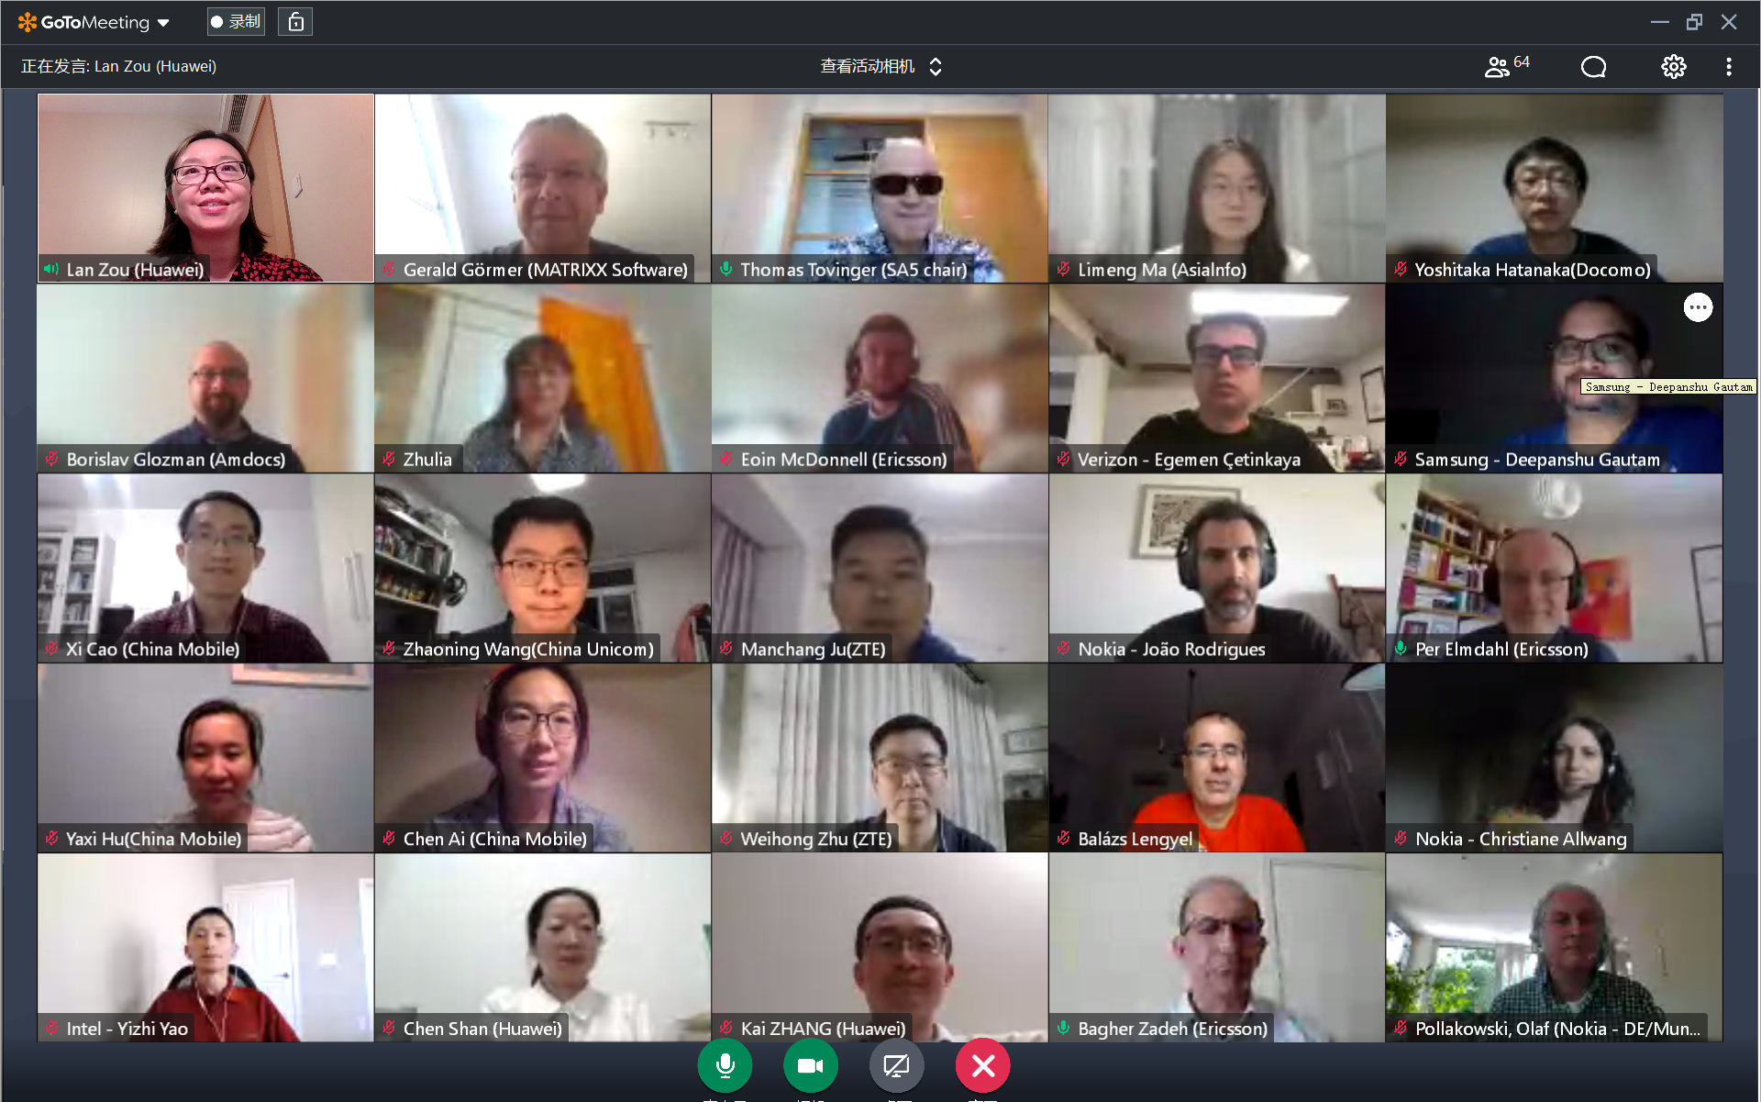
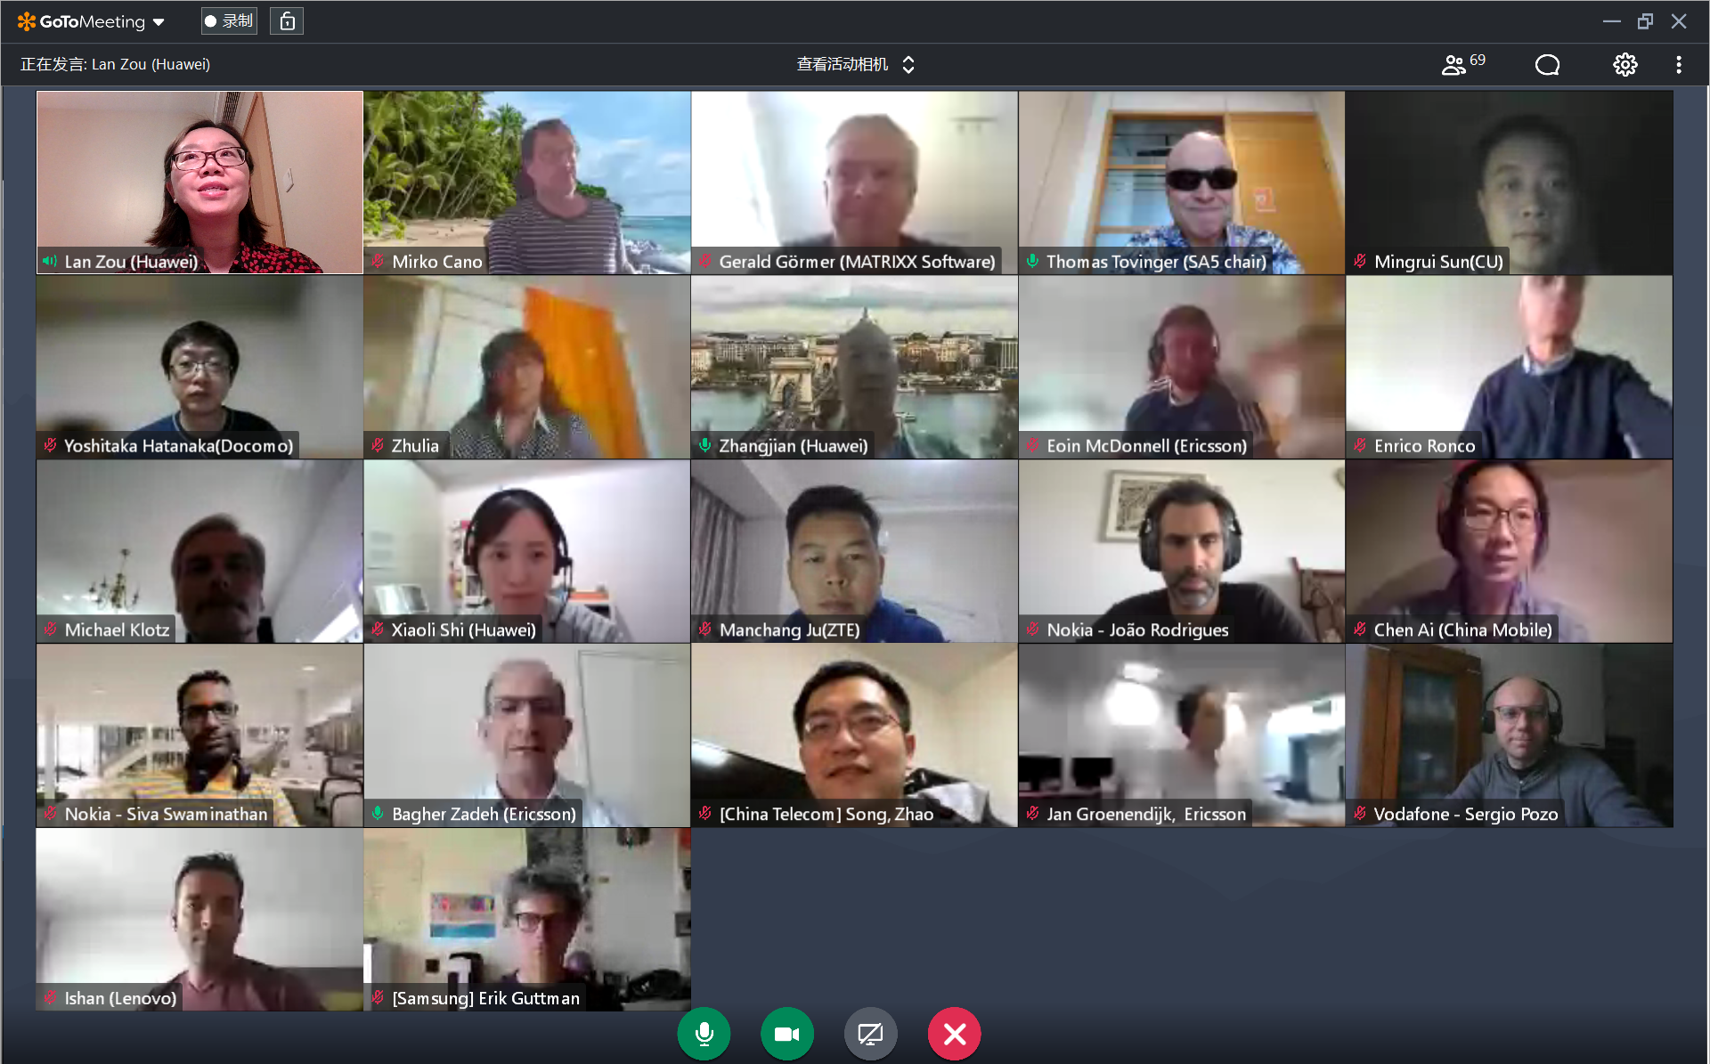
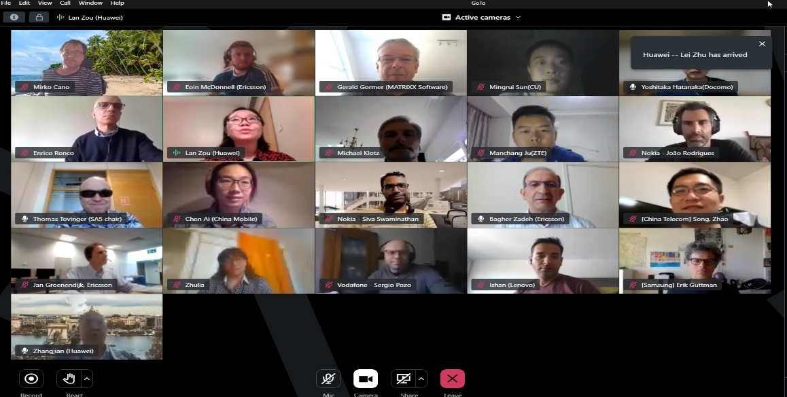
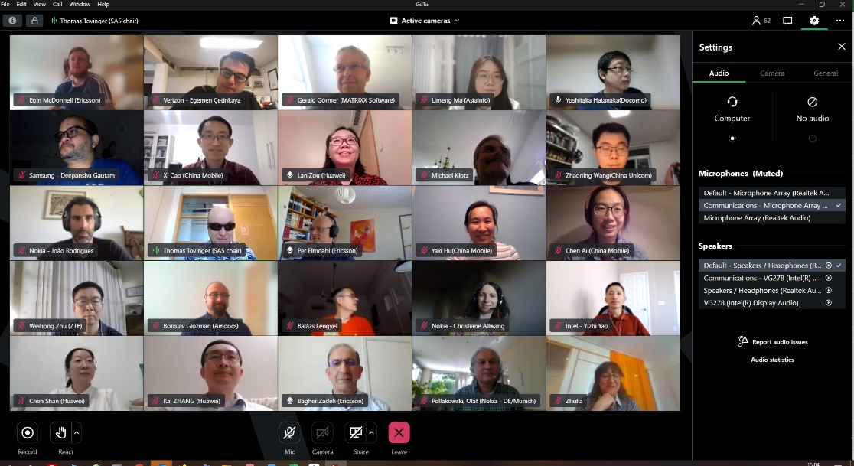
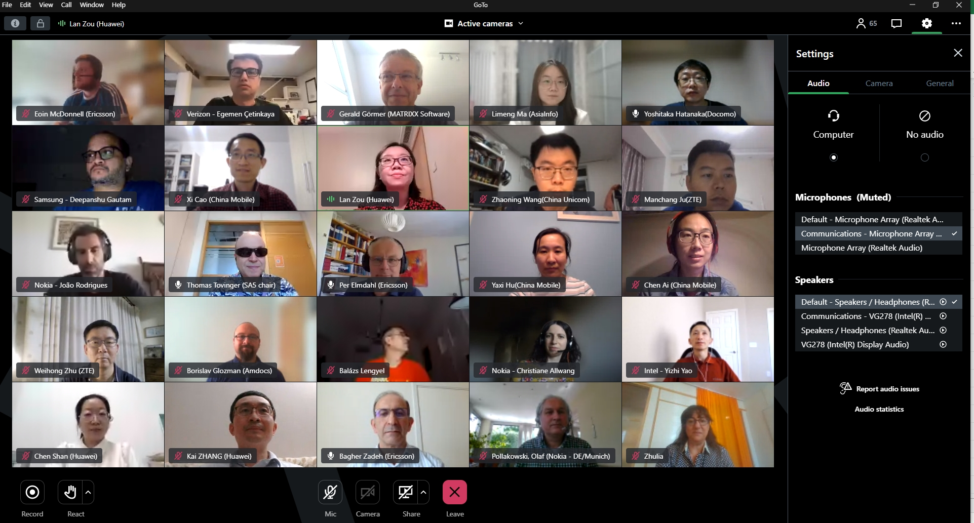
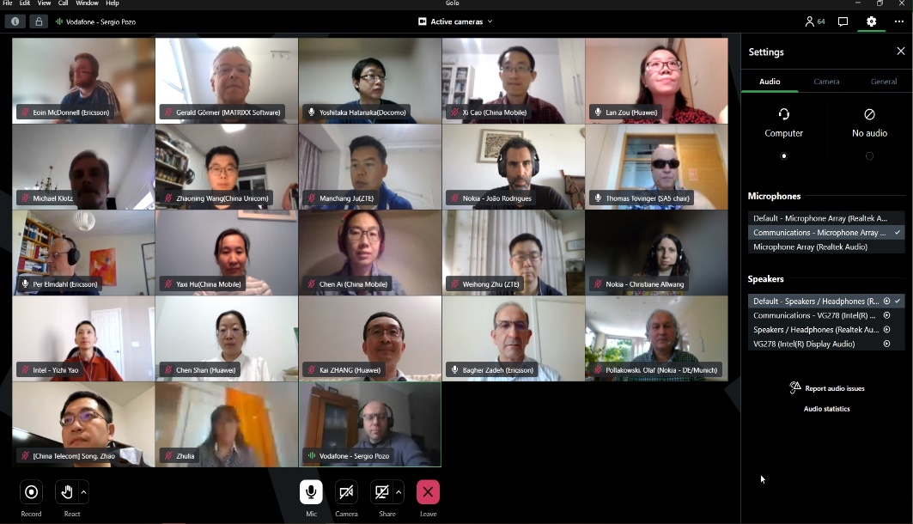
Thank you!

Slide 29
3GPP SA5 Time plan
SA5 time plan:
S5-221173 Rel-18 time plan proposal for OAM (Endorsed)
  SA5 OAM Release 18 planning：
  Mar 2022 (TSG#95): SA5 SIDs/WIDs specified
  Sept 2022 (#97) and Dec 2022 (#98): SA5 SID concluded and Rel-18 WID started if needed
  Mar 2023 (TSG#99): Stage 1 work freeze
  Sep 2023 (TSG#101): Stage 2 Functional work Freeze and stage 3(OAM/CN related), provide inputs to CT
  Dec 2023 (TSG#102): Stage 2 Functional work Freeze and stage 3 (RAN related)
  SA5 OAM Release 19 planning：
  After Jun 2023 (TSG#100): start of Rel-19 planning
  Sep 2023 (TSG#101): Start of Rel-19

Slide 30
Release 18 timeline – figure with SA5 OAM
2021
Now
2022
2023
2024
TSG#
91
92
93
94
95
96
97
98
99
100
101
102
103
104
Stage 1 (SA1)
Rel-18 Content def.
Content def. RAN4
Prio
Stage 2 (SA2, SA6,…)
RAN1
RAN Completion (RAN2, RAN3, RAN4 core)
Stage 3 (CT & SA)
ASN.1 & Open APIs
RAN4 performance
Studies (SA5 OAM)
Stage 1 (SA5 OAM)
Stage 2 Functional and stage 3 work (OAM/CN related),
provide inputs to CT
SA5 OAM Rel-18 Timeline
Stage 2 Functional and stage 3 work (RAN related)
SA5 OAM Rel-19 Timeline
Rel-19 planning
Start of Rel-19
Note: starting dates are indicative

