Slide 1
Discussion Paper on
5G exposure
Source: AT&T, Deutsche Telekom, Ericsson, Huawei, Intel, Orange, Samsung, Telefonica, Verizon

Slide 2
Observations
Exposure of 5G (in general) is an important topic for Network Operators and for some customers (Verticals, etc.)
SA5 has been working for months on ‘network slice management capabilities exposure’
  Little progress - seems difficult to reach any consensus
  The problem is not clearly stated: no business-level use cases / requirements (call flows are NOT use cases)
  Early deep dive into describing solutions
  Several study items, separated from each others, lack of global view

Slide 3
Problem #1
Exposure of 5G capabilities (in general) is part of use cases and requirements expressed by (potential) B2B customers, e.g. by (non-exhaustive list):
  5G-ACIA (see https://5g-acia.org/whitepapers/exposure-of-5g-capabilities-for-connected-industries-and-automation-applications-2/)
  5G Slicing Association (see https://www.5g-sa.org/page161)
  SA1 - cf. TS 22.261 (Service requirements for the 5G system; Stage 1)
  Etc.
  See examples on next slides.
In SA5, these use cases and requirements have not been:
  Inventoried
  Analyzed,
  , leading thus SA5 to work on solutions with no clear requirements

Slide 4
SA1 - Requirements
TS 22.261 (Service requirements for the 5G system; Stage 1) https://portal.3gpp.org/desktopmodules/Specifications/SpecificationDetails.aspx?specificationId=3107

Slide 5


Slide 8
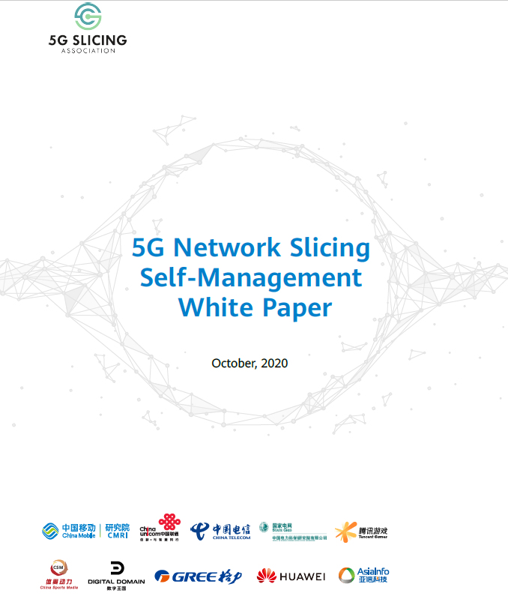

Slide 9
Example of self-management requirements for Power Grid industry

Slide 10
Proposal No. 1
The WG is asked to endorse the need for studying and analyzing the industry use cases and requirements for 5G (including network slice) management capabilities exposure (e.g. from 5G-ACIA, 5G Slicing Association, SA1, etc.) in a new or an existing SID.

Slide 11
Problem #2
Several initiatives exist in 3GPP to offer solutions for 5G exposure:
  SA2 - cf. TS 23.501 (System architecture for the 5G System (5GS)) -> NEF
  SA6 - cf. TS 23.222 (Functional architecture and information flows to support Common API Framework for 3GPP Northbound APIs) -> CAPIF
  SA5 - work is ongoing. Several Rel-17 Study / Work Items on:
    Network slice management capability exposure (FS_NSCE),
    Access (to Management Service) control (FS_MNSAC, MSAC),
    Tenant management (eMEMTANE),
    + discussions on Management Service (MnS) discovery
  , with little progress
  , with no global picture of management capabilities exposure.
It may be good to have a homogeneous cross-WG approach within 3GPP

Slide 12
Different levels of 5G exposure
Exposure at BSS level (not in 3GPP Scope of Work (SoW))
  Exposure of Product Specification as part of CSP offering catalog
  Customer can select and order Products via Product Ordering API specified by TM Forum and exposed by CSP
  A Network Slice can be a Product
Exposure at OSS level (if needed, would be part of 3GPP SA5 SoW)
  Exposure of Management Services (MnS))
Exposure at Network Function level (3GPP SA2 SoW)
  Exposure of Network Functions, via NEF (Network Exposure Function), as in TS 23.501
Exposure at Application level (3GPP SA6 SoW)
  Exposure of application capabilities + …
-> It may be good to have a homogeneous cross-WG approach within 3GPP

Slide 13



SA2 - NEF
NEF (Network Exposure Function), a 5G core network function which supports external exposure of capabilities of network functions. External exposure can be categorized as:
  Monitoring capability: is for monitoring of specific event for UE in 5G System and making such monitoring events information available for external exposure via the NEF;
  Provisioning capability: is for allowing external party to provision of information which can be used for the UE in 5G System.
  Policy/Charging capability: is for handling QoS and charging policy for the UE based on the request from external party.
  Analytics reporting capability: is for allowing an external party to fetch or subscribe/unsubscribe to analytics information generated by 5G System
The NEF communicates with external AF (Application Function) via the 3GPP N33 reference point
An NEF may support CAPIF functions for external exposure as specified in clause 6.2.5.1
TS 23.501 (System architecture for the 5G System (5GS)) https://portal.3gpp.org/desktopmodules/Specifications/SpecificationDetails.aspx?specificationId=3144

Slide 14
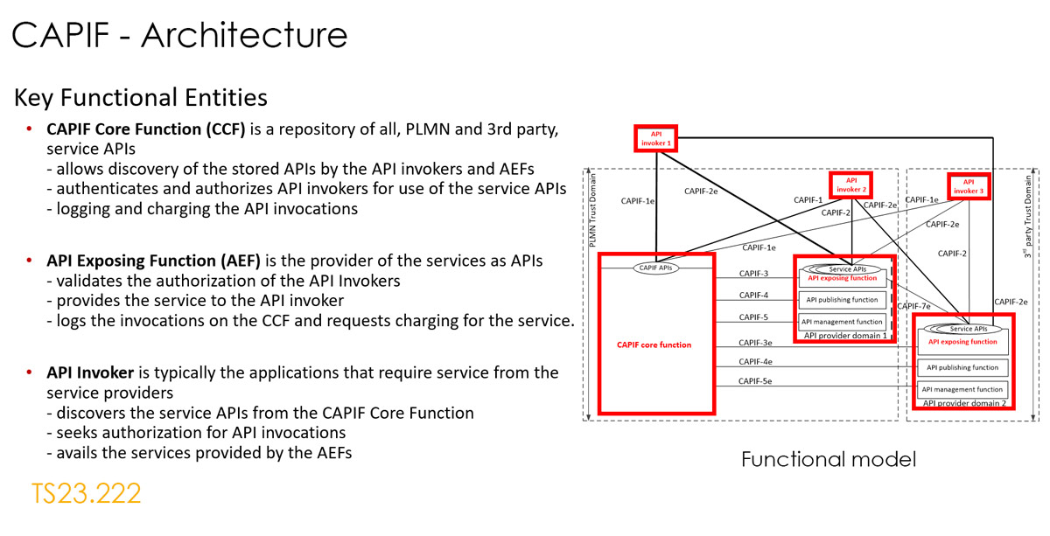
SA6 - CAPIF Architecture
TS 23.222 (Functional architecture and information flows to support Common API Framework for 3GPP Northbound APIs; Stage 2) https://portal.3gpp.org/desktopmodules/Specifications/SpecificationDetails.aspx?specificationId=3337
TR 23.722 (Study on Common API Framework for 3GPP Northbound APIs) https://portal.3gpp.org/desktopmodules/Specifications/SpecificationDetails.aspx?specificationId=3188

Slide 15
CAPIF functions (from TS 23.222)

Slide 16
Example of deployment models for CAPIF in 5GS (TS 23.222)
NEF
NEF

Slide 17
Examples of deployment model of CAPIF in 3GPP management system (1/3)
(for discussion) (non-exhaustive)
Model #1: A MF (possibly EGMF) implements the CAPIF CCF + API provider domain functions
MnS Consumers
API Invoker
Customer domain
EGMF / MnS Producers to implement API provider domain functionalities + CAPIF Core Function
MnS Consumers to implement API invoker functionality.
NOP trust domain
CAPIF-2e
MnS Consumers
API Invoker
CAPIF-1e
CAPIF-1
CAPIF-2
CAPIF
Core
Function
CAPIF-3
API exposing function
CAPIF-4
API publishing function
MF (EGMF?) /
MnS Producers?
CAPIF-5
API management function
API Provider domain functions

Slide 18
Examples of deployment model of CAPIF in 3GPP management system (2/3)
(for discussion) (non-exhaustive)
Model #2: EGMF implements the CAPIF Core Function (CCF)
API Invoker
Customer
domain
MnS Consumers
API provider domain functions embedding MnS Producer(s) + CCF consumer role
API invoker may implement an MnS Consumer
CAPIF-2 and CAPIF-2e to represent SA5 defined Management Services (MnS)
NOP trust domain
CAPIF-2e
API Invoker
MnS Consumers
CAPIF-1e
CAPIF-1
CAPIF-2
EGMF
CAPIF
Core
Function
CAPIF-3
API exposing function
MF (EGMF ?) containing
MnS Producers and CCF consumers
CAPIF-4
API publishing function
CAPIF-5
API management function
API Provider domain functions

Slide 19
Examples of deployment model of CAPIF in 3GPP management system (3/3)
(for discussion) (non-exhaustive)
Model #3: some MF (EGMF?) implements API provider domain functions
MnS Consumers
API Invoker
Customer domain
xxMF (EGMF?) embedding MnS Producer(s) + CCF consumer role
MnS Consumers to implement API invoker functionality.
NOP trust domain
CAPIF-2e
MnS Consumers
API Invoker
CAPIF-1e
CAPIF-1
CAPIF-2
CAPIF
Core
Function
CAPIF-3
API exposing function
CAPIF-4
API publishing function
MF
(EGMF ?)
CAPIF-5
API management function
API Provider domain functions

Slide 20
CAPIF Core Function common to SA2 and SA5 (for discussion)
API Invoker
Customer domain
NOP trust domain
CAPIF-2e
CAPIF-2e
API Invoker
CAPIF-1e
CAPIF-2
CAPIF-1
CAPIF-2
CAPIF
Core
Function
CAPIF-3
API exposing function
CAPIF-4
API publishing function
NEF
CAPIF-5
API management function
CAPIF-3
API Provider domain functions
CAPIF-4
API exposing function
CAPIF-5
API publishing function
MF (EGMF?)
API management function
API Provider domain functions

Slide 21
Proposal No. 2
The WG is asked to endorse the following:
  Send a LS to SA6 (Cc. SA) asking their feedback on the proposed potential deployment models in this DP.
  In parallel, investigate if and to which extent, CAPIF is suitable to address 5G (including network slice) management capabilities exposure

Slide 22
Thank you!

