Slide 1
Discussion paper on Asynchronous interactions
Ericsson,
based on work of Nokia, Nokia Shanghai Bell

Slide 2
Rationale
Certain interactions may take a long time, from minutes over hours to even days. It is inappropriate for the REST/Netconf client to keep the connection open (in a single synchronous call) to wait for the result
For these cases, asynchronous interactions are used
  The operation immediately returns the response “OK” to indicate that the request was accepted, and processing has started. This typically result in some long running associated job being initiated
  The client can subscribe to data change notifications (e.g., notifyMOIChanges) for immediate notification about updates to the status of the associated job
  The client can check the status of the associated job by polling

Slide 3
Asynchronous interactions: Major Aspects to address
For typical Asynchronous interactions, there are three types of information (Request, Monitoring, Results information)
A discussion is needed in SA5 to agree (a) common design pattern(s) for Asynchronous interaction for the following two aspects:
  Modeling the different types of information in NRM
  Define common Asynchronous Procedures aligned with the NRM model

Slide 4
Principles
All CRUD operations are always synchronous
  Introducing asynchronous CRUD is a big and unneeded task
Long running interactions are started by CRUD operations
  The response for the CRUD operation is NOT delayed to await the result of the long running interaction
Request-Information is available as read-write IOCs/attributes
Monitoring- and Result-information is available as read-only attributes

Slide 5
Goal
Describe a generic asynchronous design pattern that can be used by any asynchronous use-case
Define a generic JobProgress data type that can be used for providing progress and result information about any asynchronous (long running) background job

Slide 6
Asynchronous operation Types
Operations inherently connected to an IOC and invoked using createMOI, modifyMOIAttributes, deleteMOI
Operations Not inherently connected to IOCs.
  Create a “Job” IOC to hold the request and the job monitoring/result information
  CreateMOI for the “Job” MOI initiates the interaction, no need for a dedicated operation
  The system is allowed to automatically delete such “Job” IOCs (not immediately).

Slide 7
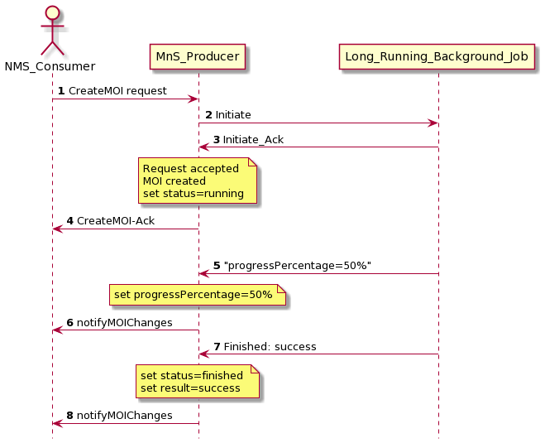
Asynchronous pattern: CreateMOI
CreateMoi initiates the process
The associated job is started
The MOI is created in a synchronous manner, its creation indicates the request (including the starting of the long running process) is accepted.
When the associated job reports progress/finished/failed/success, this is used to set jobProgress in the MOI
The change in the MOI is reported by the usual data change notifications (28.532 clause 11.1.1)
Communication between the Provider and the associated process is internal and implementation specific.

Slide 8
JobProgress - Datatype
Contains monitoring and result information
Shall be uniform for all asynchronous operations
May have a cardinality greater than 1
Mandatory structured attribute named jobProgress and defined with a datatype JobProgress
May be accompanied by use-case specific additional items

Slide 9
JobProgress - Datatype
Attribute name | Support Qualifier | isReadable | isWritable | Type | Description
jobId | M | T | F | string | Id of the associated job
jobStatus | M | T | F | enum | Represents the status of only the job itself. A successfully finished resource-reservation job may still report resource-not-available. cancelling (Cancellation is in progress.) running (The execution of the associated job is currently in progress.) finished (The associated job finished successfully.) cancelled failed partially-failed
jobProgressPercentage | O | T | F | integer | Progress of the associated job as percentage: 0..100
jobProgressInfo | O | T | F | string 0..* | Textual information about the state and progress of the associated job. Specific jobs may define specific well-defined strings to be used in this attribute.
jobResult | O | T | F | string | Detailed result or reason Specific jobs may define specific well-defined strings to be used in this attribute.
jobStartTime | O | T | F | dateTime | Date and time when the associated job was started.
jobEndTime | O | T | F | dateTime | Date and time when the state changed to finished or cancelled
jobTimer | O | T | T | integer | Time until the associated job is automatically cancelled by the provider. If not set, there is no time limit for the job.
cancelJob | O | T | T | boolean | If set to True, the job is requested to be cancelled

Slide 10
DeleteMOI asynchronously ?
Asynchronous deleteMOI should not be needed
Some IOCs might need to be in a certain state before deletion is allowed
  E.g., a state indicating that associated processes and resources are cleaned up
Use two attributes and modifyMOIAttributes to bring the MOI to a state when it can be deleted.
  See example to the right:
  deleteMOI shall be rejected unless
  preparedForDelete=PREPARED
  attribute startCleanUp
  isWritable=True
  type boolean
  attribute preparedForDelete
  isWritable=False
  NOT_PREPARED;
  PENDING;
  PREPARED;

Slide 11
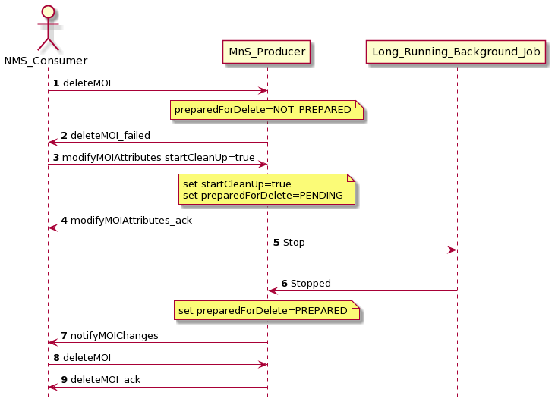
Asynchronous pattern: Delete an MOI
deleteMoi fails first as the IOC needs to prepared before deletion, it needs to be in state preparedForDelete=PREPARED
Consumer orders the startCleanUp using modiyMOIAttributes
Order is sent to stop a associated job
When the associated job reports “Stopped” preparedForDelete=PREPARED is set.
The change in the MOI is reported by the notifyMOIChanges
deleteMoi succeeds as the MOI is in the correct state
Communication between the Provider and the associated process is internal and implementation specific

Slide 12
Additionals
jobProgress may be polled (getMOIAttributes) beside or instead of subscribing to notifications
To cancel a running associated job set jobProgress.cancelJob=True
If jobProgress.jobTimer is set, the provider automatically cancels the associated job when the timer reaches zero if the job is still running.
Producer system may delete jobProgress attributes or “Job” IOCs after the jobProgress.status is finished, cancelled, failed or partially_failed AND after some time has elapsed or some condition is met
  Automatic deletion immediately after the associated process stopped is not allowed, as it would make checking the result impossible.
    E.g., remove jobs that stopped more then a week ago.

